Slide 1
FIGURE 1

Slide 2
FIGURE 2

Slide 3
FIGURE 3

Slide 4
FIGURE 4. Evolution of DNA calculated using the theoretically (dotted line) and experimentally (solid line) estimated hybridization rate parameters.

Slide 5
FIGURE 5

Slide 6
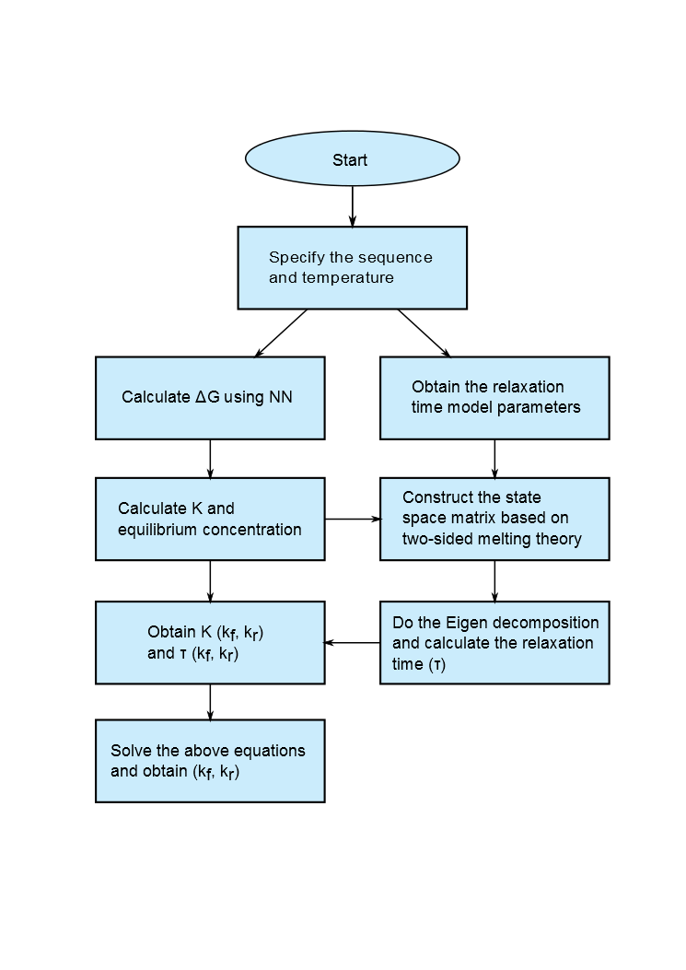
FIGURE 6. Flowchart for calculation of annealing rate constants

Slide 7
FIGURE 7. Predicted evolution of reaction species during a typical primer annealing reaction

Slide 8
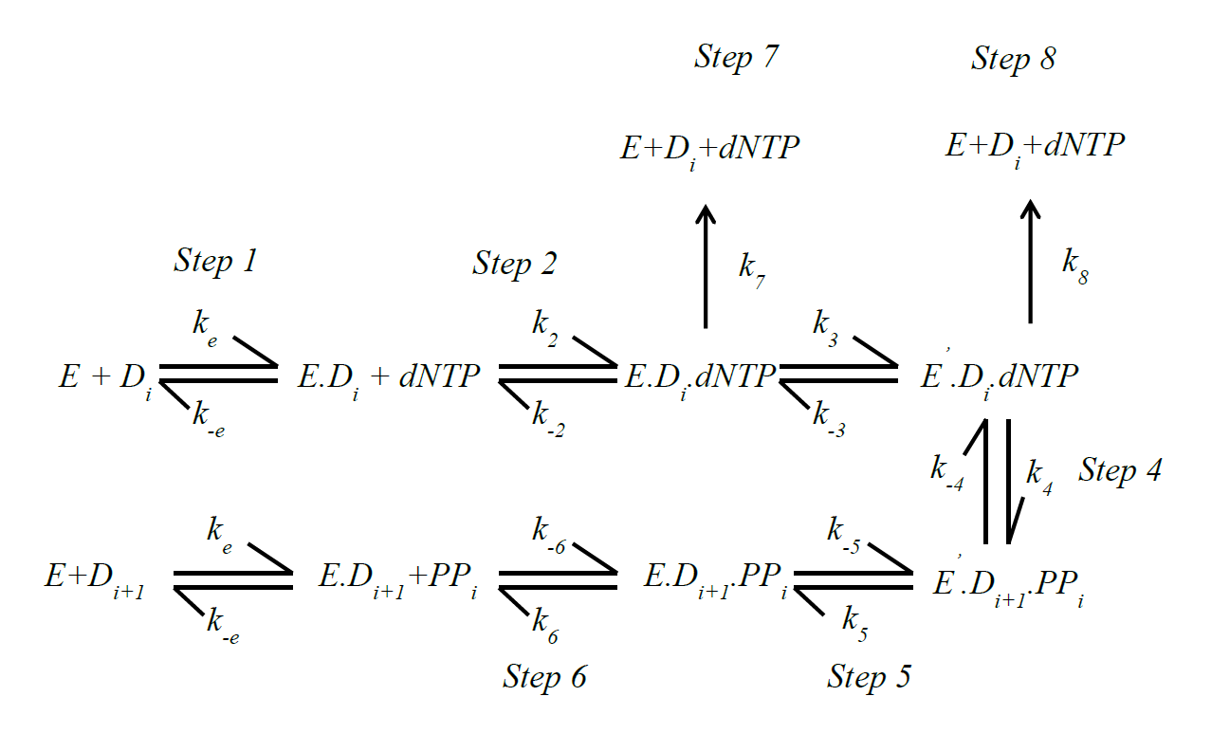
FIGURE 8. Reaction scheme for polymerase-mediated DNA extension.

Slide 9
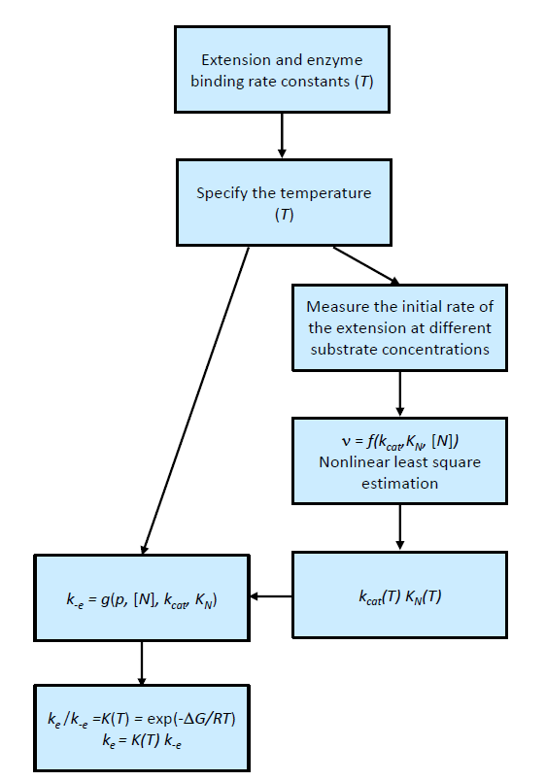
FIGURE 9. Flowchart for calculation of polymerase extension rate constants.

Slide 10
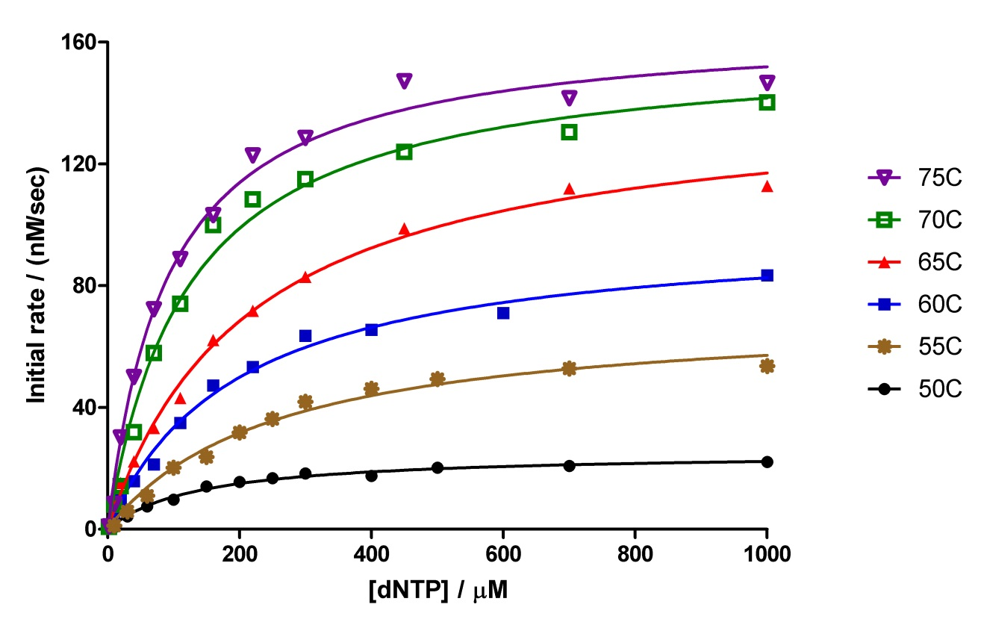
FIGURE 10

Slide 11
FIGURE 11

Slide 12
FIGURE 12

Slide 13
FIGURE 13

Slide 14
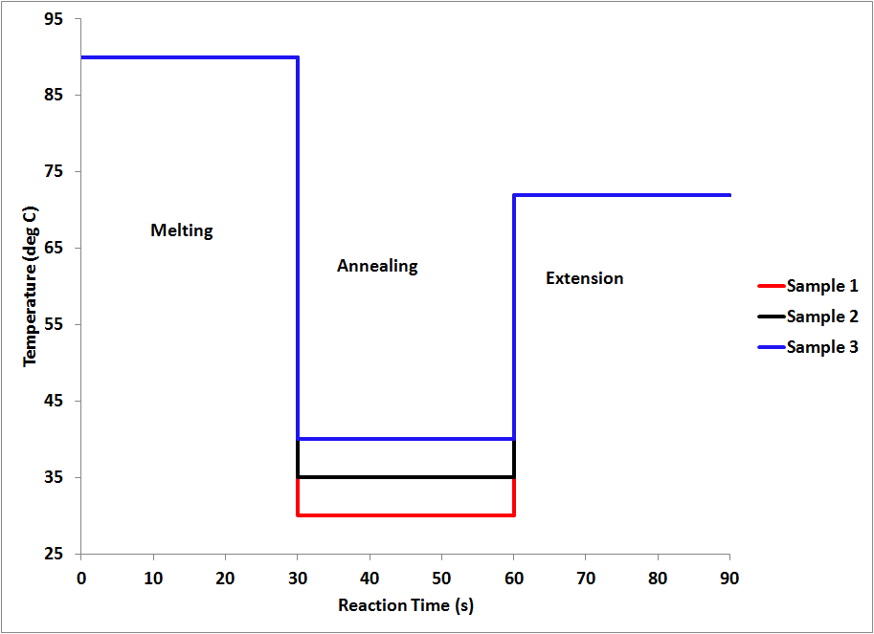
FIGURE 14

Slide 15
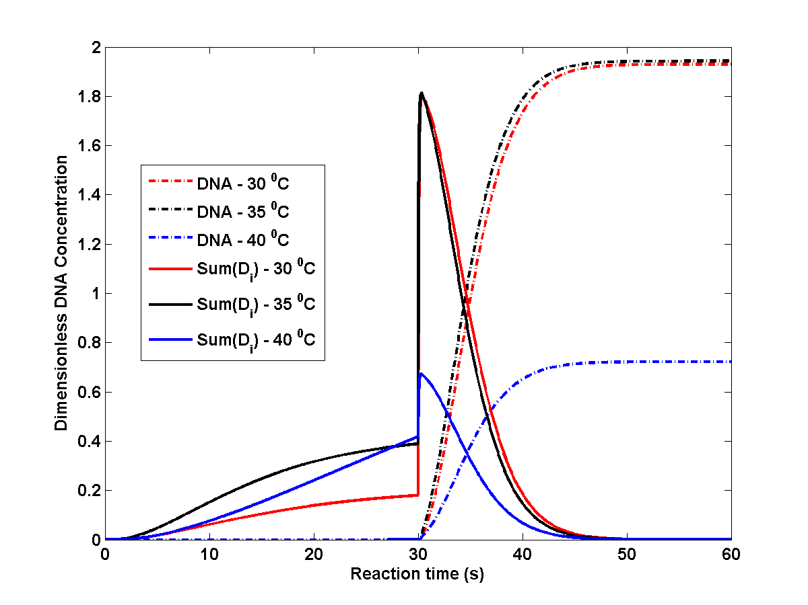
FIGURE 15

Slide 16
FIGURE 16

Slide 17
FIGURE 17

Slide 18
FIGURE 18

Slide 19
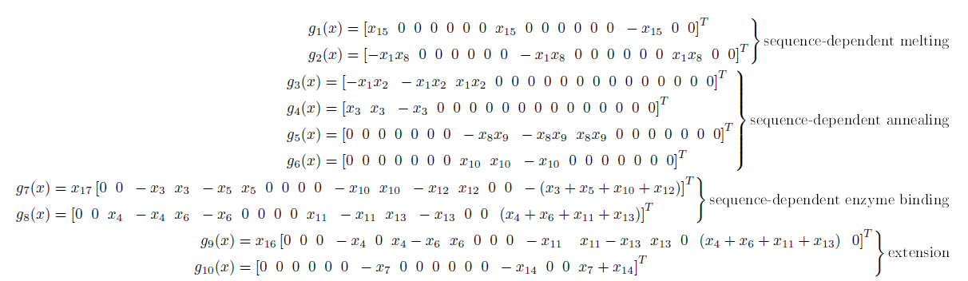
FIGURE 19

Slide 20
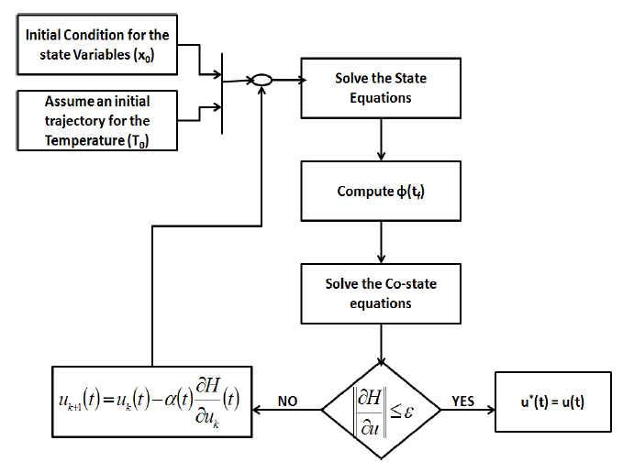
FIGURE 20

Slide 21
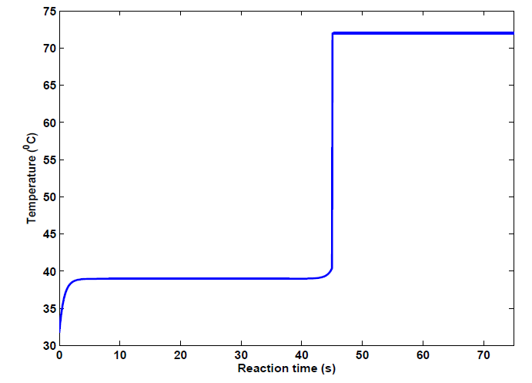
FIGURE 21

Slide 22
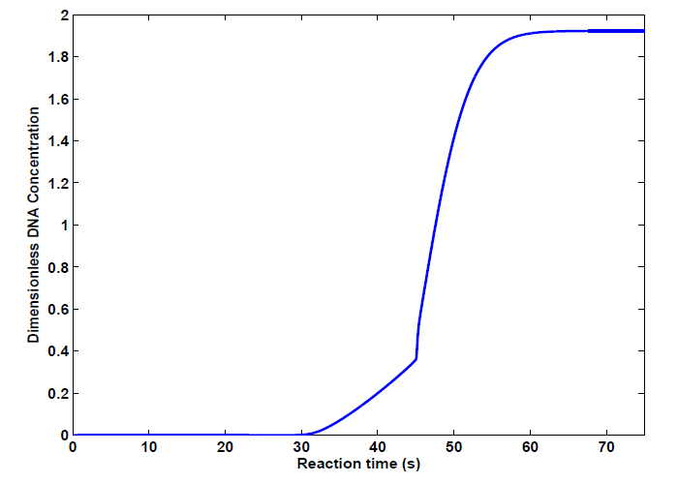
FIGURE 22

Slide 23
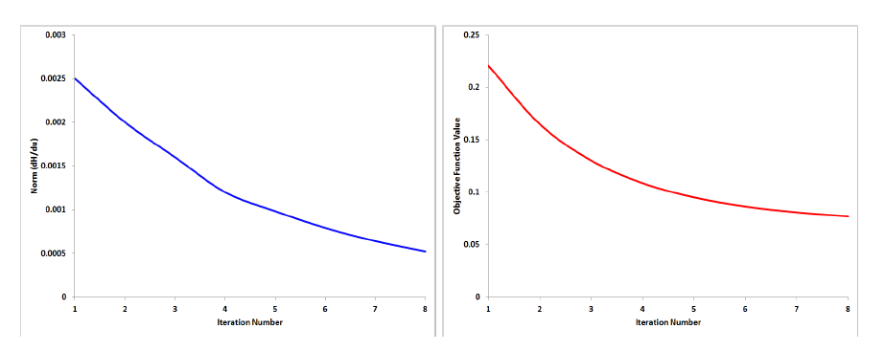
(a)
(b)
FIGURE 23

Slide 24
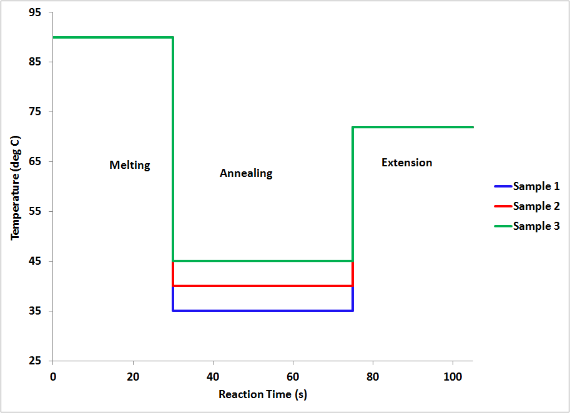
FIGURE 14 (BP version)

Slide 25
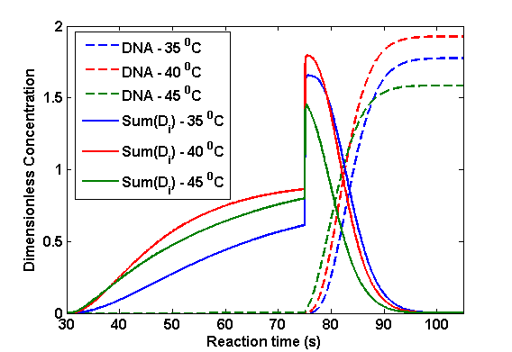
FIGURE 15 (BP version)

Slide 26
FIGURE 12 (previous version)

Slide 27
FIGURE 13 (previous version)

