Slide 2
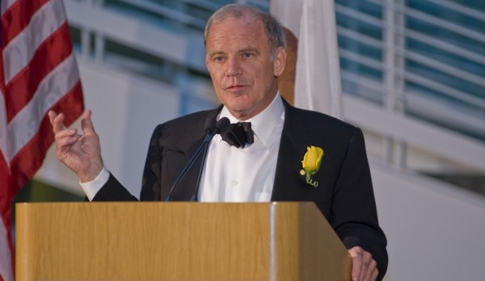
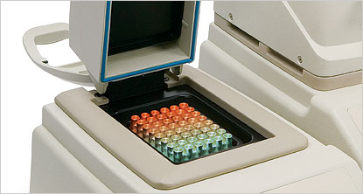
Polymerase Chain Reaction: Geometric Amplification of DNA
Nobel Prize - One of the most cited papers in Science journal (~17000 in 26 years)
Central technology of modern microbiology.
Diagnosis, Genome Sequencing, Personalized Medicine, Evolutionary Studies etc.
Global market - $27.4 billion by 2015*.
* On line summary of PCR in medical application – (2009 – 2015)
Notes:
Polymerase Chain Reaction is a DNA amplification Reaction. It was invented by Kary Mullis in 1987 and he won the Nobel prize for this. After getting rejected from Nature Journal, this work got published in Science which eventually got cited around 16,000 times so far in last 25 years.
Thermal Cycler is a device which is used to conduct PCR reactions. This reaction is a work horse of every modern biochemistry and molecular biology labs for various research Application. Few main applications includes: Diagnosis, Genome sequencing, Personalized medicine and Evolutionary studies.
Though it is very important, it suffers to amplify specific genes, in particular, genes that has more GC content.

Slide 3
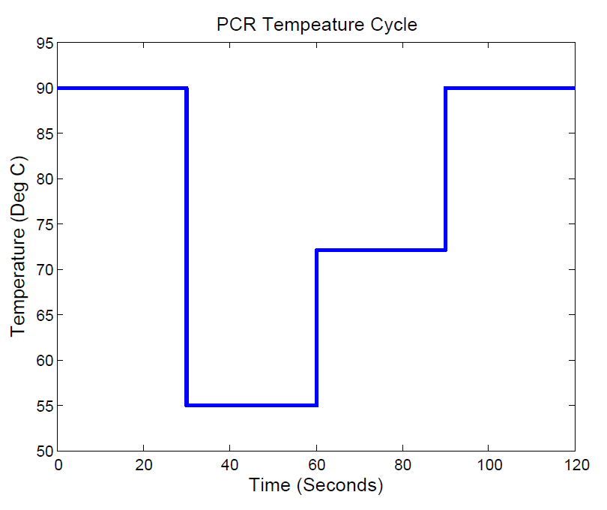

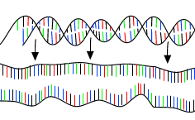
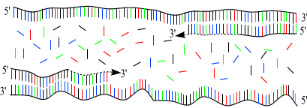
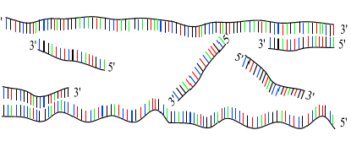
Single Strand – Primer Duplex
Extension
DNA Melting
Again
DNA Melting
Primer
Annealing
Notes:
PCR is a cyclic process and each cycle consists of 3 steps.
1st Step is called as a melting step in which double stranded DNA is separated in to two single strand DNA. This step occurs relatively at a higher temperature (mostly at 90 deg C). A chemical reaction for this step is written as –
2nd Step is called as a Annealing step in which a small single strand primer molecule hybridized on a specific spot on a single strand molecule at relative lower temperature. Primer molecules are designed in such a way that it can hybridize on the single strand molecule. There are two types of primer molecules for two single strands and their hybridization reaction is represented as. Note that single strands can also hybridize each other at lower temperature as per this reaction but the primer concentration is kept in excess so that primer annealing dominates the single strands annealing – Towards the end of the PCR this is not the case.
3rd Step is enzymatic extension of the partially completed Single stranded primer duplex to convert it in to a complete double strand DNA. An enzyme called Taq polymerase which is even active at 72 deg C, binds on the SP molecule and add the nuclo-bases on it to convert in to a DNA. The Michalis Menton based Reaction is given as:
As we can see here at the end of three steps we got 2 DNAs from 1 DNA and now we will repeat for n cycles and after n cycles we will get 2^n. n is typically 25 to 30. Thus using PCR we get million copies of DNA from 1 DNA.
The temperature vs time profile that is typically followed for this reaction is indicated by blue line. This may or may not optimal. We look for a tempeature profile which optimizes the DNA concentration. Possibly something like which is indicated in brown line.

Slide 4
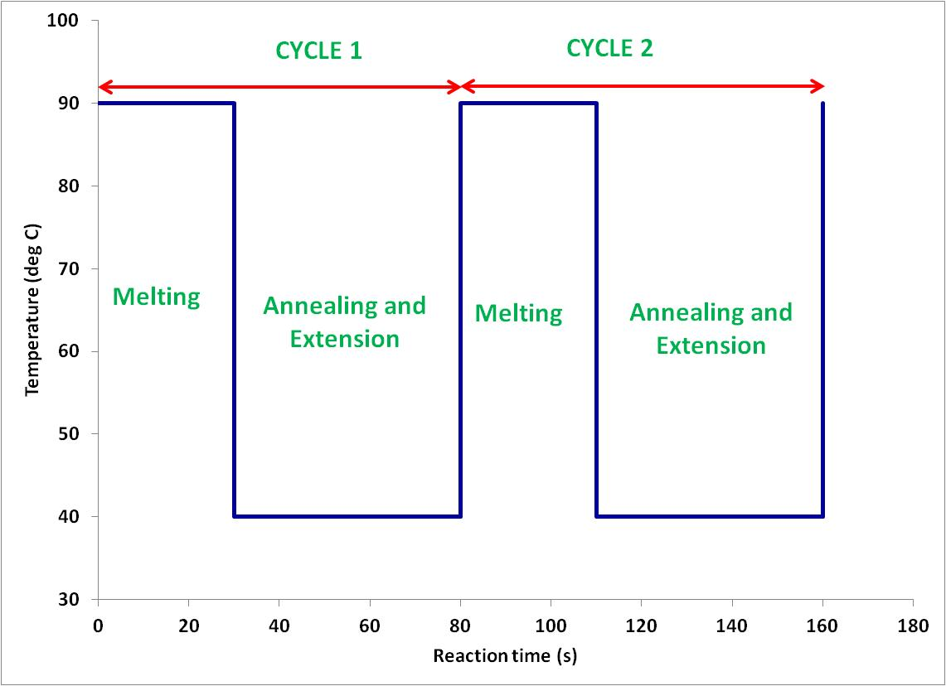
Types of PCR
Last two decades several new PCR have been proposed – Heuristic approach
Two step PCR¹
1. Skladny et al, Journal of Clinical Microbiology (1999), 37, 3865 - 3871
Notes:
In this slide, we discuss how PCR is used in Cancer Diagnostics, which is one of the most important applications of the PCR. A person who has cancer can have two types of DNA. The first one is wild type DNA and the second one is mutated DNA. As we know, mutated DNA causes the Cancer. The aim is now to find out whether a person has mutated DNA or not. if yes, how much is the concentration of such a DNA. If we can amplify the mutated DNA, it is possible to back calculate the amount of original DNA. So, here one can post an Optimization problem with an Objective : Maximize the concentration of mutated DNA. Note that we also have a wild type DNA. Change the reaction environment in such a way that, it maximizes the concentration of mutated DNA. Analogy can be made with exiting process in a tight parking spot. The plot suggest a such a possible reaction condition. While the blue one maximizes the wild type DNA, red one suppose to maximize the concentration of mutated DNA. What could be the optimal reaction condition that maximizes the mutated DNA concentration . Probably the brown one. One need to formulate an optimization problem systematically and solve. This study can also be used to monitor the performance of cancer treatment.

Slide 5
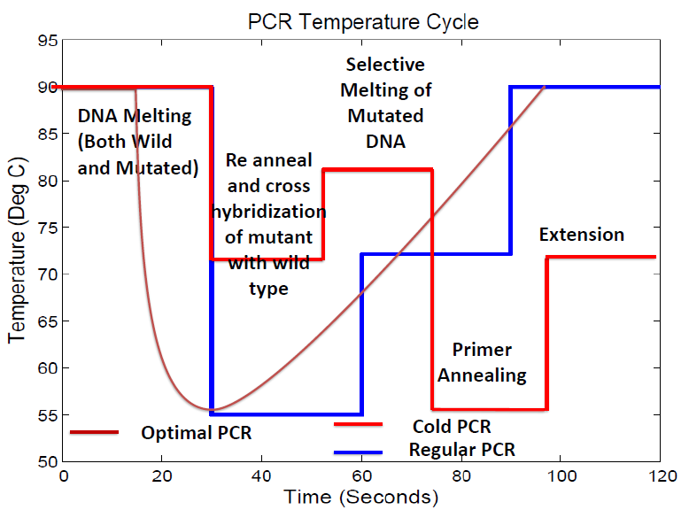
Types of PCR
Last two decades several new PCR have been proposed – Heuristic approach
Two step PCR¹
COLD PCR² in Cancer Diagnosis
2. Jin et al, Nature Medicine (2008), 14, 579 – 584
Notes:
In this slide, we discuss how PCR is used in Cancer Diagnostics, which is one of the most important applications of the PCR. A person who has cancer can have two types of DNA. The first one is wild type DNA and the second one is mutated DNA. As we know, mutated DNA causes the Cancer. The aim is now to find out whether a person has mutated DNA or not. if yes, how much is the concentration of such a DNA. If we can amplify the mutated DNA, it is possible to back calculate the amount of original DNA. So, here one can post an Optimization problem with an Objective : Maximize the concentration of mutated DNA. Note that we also have a wild type DNA. Change the reaction environment in such a way that, it maximizes the concentration of mutated DNA. Analogy can be made with exiting process in a tight parking spot. The plot suggest a such a possible reaction condition. While the blue one maximizes the wild type DNA, red one suppose to maximize the concentration of mutated DNA. What could be the optimal reaction condition that maximizes the mutated DNA concentration . Probably the brown one. One need to formulate an optimization problem systematically and solve. This study can also be used to monitor the performance of cancer treatment.

Slide 6
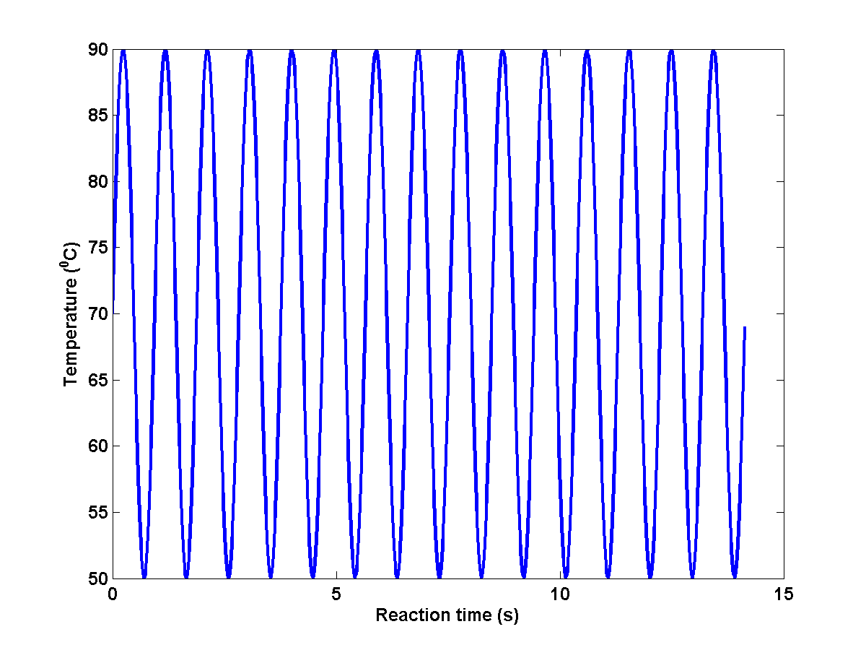
Types of PCR
Last two decades several new PCR have been proposed – Heuristic approach.
Two step PCR¹
COLD PCR² in Cancer Diagnosis
Rapid PCR³
3. Wittwer CT and Garling DJ (1991) BioTechniques 10: 7683
Notes:
In this slide, we discuss how PCR is used in Cancer Diagnostics, which is one of the most important applications of the PCR. A person who has cancer can have two types of DNA. The first one is wild type DNA and the second one is mutated DNA. As we know, mutated DNA causes the Cancer. The aim is now to find out whether a person has mutated DNA or not. if yes, how much is the concentration of such a DNA. If we can amplify the mutated DNA, it is possible to back calculate the amount of original DNA. So, here one can post an Optimization problem with an Objective : Maximize the concentration of mutated DNA. Note that we also have a wild type DNA. Change the reaction environment in such a way that, it maximizes the concentration of mutated DNA. Analogy can be made with exiting process in a tight parking spot. The plot suggest a such a possible reaction condition. While the blue one maximizes the wild type DNA, red one suppose to maximize the concentration of mutated DNA. What could be the optimal reaction condition that maximizes the mutated DNA concentration . Probably the brown one. One need to formulate an optimization problem systematically and solve. This study can also be used to monitor the performance of cancer treatment.

Slide 7
Unified Framework for DNA Amplification Reactions
Heuristic Approaches – In the absence of predictive model.
Requires a large number of experiments – Expensive and time consuming.
Huge variation in the composition of target DNA (large number of target sequence) – Each target DNA in principle constitutes a new PCR.
Can all of these and other reactions be unified under one principle?
A general approach to dynamic optimization of DNA amplification has applications to the design of new types of amplification reactions, in addition to enhancement of existing reactions.
Notes:
In this slide, we discuss how PCR is used in Cancer Diagnostics, which is one of the most important applications of the PCR. A person who has cancer can have two types of DNA. The first one is wild type DNA and the second one is mutated DNA. As we know, mutated DNA causes the Cancer. The aim is now to find out whether a person has mutated DNA or not. if yes, how much is the concentration of such a DNA. If we can amplify the mutated DNA, it is possible to back calculate the amount of original DNA. So, here one can post an Optimization problem with an Objective : Maximize the concentration of mutated DNA. Note that we also have a wild type DNA. Change the reaction environment in such a way that, it maximizes the concentration of mutated DNA. Analogy can be made with exiting process in a tight parking spot. The plot suggest a such a possible reaction condition. While the blue one maximizes the wild type DNA, red one suppose to maximize the concentration of mutated DNA. What could be the optimal reaction condition that maximizes the mutated DNA concentration . Probably the brown one. One need to formulate an optimization problem systematically and solve. This study can also be used to monitor the performance of cancer treatment.

Slide 8
Outline
Systems Biology Approach – Unified Framework
Sequence-Dependent DNA Amplification Models.
Sequence-Dependent DNA Amplification Dynamics – Geometric Growth.
Optimal Control of DNA Amplification.
Conclusions.

Slide 9
Outline
Systems Biology Approach – Unified Framework
Sequence-Dependent DNA Amplification Models.
Sequence-Dependent DNA Amplification Dynamics – Geometric Growth.
Optimal Control of DNA Amplification.
Conclusions.

Slide 10
Unified Framework for DNA Amplification Reactions
Systems Biology Approach
First Principle Sequence Dependent Modeling of system
Optimal Control
Target DNA sequence
Optimal Reaction Conditions
This necessitates the development of new paradigms for modeling and control wherein first principle Sequence-Dependent Modeling of Biochemical Reaction Network is essential.

Slide 11
DNA Amplification Models – Literature Review
Sequence Independent Annealing Modeling
Craig et al (1971) , J. Mol. Bio
Porschke and Eigen (1971) – J. Mol. Bio
Sequence and Temperature Independent PCR Model
Equilibrium Thermodynamics of Enzyme Binding
Datta and LiCata (2003),
Nucleic Acids Research
Mehra and Hu (2005), Biotechnology Bioengineering
Stolovitzky and Cecchi (1996), PNAS
Gevertz et al (2005) - Biotechnology Bioengineering
Temperature independent Kinetics of Extension Reaction for Non – Taq Enzymes
Kuchta at al (1987), Biochemistry
Hung, M., N. Arnheim, and M. Goodman. (1992), Nucleic Acids Research
Notes:
There is no sequence and temperature dependent kinetic model for PCR. Few work was done on a specific type of DNA.
No optimal control frame work to optimize PCR have been presented so far.

Slide 12
DNA Amplification Models – Literature Review
Sequence and Temperature Independent PCR model
Thermodynamically Inconsistent
Optimization Framework can’t be developed
There is no optimal control framework on this problem
Notes:
There is no sequence and temperature dependent kinetic model for PCR. Few work was done on a specific type of DNA.
No optimal control frame work to optimize PCR have been presented so far.

Slide 13
Objectives & Approach
PCR Model
Melting
Annealing
Enzyme Binding and Extension
Optimal Control
Objective: Maximize the Desired DNA Concentration
Model
Optimal Control Solver
Optimal Reaction Condition
Sequence and Temperature dependent Kinetic Model
Notes:
Thus, the following goals to maximize the DNA concentration should be attained.

Slide 14
Outline
Systems Biology Approach – Unified Framework
Sequence Dependent DNA Amplification Models.
  Annealing/Melting Reaction Model
  Enzyme Binding/Extension Reaction Model
Sequence Dependent DNA Amplification Dynamics – Geometric Growth.
Optimal Control of DNA Amplification.
Conclusions.

Slide 15
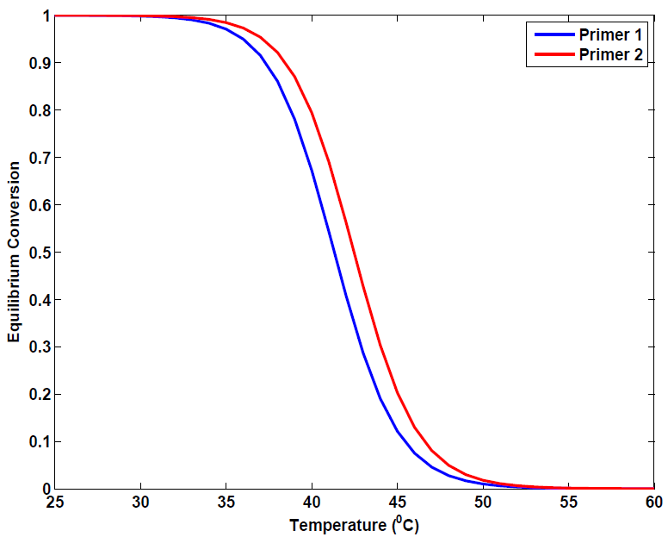
DNA Melting Thermodynamics
Reaction
Equilibrium Information
ΔG – From Nearest Neighbor (NN) Method (Theoretical)
NN Method - State of the art of knowledge regarding sequence-dependent modeling of DNA melting thermodynamics.
PCR operating condition is currently chosen only based on the above thermodynamic method.
Notes:
The annealing Reaction is –
Equilibrium relationship for this reaction is written as
Gibbs free energy is estimated using well established Nearest Neighbor method – This is sequence dependent model that estimates the Gibbs free energy.
We have only one relationship for the forward and reverse rate constant.
Second relationship can be obtained from the relaxation time. Relaxation is similar to the time constant in Process control. Perturb the equilibrium and measure the time that is taken for the system to reach the equilibrium.
Solve both equations to obtain the forward and reverse reaction constant.
Experimentally relation time can be estimated! We can’t do this for every DNA sequence. A theoretical method is required!!

Slide 16
Kinetic Model (Annealing/Melting)
Relaxation Time – Measure of Kinetics
Similar to the time constant in process control
Experimental estimation of relaxation time is time consuming and expensive.
Theoretical estimation of relaxation time is preferable.
Sequence-dependent predictive model to estimate relaxation time
Solve the above equations to obtain rate constants
Notes:
The annealing Reaction is –
Equilibrium relationship for this reaction is written as
Gibbs free energy is estimated using well established Nearest Neighbor method – This is sequence dependent model that estimates the Gibbs free energy.
We have only one relationship for the forward and reverse rate constant.
Second relationship can be obtained from the relaxation time. Relaxation is similar to the time constant in Process control. Perturb the equilibrium and measure the time that is taken for the system to reach the equilibrium.
Solve both equations to obtain the forward and reverse reaction constant.
Experimentally relation time can be estimated! We can’t do this for every DNA sequence. A theoretical method is required!!

Slide 17
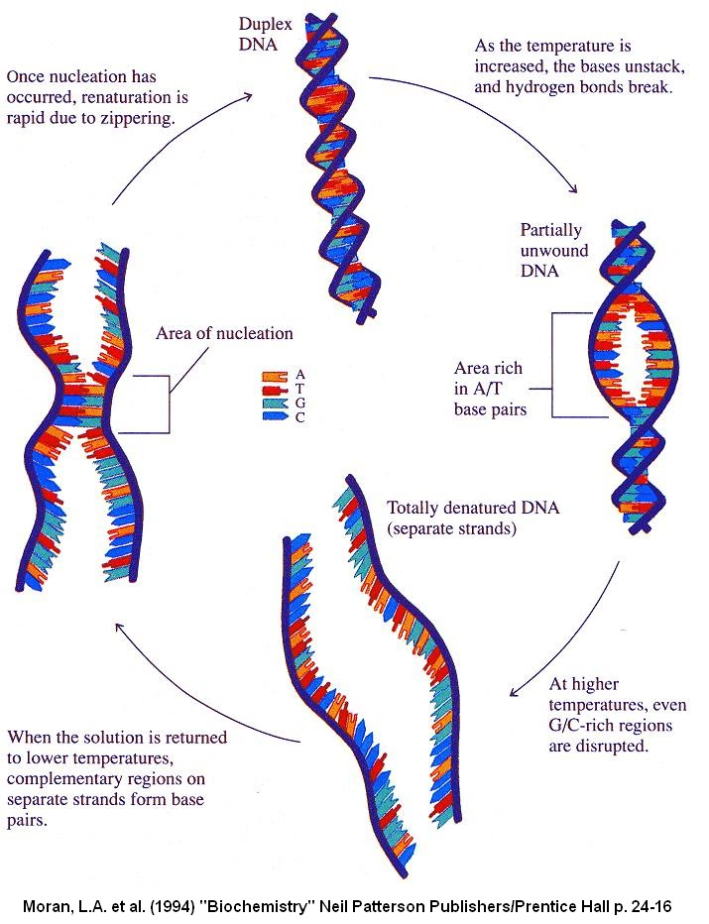
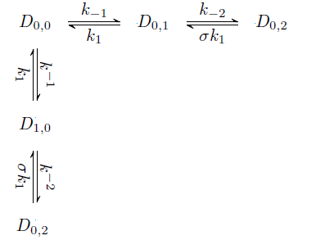
Hybridization /Melting–Mechanism
Two sided modified melting theory.
Identify the rate limiting step and hence the relaxation time.
Marimuthu and Chakrabarti (2014), J.Chem.Phys
Schwarz Jr and Poland (1975), J.Chem.Phys
Notes:
We propose a theoretical method to estimate the relaxation time from the reaction mechanism of annealing reaction.
Each step of the above mechanism represent the formation of a single (hybridization) bond.
The parameter sigma accounts for the resistance for the formation of the first bond. The ratio of the forward and reverse rate constant is called as stability constant and it can be estimated using the NN. Each bond will have a separate stability constant.
The forward rate constant is assumed to be a constant (This is an assumption based on the work Wetmur and Craig) – This need to be experimentally validated.
Reverse state constant can be determined from the stability constant.

Slide 18
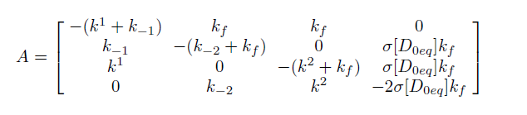
Relaxation time – Exact Model
State Space Representation:
N = 2
Temperature and sequence length dependent model parameters have been estimated using known relaxation time.
Negative reciprocal of the maximum Eigenvalue is the Relaxation time.
Marimuthu and Chakrabarti (2014), J.Chem.Phys
Notes:
Exact Model – Form a state space matrix
Eigenvalue of the matrix A will give the several time constant – The negative reciprocal of the maximum eigenvalue is the dominating time constant or the relaxation time.

Slide 19
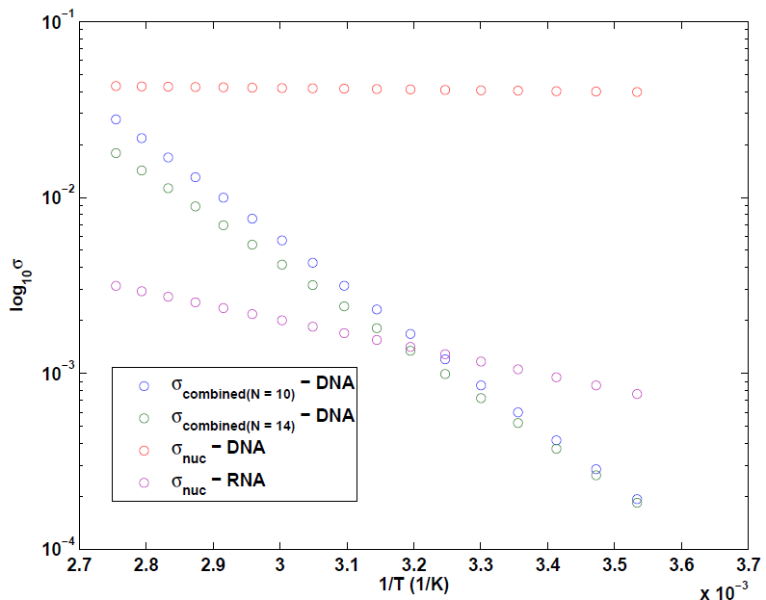
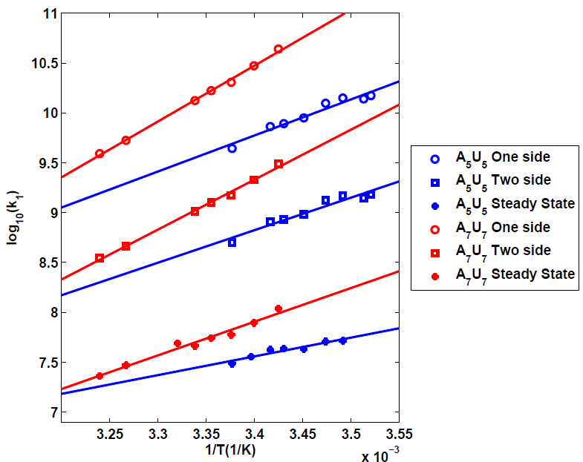
Relaxation Time Model Parameters
Sequence and Temperature Dependent Model Parameters
Marimuthu and Chakrabarti (2014), J.Chem.Phys

Slide 20
Estimation of Annealing Rate Constants
Start
Specify the Sequence and Temperature
Calculate ΔG using NN
Obtain the Relaxation time model Parameters
Calculate K and Equilibrium Concentration
Construct the State Space
Obtain K and τ
Eigen Decomposition
Solve the above equations
Notes:
Exact Model – Form a state space matrix
Eigenvalue of the matrix A will give the several time constant – The negative reciprocal of the maximum eigenvalue is the dominating time constant or the relaxation time.

Slide 21
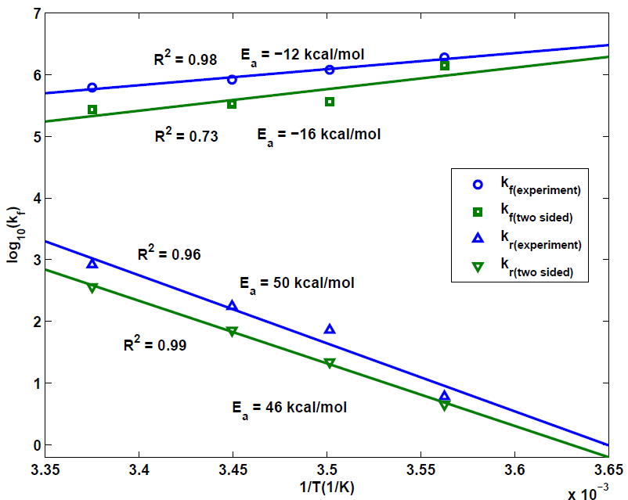
Experimental Validation
Applications other than PCR
Microarray. (Multiplex framework)
Southern blot.
This frame work can be extended to
Multiplex hybridization reactions
Hybridization with mismatches
Cancer
Diagnosis
Our model matches with the
experimental results
Marimuthu and Chakrabarti (2014), J.Chem.Phys
Notes:
Figure compares the rate constants that are estimated experimentally and theoretically. It can be see that, there is only minor difference between the rate parameters that are obtained experimentally and theoretically.
This figure shows the evolution of SP molecules that was obtained using the experimentally estimated and theoretically estimated rate constants.
Thus, our theoretical model predicts the rate parameters properly.

Slide 22
Outline
Systems Biology Approach – Unified Framework
Sequence Dependent DNA Amplification Models.
  Annealing/Melting Reaction Model
  Enzyme Binding/Extension Reaction Model
Sequence Dependent DNA Amplification Dynamics – Geometric Growth.
Optimal Control of DNA Amplification
Conclusions.

Slide 23
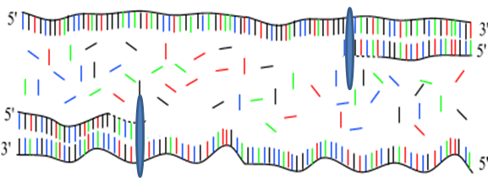
Kinetic Model (Enzyme Binding & Extension)
ENZYME BINDING
EXTENSION
Notes:
Enzyme binding reaction is represented as—
Equilibrium thermodynamics is well established by Datta and Licata at various temperature.
We need one more relationship.
Can be obtained from the relaxation time and the value is available for a same family of the enzyme at 20 deg C. We assume the same value for all other temperature. Relaxation time does not vary much with respect to temperature (Same order of magitude).
Hence, found the rate constants at various temperatures (Need to validate this assumption experimentally).

Slide 24
Reaction Mechanism
Step 7
E+D_{i}+dNTP
E+D_{i}+dNTP
Step 8
Step 1
Step 2
k₇
Step 3
k₈
k₁
k₂
k₃
E + D_{i} E.D_{i} + dNTP E.D_{i}.dNTP E’.D_{i}.dNTP
Per Nucleobase Addition
k₋₁
k₋₂
k₋₃
Step 4
k₋₄
k₄
k₁
k₋₆
k₋₅
E+D_{i+1}
E.D_{i+1}+PP_{i}
E.D_{i+1}.PP_{i}
E’.D_{i+1}.PP_{i}
k₋₁
k₆
k₅
Step 6
Step 5
Simplified
k₁
k₂
k_{cat}
k₋₁
E+D_{i}
E.D_{i} + dNTP
E.D_{i} .dNTP
E.D_{i+1} + PP_{i}
E +D_{i+1} + PP_{i}
k₋₁
k₋₂
k₁
Michaelis Menten Kinetics
Brown et al (2009), Hung, M., N. Arnheim, and M. Goodman. (1992)

Slide 25
Experimental Estimation of Extension
Rate Constants
Measured the initial rate at different substrate (N₀) concentration
Parameters are estimated using non linear parameter estimation
Marimuthu et al., Biophysical J (Under Review)
Notes:
Extension reaction of single nucleotide insertion is represented by----
The rate equation can be derived ----
Innis et al determined the number of nucleotide added per enzyme molecule per second at various temperature.
Using this data, we determined kcat/Kn value at several temperatures and plotted the Arrhenius plot and the data agrees the Arrhenius plot properly.

Slide 26
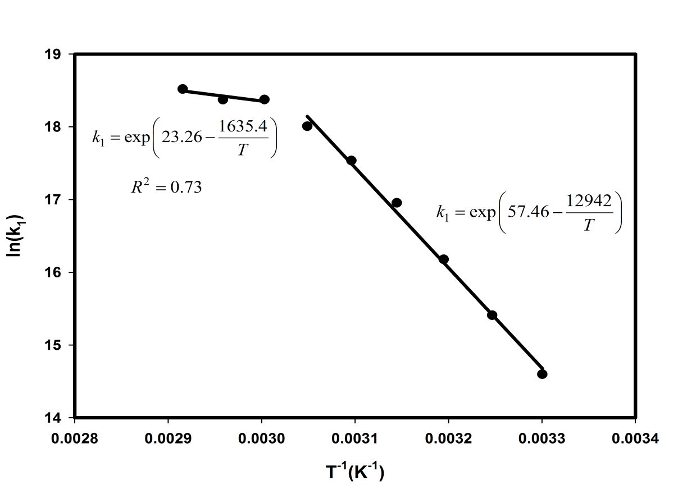
Experimental Estimation of
Enzyme Binding Rate Constant
Extension rate constant and Enzyme binding rate constants can be related as
P - The expected position of dissociation of the polymerase (expected stopping time) called the micro-processivity
Marimuthu et al., Biophysical J (Under Review)
Notes:
Extension reaction of single nucleotide insertion is represented by----
The rate equation can be derived ----
Innis et al determined the number of nucleotide added per enzyme molecule per second at various temperature.
Using this data, we determined kcat/Kn value at several temperatures and plotted the Arrhenius plot and the data agrees the Arrhenius plot properly.

Slide 27
Single Strand – Primer Duplex
Extension
DNA Melting
Again
DNA Melting
Primer
Annealing
Notes:
PCR is a cyclic process and each cycle consists of 3 steps.
1st Step is called as a melting step in which double stranded DNA is separated in to two single strand DNA. This step occurs relatively at a higher temperature (mostly at 90 deg C). A chemical reaction for this step is written as –
2nd Step is called as a Annealing step in which a small single strand primer molecule hybridized on a specific spot on a single strand molecule at relative lower temperature. Primer molecules are designed in such a way that it can hybridize on the single strand molecule. There are two types of primer molecules for two single strands and their hybridization reaction is represented as. Note that single strands can also hybridize each other at lower temperature as per this reaction but the primer concentration is kept in excess so that primer annealing dominates the single strands annealing – Towards the end of the PCR this is not the case.
3rd Step is enzymatic extension of the partially completed Single stranded primer duplex to convert it in to a complete double strand DNA. An enzyme called Taq polymerase which is even active at 72 deg C, binds on the SP molecule and add the nuclo-bases on it to convert in to a DNA. The Michalis Menton based Reaction is given as:
As we can see here at the end of three steps we got 2 DNAs from 1 DNA and now we will repeat for n cycles and after n cycles we will get 2^n. n is typically 25 to 30. Thus using PCR we get million copies of DNA from 1 DNA.
The temperature vs time profile that is typically followed for this reaction is indicated by blue line. This may or may not optimal. We look for a tempeature profile which optimizes the DNA concentration. Possibly something like which is indicated in brown line.

Slide 28
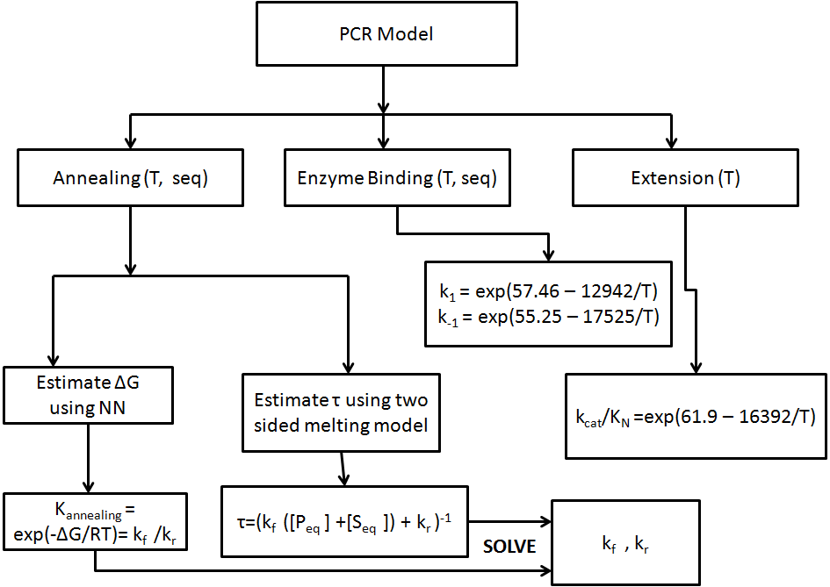
Summary of DNA Amplification Model
Marimuthu et al., Biophysical J (Under Review)

Slide 29
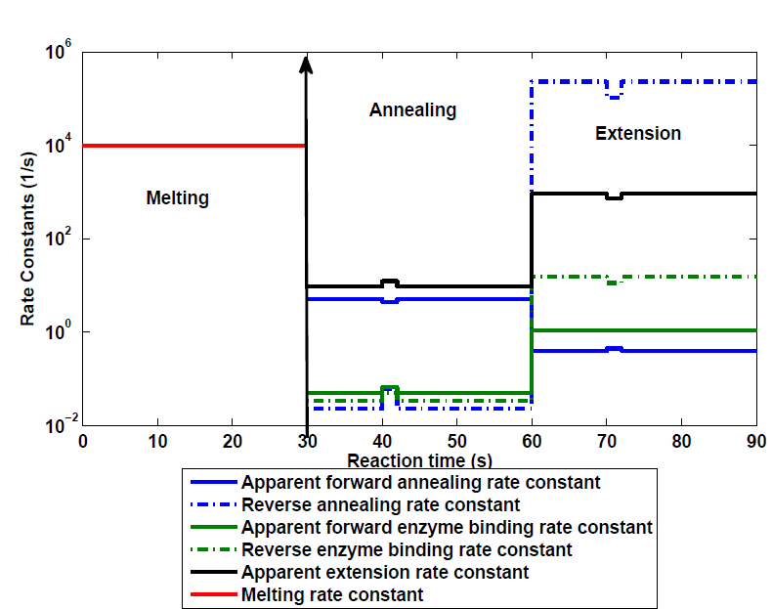
Comparison between PCR Models

Slide 30
Outline
Systems Biology Approach – Unified Framework
Sequence-Dependent DNA Amplification models.
Sequence- Dependent DNA Amplification Dynamics – Geometric Growth.
Optimal Control of DNA Amplification
Conclusions.

Slide 31
Overall Reaction Scheme of PCR and State Equations
Stiff System of DE
If the length of the target is N, the total number of state equations are 4 N + 9 (N varies from 500 – 2000)
.
.
.

Slide 32
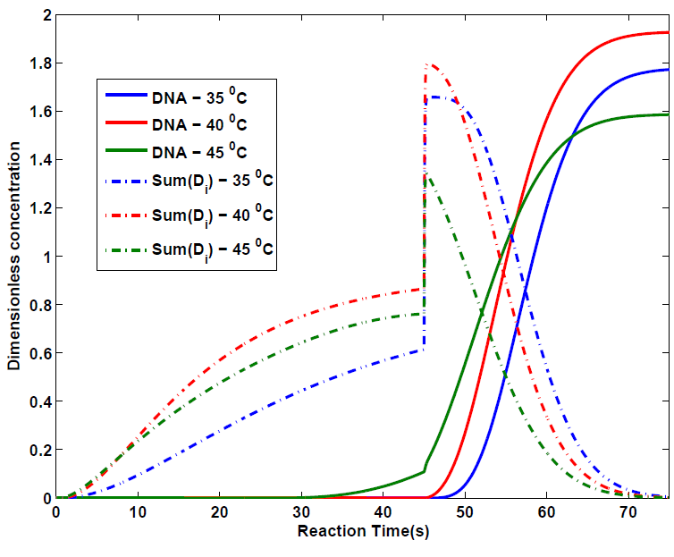
Transient Kinetics – Single Cycle (1st)
Extension Reaction time – 30 seconds.
Annealing Reaction time – 45 seconds.
Extension temperature = 72 ⁰ C
Enzyme Concentration = 10 nM.
Template Concentration = 10⁻¹⁴ M
Primer Concentration = 0.2 μM
If the annealing temperature is 40 deg C, the overall PCR is faster with nearly 100% efficiency.
Length of the target – 1000 bp
Marimuthu et al., Biophysical J (Under Review)

Slide 33
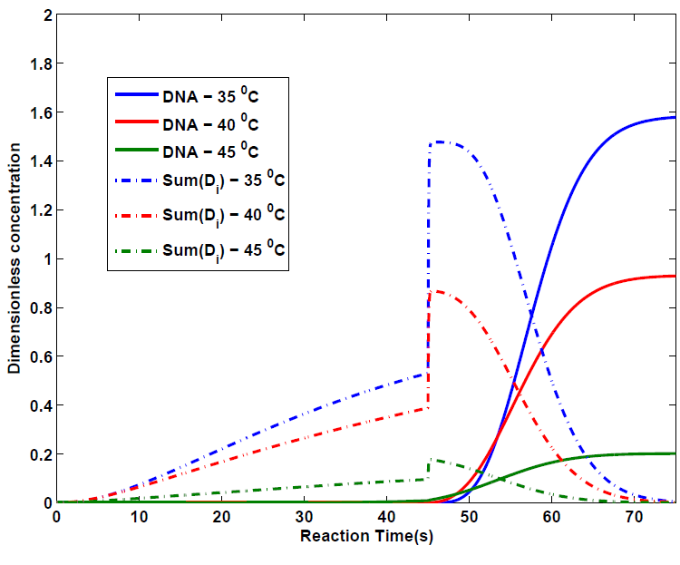
Transient Kinetics – Single Cycle (1st)
Same reaction conditions but different target sequence.
Maximum efficiency (based on these three sampling) of 70% is achieved at 35 ⁰C
Sequence dependent model is the key
Marimuthu et al., Biophysical J (Under Review)

Slide 34
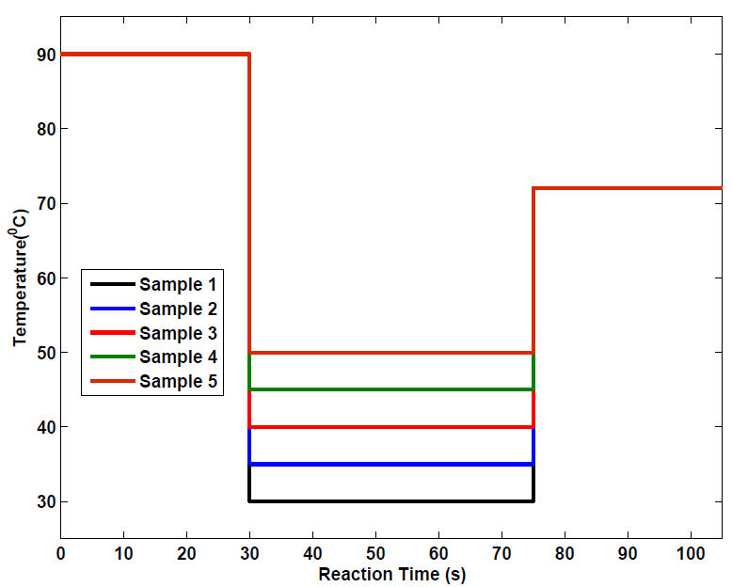
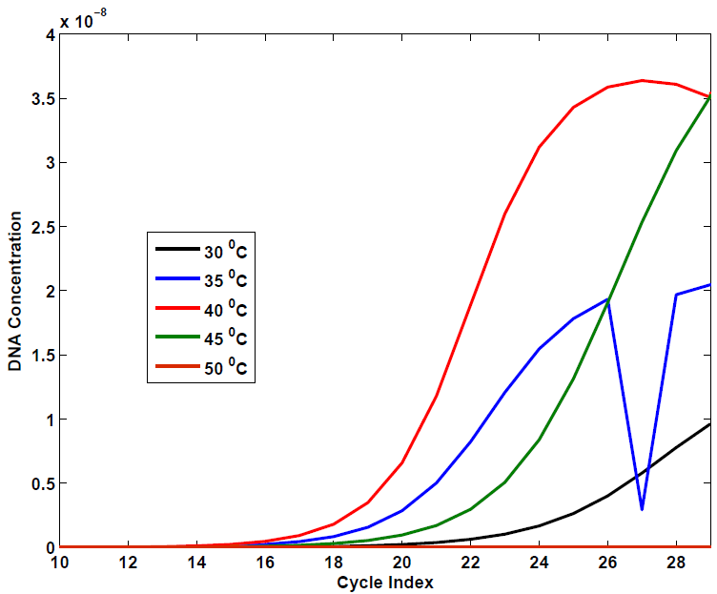
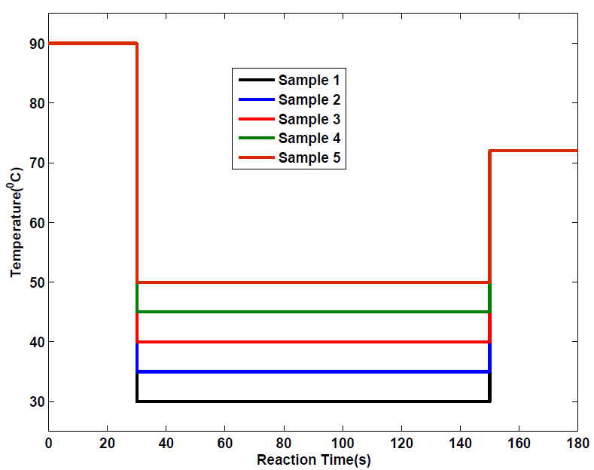
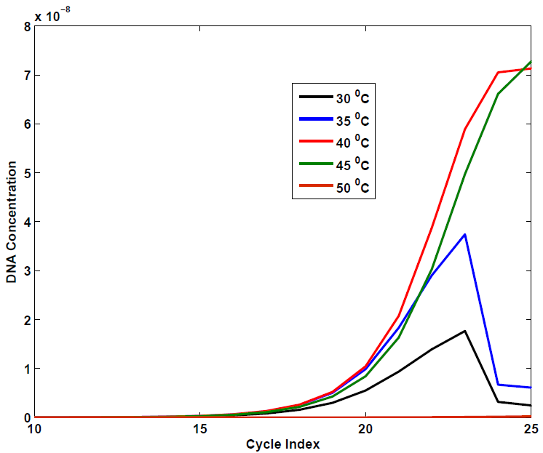
Geometric Growth of Target DNA
Shorter reaction time
Longer
reaction time

Slide 35
Geometric Growth of Target DNA
Enzyme Concentration is constant throughout the PCR
Concentration of DNA increases when cycle no increases
Once single strands concentration exceeds the enzyme concentration, more enzyme is needed.
More enzyme can be provided when we recycle the enzyme.
Enzyme concentration
is in Excess
Enzyme concentration
is limited
Stage 2
Stage 1
SP is in excess
Recycle this enzyme once it produce
some DNA so that it can react with all SP

Slide 36
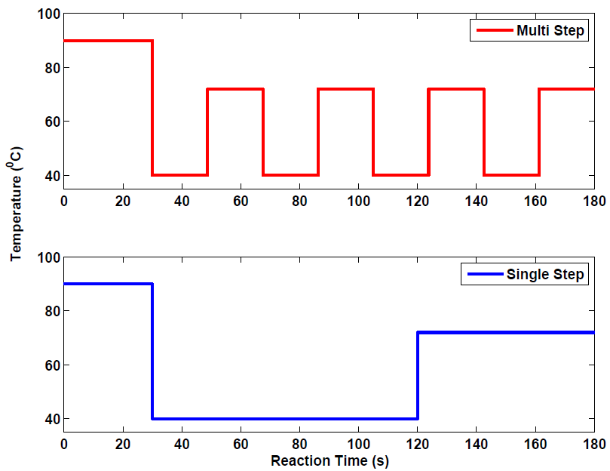
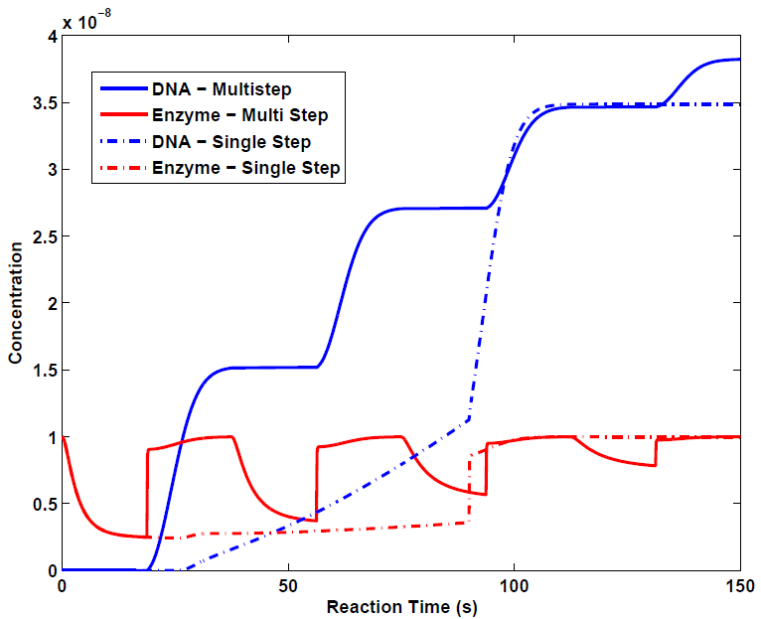
Multistep Approach (i^{th} Cycle)
Two new types of PCR cycling strategies shown to improve the efficiency.
This demonstrates how sequence dependent models can be used to develop new nonstandard PCR cycling strategies.
Marimuthu and Chakrabarti (2014), Molecular Systems Biology, (Submitted)

Slide 37
Outline
Systems Biology Approach – Unified Framework
Sequence-Dependent DNA Amplification Models.
Sequence-Dependent DNA Amplification Dynamics – Geometric Growth.
Optimal Control of DNA Amplification
Conclusions.

Slide 38
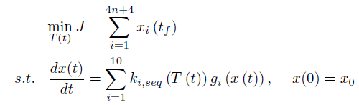
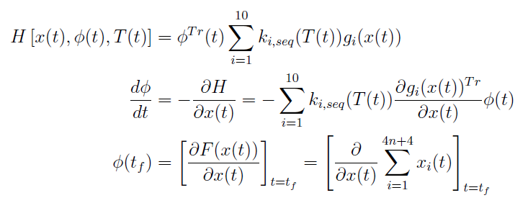
Optimal Control Formulation
Condition for Optimality - Pontryagin’s Maximum Principle

Slide 39
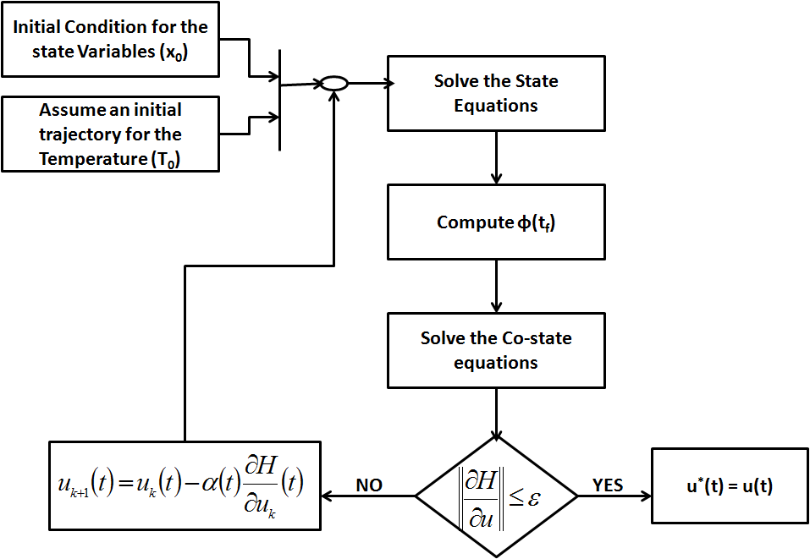
Control Vector Iteration

Slide 40
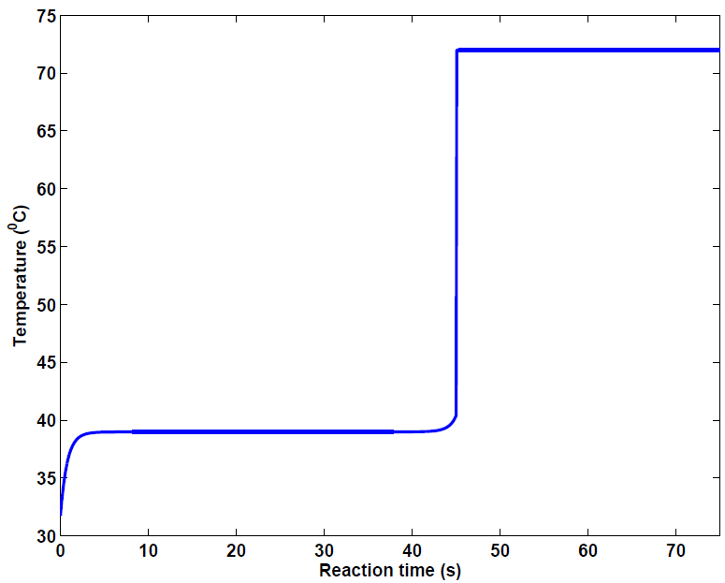
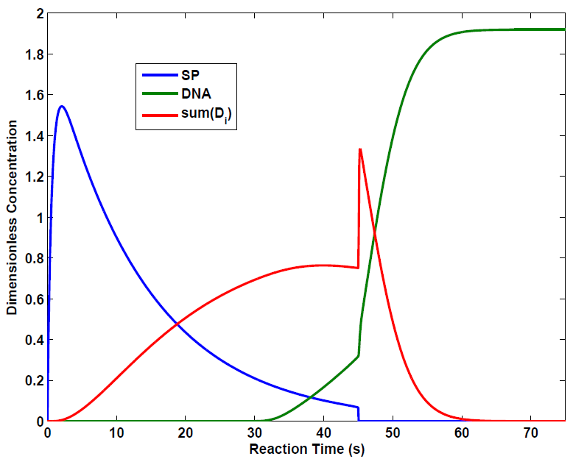
Optimal Control
Optimal control profile.
Optimal DNA concentration
profile.
Initial concentration of DNA is 10⁻¹⁴ M and Initial concentration of Enzyme is 10 nM.

Slide 41


Minimal Time Control of
Geometric Growth
In stage 1, temperature profile is periodic – Pseudo first order reactions due to high enzyme and primer concentrations.
With fixed reaction time, find the cyclic efficiency that can reduce the overall reaction time (For example, Rapid cycle PCR) – 100 % efficiency may not be desirable – Takes long time.
Solve the following optimization problem

Slide 42
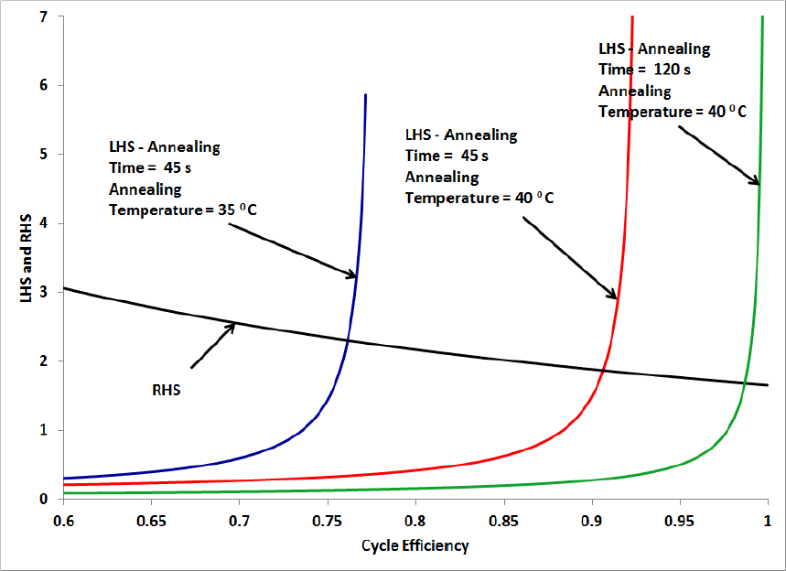
Minimal Time Control of
Geometric Growth
Optimal cyclic efficiency and cycle time that can reduce the overall reaction time.
Marimuthu and Chakrabarti (2014), Molecular Systems Biology, (Submitted)

Slide 43
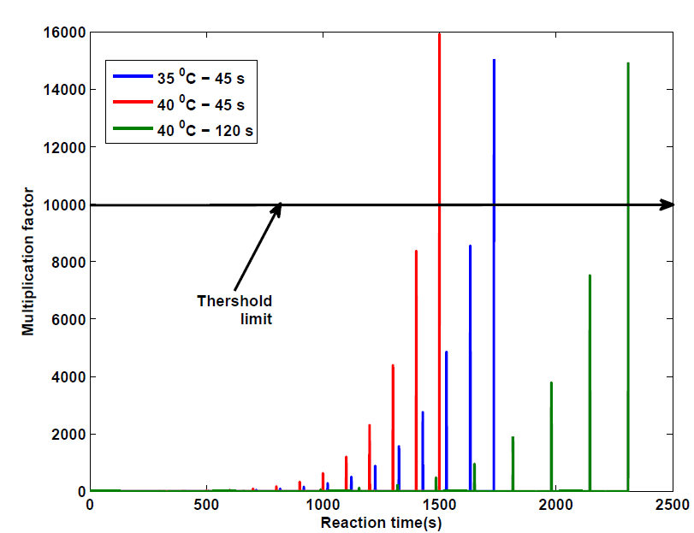
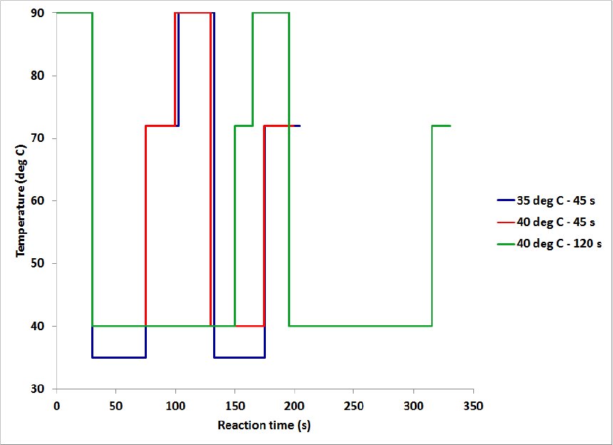
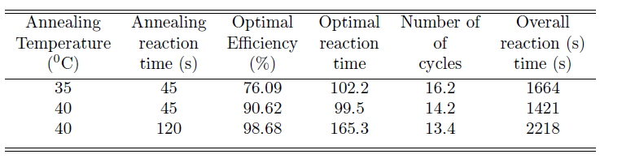
Minimal Time Control of
Geometric Growth
Marimuthu and Chakrabarti (2014), Molecular Systems Biology, (Submitted)

Slide 44
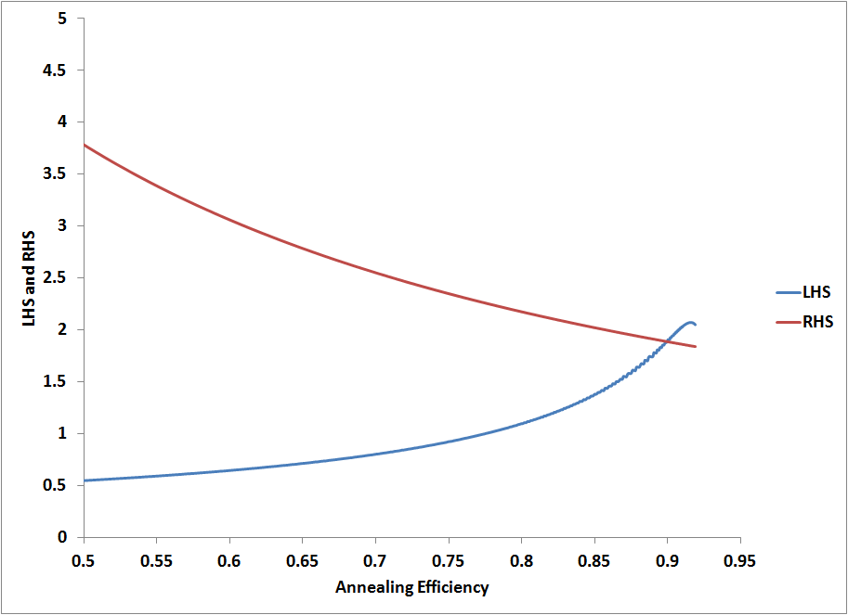
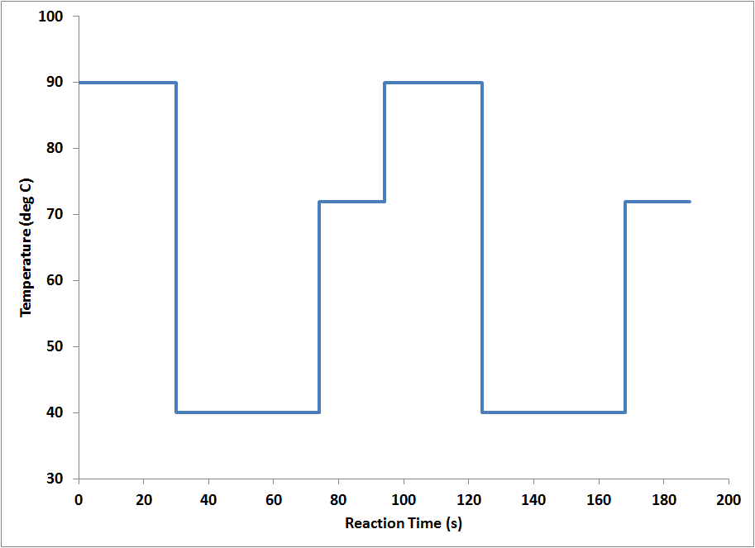
Optimal Switching Time – Approximate Solution
Minimum time analysis using the optimal DNA concentration profile.
Optimal Cyclic Efficiency
Optimal Temperature Profile

Slide 45
Outline
Systems Biology Approach – Unified Framework.
Sequence-Dependent DNA Amplification Models.
Sequence-Dependent DNA Amplification Dynamics – Geometric Growth.
Optimal Control of DNA Amplification.
Conclusions.

Slide 46
Conclusions
Proposed a unified framework to design the new types of DNA amplification reactions.
We have developed the first sequence and temperature-dependent kinetic model for PCR reactions that is suitable for engineering control, validating this state space model through comparison to experimental data.
Our Systems Biology approach can be applied to various types of applications such as Polymerase Chain Reactions, Microarray applications, Southern Blot, etc.

Slide 47
Conclusions
Using the theory of Optimal control, optimal temperature profile for a given PCR has been developed.
The time optimal switching time calculation can be used to determine proper time for a given cycling approach.
Our kinetic model can be extended to application such as Rapid PCR, PCR with mismatches, Multiplex PCR, Cold PCR – Cancer Diagnosis.

Slide 48
Contribution
Marimuthu, K and Chakrabarti, R - Sequence-dependent theory of oligonuclotide hybridization kinetics - Journal of Chemical Physics – 140 (2) - 2014
Marimuthu, K , Jing, C and Chakrabarti, R - Sequence-dependent biophysical modeling of DNA amplification - Biophysical Journal (Under Review).
Marimuthu, K and Chakrabarti, R – Sequence-dependent theory of DNA amplification dynamics: toward optimally controlled DNA amplification – Molecular Systems Biology (Under Review).
Jing, C., Moorthy, S., Marimuthu, K., and Chakrabarti, R - Predictive kinetic modeling of DNA polymerases. To be Submitted.
Marimuthu, K and Chakrabarti, R – Optimally Controlled DNA amplification reaction – In Preparation.

Slide 49
Acknowledgement
Advisor: Raj Chakrabarti
Committee Members : Prof. Lorenz Biegler
: Prof. Nickolaos Sahinidis
: Prof. Robert Tilton
Prof. Shankar Narasimhan, IIT Madras.
Partial Financial support from Purdue University
Family members and Friends.

Slide 50
Thank You

Slide 51
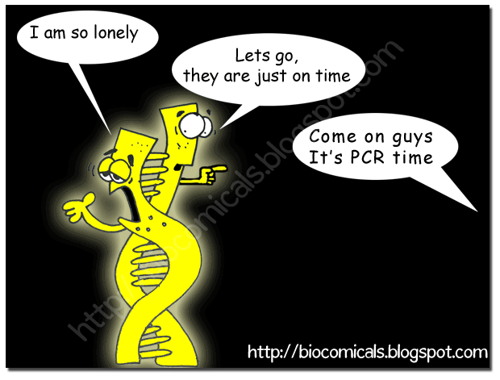
Thank You

Slide 52
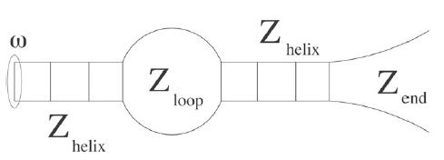
Melting of Long DNA
Co-operative melting – Simultaneous melting of different regions of a DNA
Each of the above domain melts based on the two state theory
Relaxation time of each domain can be estimated and hence the rate limiting step as well.
Notes:
In this slide, we discuss how PCR is used in Cancer Diagnostics, which is one of the most important applications of the PCR. A person who has cancer can have two types of DNA. The first one is wild type DNA and the second one is mutated DNA. As we know, mutated DNA causes the Cancer. The aim is now to find out whether a person has mutated DNA or not. if yes, how much is the concentration of such a DNA. If we can amplify the mutated DNA, it is possible to back calculate the amount of original DNA. So, here one can post an Optimization problem with an Objective : Maximize the concentration of mutated DNA. Note that we also have a wild type DNA. Change the reaction environment in such a way that, it maximizes the concentration of mutated DNA. Analogy can be made with exiting process in a tight parking spot. The plot suggest a such a possible reaction condition. While the blue one maximizes the wild type DNA, red one suppose to maximize the concentration of mutated DNA. What could be the optimal reaction condition that maximizes the mutated DNA concentration . Probably the brown one. One need to formulate an optimization problem systematically and solve. This study can also be used to monitor the performance of cancer treatment.

Slide 53
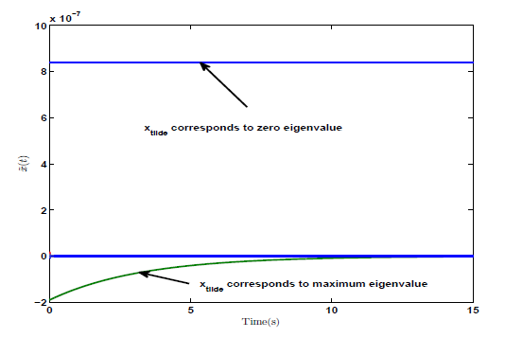
Two state theory
One Eigenvalue determines the rate of the reaction.
Notes:
In this slide, we discuss how PCR is used in Cancer Diagnostics, which is one of the most important applications of the PCR. A person who has cancer can have two types of DNA. The first one is wild type DNA and the second one is mutated DNA. As we know, mutated DNA causes the Cancer. The aim is now to find out whether a person has mutated DNA or not. if yes, how much is the concentration of such a DNA. If we can amplify the mutated DNA, it is possible to back calculate the amount of original DNA. So, here one can post an Optimization problem with an Objective : Maximize the concentration of mutated DNA. Note that we also have a wild type DNA. Change the reaction environment in such a way that, it maximizes the concentration of mutated DNA. Analogy can be made with exiting process in a tight parking spot. The plot suggest a such a possible reaction condition. While the blue one maximizes the wild type DNA, red one suppose to maximize the concentration of mutated DNA. What could be the optimal reaction condition that maximizes the mutated DNA concentration . Probably the brown one. One need to formulate an optimization problem systematically and solve. This study can also be used to monitor the performance of cancer treatment.

Slide 54
Processivity
Definition of Processivity
State Space of Enzyme binding and Extension reaction
Master Equation
Notes:
In this slide, we discuss how PCR is used in Cancer Diagnostics, which is one of the most important applications of the PCR. A person who has cancer can have two types of DNA. The first one is wild type DNA and the second one is mutated DNA. As we know, mutated DNA causes the Cancer. The aim is now to find out whether a person has mutated DNA or not. if yes, how much is the concentration of such a DNA. If we can amplify the mutated DNA, it is possible to back calculate the amount of original DNA. So, here one can post an Optimization problem with an Objective : Maximize the concentration of mutated DNA. Note that we also have a wild type DNA. Change the reaction environment in such a way that, it maximizes the concentration of mutated DNA. Analogy can be made with exiting process in a tight parking spot. The plot suggest a such a possible reaction condition. While the blue one maximizes the wild type DNA, red one suppose to maximize the concentration of mutated DNA. What could be the optimal reaction condition that maximizes the mutated DNA concentration . Probably the brown one. One need to formulate an optimization problem systematically and solve. This study can also be used to monitor the performance of cancer treatment.

Slide 55
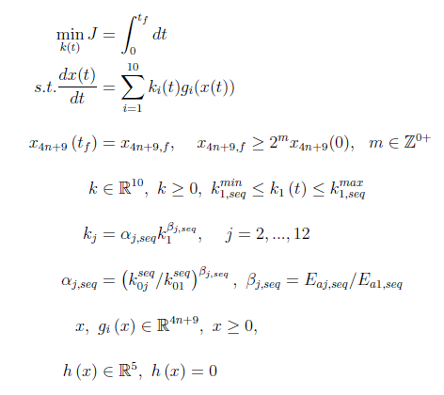
Time Optimal Control
Notes:
In this slide, we discuss how PCR is used in Cancer Diagnostics, which is one of the most important applications of the PCR. A person who has cancer can have two types of DNA. The first one is wild type DNA and the second one is mutated DNA. As we know, mutated DNA causes the Cancer. The aim is now to find out whether a person has mutated DNA or not. if yes, how much is the concentration of such a DNA. If we can amplify the mutated DNA, it is possible to back calculate the amount of original DNA. So, here one can post an Optimization problem with an Objective : Maximize the concentration of mutated DNA. Note that we also have a wild type DNA. Change the reaction environment in such a way that, it maximizes the concentration of mutated DNA. Analogy can be made with exiting process in a tight parking spot. The plot suggest a such a possible reaction condition. While the blue one maximizes the wild type DNA, red one suppose to maximize the concentration of mutated DNA. What could be the optimal reaction condition that maximizes the mutated DNA concentration . Probably the brown one. One need to formulate an optimization problem systematically and solve. This study can also be used to monitor the performance of cancer treatment.

Slide 56


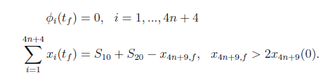

Time Optimal Control
Notes:
In this slide, we discuss how PCR is used in Cancer Diagnostics, which is one of the most important applications of the PCR. A person who has cancer can have two types of DNA. The first one is wild type DNA and the second one is mutated DNA. As we know, mutated DNA causes the Cancer. The aim is now to find out whether a person has mutated DNA or not. if yes, how much is the concentration of such a DNA. If we can amplify the mutated DNA, it is possible to back calculate the amount of original DNA. So, here one can post an Optimization problem with an Objective : Maximize the concentration of mutated DNA. Note that we also have a wild type DNA. Change the reaction environment in such a way that, it maximizes the concentration of mutated DNA. Analogy can be made with exiting process in a tight parking spot. The plot suggest a such a possible reaction condition. While the blue one maximizes the wild type DNA, red one suppose to maximize the concentration of mutated DNA. What could be the optimal reaction condition that maximizes the mutated DNA concentration . Probably the brown one. One need to formulate an optimization problem systematically and solve. This study can also be used to monitor the performance of cancer treatment.

