Slide 1
Group meeting objectives

Slide 2
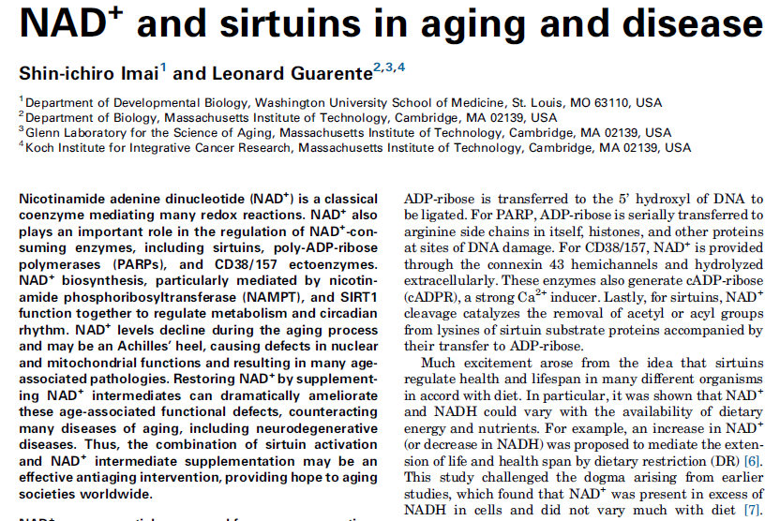
Survey of some literature/reviews on NAD+/NAM regulation of sirtuins
NAD+ decline as a possible cause of aging – many leading groups currently pursuing research in this vein and in vivo studies have been prioritized in future research plans

Slide 3
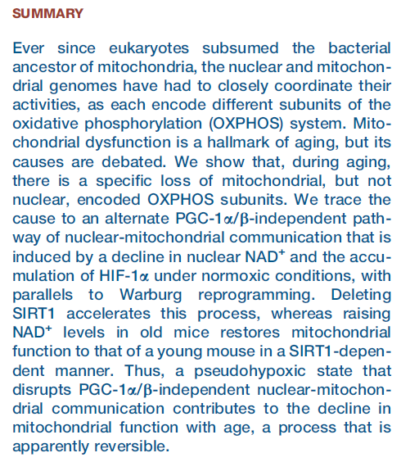
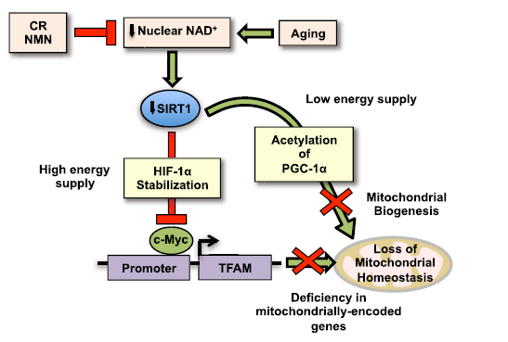
Reversal of age-related decline through NAD+ supplementation

Slide 4
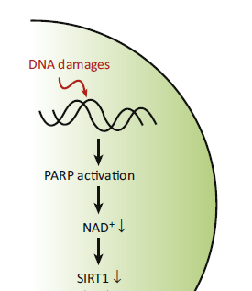
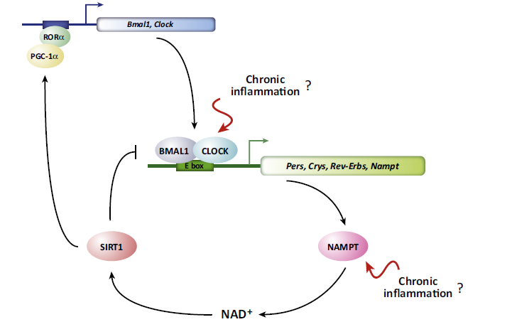
Nampt and PARP pathways determine the physiological concentrations of NAD+ and NAM; NAD+ declines with age

Slide 5
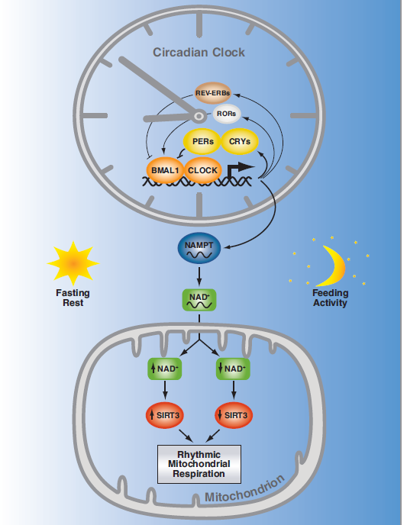
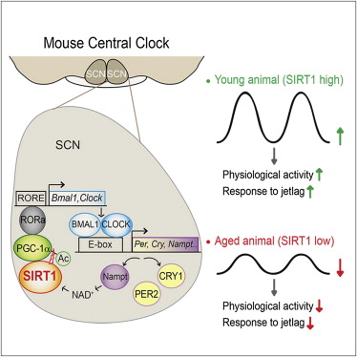
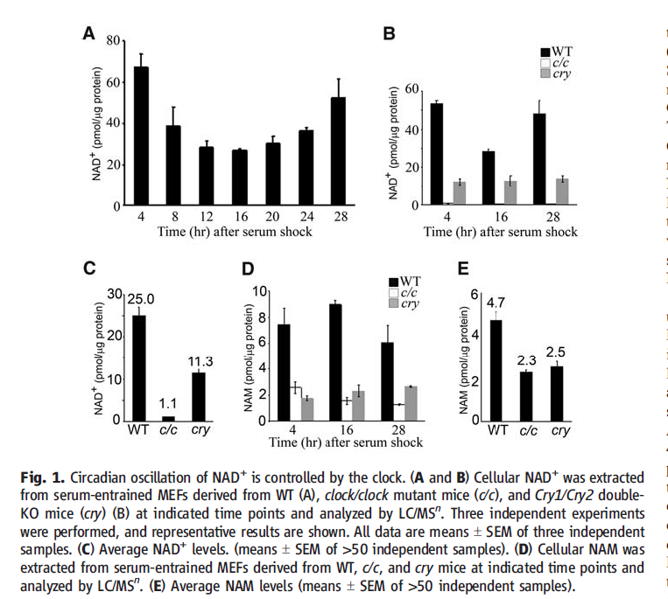
Oscillation of NAD+/NAM levels, decreasing amplitude with age (inflammation)
SIRT1
SIRT3

Slide 6
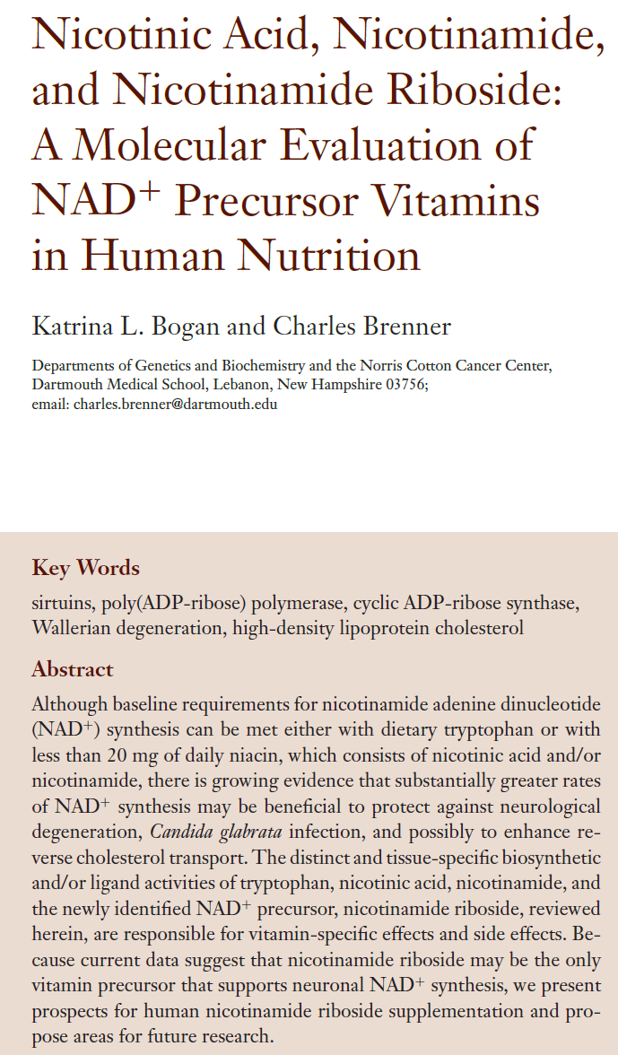
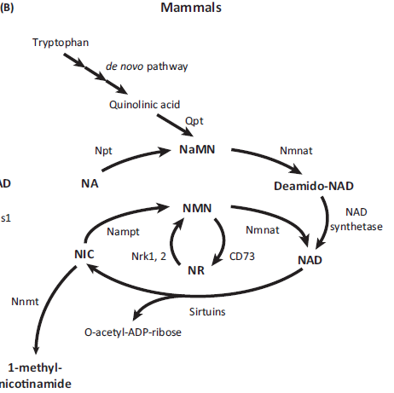
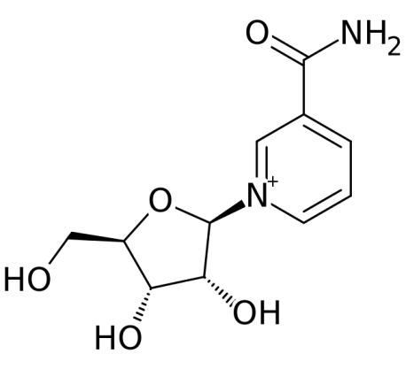
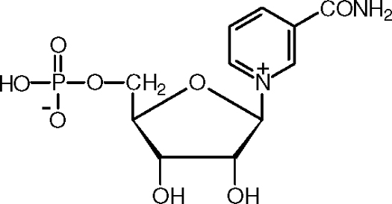
NR and NMN supplementation

Slide 7
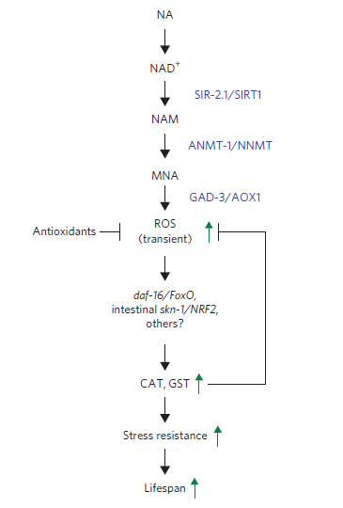
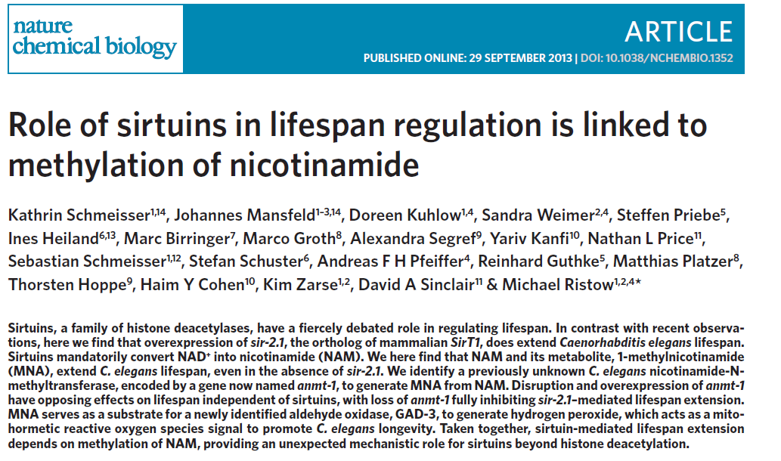
Sirtuin role in lifespan extension linked to NAM

Slide 8
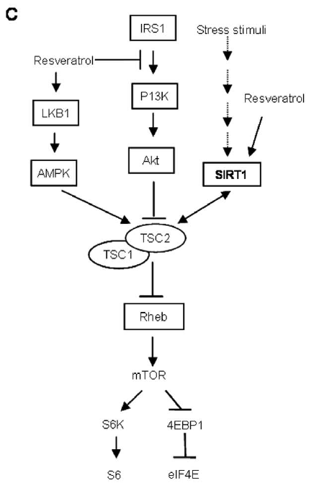
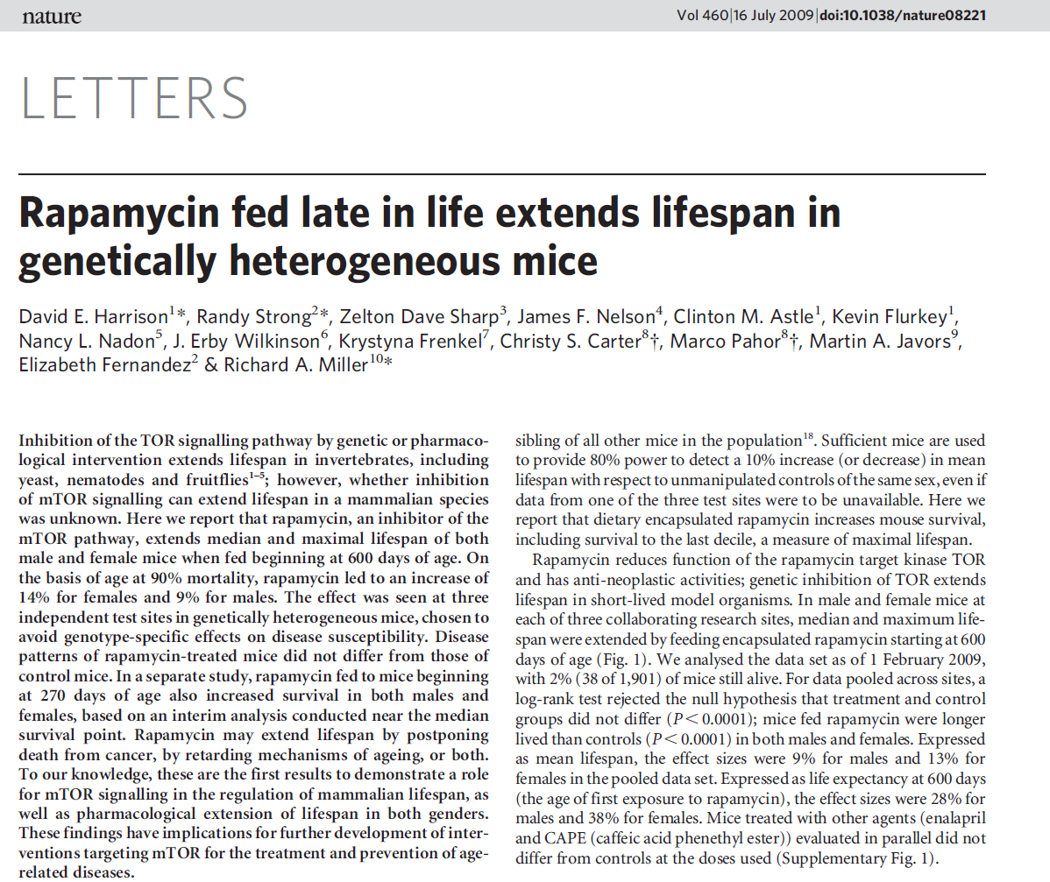
mTOR-mediated lifespan extension; SIRT1 downregulation of mTOR

Slide 9
Summary of implications
These findings point to the central importance of NAD+/NAM regulation; e.g., if NAD+ levels fall below K_{m}, activation by e.g. allosteric activators may not help
Most sirtuin activation strategies have targeted SIRT1. Allosteric activators like resveratrol not effective with SIRT3 and other important sirtuins
Ambiguous role of physiological [NAM] in sirtuin regulation; diffuses between compartments

Slide 10
Our work vis-à-vis recent developments
Important differences (isoform-specific) between yeast and mammalian sirtuin NAD+/NAM regulation. Sauve’s conjectures about isoNAM effects on mammalian sirtuins were oversimplified. Opportunity. Building upon our 1st paper findings.
Mechanism-based inhibitors: Ex-527 and Huntington’s. M-based inhibitors can be highly potent. Our studies of sirtuin inhibitory mechanisms are relevant.
Ours is also the first work on computational estimation of binding affinities in context of mechanism-based sirtuin drug design

Slide 11
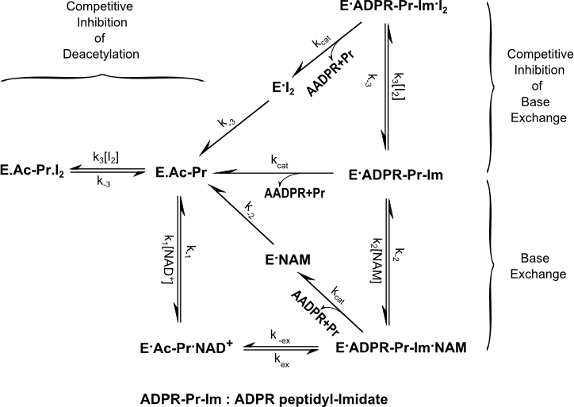
Mechanism based inhibition/activation

Slide 12
Mechanism based inhibition/activation (cont’d)

Slide 13
Our objectives
Developing ability to turn off NAM inhibition of specific sirtuins will open up opportunities for in vivo experiments that can explore effects of varying NAD+/NAM concentrations on lifespan extension. Prerequisite for maximization our scientific impact through possible collaborations.
Requires selective binding to specified intermediates

Slide 14
Our objectives (cont’d)
2) Computationally driven mechanism-based inhibition of deacetylation and base exchange.
Requires abilities to grow molecules, estimate binding affinities of specified complexes, and optimization of those binding affinities
Isoform selectivity - may be difficult to achieve
without computational design

Slide 15
Short-term goals
Submission of 2nd paper
Accumulation of data and proposed methods required for drafting of provisional patent (full patent will require doing more of the proposed experiments)

Slide 16
Short-term goals: provisional patent
File a provisional patent on our method for mechanism-based inhibitor/activator discovery
For full patent, need to show at least one example of successful discovery/validation of an activator or inhibitor via our computationally driven workflow
Also want to show ability to predict binding affinities based on computational/experimental correlations. this can be done with larger datasets of existing molecules
Software development will be planned according to this goal

Slide 17
Short-term goals: provisional patent
Computationally, the focus will be developing workflows for growing molecules based on existing leads and rank ordering them by binding affinity. Binding affinity will be an input to the predictive model. Consideration of required computational resources
Experimentally, we will focus on implementation of high-throughput screening assays, developing datasets for the purpose of training computational models, and methods for kinetic characterization of sirtuins
Synergies with enzyme engineering workflows

Slide 18
Short-term goals: 2nd paper
For activator discovery, sirtuin kinetic model required – this may be the subject of a 2nd theoretically / computationally oriented paper that may go in PCB. Includes derivation of the kinetic model in PLOS One.
An outline/draft will be sent shortly and both XG and PL will be given tasks associated with continuing to refine this outline.
Experimentally, little work will be done, but an experimental method for parameter estimation will be proposed. Hence questions have been asked regarding transient kinetics experiments in the lit and in our lab.

