Slide 1
PMC-AT Group Meeting
Ping Lin
09/05/2014

Slide 2
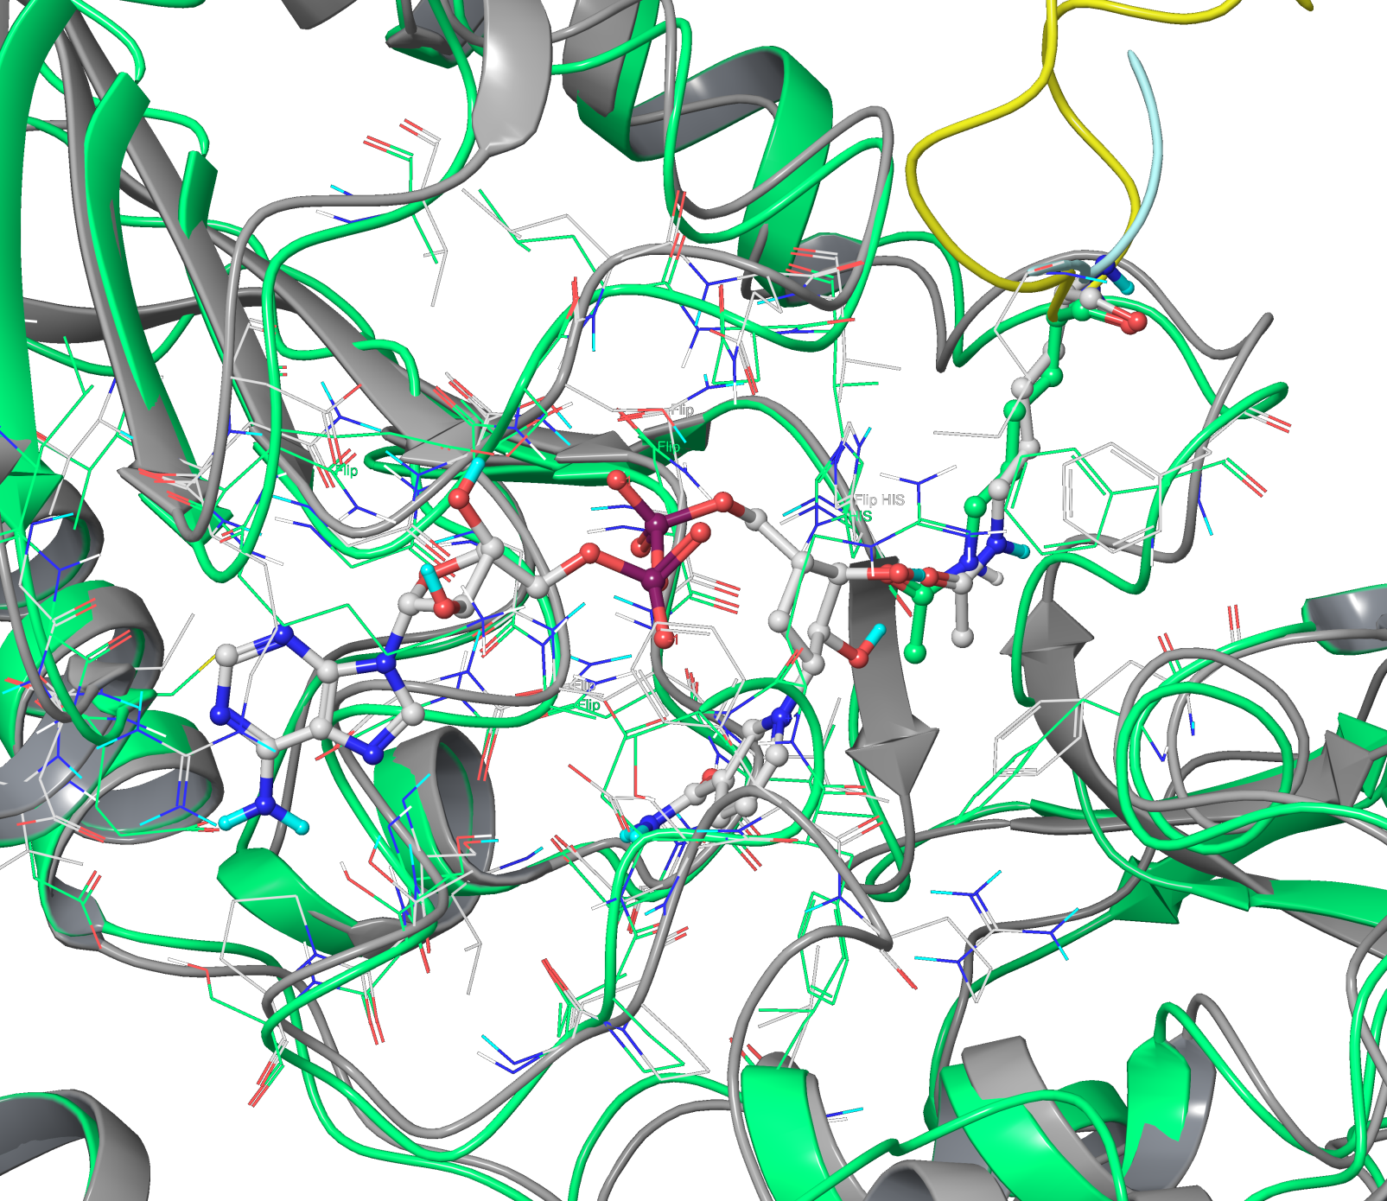
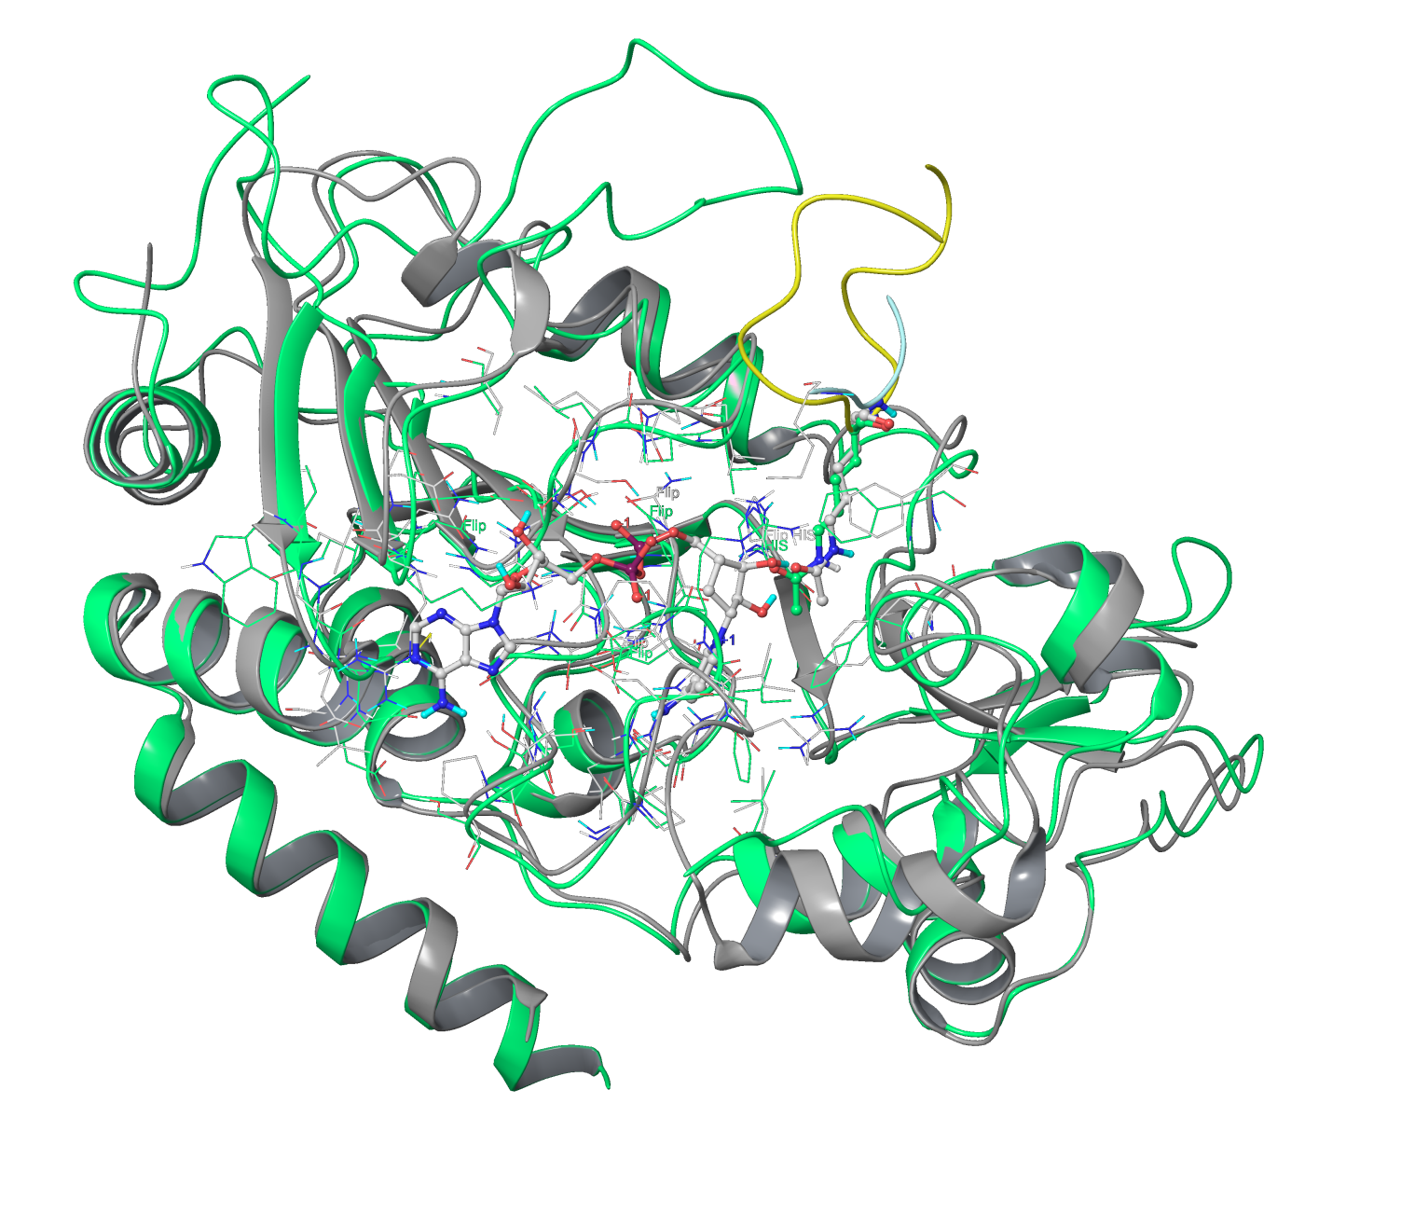
Comparing C pocket in SIRT3 & SIRT2
SIRT3 taken from ternary structure: 4FVT (grey)
SIRT2 taken from binary structure 4L3O (green)

Slide 3
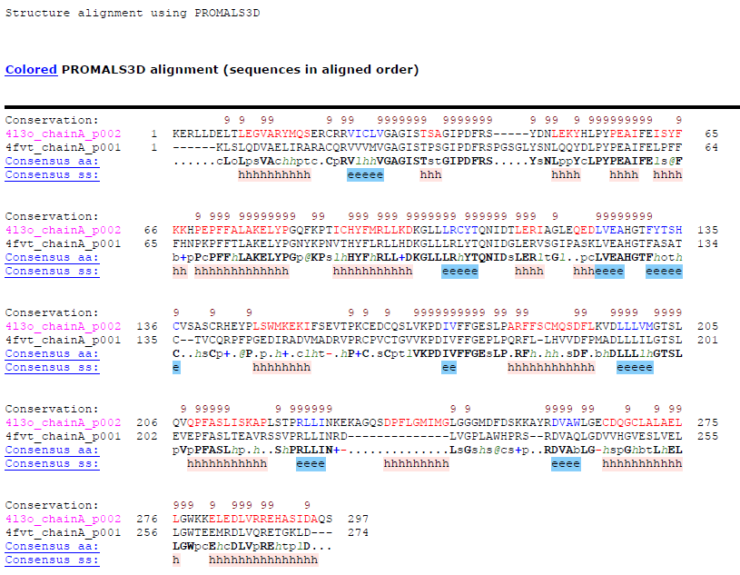
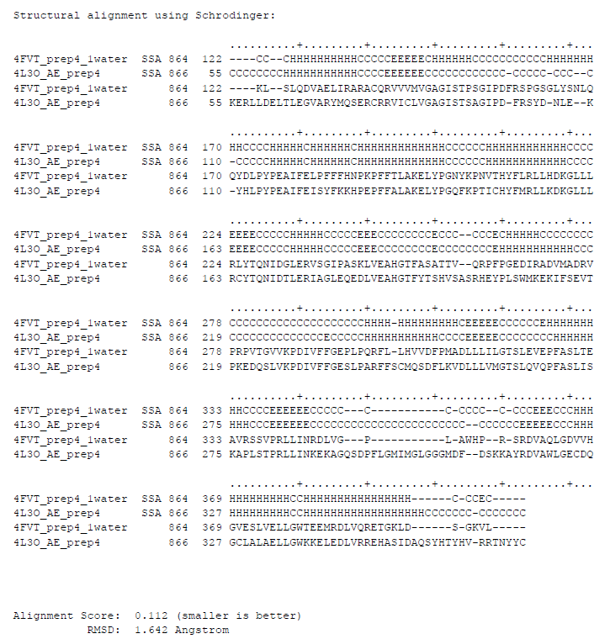
Structural Based Sequence Alignment

Slide 4
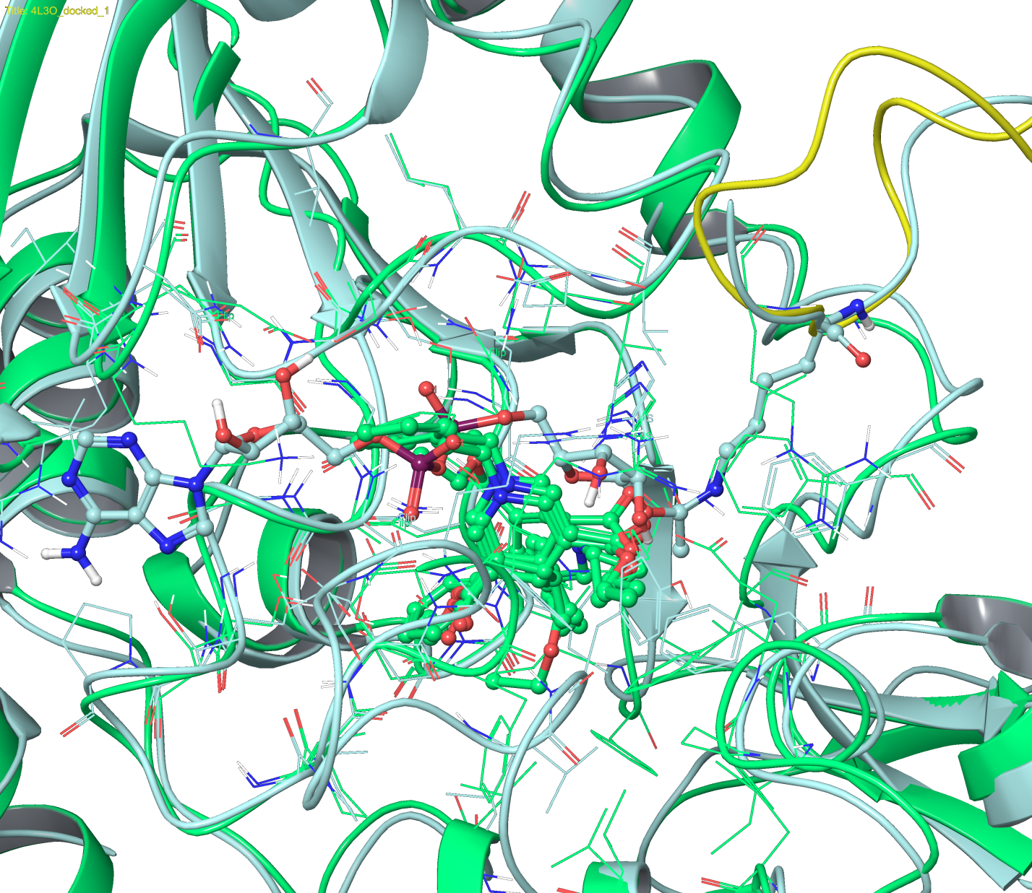
Alignment w/ Docked Structures
SIRT3:intermediate (4BVG, light blue) vs SIRT2:peptide:DHPs (4L3O, green)

Slide 5
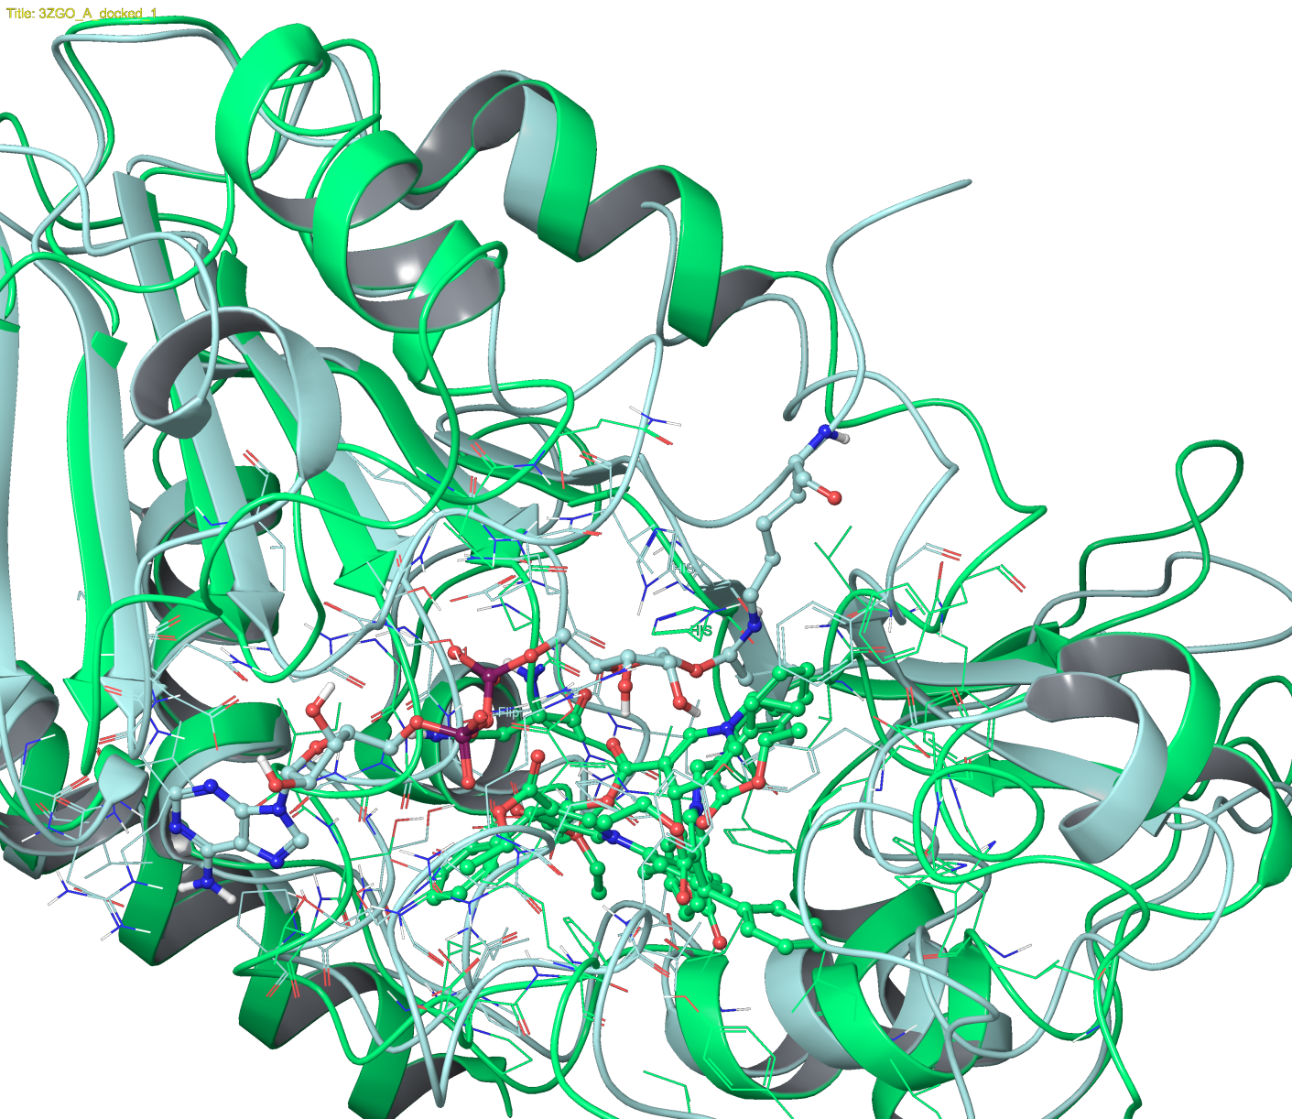
SIRT3:intermediate (4BVG, light blue) vs SIRT2:DHPs (3ZGO, apo, green)

Slide 6
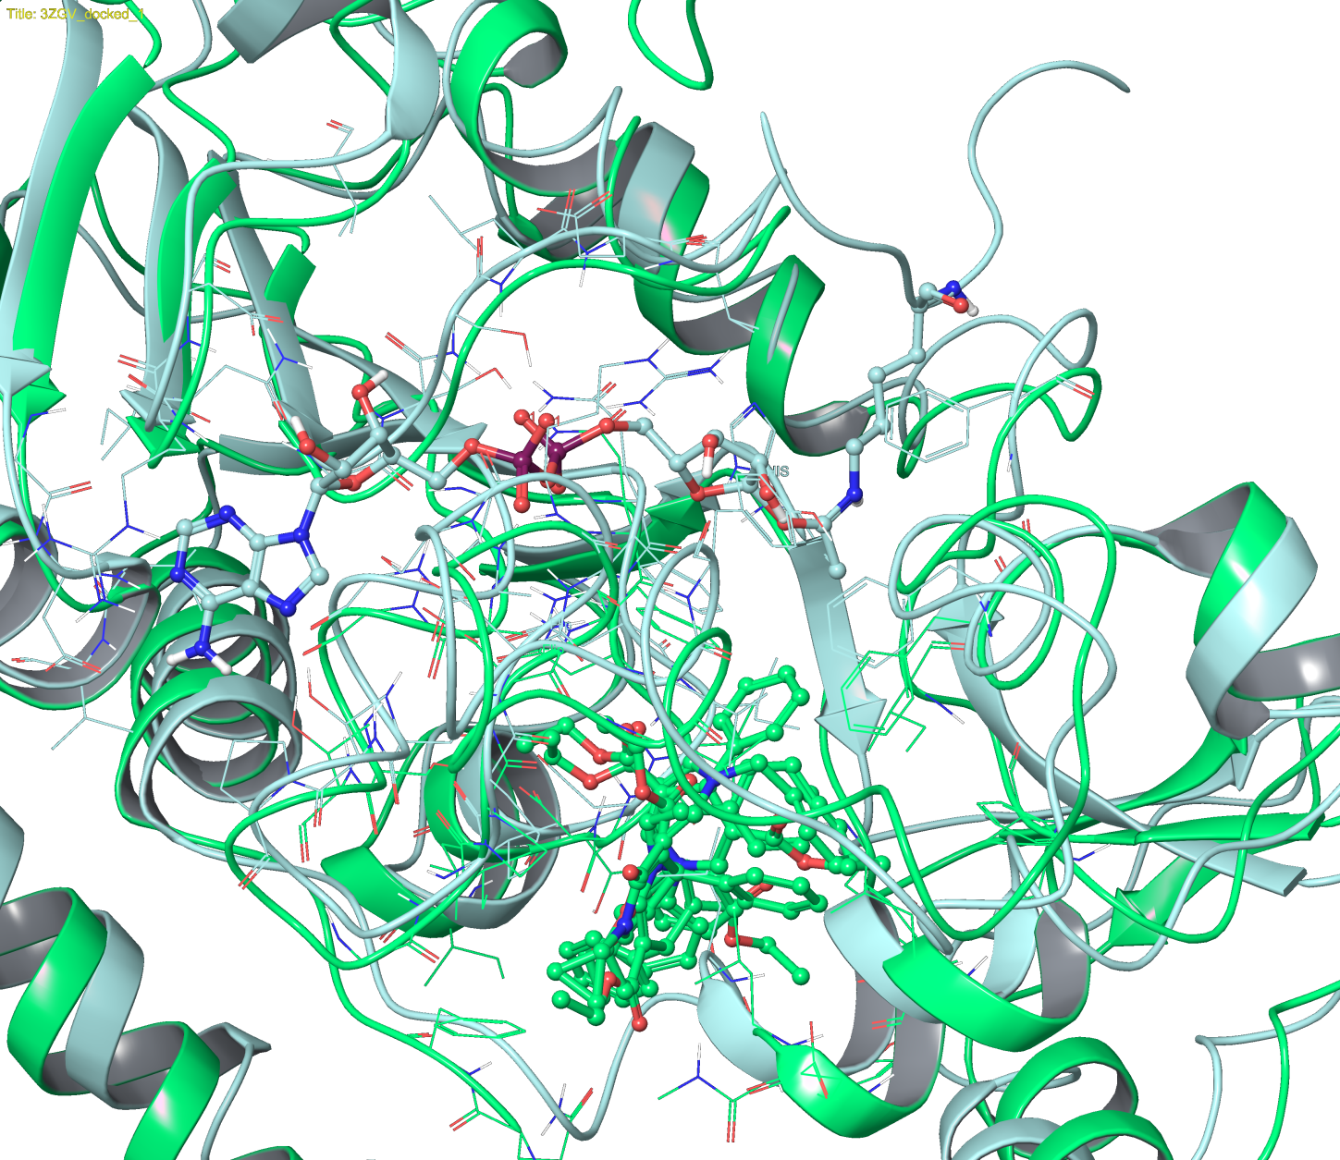
SIRT3:intermediate (4BVG, light blue) vs SIRT2:DHPs (3ZGV, no ADP, green)

Slide 7
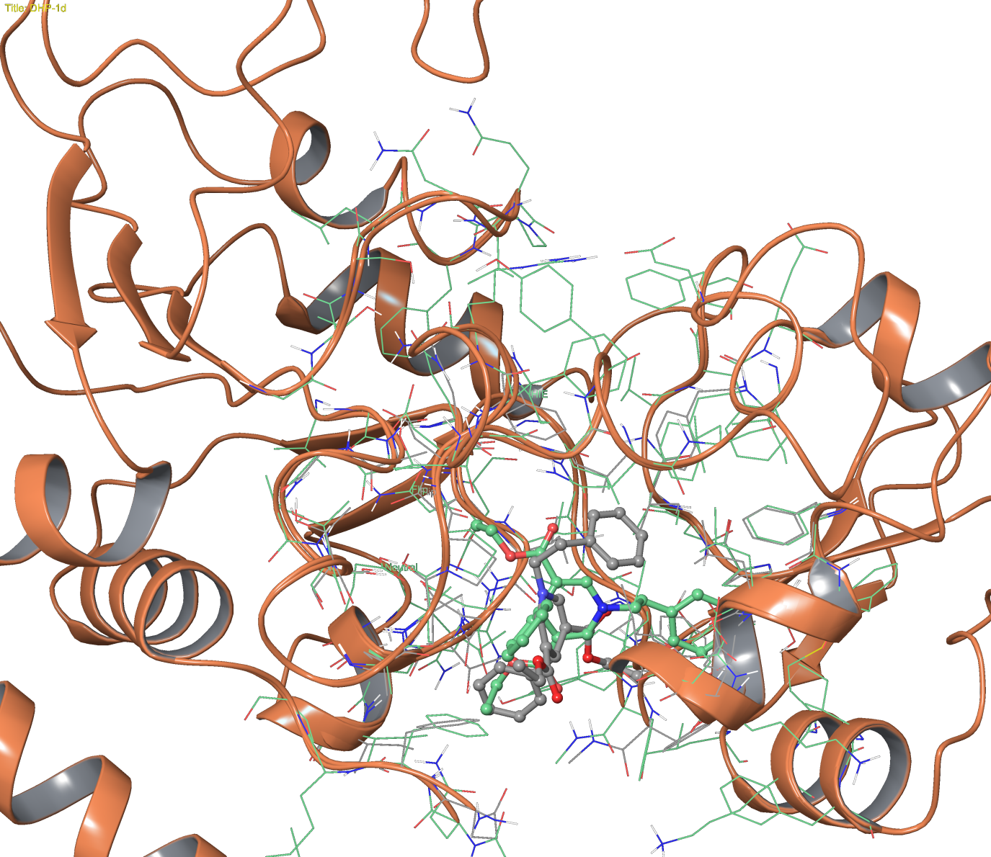
SIRT2:DHP-1d (3ZGV, no ADP), Glide XP (grey) vs Induced Fit (green)

Slide 8
Amber MM-GBSA vs Schrodinger MM-GBSA
Amber MM-GBSA:
  Free;
  More choice of MM-GBSA settings;
  Overhead for creating proper file conversion (receptor in pdb, ligand poses in mol2 format, extra processing steps are usually required.);
  Faster (2500 poses in 28 hours);
  Large storage for temporary files (~6GB used for 2500 poses, can be reduced after completion);
  Requires post-processing of outputs;
  May be parallelized.
Schrodinger MM-GBSA:
  Sometime fails when a large number of poses are selected;

Slide 9
Comparing Schrodinger/AMBER MM-GBSA

