Slide 1
PMC Group Meeting – Computational Results
Ping Lin
09/12/2014

Slide 2
Available PDB Structures
4 SIRT2 structure available:
3ZGO is apo SIRT2 structure; (1J8F is also apo SIRT2 structure from 2001)
3ZGV is SIRT2:ADP binary structure; (2013)
4L3O is SIRT2:Ac-Peptide binary structure; (2014)
20 SIRT3 structures available:
4FVT is SIRT3:Ac-Peptide:NAD+ ternary structure;
4JSR is SIRT3:ELT inhibitor binary structure;
4BN5 is SIRT3:carba-NAD+:SRT1720 ternary structure;
4BVH is SIRT3:Ac-ADPR:Ex-243 ternary structure;
4BV3 is SIRT3:NAD+:Ex-243 structure;

Slide 3
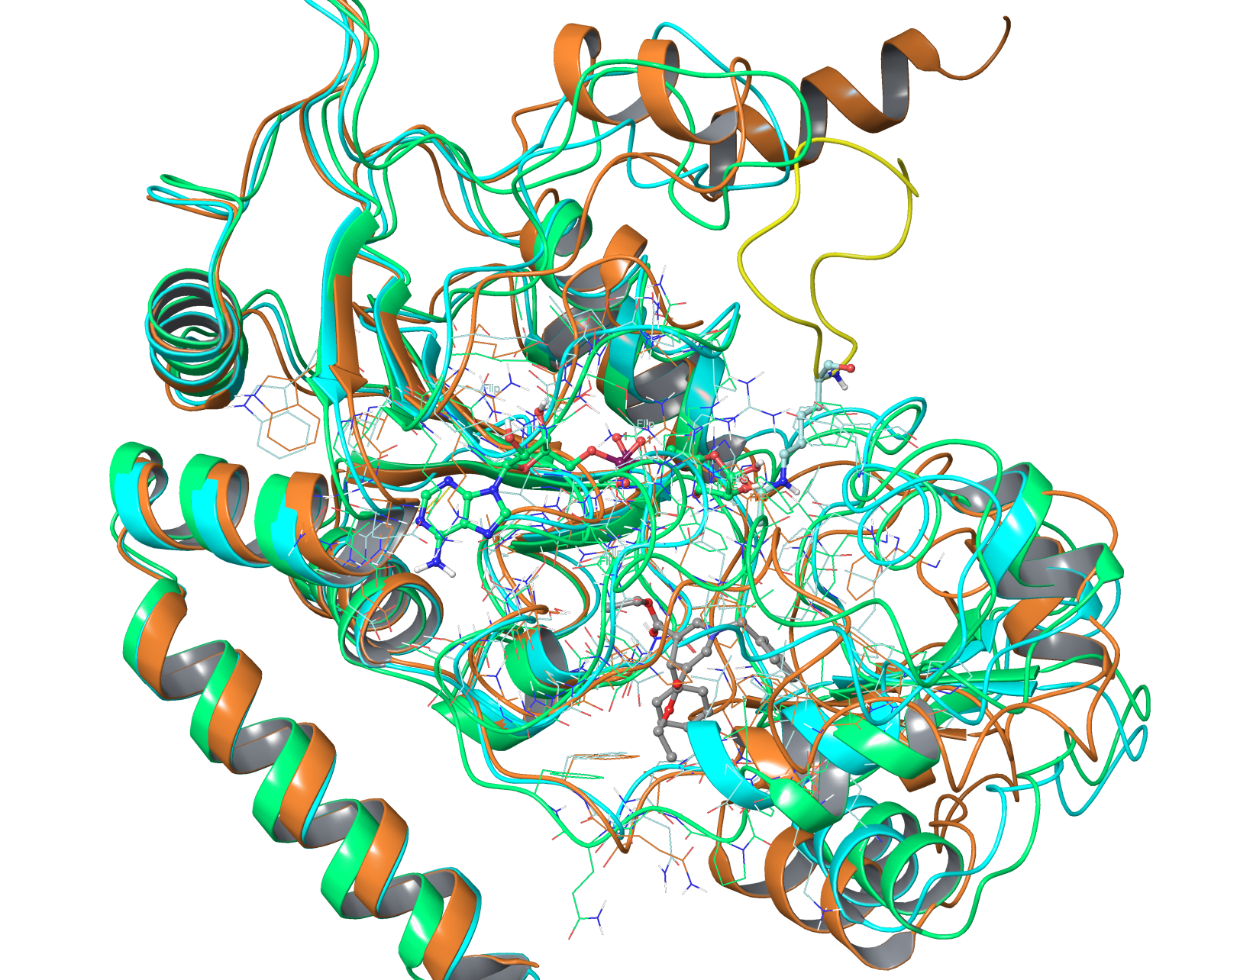
Various SIRT2 Structural Comparison
The loop below the C pocket has a significant effect on the binding of DHP-1 deriratives.

Slide 4
Task Completed so far
Ligands | Receptor
DHP-1 a,b,c,d, b1* | SIRT3:ac-Peptide(from 4FVT)
DHP-1 a,b,c,d, b1* | SIRT3 (from 4FVT)
DHP-1 a,b,c,d | SIRT3(from 4BVH)
DHP-1 a,b,c,d, b1* | SIRT3(from 4BN5)
DHP-1 a,b,c,d, b1* | SIRT3(from 4JSR)
DHP-1 a,b,c,d, b1* | SIRT3:NAD+(from 4BV3)
DHP-1 a,b,c,d | SIRT3:Intermediate (from 4BVG, large grid to include outer space)
DHP-1 a,b,c,d | SIRT3:ac-Pep:NAD+ (from 4FVT, large grid to include outer space)
DHP-1 a,b,c,d, b1* | SIRT2(from 3ZGO)
DHP-1 a,b,c,d, b1* | SIRT2(from 3ZGV, loop fixed)
DHP-1 a,b,c,d | SIRT2(from 3ZGV, missing 2 residues at the loop)
DHP-1 a,b,c,d, b1* | SIRT2:ADP(from 3ZGV, loop fixed)
DHP-1 a,b,c,d, b1* | SIRT2(from 4L3O)
DHP-1 a,b,c,d | Induced Fit; SIRT2(from 3ZGV, loop fixed)
DHP-1 a,b,c,d | Induced Fit; SIRT3(from 4FVT)
DHP-1 a,b,c,d | Induced Fit; SIRT3:ac-Peptide(from 4FVT)
DHP-1 a,b,c,d | Induced Fit; SIRT3:Intermediate (from 4BVG)
Failed Glide XP Docking:
DHP-1a,b,c,d,b1 vs. SIRT3:ac-ADPR(from 4BVH)
DHP-1a,b,c,d,b1 vs. SIRT3:Intermediate (from 4BVG)
DHP-1b,d vs. SIRT2:ac-Pep(from 4L3O)
DHP-1a,c vs. SIRT3:NAD+(from 4BV3)

Slide 5
Structures Sampled by Induced Fit
By merging the predictive power of Prime with the docking and scoring capabilities of Glide, Induced Fit is able to predict active site geometries with remarkable success.
The Induced Fit protocol:
docking the active ligand with Glide using reduced van der Waals radii and an increased Coulomb-vdW cutoff, and can temporarily remove highly flexible side chains during the docking step.
Prime structure prediction is then used to accommodate the ligand by reorienting nearby side chains. These residues and the ligand are then minimized.
Finally, each ligand is re-docked into its corresponding low energy protein structures and the resulting complexes are ranked according to GlideScore.
By default, residues with 5 Å of ligand poses are refined.

Slide 6
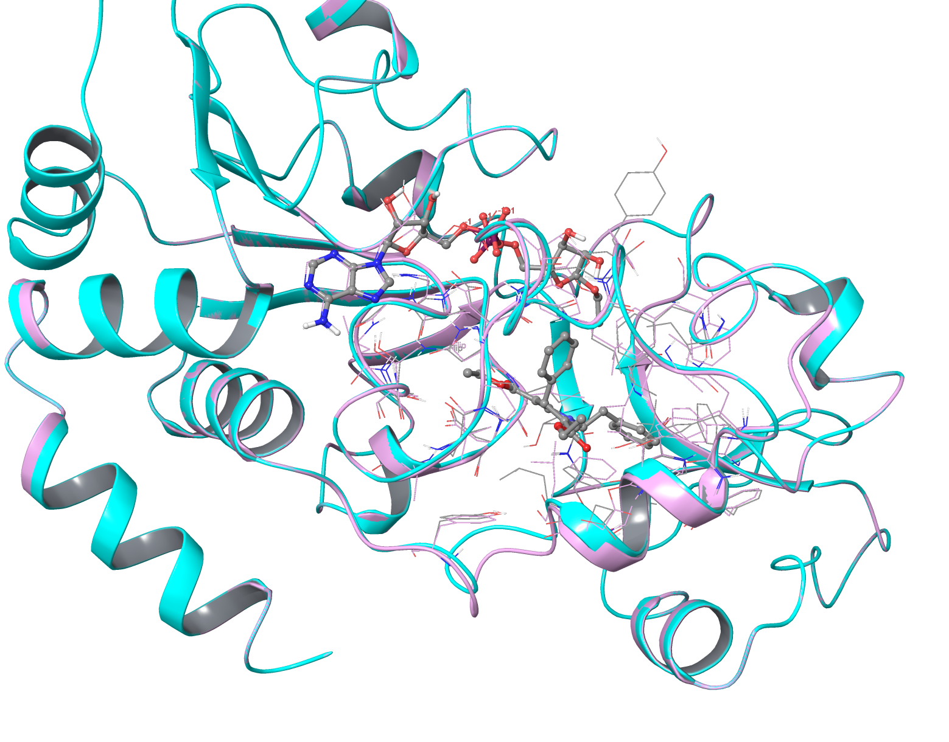
Induced Fit for SIRT3:Intermediate
Only side chain movement is needed for DHP-1 derivative to fit below the C pocket.

Slide 7
Planned Glide XP Docking/Induced Fit
Receptor:
Induced Fit; SIRT2:ADP(from 3ZGV, loop fixed)
Induced Fit; SIRT2 (from 3ZGV, loop unfixed)
Induced Fit; SIRT2(from 3ZGO)
Induced Fit; SIRT2:ac-Peptide(from 4L3O)
Induced Fit; SIRT3 (from 4BN5)
Induced Fit; SIRT3 (from 4BV3)
Induced Fit; SIRT3 (from 4JSR)
Induced Fit; SIRT3:ac-ADPR(from 4BVH)
Induced Fit; SIRT3:NAD+ (from 4BV3)

Slide 8
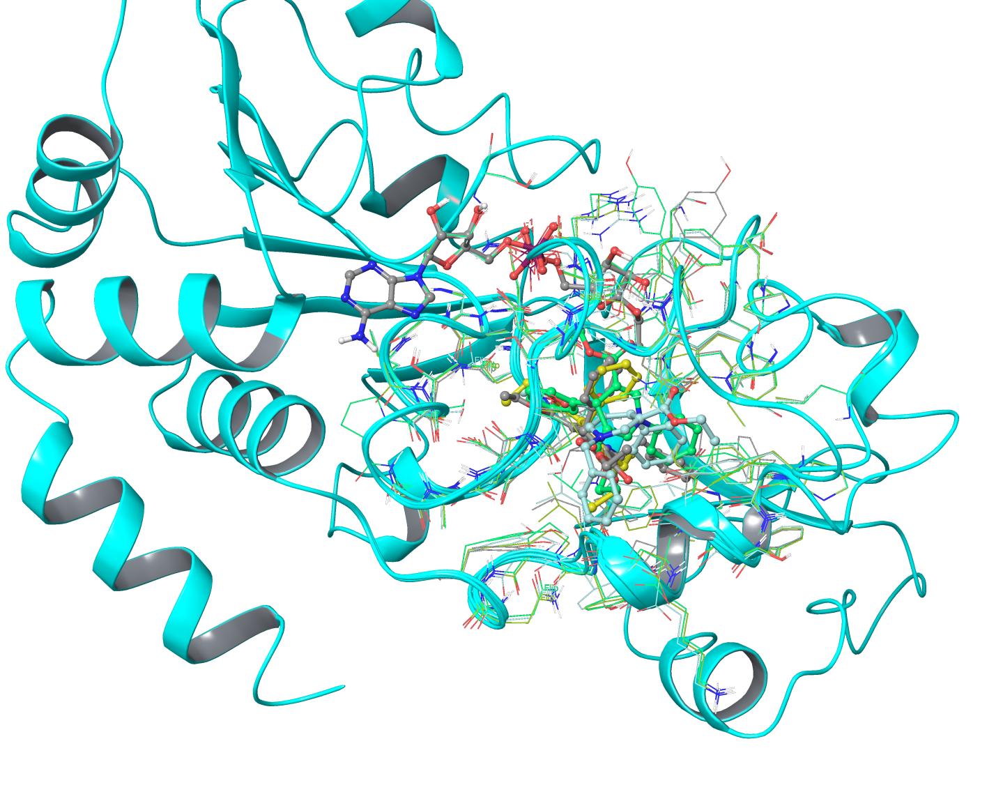
MM-GBSA Calculation on Induced Fit
Ligand | Receptor | MM-GBSA scores | Glide Score (XP)
DHP-1d | Induced Fit; SIRT3:Intermediate (4BVG) | -139.99 | -11.982
DHP-1c | Induced Fit; SIRT3:Intermediate (4BVG) | -127.48 | -11.131
DHP-1b | Induced Fit; SIRT3:Intermediate (4BVG) | -121.64 | -10.977
DHP-1a | Induced Fit; SIRT3:Intermediate (4BVG) | -125.28 | -10.613

