Slide 1
PMC-AT Group Meeting: Computational
Ping Lin
09/29/14

Slide 2
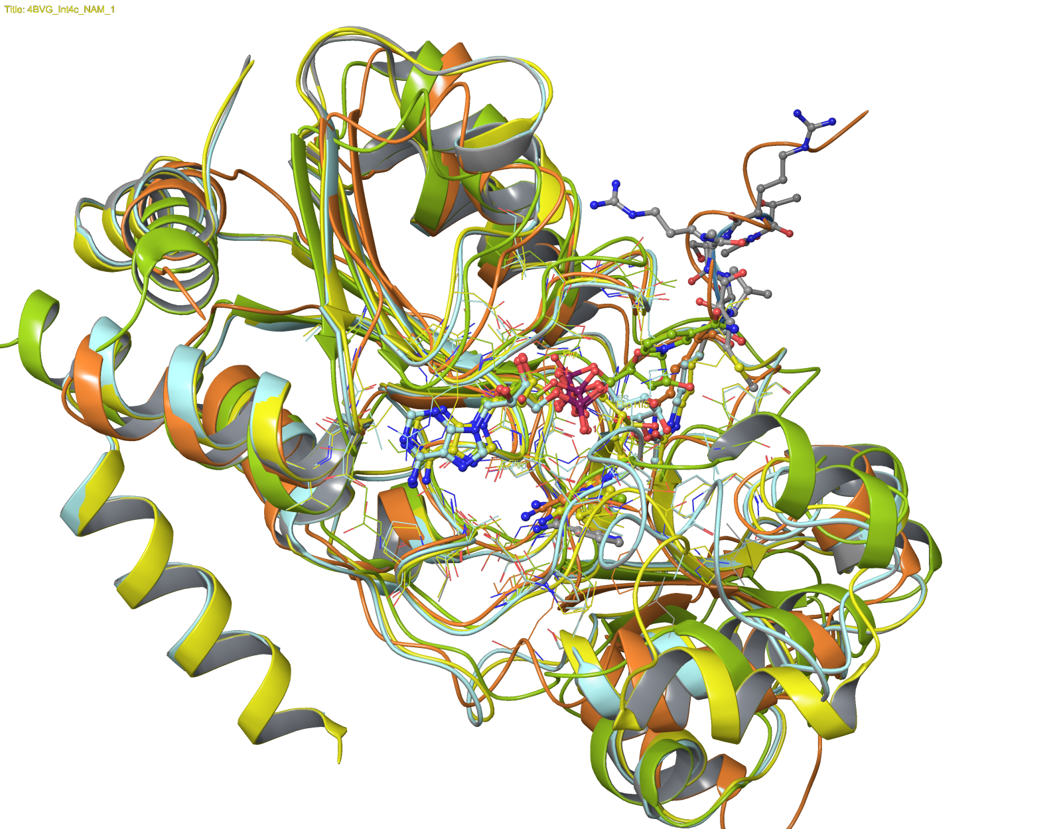
SIRT:NAD+:peptide and SIRT3:intermediate
the flexible loop
the NAM moiety
4FVT: Yellow
4BVG: Light Blue
4BVG/NAM: Gray
1YC2/A: Yellow Green
1YC5: Orange

Slide 3
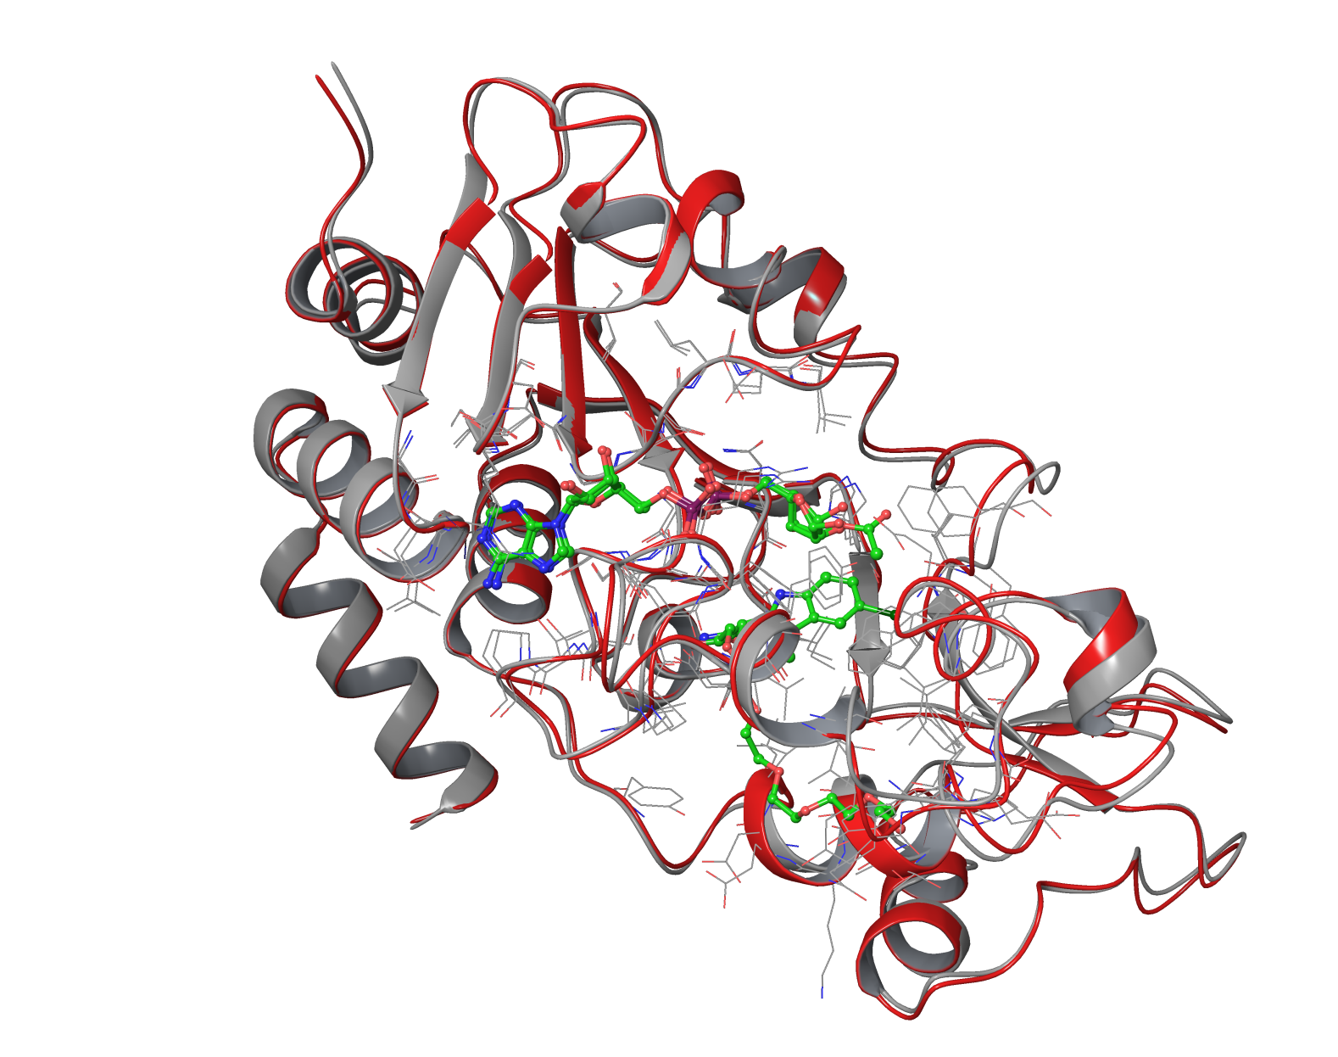
SIRT3:ac-ADPR:Ex-527
structure in the absence of Ex-527
flexible loop conformation
4BN4: Gray
4BVH: Red

Slide 4
Recent Induced Fit Results
DHP-1a,b,c,d; Induced Fit Docking; SIRT3 (from 4BN5)
DHP-1a,b,c,d, DHP-1b1, Ex-527; Induced Fit Docking; SIRT3:ac-ADPR (from 4BVH)
DHP-1a,b,c,d; Induced Fit Docking; SIRT3:NAD+ (from 4BV3)
DHP-1c; Induced Fit Docking; SIRT3:Intermediate:NAM
Ex-527; Induced Fit Docking; SIRT3:carbaNAD+:ac-Peptide (from 4FVT)
DHP-1c; Induced Fit Docking; SIRT3:carbaNAD+:ac-Peptide (from 4FVT)
DHP-1c; Induced Fit Docking; SIRT3 (from 4BVG)

Slide 5
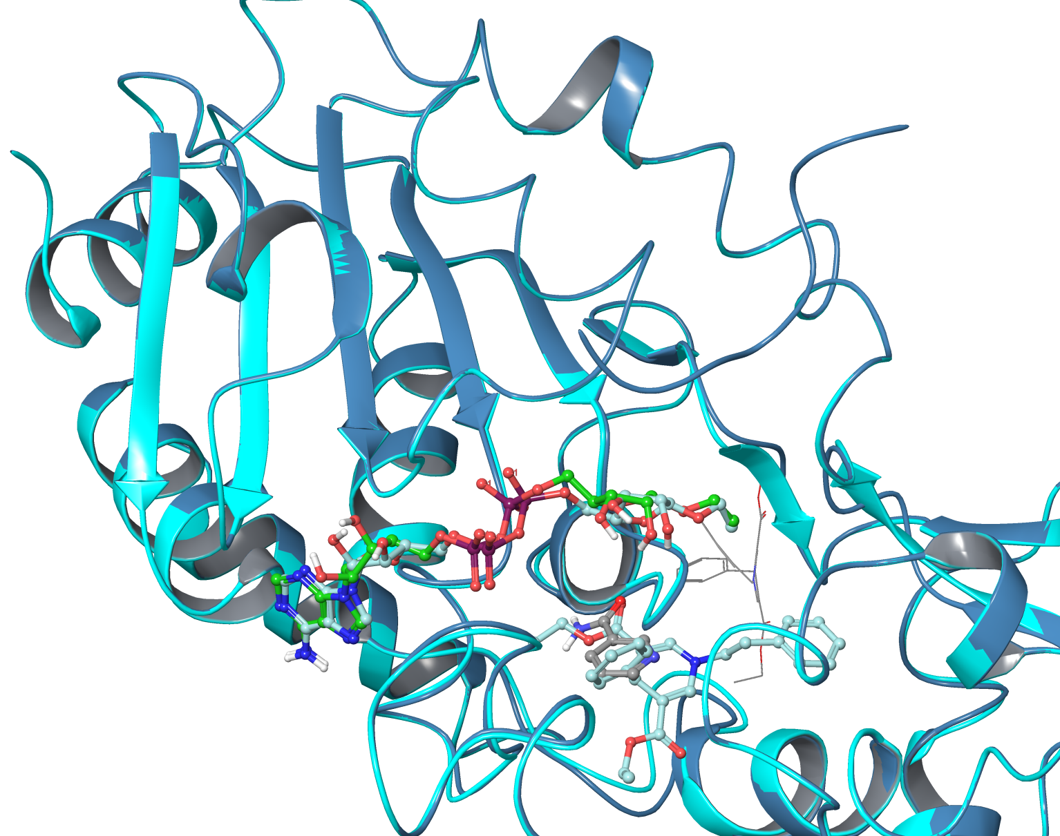
DHP-1c in SIRT3:Intermediate:NAM vs DHP-1d in SIRT3:Intermediate

Slide 6
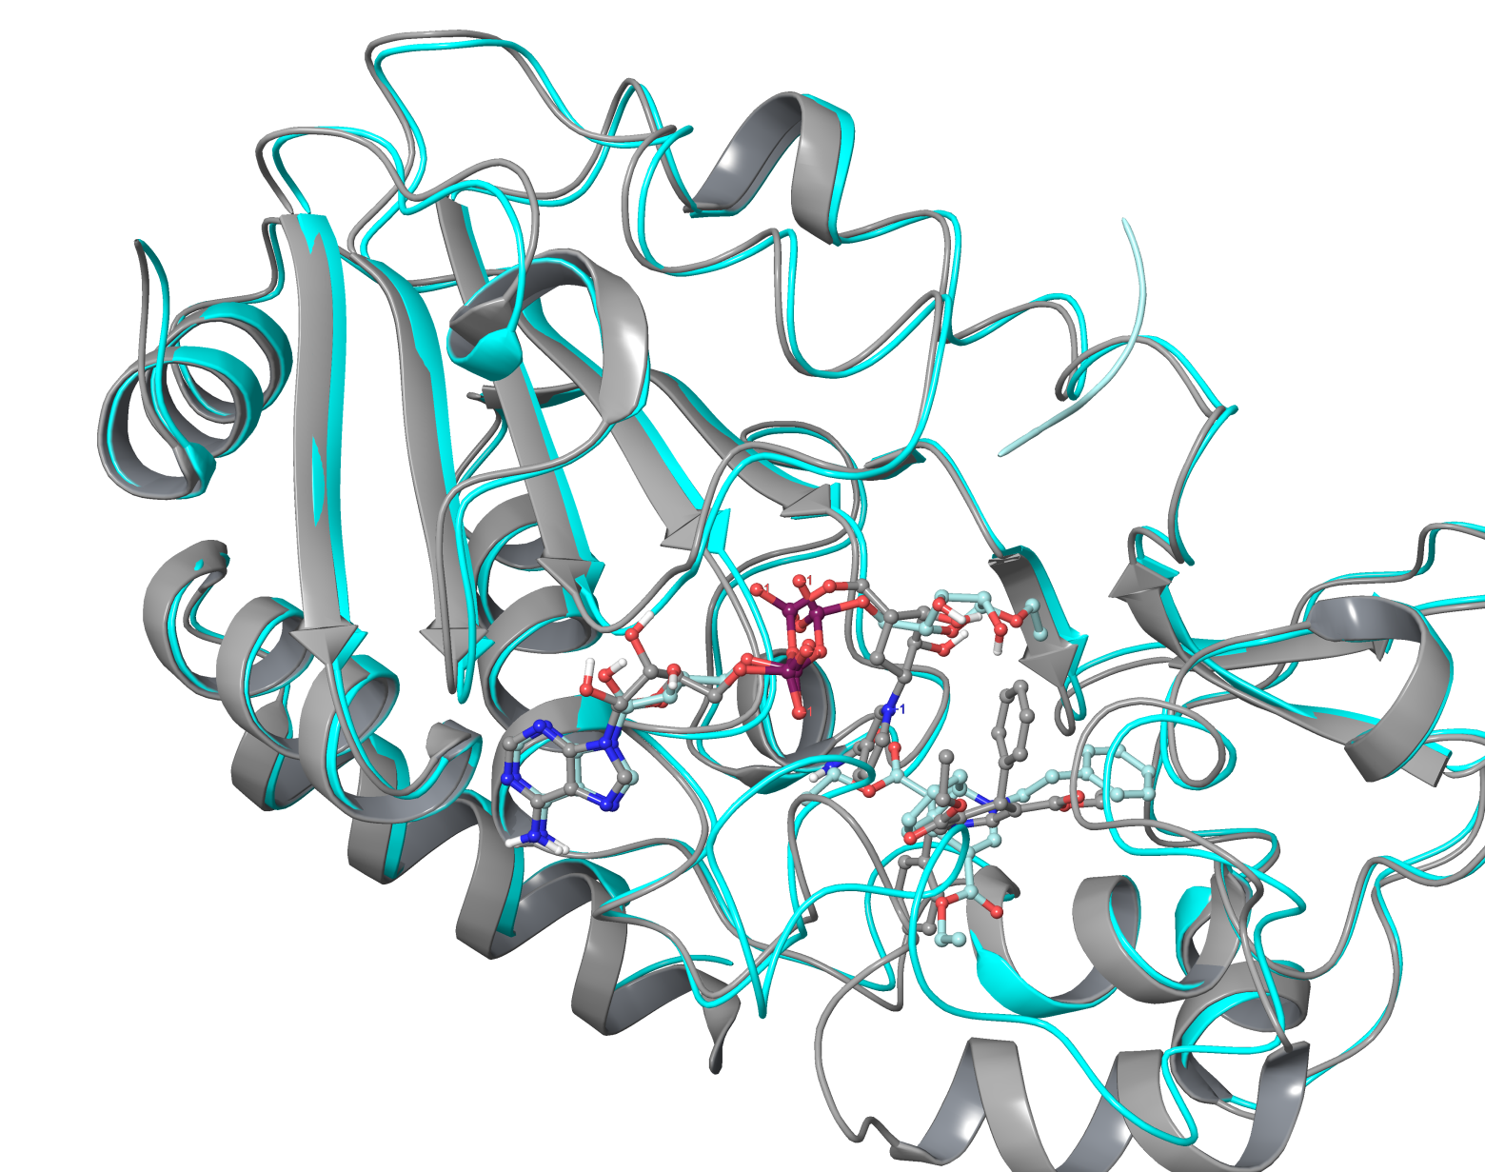
DHP-1c in SIRT3:carbaNAD+:ac-Peptide vs DHP-1d in SIRT3:Intermediate

Slide 7
MM-GBSA Calculations
For complex: SIRT3:carbaNAD+:Ac-Pep:DHP-1c
DHP-1c in SIRT3:carbaNAD+:Ac-Pep : -124.92 kcal/mol
carbaNAD+: in SIRT3Ac-Pep:DHP-1c : -152.89 kcal/mol
Ac-Pep in SIRT3:carbaNAD+:DHP-1c : -129.88 kcal/mol

Slide 8
False Positive
In the mixture of enzyme, substrate, inhibitor, cofactor
Finding the most energetically favorable combination and conformation
Determine the binding modes

