Slide 1
PMC-AT Group Meeting: Computational
Ping Lin
10/17/14

Slide 2
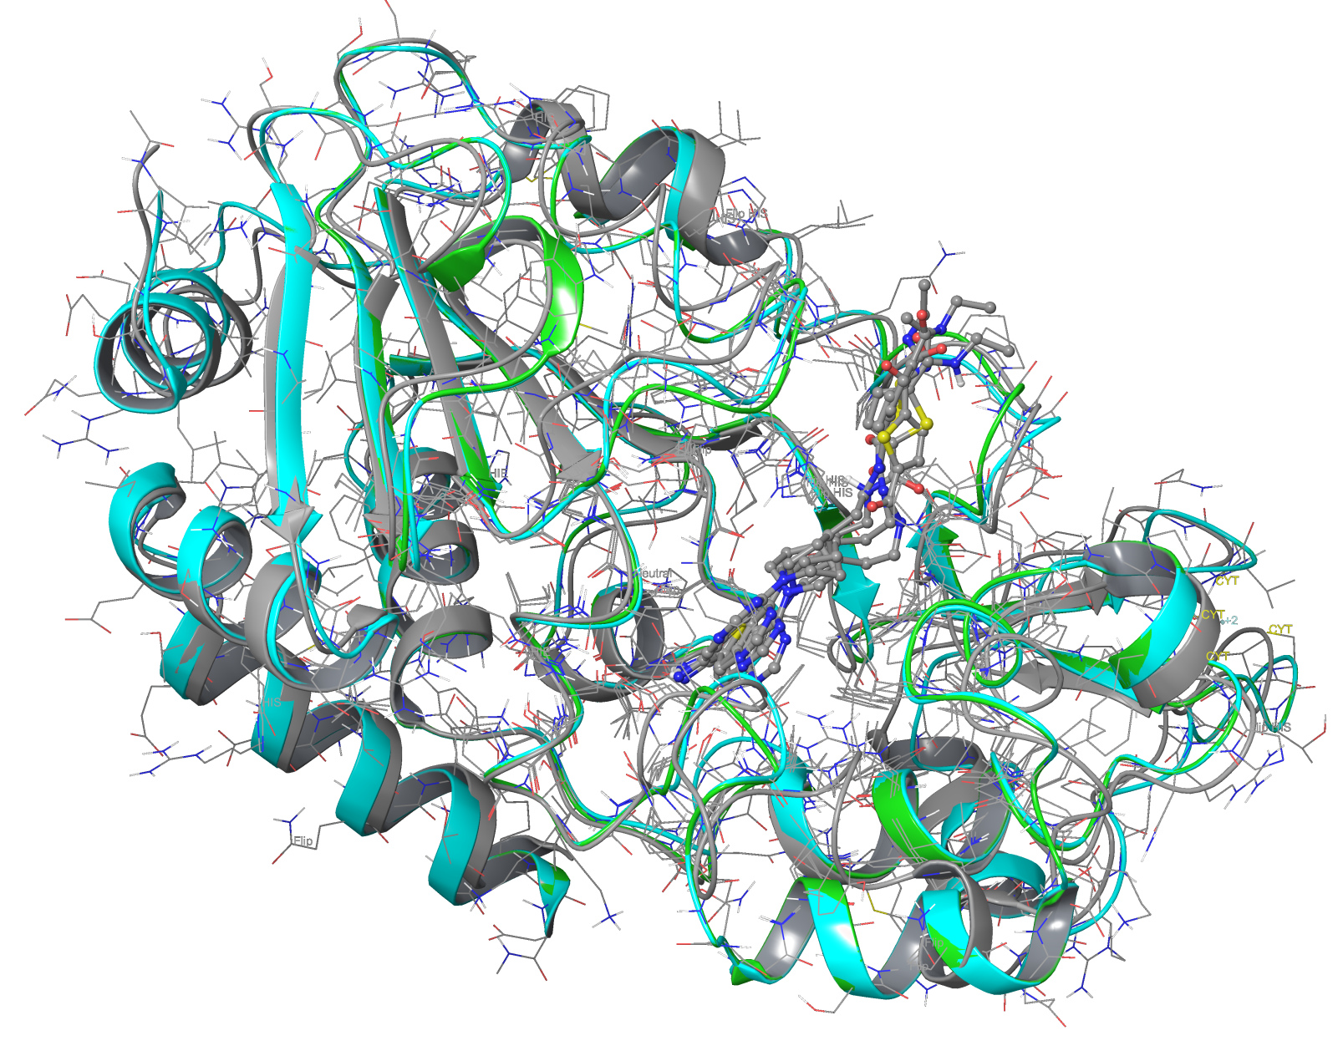
Testing Induced Fit Docking
ELT-11c (from 4JSR) was docked into 4FVT using Glide XP and IFD
The binding pocket is reasonably defined in 4FVT, therefore no significant improvement found for IFD.

Slide 3
Induced Fit Scoring Function
Standard IFD (2006)
  Initial Glide docking of each ligand using a softened potential, optional removal of side chains
  Prime side-chain prediction for each protein-ligand complex
  Prime minimization
  Glide redocking of each protein-ligand complex structure
  IFDScore = 1.0*glide_gscore + 0.05*Prime_Energy
Extended Sampling IFD (2013)
  Similar to Standard IFD, but side chain removal are selected using properties (SASA, B-factors), up to 80 poses retained in several initial docking runs.
  IFDScore = 1.0*Prime_Energy + 9.057*glide_gscore + 1.428*glide_ecoul
Changing the protocol by modifying the input file for command line mode execution

Slide 4
STAGES available for Induced Fit
  COMPILE_RESIDUE_LIST: Compile a list of residues for refinement.
  GLIDE_DOCKING: Dock ligands using Glide (standard protocol). This stage includes both grid generation and ligand docking. It is now made obsolete by the GLIDE_DOCKING2 stage, which can be used for both protocols.
  GLIDE_DOCKING2: Dock ligands using Glide. This stage includes both grid generation and ligand docking.
  INITIAL_DOCKING: Initial docking of ligands using Glide (extended sampling protocol). This stage includes both grid generation and ligand docking. Must be preceded by PREDICT_FLEXIBILITY and VDW_SCALING stages.
  PPREP: Prepare the protein using the refinement part of the Glide protein preparation facility.
  PREDICT_FLEXIBILITY: Determine the residues whose side chains should be ignored during initial docking. Extended protocol only. Must be run before the INITIAL_DOCKING stage.
  PRIME_ECALC: Perform a Prime energy calculation.
  PRIME_HELIX: Perform a Prime rigid-body helix refinement for a specified helix.
  PRIME_LOOP: Perform a Prime loop prediction for the specified loop.
  PRIME_MINIMIZATION: Perform a Prime minimization on the compiled list of residues.
  PRIME_REFINEMENT: Perform a Prime refinement on the compiled list of residues.
  PRIME_SIDECHAIN: Perform a Prime side-chain prediction on the compiled list of residues.
  SCORING: Calculate scores for the poses.
  SORT_AND_FILTER: Sort and filter poses.
  TRIM_SIDECHAINS: Temporarily mutate the specified residues to alanine, to remove side chains for a following docking stage. Standard protocol only.
  VDW_SCALING: Estimate side-chain flexibility in the binding site and set van der Waals radius scaling factors for Glide docking. Extended protocol only. Must be run before the INITIAL_DOCKING stage.

Slide 5
Extended Sampling IFD Protocol
STAGE VDW_SCALING
STAGE PREDICT_FLEXIBILITY
STAGE INITIAL_DOCKING
STAGE COMPILE_RESIDUE_LIST
STAGE PRIME_REFINEMENT
STAGE GLIDE_DOCKING2
STAGE SCORING

Slide 6
Modifying IFD Protocol?
Yes. Modifying IFD is possible by:
  Modifying the STAGES used and the order of the STAGES
  Modifying the inputs at each STAGE and scoring function
  Modifying the source code (e.g. ifd_startup.py; ifd_driver.py)
Example 1:
  Add “STAGE PRIME_LOOP” before any other STAGES allows sampling over multiple loop configurations
However, extensive tests needed to validate the new protocol
  In studies of 14 ligand-receptor pairs that required induced fit docking, the original Induced Fit Docking protocol yielded an average heavy-atom RMSD of 1.2 Å for the top-ranked output ligand pose to the native ligand. In contrast, rigid-receptor docking with the same ligand-receptor pairs yielded eight cases in which a pose could not be found and an average RMSD of 6.1 Å for the remaining six pairs. Targets included aldose reductase, CDK2 (2), estrogen receptor, HIV protease, protein kinase B, PPAR-gamma, LXR-beta, and thymidine kinase.

Slide 7
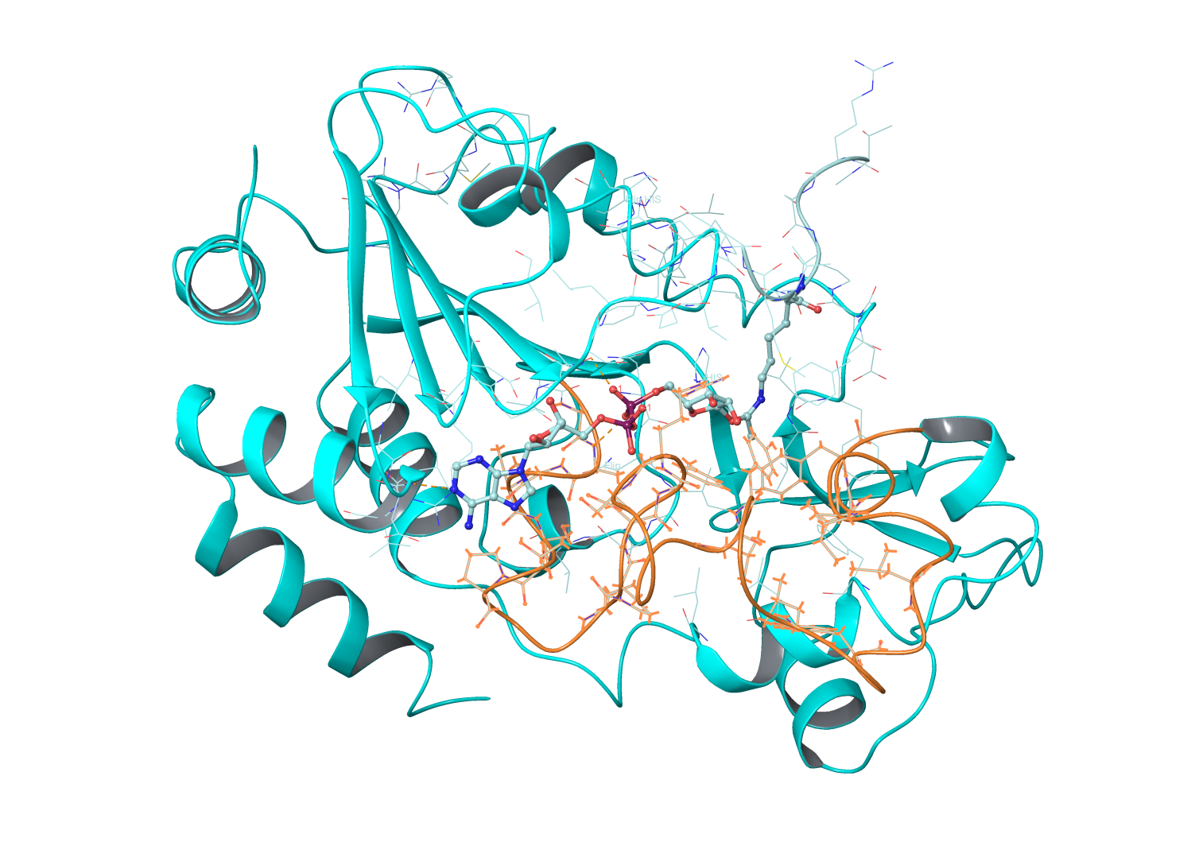
Prime Loop Prediction
Prime Refine Loops panel allows to set up loops refinement and generate multiple loop configurations (with specified Solvation model)
  Test run is underway
  4BVG (res.145-181)
  In orange color

Slide 8
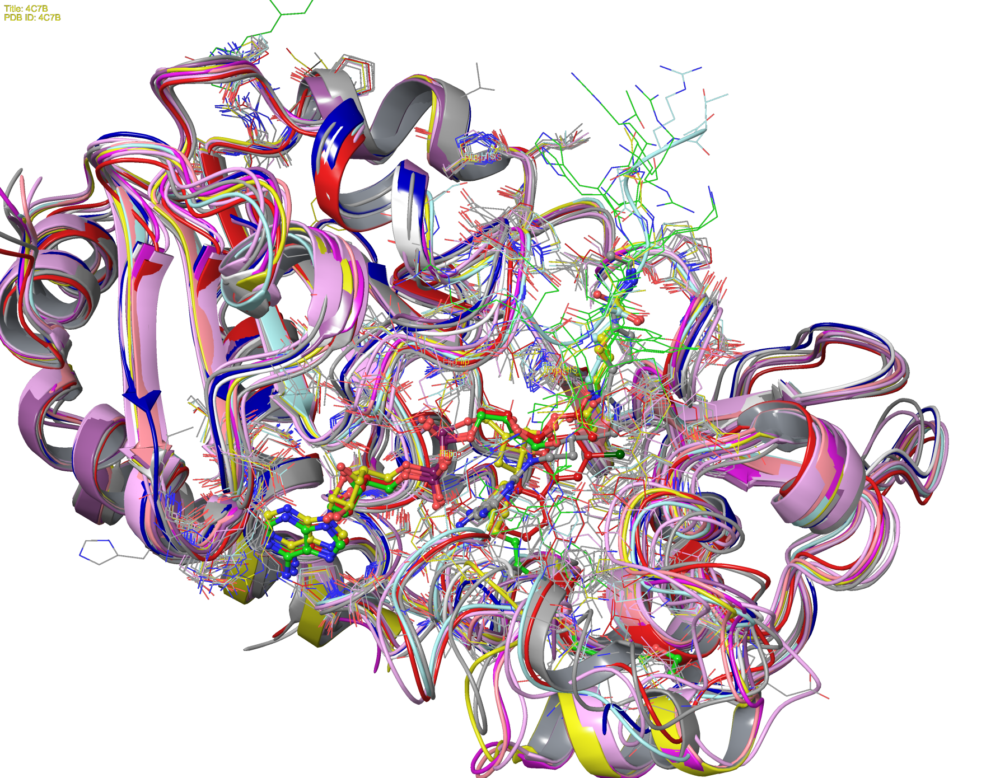
Various NAD⁺ Binding Loop Structures

Slide 9
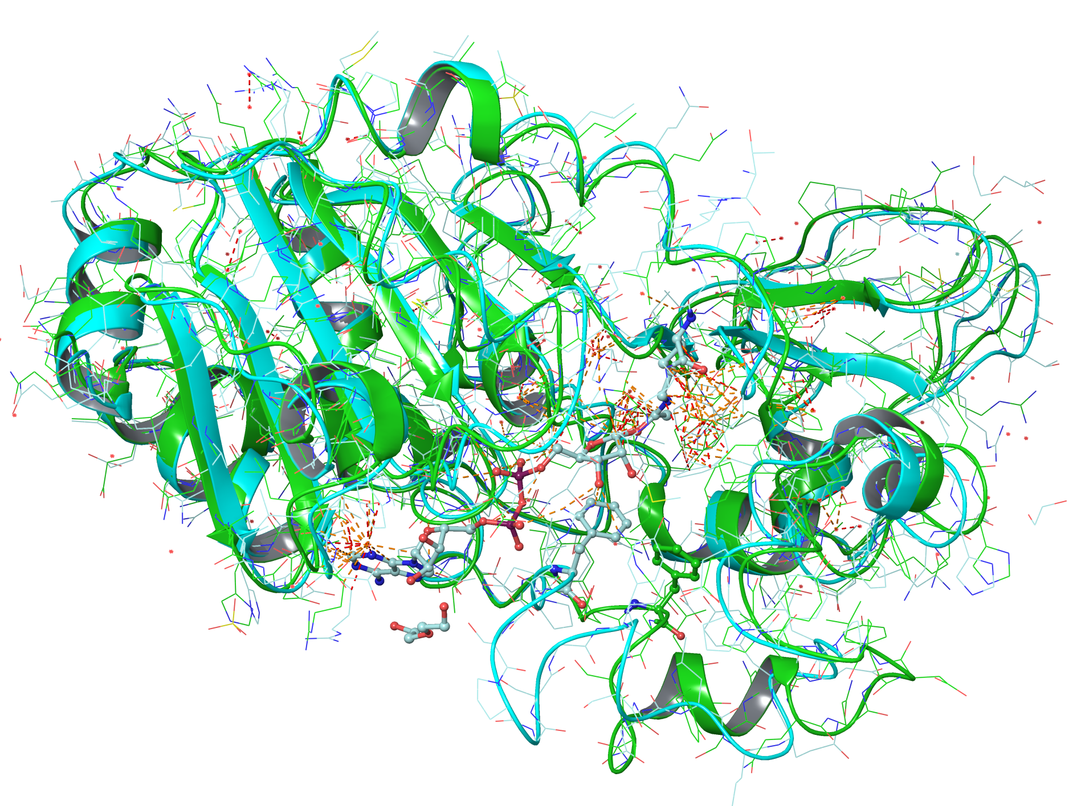
Comparison 4BVG vs 3GLS

Slide 10
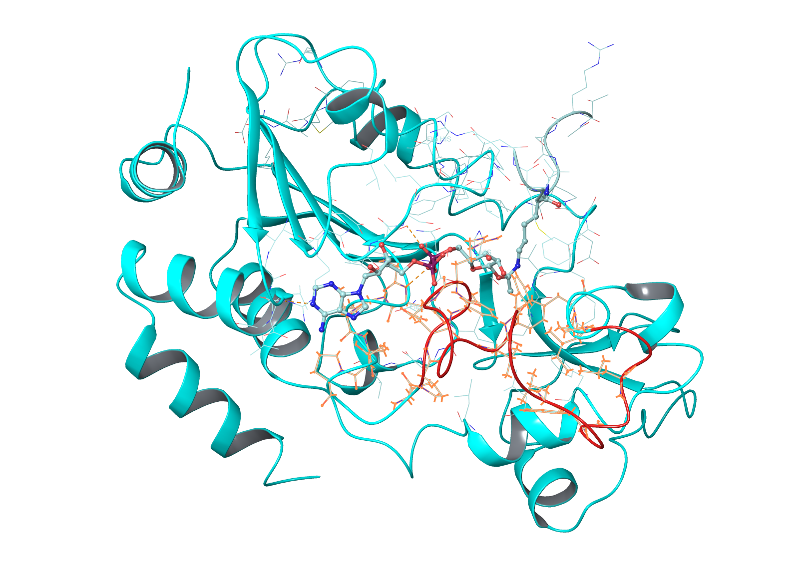
B-factors from SIRT3 Complex MD
B-factors of res.155-175 (in Red color) are presented.
the mean squared displacement.
B-factor | SIRT3/NADp | SIRT3/Ac-CS2/NADp/NAM | SIRT3/Ac-CS2/NADp | SIRT3/Int | SIRT3/Int/NAM | SIRT3/Int/isoNAM | SIRT3/NADp/Ex527 | SIRT3/aADPR/Ex527 | SIRT3/aADPR
35 | 109.8357 | 28.2419 | 52.2937 | 22.2517 | 19.052 | 20.0051 | 24.6221 | 18.7343 | 22.1493
36 | 192.2397 | 33.8394 | 75.8002 | 19.3451 | 21.6407 | 19.6093 | 26.8094 | 21.7725 | 17.3907
37 | 216.7305 | 107.8432 | 209.894 | 17.5901 | 8.9815 | 11.5452 | 19.7207 | 25.1956 | 20.9487
38 | 199.6421 | 76.4509 | 211.9775 | 16.7739 | 10.379 | 78.9005 | 100.7506 | 25.1452 | 9.8326
39 | 186.6718 | 194.5454 | 153.7296 | 13.7834 | 14.6455 | 18.9088 | 31.8969 | 13.9212 | 10.6544
40 | 191.5806 | 110.5673 | 185.7761 | 33.2502 | 32.2681 | 41.9058 | 68.3612 | 17.0336 | 17.2915
41 | 250.7241 | 167.7653 | 245.1798 | 46.187 | 39.3407 | 40.1074 | 76.9019 | 37.274 | 36.688
42 | 220.0576 | 205.9661 | 137.683 | 44.81 | 36.8559 | 37.3196 | 63.2886 | 51.505 | 45.7314
43 | 311.6306 | 143.2884 | 113.6216 | 21.0768 | 16.0309 | 15.7849 | 26.1055 | 48.5901 | 41.7687
44 | 152.7638 | 66.6826 | 144.6892 | 28.6209 | 24.9568 | 17.4003 | 30.5683 | 25.4908 | 15.891
45 | 253.5681 | 93.3065 | 403.9993 | 22.7316 | 28.4788 | 19.855 | 40.2834 | 38.9564 | 24.6756
46 | 207.1409 | 122.3645 | 166.8373 | 42.1514 | 30.1756 | 30.9891 | 63.5692 | 115.4641 | 13.0134
47 | 96.9619 | 103.0758 | 97.5541 | 66.6259 | 44.9216 | 73.0404 | 121.2452 | 54.4509 | 25.7014
48 | 77.1713 | 61.228 | 94.446 | 39.2714 | 32.2841 | 24.8799 | 67.5389 | 64.144 | 55.1968
49 | 260.061 | 128.8019 | 255.0471 | 185.7674 | 129.2685 | 103.6056 | 142.9989 | 48.8716 | 28.7789
50 | 173.2683 | 185.3311 | 160.946 | 224.6516 | 141.661 | 133.4918 | 90.4117 | 105.6729 | 155.8615
51 | 81.5911 | 130.9852 | 94.4278 | 39.2744 | 62.1061 | 26.9707 | 61.2405 | 166.4179 | 198.4134
52 | 203.8611 | 161.2961 | 273.1892 | 90.54 | 103.4301 | 55.7197 | 104.7109 | 65.753 | 63.4888
53 | 104.0051 | 94.7753 | 179.6357 | 68.3902 | 42.179 | 22.2683 | 42.2694 | 121.8491 | 107.8732
54 | 152.682 | 104.0974 | 207.3225 | 36.1162 | 50.8717 | 29.6852 | 62.9794 | 49.5269 | 44.4778
55 | 198.9721 | 162.4521 | 181.4331 | 25.9103 | 38.8656 | 26.0166 | 48.4345 | 90.7961 | 49.9212

