Slide 1
PMC-AT Group Meeting: Computational
Ping Lin
11/10/14

Slide 2
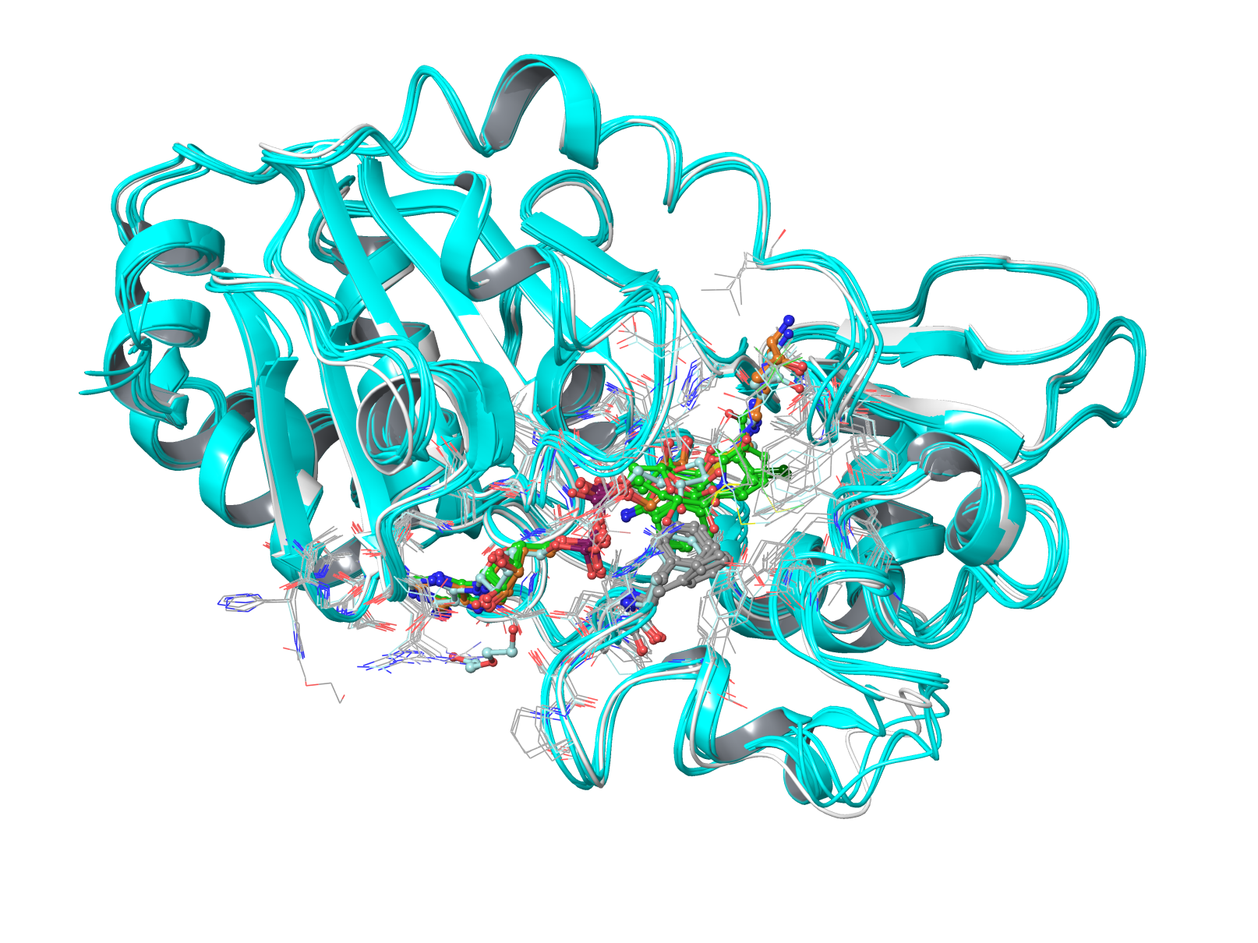
Prepare dataset for SIRT3 Docking
with NAD+/ADPR/ac-ADRP/Intermediate(or thio-substituted intermediate) bound but not NAD+ in AC binding mode, (pdbID: 4BVG, 3GLT, 4BN4, 4BV3, 4BVH, 4BVB, 4BVE, 4BVF). The loop of ILE154-SER166 are quite similar, and the RMSD of these structures are less than 0.9 Angstrom. With or without Ex527 didn't change much the loop structure, therefore the claim in hte PNAS paper than Ex527 stabilize the loop may not be true.
class 1:
4BVG | 0 | Angstrom
3GLT | 0.818 | Angstrom
4BN4 | 0.835 | Angstrom
4BV3 | 0.848 | Angstrom
4BVH | 0.874 | Angstrom
4BVB | 0.855 | Angstrom
4BVE | 0.839 | Angstrom
4BVF | 0.873 | Angstrom

Slide 3
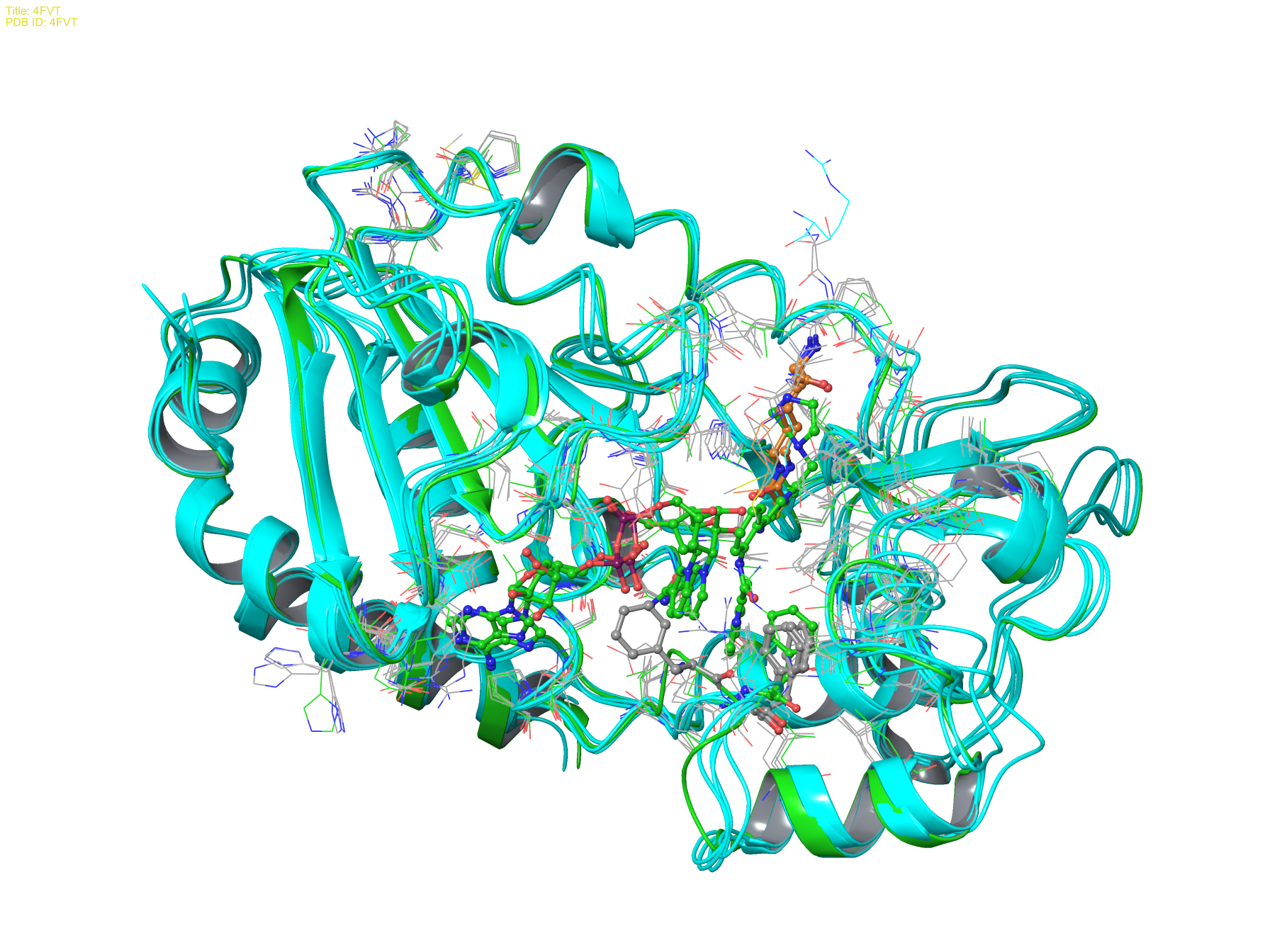
Cont.
no ADP moiety bound or NAD+ in AC pose: helix in loop (residue 162-170) is preserved. (pdbID: 3GLS, 3GLR, 4BN5, 4FVT, 3GLU), which the ternary structure 4FVT is unique in that loop 154-161 differs from others.
class 2:
3GLS | 1.389 | Angstrom
3GLR | 1.096 | Angstrom
4BN5 | 1.169 | Angstrom
4FVT | 0.946 | Angstrom
3GLU | 1.091 | Angstrom

Slide 4
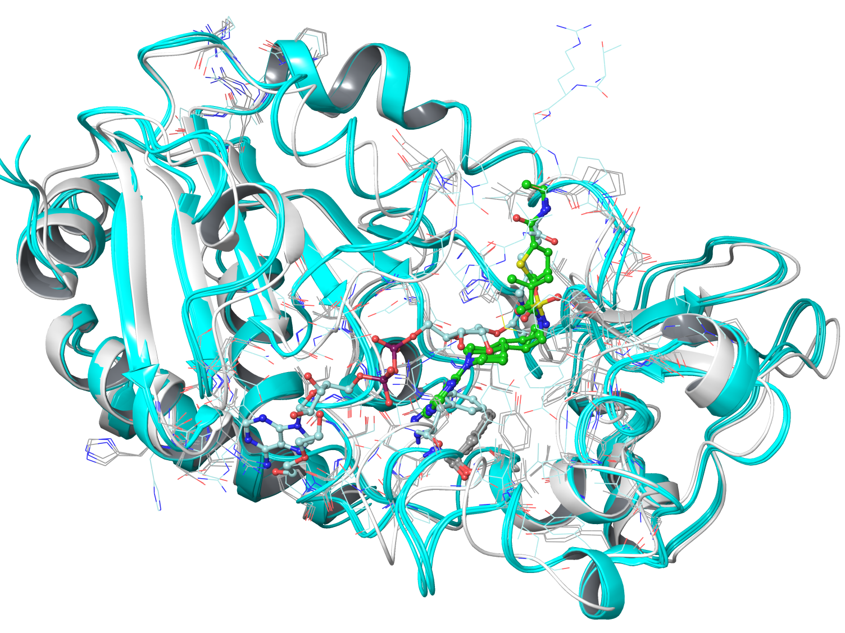
Cont.
ELT inhibitor create a new situation for C pocket binding and cause the shift of the loop, and changes in the helix (pdbID: 4JSR, 4JT8, 4JT9).
class 3:
4JSR | 1.466 | Angstrom
4JT8 | 1.537 | Angstrom
4JT9 | 1.585 | Angstrom

Slide 5
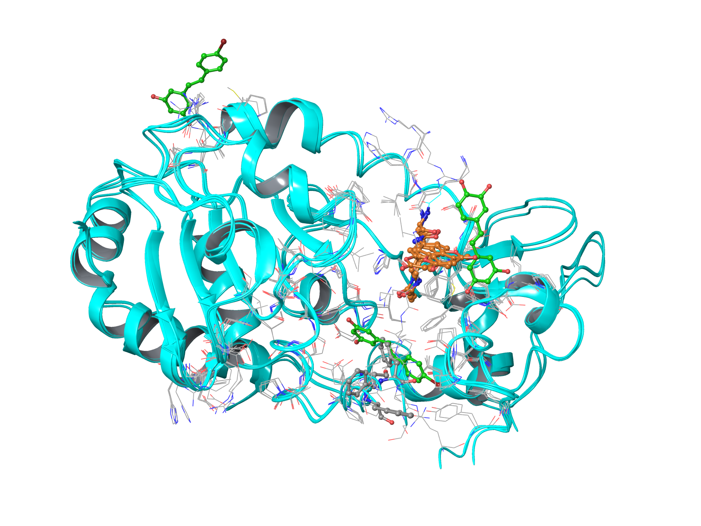
Cont.
Loop structure not completely resolved, in the region 158-170 (pdbID: 4C78, 4C7B, 4FZ3, 4HD8)
class 4:
4C78 | 1.185 | Angstrom
4FZ3 | 1.092 | Angstrom
4HD8 | 0.992 | Angstrom
4C7B | 0.951 | Angstrom

Slide 6
Creating the dataset
From the structures category above, we can choose 4 receptors: (SIRT3 from 4BVG, 3GLR, 4FVT, 4JSR) and three types of ligands (ADPR from 4BN4 and ELT-11c from 4JSR), especially the docking of ELT-11c into 4BVG, as the receptor cannot accommodate the inhibitors in its original pose. For others, although the active size conformations are different, the inhibitors can still fit it easily, the tests in these cases will be to test if the loop conformation can be predicted upon binding of new ligand.
Success and failure of docking tests depend on the initial structures.
 | SIRT3 (4FVT) | SIRT3 (4FVT) | SIRT3 (4FVT) | SIRT3 (4FVT) | SIRT3 (3GLS)
Note | 1 water, NAD+ in AC | w/o water, Glide XP, NAD+ in AC | with AcLys, one water, Glide SP, NAD+ in AC | with AcLys, NAM in C, NAD+ in AX | Glide XP, NAD+ in AC
MM-GBSA (kcal/mol) | -104.64 | -79.89 | -105.41 | -81.41 | -67.72
 | SIRT3 (3GLU) | SIRT3 (3GLS) | SIRT3 (4BVG) | SIRT3 (4JSR) | SIRT3 (4BN5)
Note | with peptide substrate, Glide SP, failed | Glide SP, failed | NAD+ in A and AcLys site | NAD+ close to AD | NAD+ in A and AcLys site
MM-GBSA (kcal/mol) | -66.29 | -84.43 | -100.88 | -86.29 | -87.34
MM-GBSA (kcal/mol) | Ex527 ( R) | Ex527 ( S) | Salermide | Ac93253
SIRT3 (4FVT), with water | -55.12 | -50.37 | -62.84 | -91.71
SIRT3 (4FVT), with NAD+ | -46.47 | -42.82 | -58.85 | -60.81
SIRT3 (4FVT), w/o water | -52.25 | -56.79 | -61.16 | -101.05
SIRT3 (3GLS) | -52.64 | -53.57 | -65.98 | -80.27
SIRT3 (4BVG) | -55.25 | -43.69 | -78.54 | -89.31
SIRT3 (4JSR) | -55.89 | -56.14 | -67.82 | -93.32
SIRT3 (4BN5) | -49.34 | -43.68 | -74.38 | -88.71

Slide 7
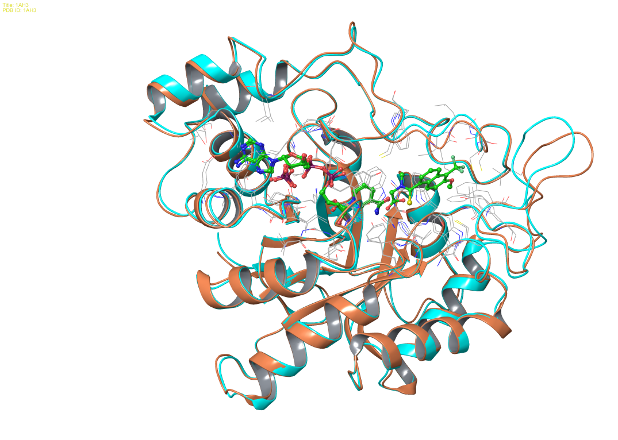
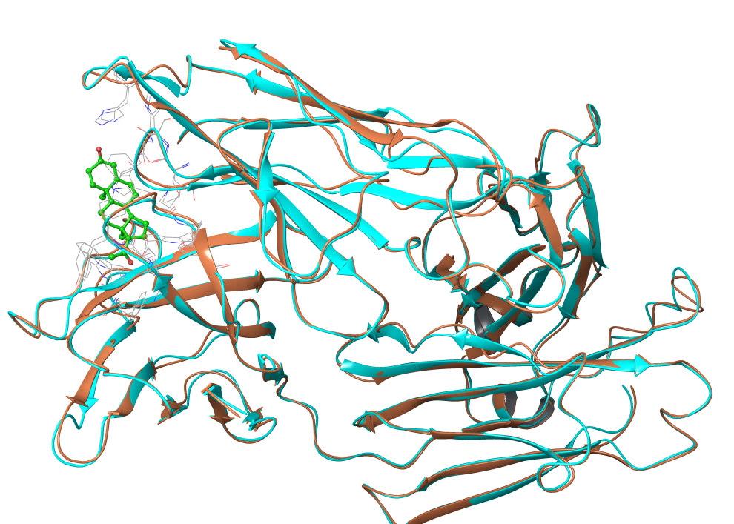
What about Schrodinger’s dataset
 |  | RMSD
Aldose Reductase | 1AH3 | 0
 | 2ACR | 0.630 Angstrom
Antibody DB3 | 1DBA | 0
 | 1DBB | 0.503 Angstrom
protein CDK2 | 1BUH | 0
 | 1DM2 | 1.155 Angstrom
 | 1AQ1 | 1.310 Angstrom
COX-2 | 3PGH | 0
 | 1CX2 | 1.594 Angstrom
Estrogen Receptor | 1ERR | 0
 | 3ERT | 0.961 Angstrom
Factor Xa | 1KSN | 0
 | 1XKA | 0.599 Angstrom
HIV-RT | 1RTH | 0
 | 1C1C | 0.884 Angstrom
neuraminidase | 1NSC | 0
 | 1A4Q | 0.217 Angstrom
PPAR_gama | 1FM9 | 0
 | 2PRG | 0.879 Angstrom
thermolysin | 1KR6 | 0
 | 1KJO | 0.134 Angstrom
thymidine kinase | 1KIM | 0
 | 1KI4 | 0.219 Angstrom
Aldose Reductase
Antibody DB3

Slide 8
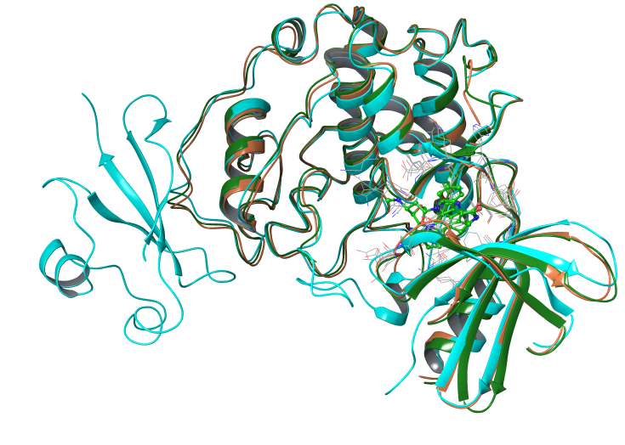
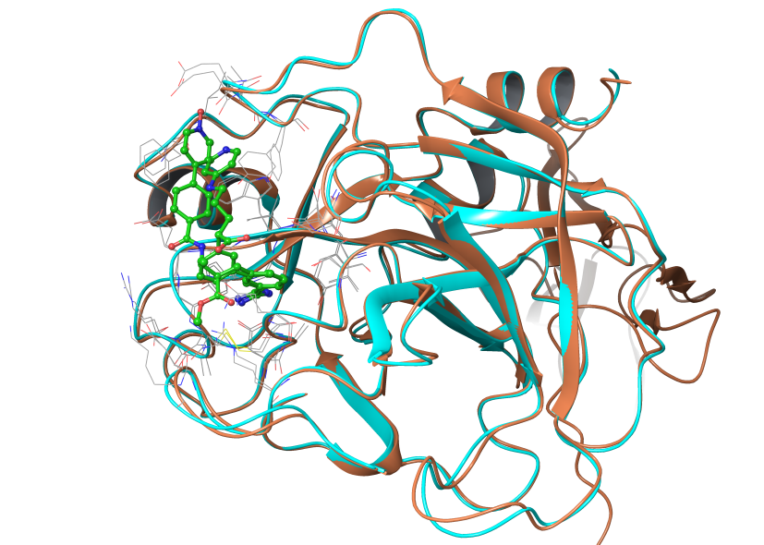
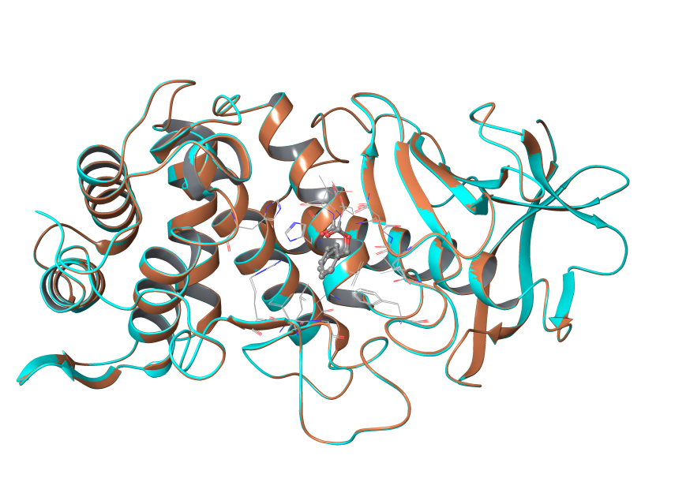
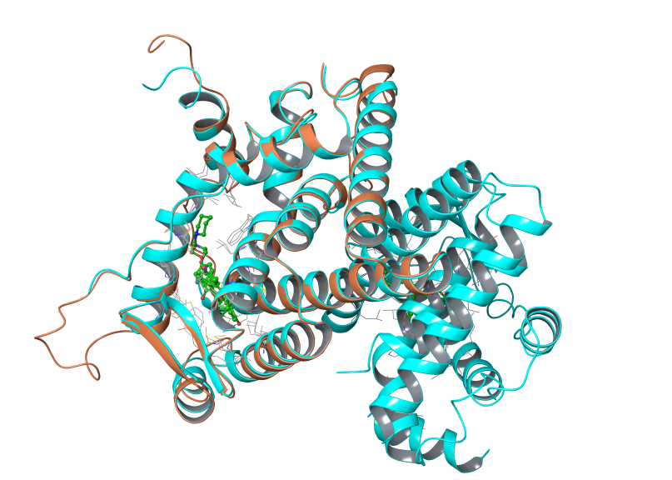
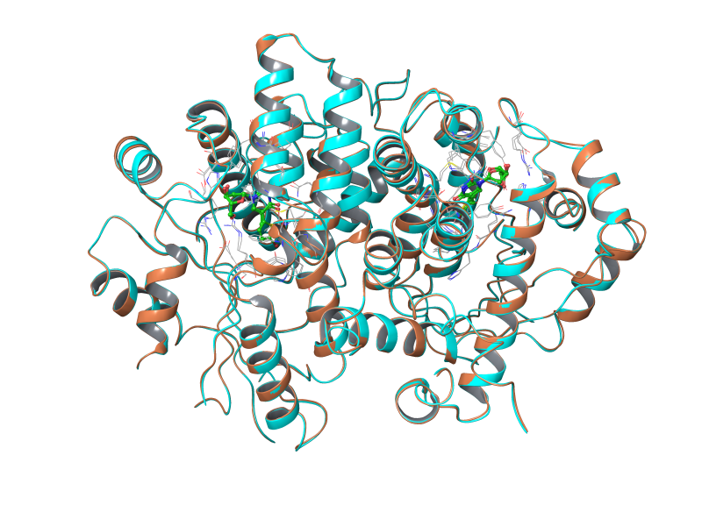
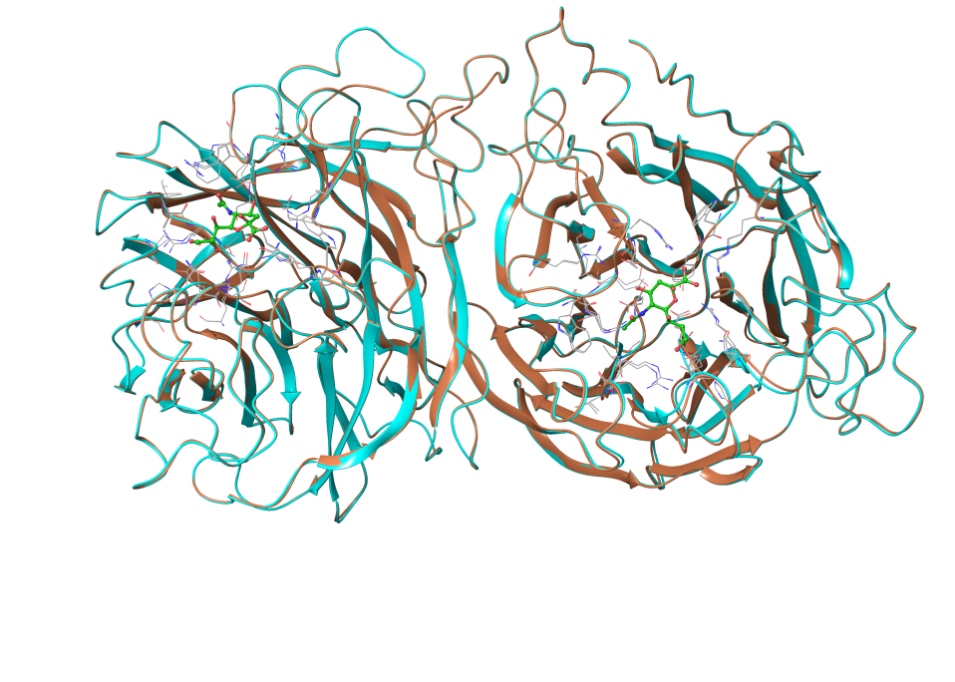
protein CDK2
Factor Xa
thermolysin
neuraminidase
thymidine kinase
Estrogen Receptor

Slide 9
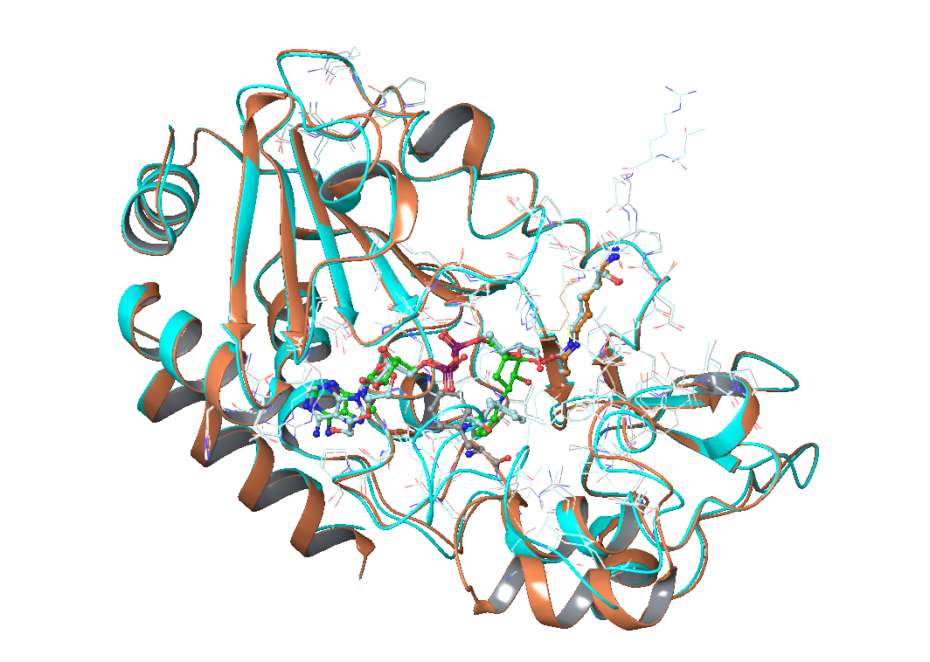
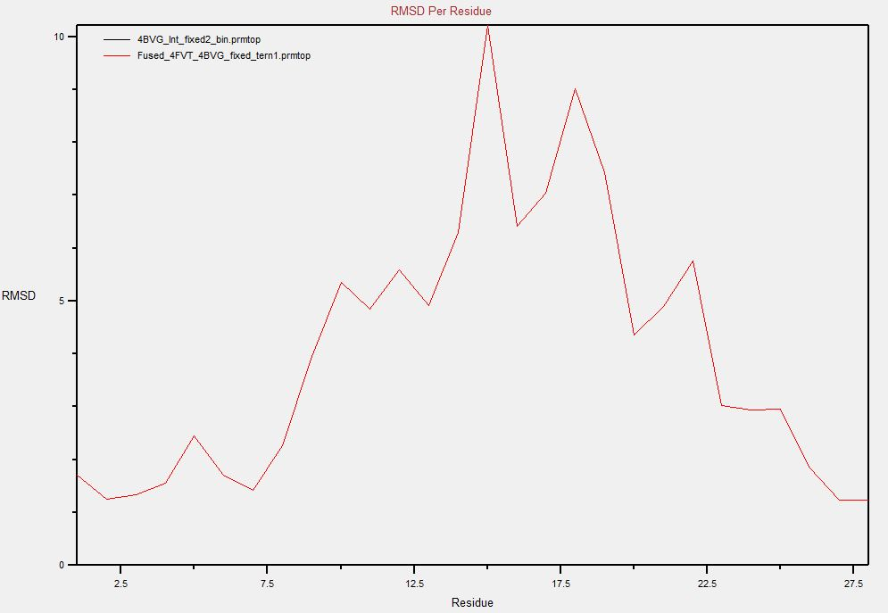
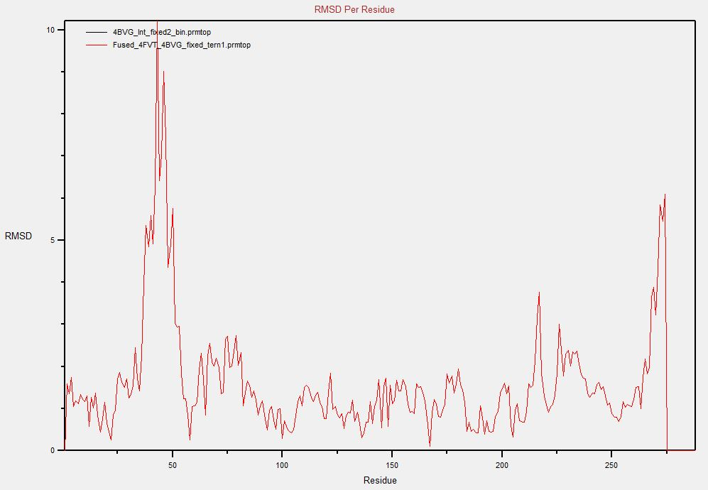
Comparison: 4FVT vs 4BVG
4FVT: SIRT3/ac-AceCS2/NAD+
4BVG: SIRT3/Intermediate
Flexible loop region:
155-173
By-Residue RMSD:
RMSD w/o the loop 155-173: 0.425 Angstrom
RMSD of the whole chain: 0.936 Angstrom

Slide 10
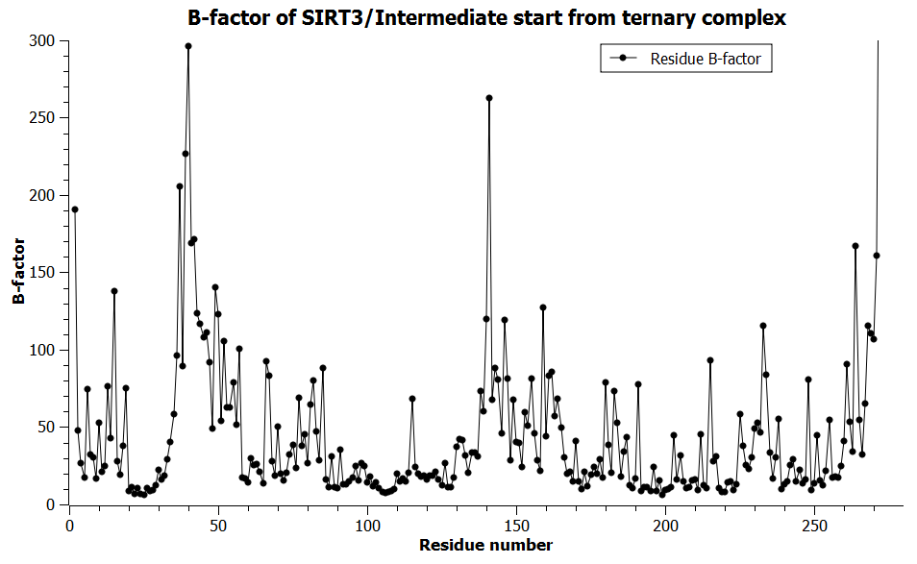
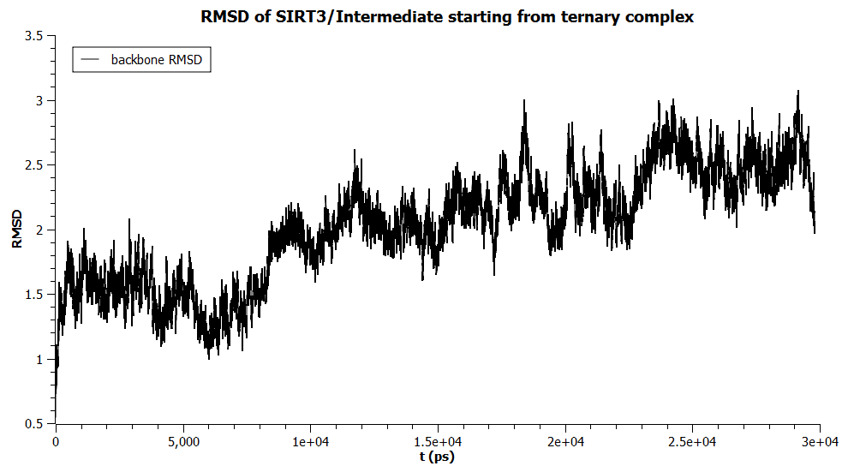
MD simulation of SIRT3/Intermediate starting from 4FVT/Intermediate superposition
MD simulation runs for 30 ns

Slide 11
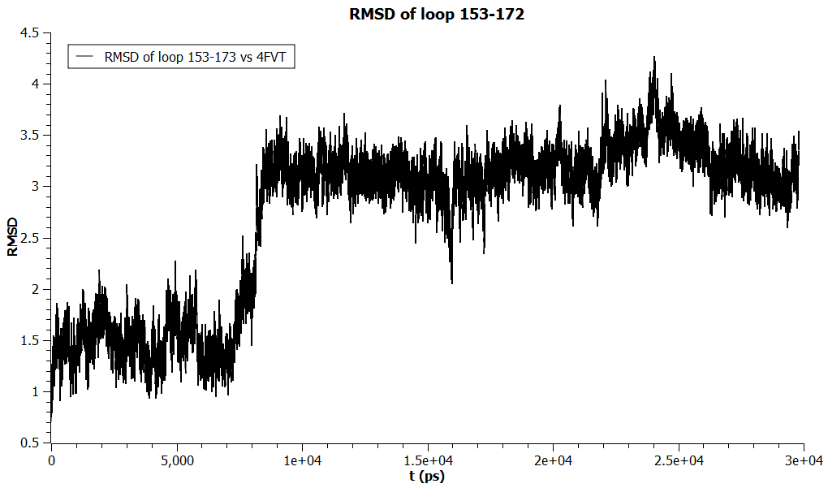
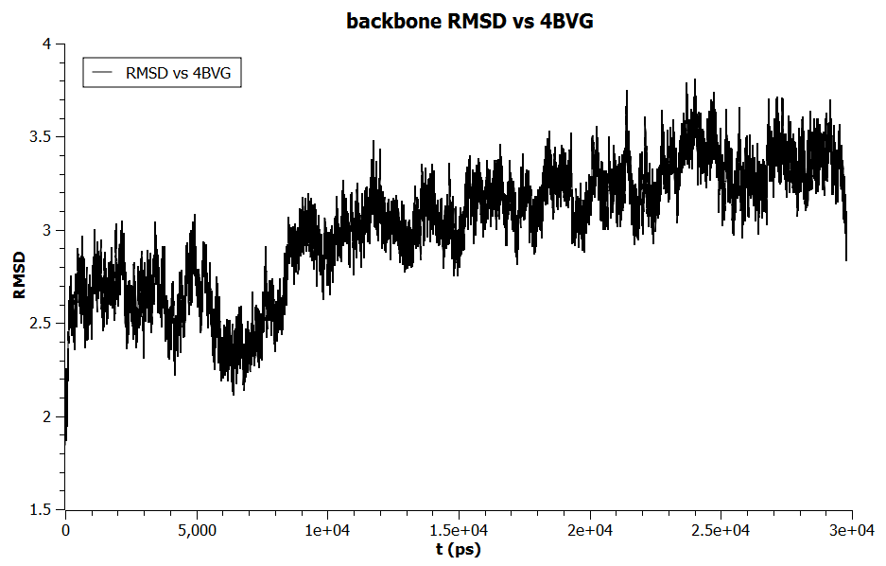
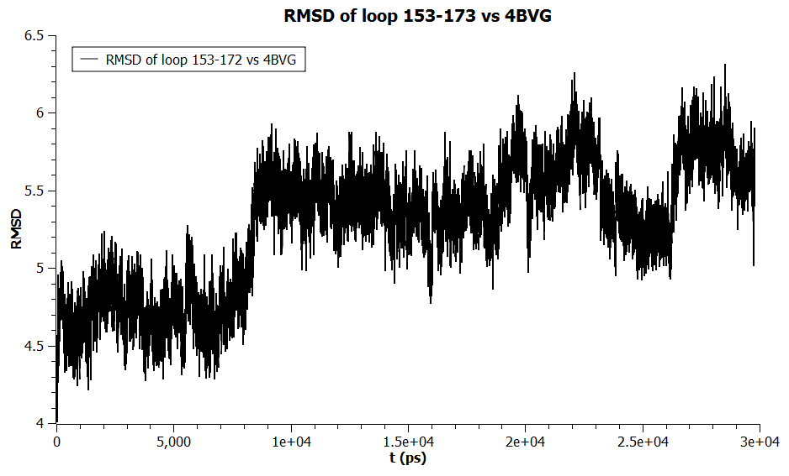
Backbone RMSD vs 4BVG and loop RMSD
Loop region not converged.

Slide 12
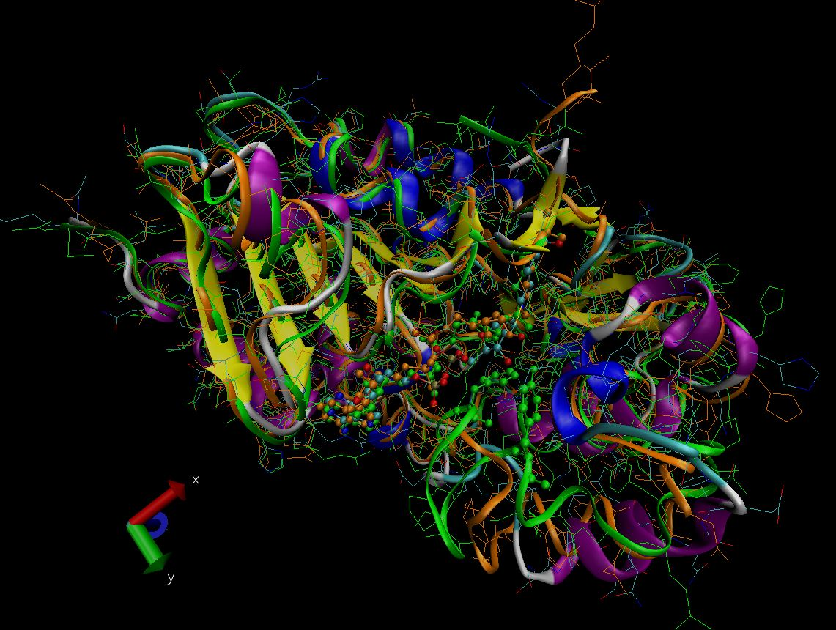
Investigating loop conformation using MD simulation
No loop convergence is found within 30 ns.
4BVG(Green ribbon); 4FVT(Organge ribbon); SIRT3/Intermediate (prepared from 4FVT after 30ns)

Slide 13
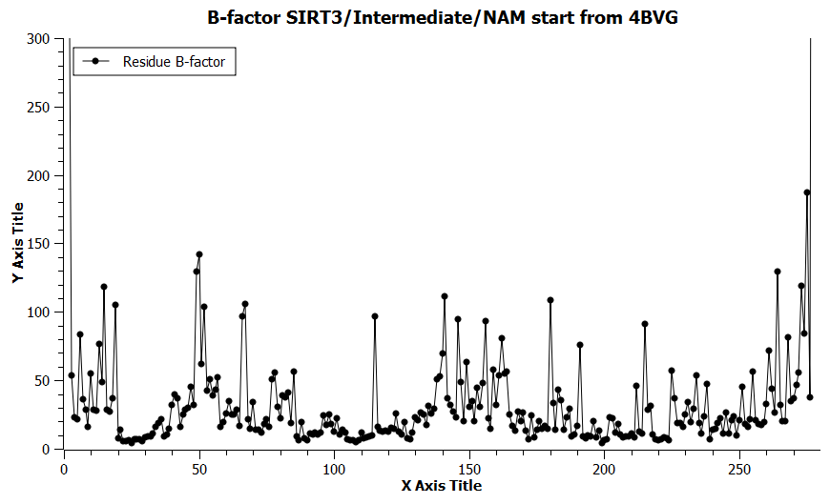
MD simulation of SIRT3/Intermediate/NAM by NAM docking

Slide 14
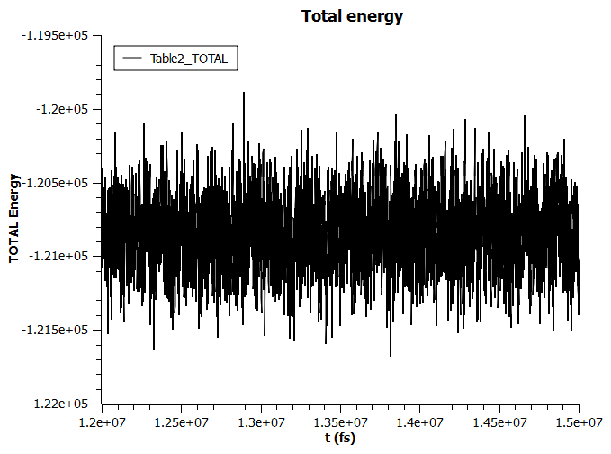
Energies from MD simulation
The bond energy and total energy from a section of MD simulation.
Energies from water is included. Temperature fluctuation is included.

Slide 15
Setting up MD by cleavage of NAM and formation of intermediate from ternary complex

Slide 16
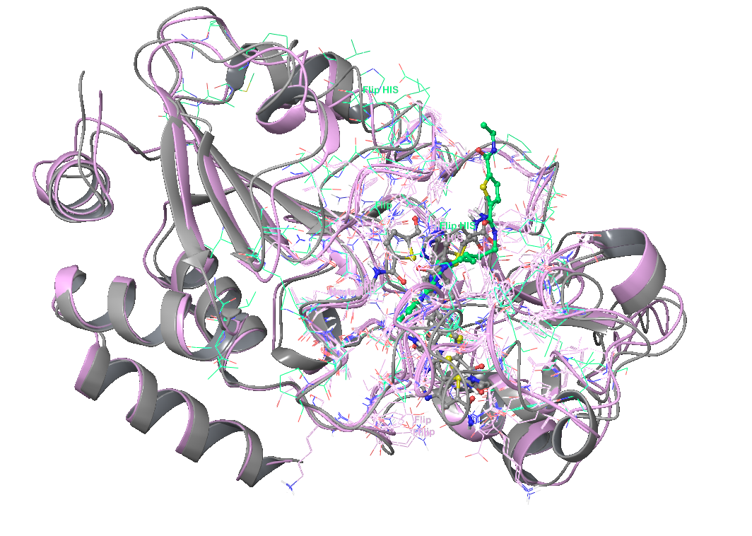
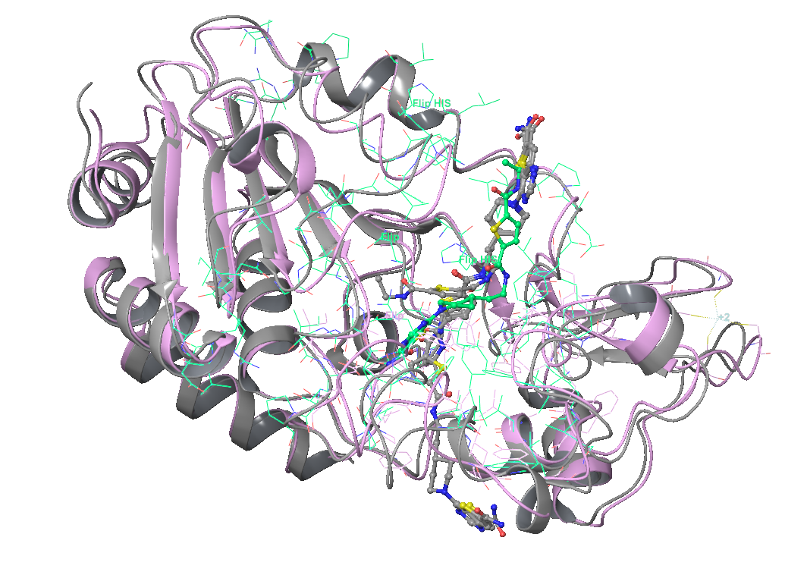
Test of docking and IFD with SIRT3
Case 1: Docking of ELT-3c into 4BVG using Glide XP or extended IFD. (failed)
Glide XP results:
IFD results:

Slide 17
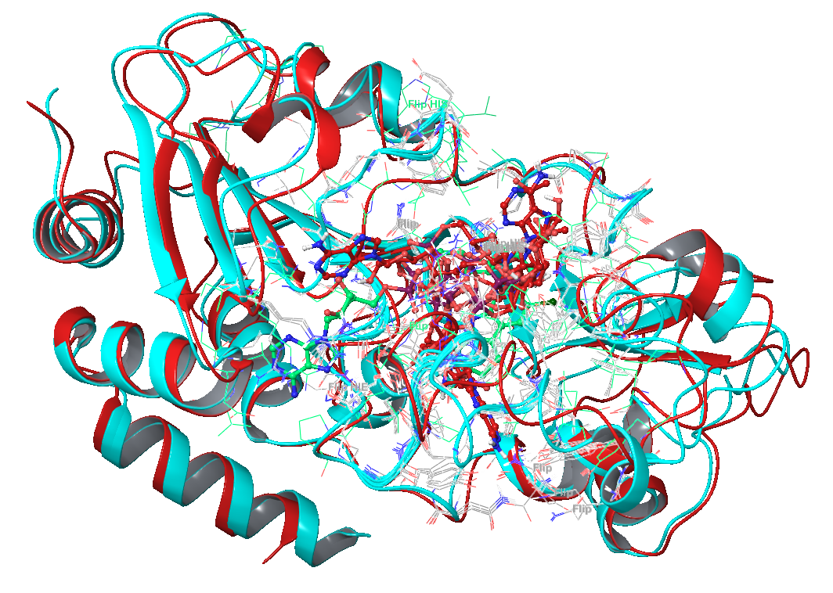
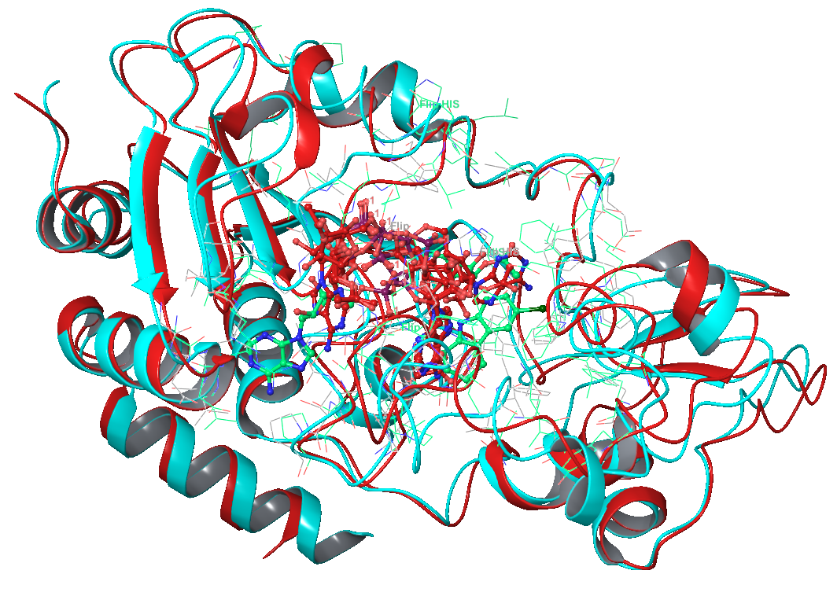
Cont.
Case 2: Docking of ac-ADPR into 4JSR using Glide XP or extended IFD. (failed)
Glide XP results:
IFD results:

Slide 18
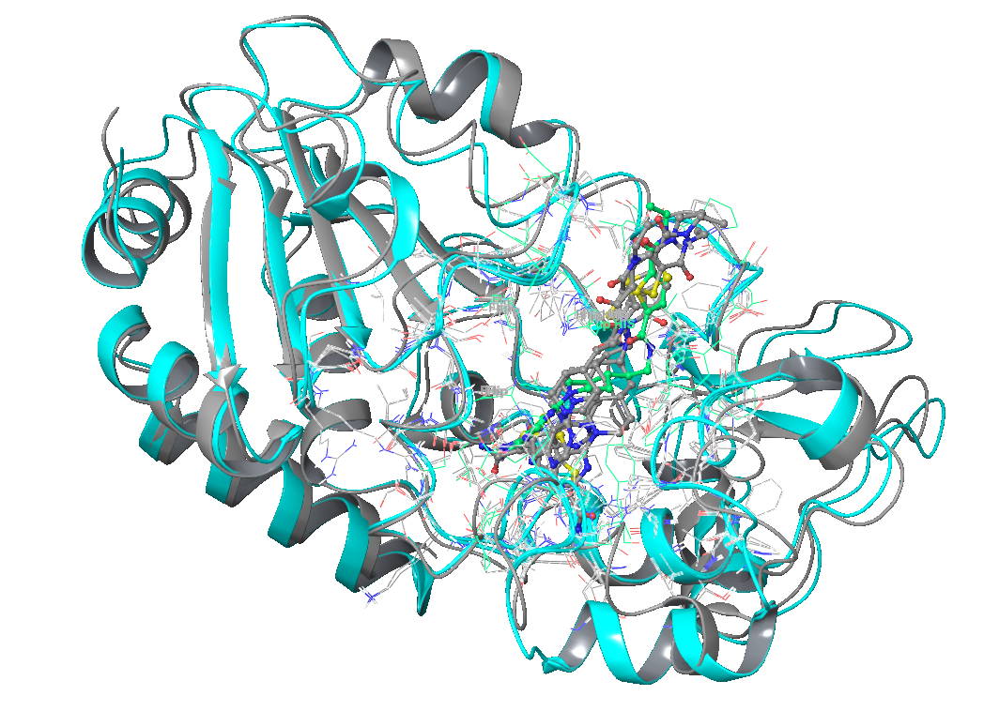
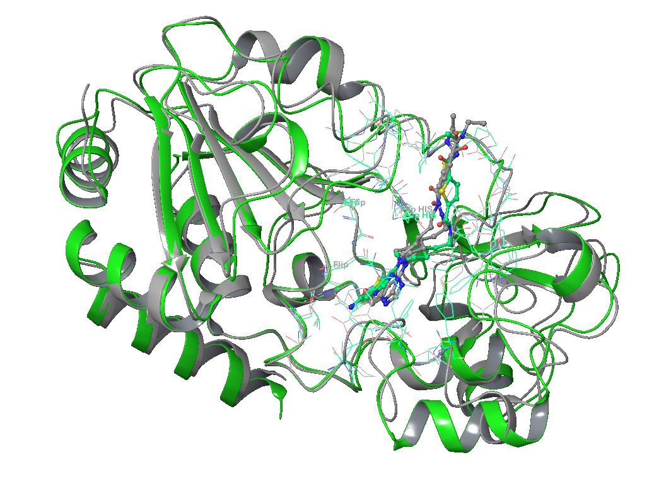
Cont.
Case 2: Docking of ELT-3c into 4FVT using Glide XP or extended IFD. (succeeded?)
Glide XP results:
IFD results:

Slide 19
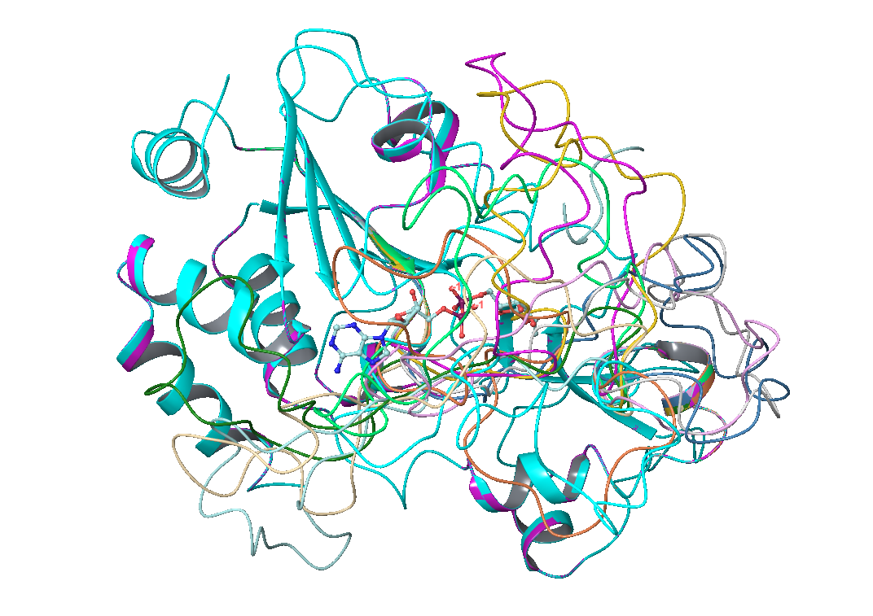
Loop refinement with Prime
Case 1: Refine loop for original 4BVG (145-181) (failed!)
Case 2: Refine loop for 4FVT after superimposing intermediate from 4BVG (155-174) (failed!)

