Slide 1
PMC-AT Group Meeting
Experimental update
XG, 8.22.2014

Slide 2
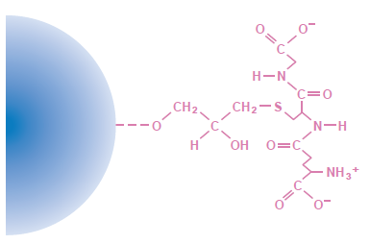
PNCA nicotinamidase purification and Continuous assay validation
Dec. 17, 2014
  Large scale of pGEX-6p3-PNCA Cell lysates were obtained.
  pGEX-6p3-PNCA is GST fusion protein which can be purified directly from cell lysate by affinity chromatography using glutathione immobilized to a matrix such as Sepharose. When applied to the affinity medium, fusion proteins bind to the ligand, and impurities are removed by washing with binding buffer. Fusion proteins are then eluted from the Glutathione Sepharose under mild, non-denaturing conditions that preserve both protein antigenicity and function.
  Two different purification methods were applied in order to get high yield of target protein.
    Method 1- Pierce GST Spin Purification Kit (ThermoScientific)
    Method 2- GST Fusion Protein Purification Kit (GenScript)
 | ThermoScientific | GenScript
Binding Capacity | 40 mg of GST protein/ml of settled resin | 20 mg of GST protein/ml of settled resin
Resin | 0.2 ml resin bed | 10 ml settled resin (~20 mg GST protein)
Columns | 25 Glutathione spin columns (1.5 ml) | 5 empty columns (10ml)
Glutathione (reduced) | 184 mg/6ml equilibrtion buffer to make 10X Glutathione. Store at -20ºC up to 18m. | 5X0.154 g (5X50 ml of 10 mM glutathione elution buffer)

Slide 3
Aug. 18, 2014 – Aug. 21, 2014
  SDS PAGE for 20 lysate samples (-20ºC).
  Purification of GST fusion protein.
    Pack the column
    Pre-equilibration the column
    Load sample and incubation for max binding
    Flow through (FT)
    Wash (W)
    Elute target protein (E)
  SDS PAGE for sample from FT, W, and E.
  Dialysis
  Precission Protease Cleavage
  Purity measurement
  Enzyme activity measurement
  Coupled-enzyme assay validation

Slide 4
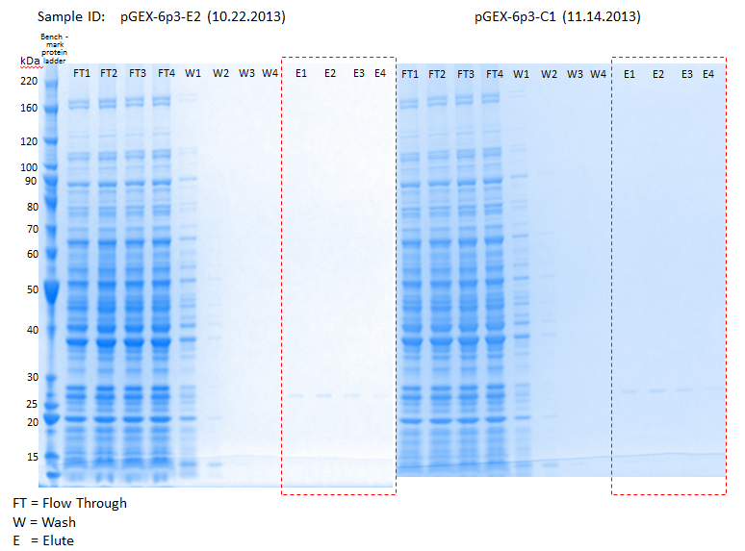
Low yield

Slide 5
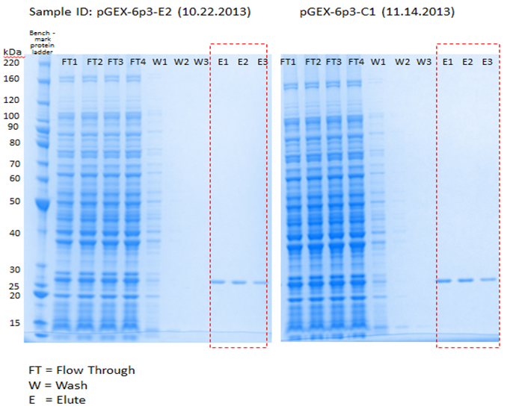
High yield

Slide 6
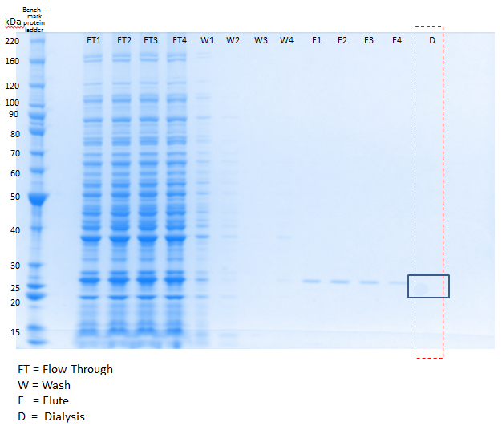
Steps | Time Needed
Dialysis trouble shouting | 2-3 days
Prescission Protease Cleavage | 1 day
Purity | 1 day
Enzyme activity | 1 week
Enzyme-coupled assay | 2-3 weeks

Slide 7
RC (8/18): Ok, please provide a suggested timetable of experiments with this molecule including the initial validation of the results from the paper and then kinetic studies investigating the degree of competition with NAD and peptide.
Some of these experiments could start with FdL (given that the paper also used FdL) while completing the continuous assay preparation. Depending on when the experiments would start, we could plan to discuss the [NAM] produced during the endpoint assay around that time.
Steps | Time Needed
Order Reagent(s), if not commercial available ask for custom synthesis | ~2 weeks
Validation of the compound activities results (I. Med. Chem., 2009) | 2 days per protein (Fluor-de-Lys kit)
Validation of the compound activities results (I. Med. Chem., 2009) | 2 days (continuous assay)
Relative inhibition effect (in the presence of 50 uM and 100 uM of NAM) | 3 days (Fluor-de-Lys kit) Note: continuous assay is not applicable
Investigate the activation mechanism_increasing [peptide] at saturating levels of NAD⁺) | 2 weeks (5-7 [peptide]s)
Investigate the activation mechanism_increasing [NAD⁺] at saturating levels of peptide) | 2 weeks (5-7 [NAD⁺]s)
NAM Exchange Kinetics | Need to set up radioactive based assay

Slide 8
RC(8/7): j) regarding base exchange assay, we need info on: price of custom-labeled reagents (e.g. NAM), whether reagent vendors can ship to us without any validation of our ability to handle such reagents, price of LSC, whether LSC can be purchased by any lab, confirmation that no local approval is needed for us to use such reagents.
PMC-AT Email at 10/29/2013 9:31 AM
Specific license application for the use of radioactive material in NJ.
Catherine L. Biel
Radiation Physicist
NJDEP Bureau of Environmental Radiation
Radioactive Materials Program
Mail Code 25-01
P.O. Box 420
Trenton, NJ 08625-0420
Office: (609) 984-5663
Fax: (609) 633-2210
Email: Catherine.biel@dep.state.nj.us
Physical Location:
25 Arctic Parkway
Ewing, NJ 08638
Website: www.agreementstate.nj.gov
PMC-AT Email at 10/30/2013 10:43 AM
Waste pickup
Sam Suevo
Operations Manager- Philadelphia Pa
Veolia ES Technical Solutions, L.L.C.
Office: 215-537-7342
Fax: 215-533-6799
Cell: 215-416-5260
Email: Sam.Suevo@VeoliaES.com
Website: http://www.Veoliaes.com/
Notes:
The exempt quantity of C-14, is 100 microcuries.

Slide 9
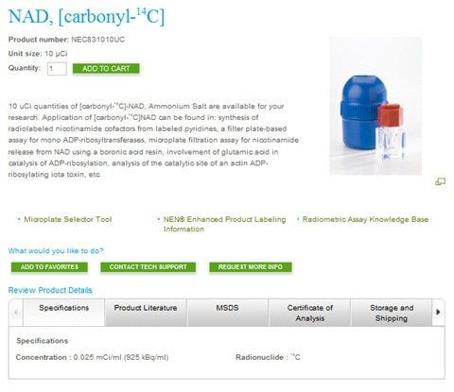
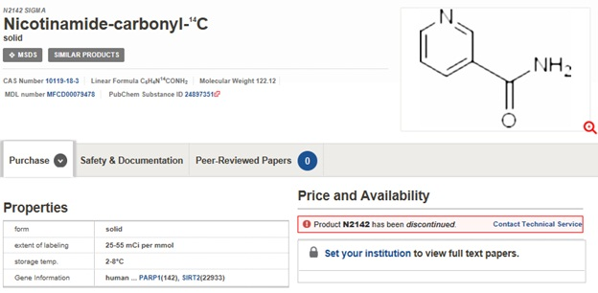
Liquid scintillation counting?

Slide 10
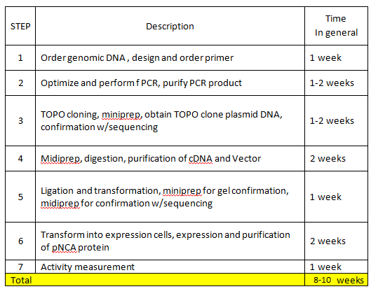
To-do List
Proteins interested
  SIRT1: Sigma-Aldrich $473/150 μg
  SIRT3: Creative BioMart $590/100 μg
  SIRT6?
Clone, Express, and Purify SIRTUINs in house (~3 month for 2 proteins)
Peptide substrate
  Enzyme specific substrate: Peptide 2.0 / GenScript

Slide 11
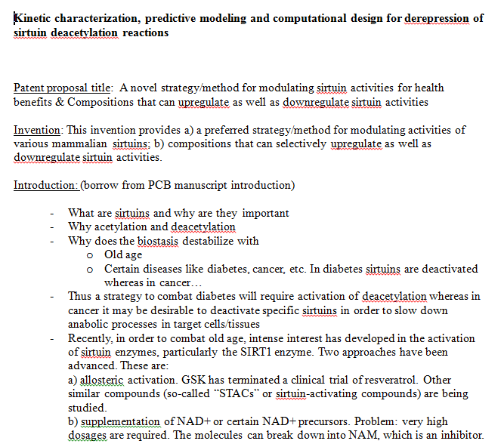
2nd Paper is on.
RC (8/7): Over the next month or so (until the continuous assay is finished) you should spend 2/3 of your time as priority finishing the continuous assay and 1/3 of time on the 2nd paper outlining.

