Slide 1
PMC-AT Group Meeting
Experimental update
XG, 9.5.2014

Slide 2
Outline
Format the PLOS ONE manuscript for final production step.
2nd paper draft
  Review on the current state of knowledge of NAD⁺ metabolism (Introduction)
  Map of the reported experimental rate constants to our diagram
  Summary on the reported data with references for the future use of bulletin point
  3 Base Exchange detailed protocols from two individual groups
  Transition kinetic experimental protocol
Test solubility of the compound 1c and 1b derivative
Test the modulation effects of aforementioned compound

Slide 3
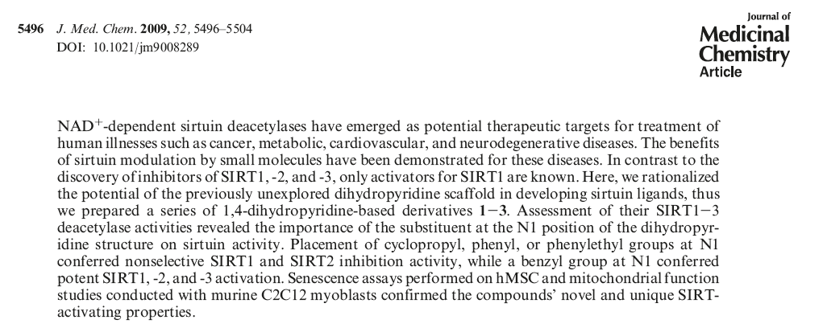
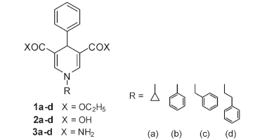
Study of 1,4-Dihydropyridine Structural
SIRT1 SIRT3
EC₁₅₀ 36 uM ~50 uM
effective concentration able to increase the enzyme activity of 150%

Slide 4
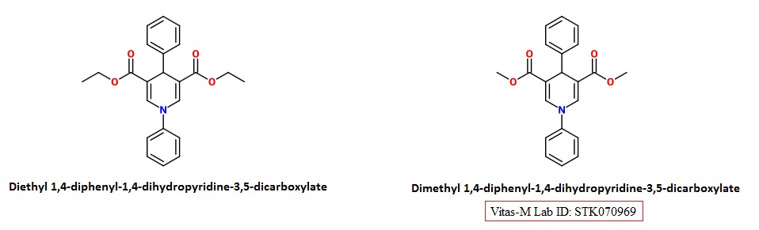
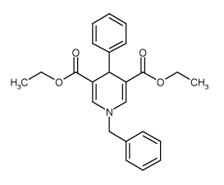
Commercial available DHPs
1b
1c
Enzo BML-GR359-0005

Slide 5
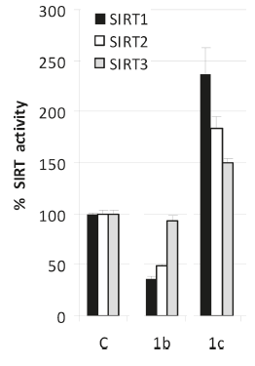
Modulation effect
SIRT3 modulating activities of compounds tested at 50 μM

