Slide 1
PMC-AT Group Meeting
Experimental update
XG, 9.12.2014

Slide 2
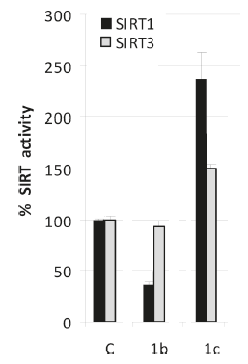
DHPs Compound Modulation effect
 | DHP 1b (Inhibition) | DHP 1b derivative (Activation) | DHP 1c (Activation)
 | JMC | PMC-AT | JMC | PMC-AT | Ratio
SIRT1 | 40% | 250 | 240 | 445 | 1.9
SIRT3 | 90% | 193 | 150 | 319 | 2.1

Slide 3
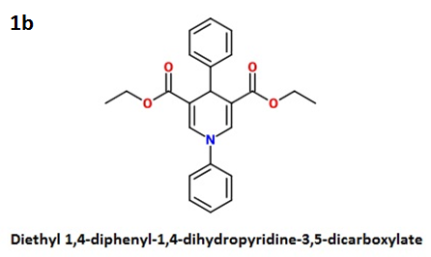
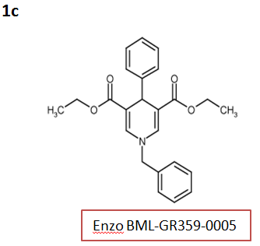
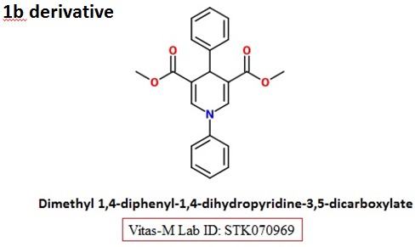
Commercial available DHPs

Slide 4
DHPs Compound Modulation effect on SIRT1
[SIRT1]=1U/reaction
[NAD⁺]=500 μM
[Substrate]=250 μM
[modulator]=50 μM
Incubation 1 hr after addition of enzyme
Shake for 15 min after addition of Developer
[SIRT1]=1U/reaction
[NAD⁺]=500 μM
[Substrate]=100 μM
[modulator]=50 μM
Incubation 1 hr after addition of enzyme
Shake for 15 min after addition of Developer

Slide 5
Fluoroskan vs. TECAN
Fluoroskan TECAN Gain: 45 TECAN Gain: 80
 | 11 | 12
A | 388.1 | 399
B | 1053 | 1134
C | 586.2 | 610.5
D | 964.5 | 1016
E | 1702 | 1783
F | 2568 | 2681
G
H
 | 11 | 12
A | 280 | 284
B | 1306 | 1337
C | 544 | 550
D | 1156 | 1182
E | 1682 | 1750
F | 2479 | 2590
G
H
 | 11 | 12
A | 23535 | 23640
B | OVER | OVER
C | 44592 | 44871
D | OVER | OVER
E | OVER | OVER
F | OVER | OVER
G
H
E_{x}= 355 nm
E_{m}= 460 nm
E_{x}= 360 nm
E_{m}= 460 nm
E_{x}= 360 nm
E_{m}= 460 nm
Pre-warm up Takes ~8 min to reach 37ºC from room Temp.
Similar time for reading through the 96 wells
Not adjustable Gain: 1-255 Big range for low AFU
End point Have kinetic cycle function

Slide 6
Quotes for Customized Compound
Company | Location | Quote | Quote # | Comments | Contact
Ascendex Scientific | 360 George Patterson Blvd Suite 204 Bristol, PA 19007 Phone: (215) 788-5640 www.ascendexllc.com | 390 >97% by HPLC in 2 weeks |  |  | Gao Shang, Ph.D. sales@ascendexllc.com
KareBay Biochem | 11 Deerpark Dr #204, Monmouth Junction, NJ 08852 Phone: 732-823-1545 Fax: 732-823-1349 service@karebaybio.com | $390.00 | KBQ-140827 | Includes shipping & handling fee | Andrew Dai, Ph.D. andrew.dai@karebaybio.com Yi Yua, Ph.D. yi.yuan@karebaybio.com
The Chemistry Research Solution LLC | 360 George Patterson Blvd. Suite 101E Bristol, PA 19007 215-788-3603 (Phone) 267-401-1028 (Fax) | $2,250.00 |  |  | Ralf Mueller, Ph.D. rmueller@tcrs-us.com
Dalton Pharma Services | 349 Wildcat Road Toronto, ON M3J 2S3 Canada Phone: (416) 661-2102 ext 485 | $2,135.00 | 14-0943 |  | Lidia Siniavskaia, M.Sc. lsiniavskaia@dalton.com

