Slide 1
PMC-AT Group Meeting
Experimental update
XG (9.29.2014)

Slide 2
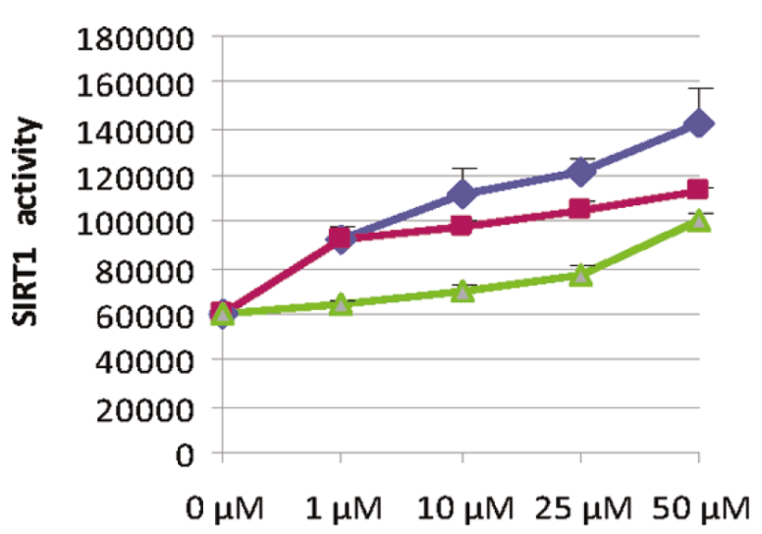
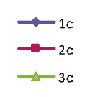
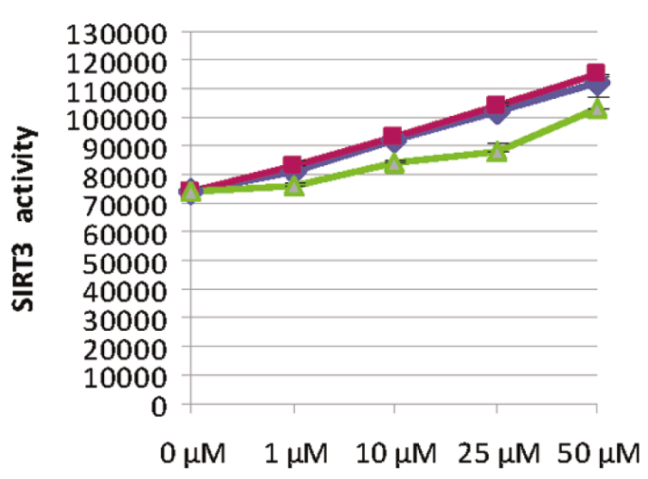
DHP 1c mechanistic study
– How High the DHP 1c Concentration Can Go?
Mai A et al. Study of 1,4-Dihydropyridine Structural Scaffold: Discovery of Novel Sirtuin Activators and Inhibitors. J Med. Chem. (2009) 52: 5496-5504.

Slide 3
DHP 1c mechanistic study
– How High the DHP 1c Concentration Can Go?
[DHP 1c], μM | Ratio
0 | 1.00
25 | 1.36
50 | 1.55
100 | 1.78
200 | 1.98
300 | 1.98

Slide 4
DHP 1c mechanistic study
– What DHP 1c and SIRT3 Concentrations are Picked ?
[NAD⁺] = 500 μM
[Substrate] = 100 μM
[DHP 1c] = 25 μM
50 μM
100 μM
200 μM
300 μM
[SIRT3] = 5 U per reaction
Incubation time 1 hr
[DHP 1c], μM | 0 min, AFU | 60 min, AFU | s/n | ΔAFU
0 | 309 | 928 | 3.003 | 617
25 | 1573 | 2413 | 1.534 | 838
50 | 2194 | 3150 | 1.436 | 954
100 | 2927 | 4029 | 1.376 | 1100
200 | 3869 | 5092 | 1.316 | 1221
300 | 4427 | 5648 | 1.276 | 1219
[SIRT3] = 2.5 U per reaction
[Substrate] = 100 μM
[NAD⁺] = 100, 375, 750, 1500, 3000 μM
[DHP 1c] = 0, 50 μM
Time points: 0, 5, 10, 20, 30, 60, 120 min
[NAD⁺] = 500 μM
[Substrate] = 100 μM
[DHP 1c] = 50 μM
[SIRT3] = 2.5/5 U per reaction
Incubation time 1 hr
[SIRT3], U | 0 min, AFU | 60 min, AFU | s/n | ΔAFU
5 | 2194 | 3150 | 1.44 | 956.0
2.5 | 1536 | 2152 | 1.40 | 616.0

Slide 5
DHP 1c mechanistic study – 100 uM NAD⁺
Time, min | Control, μM | DHP 1c, μM | Ratio
0 | 0.000 | 0.000
5 | 0.074 | 0.115 | 1.55
10 | 0.145 | 0.211 | 1.45
20 | 0.336 | 0.475 | 1.41
30 | 0.517 | 0.694 | 1.34
60 | 0.697 | 0.982 | 1.41
120 | 0.978 | 1.405 | 1.44
Initial rate, μM/min | [NAD⁺] = 100 μM
Control | 0.02018
50 μM DHP 1c | 0.02679

Slide 6
DHP 1c mechanistic study – 375 uM NAD⁺
Time, min | Control, μM | DHP 1c, μM | Ratio
0 | 0.000 | 0.000
5 | 0.165 | 0.275 | 1.66
10 | 0.322 | 0.530 | 1.65
20 | 0.747 | 1.147 | 1.53
30 | 1.150 | 1.623 | 1.41
60 | 1.552 | 2.226 | 1.43
120 | 2.178 | 3.050 | 1.40
Initial rate, μM/min | [NAD⁺] = 100 μM
Control | 0.04486
50 μM DHP 1c | 0.06564

Slide 7
DHP 1c mechanistic study – MM Fitting
 | Control | 50 uM DHP 1c
Michaelis-Menten | Perfect fit | Perfect fit
Best-fit values
Vmax | 0.08079 | 0.1389
Km | 300.3 | 418.4
Std. Error
Vmax
Km
95% Confidence Intervals
Vmax
Km
Goodness of Fit
Degrees of Freedom | 0 | 0
R square | 1 | 1
Absolute Sum of Squares | 0 | 0
Sy.x
Constraints
Km | Km > 0.0 | Km > 0.0
Number of points
Analyzed | 2 | 2

Slide 8
DHP 1c mechanistic study – Double reciprocal Plot
1/[NAD+], μM⁻¹ | 1/v, min⁻¹
 | Control | 50 μM DHP 1c
0.01 | 49.6 | 22.3
0.002666667 | 37.3 | 15.2

Slide 9
Next steps
[DHP 1c] = 50 μM
[NAD⁺] = 750μM, 1500 μM, 3000 μM
[NAM] = 50 uM, [DHP 1c] = 50 uM
[NAD⁺] = 100 μM, 375 μM, 750μM, 1500 μM, 3000 μM

