Slide 1
PMC-AT Group Meeting
Experimental update
XG (10.17.2014)

Slide 2
Overview
[NAD⁺]=100, 375, 750, 1500, 3000 μM
[Substrate peptide]=100 μM
[SIRT3]=2.5U/reaction
[NAM]=0, 50 μM
[NAD⁺]=100, 375, 750, 1500, 3000 μM
[Substrate peptide]=100 μM
[SIRT3]=2.5U/reaction
[DHP 1c] = 50 μM
[NAM]=0, 50 μM

Slide 3
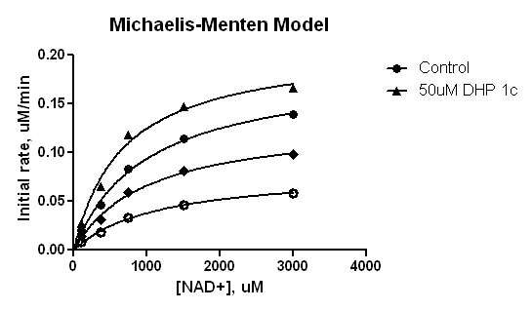
SIRT3:DHP 1c mechanistic study – MM Fitting
50uM DHP 1c
Control
50uM NAM+ 50uM DHP 1c
50uM NAM
o
Best-fit values | Control | 50μM DHP 1c | 50μM NAM | 50μM NAM + 50μM DHP 1c
Vmax | 0.1864 | 0.2082 | 0.08091 | 0.1320
Km | 988.2 | 669.5 | 1137 | 996.1

Slide 4
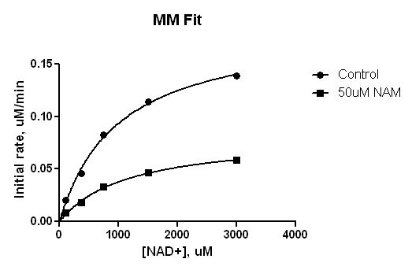
0uM DHP 1c
Michaelis-Menten (Prism)
Best-fit values
Vmax | 0.1864 | 0.08091
Km | 988.2 | 1137
Std. Error
Vmax | 0.01007 | 0.004507
Km | 131.1 | 147.8
95% Confidence Intervals
Vmax | 0.1544 to 0.2185 | 0.06656 to 0.09525
Km | 571.1 to 1405 | 666.4 to 1607
Goodness of Fit
Degrees of Freedom | 3 | 3
R square | 0.9945 | 0.9951
Absolute Sum of Squares | 5.131e-005 | 8.105e-006
Sy.x | 0.004136 | 0.001644
Constraints
Km | Km > 0.0 | Km > 0.0
Number of points
Analyzed | 5 | 5

Slide 5
0uM DHP 1c
Double reciprocal _ MM Fit
1/v = 1/Vmax*(1+Km/[S])
50uM NAM
0uM NAM
(-7.99E-04 uM⁻¹, 1.128 min.uM⁻¹)

Slide 6
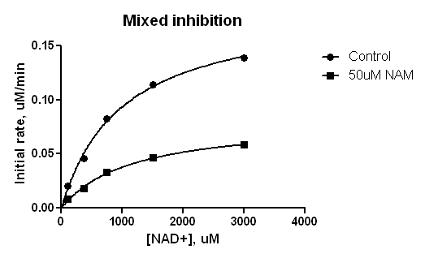
0uM DHP 1c
Mixed model inhibition (Prism)
 | Control | 50uM NAM | Global (shared)
Best-fit values
Vmax | 0.1915 | 0.1915 | 0.1915
I | = 1.000 | = 50.00
Alpha | 1.274 | 1.274 | 1.274
Ki | 28.69 | 28.69 | 28.69
Km | 981.1 | 981.1 | 981.1
Std. Error
Vmax | 0.008313 | 0.008313 | 0.008313
Alpha | 0.5898 | 0.5898 | 0.5898
Ki | 7.952 | 7.952 | 7.952
Km | 105.1 | 105.1 | 105.1
R square | 0.9945 | 0.9951 | 0.9964
Number of points
Analyzed | 5 | 5

Slide 7
0uM DHP 1c
Double reciprocal _ Mixed inhibition Fit
1/v = Km/Vmax*(1+[I]/Ki)*1/[S]+1/Vmax*(1+[I]/aKi)
50uM NAM
0uM NAM
(-7.99E-04 uM⁻¹, 1.125 min.uM⁻¹)

Slide 8
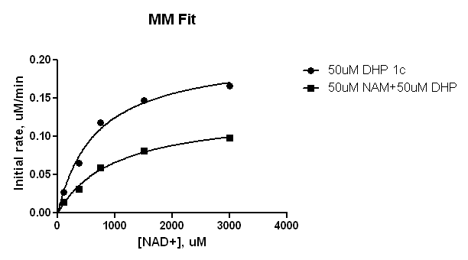
50uM DHP 1c
Michaelis-Menten (Prism)
Best-fit values
Vmax | 0.2082 | 0.1320
Km | 669.5 | 996.1
Std. Error
Vmax | 0.01391 | 0.009832
Km | 126.8 | 181.7
95% Confidence Intervals
Vmax | 0.1639 to 0.2525 | 0.1007 to 0.1633
Km | 266.1 to 1073 | 418.0 to 1574
Goodness of Fit
Degrees of Freedom | 3 | 3
R square | 0.9869 | 0.9898
Absolute Sum of Squares | 0.0001749 | 4.826e-005
Sy.x | 0.007635 | 0.004011
Constraints
Km | Km > 0.0 | Km > 0.0
Number of points
Analyzed | 5 | 5

Slide 9
Double reciprocal _ MM Fit
50uM DHP 1c
1/v = 1/Vmax*(1+Km/[S])
50uM NAM +50uM DHP 1c
0uM NAM + 50uM DHP 1c

Slide 10
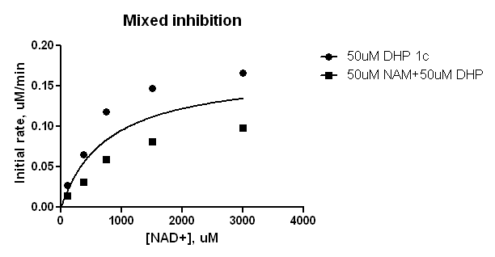
50uM DHP 1c
Mixed model inhibition (Prism)
 | Ambiguous | Ambiguous
Best-fit values
Vmax | ~ 0.1849 | ~ 0.1849 | ~ 0.1849
I | = 50.00 | = 50.00
Alpha | ~ 5.903 | ~ 5.903 | ~ 5.903
Ki | ~ 89.86 | ~ 89.86 | ~ 89.86
Km | ~ 540.2 | ~ 540.2 | ~ 540.2
Std. Error
Vmax | ~ 1.294e+009 | ~ 1.294e+009 | ~ 1.294e+009
Alpha | ~ 4.106e+011 | ~ 4.106e+011 | ~ 4.106e+011
Ki | ~ 4.328e+012 | ~ 4.328e+012 | ~ 4.328e+012
Km | ~ 8.005e+012 | ~ 8.005e+012 | ~ 8.005e+012
95% Confidence Intervals
Vmax | (Very wide) | (Very wide) | (Very wide)
Alpha | (Very wide) | (Very wide) | (Very wide)
Ki | (Very wide) | (Very wide) | (Very wide)
Km | (Very wide) | (Very wide) | (Very wide)
Goodness of Fit
Degrees of Freedom |  |  | 6
R square | 0.7287 | 0.2595 | 0.7015
Number of points
Analyzed | 5 | 5

Slide 11
Double reciprocal _ Mixed Inhibition Fit
50uM DHP 1c
1/v = Km/Vmax*(1+[I]/Ki)*1/[S]+1/Vmax*(1+[I]/aKi)
50uM NAM +50uM DHP 1c
0uM NAM + 50uM DHP 1c
(-3.136E-04 uM⁻¹, 4.492 min.uM⁻¹)

Slide 12
MM Fit
(50uM NAM+50uM DHP 1c)
Mixed inhibition Fit
(50uM NAM+50uM DHP 1c)
MM Fit
(0uM NAM+50uM DHP 1c)
Mixed inhibition Fit
(0uM NAM+50uM DHP 1c)
50uM NAM+50uM DHP 1c
0uM NAM+50uM DHP 1c

Slide 13
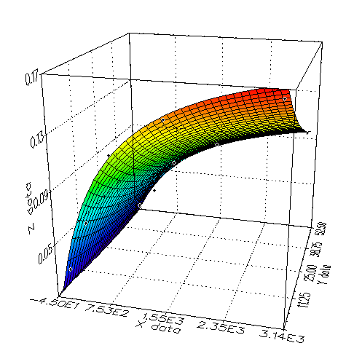

Mixed inhibition Model _ Online Tool
50uM DHP 1c
a: V_{max}
b: K_{m}
c: K_{i}
d: α*K_{i}
z: v
x: [S]
y: [I]

Slide 14
Mixed inhibition Model _ Online Tool
50uM DHP 1c
Nonlinear Fit Double reciprocal plot
(-6.41E-04 uM⁻¹, 2.743 min.uM⁻¹)
 | Vmax | Km | Ki | Alpha
Best-fit values | 0.2082 | 669.5 | 37.117 | 2.332
Stdv. | 1.23e-04 | 1.025e+04 | 1.785e+02 | 4.91e+00

Slide 15
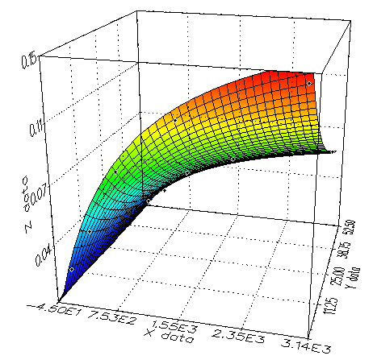
Mixed inhibition Model _ Online Tool
0uM DHP 1c
a: V_{max}
b: K_{m}
c: K_{i}
d: α*K_{i}
z: v
x: [S]
y: [I]

Slide 16
Mixed inhibition Model _ Online Tool
0uM DHP 1c
Nonlinear Fit Double reciprocal plot
(-8.00E-04 uM⁻¹, 1.124 min.uM⁻¹)
(-7.99E-04 uM⁻¹, 1.125 min.uM⁻¹) for Prism
 | Vmax | Km | Ki | Alpha
Best-fit values | 0.1864 | 988.2 | 30.3 | 1.265
Stdv. | 5.87e-05 | 9.95e+03 | 6.58e+01 | 9.10e-01
Best-fit values (Prism) | 0.1915 | 981.1 | 28.69 | 1.274
Stdv (Prism) | 8.31e-03 | 1.05e+02 | 7.95e+00 | 5.90e-01

Slide 17
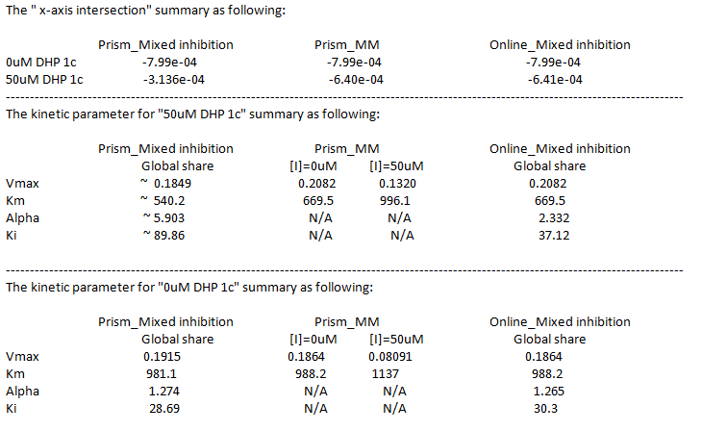

Slide 18
Next steps
An additional [NAM], at 0 and 50 uM DHP
An endpoint verification experiment with ethyl phenyl DHP derivative that was found to be an inhibitor in JMC paper

