Slide 1
PMC-AT Group Meeting
Experimental update
XG (11.11.2014)

Slide 2
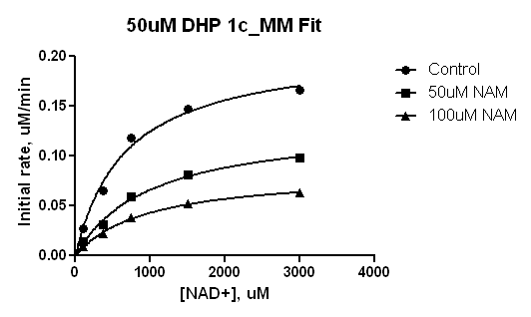
50uM DHP 1c-MM Fit
Michaelis-Menten
Best-fit values | Control | [NAM]=50 uM | [NAM]=100 uM
Vmax | 0.2082 | 0.1320 | 0.08331
Km | 669.5 | 996.1 | 938.0
Std. Error
Vmax | 0.01391 | 0.009832 | 0.003600
Km | 126.8 | 181.7 | 101.5

Slide 3
50uM DHP 1c-MM Fit: Double reciprocal
1/v = 1/Vmax*(1+Km/[S])
(-1.192E-03 uM⁻¹, -1.418 min.uM⁻¹)
(-6.400E-04 uM⁻¹, 2.745 min.uM⁻¹)

Slide 4
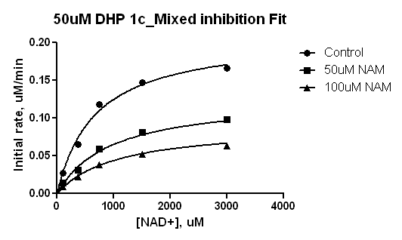
50uM DHP 1c-Mixed Inhibition Fit
Mixed model inhibition
Best-fit values | Control | [NAM]=50 uM | [NAM]=100 uM | Global (shared)
Vmax | 0.2118 | 0.2118 | 0.2118 | 0.2118
I | = 1.000 | = 50.00 | = 100.0
Alpha | 1.988 | 1.988 | 1.988 | 1.988
Ki | 36.93 | 36.93 | 36.93 | 36.93
Km | 664.8 | 664.8 | 664.8 | 664.8
Std. Error
Vmax | 0.009142 | 0.009142 | 0.009142 | 0.009142
Alpha | 0.8075 | 0.8075 | 0.8075 | 0.8075
Ki | 8.830 | 8.830 | 8.830 | 8.830
Km | 82.00 | 82.00 | 82.00 | 82.00

Slide 5
50 uM DHP 1c-Mixed Inhibition Fit:
Double reciprocal
1/v = Km/Vmax*(1+[I]/Ki)*1/[S]+1/Vmax*(1+[I]/αKi)
(-7.562E-04 uM⁻¹, 2.3489 min.uM⁻¹)

Slide 6
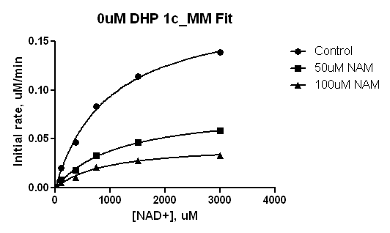
0uM DHP 1c-MM Fit
Michaelis-Menten
Best-fit values
Vmax | 0.1853 | 0.08091 | 0.04420
Km | 974.2 | 1137 | 920.1
Std. Error
Vmax | 0.009647 | 0.004507 | 0.004313
Km | 125.2 | 147.8 | 226.3

Slide 7
0uM DHP 1c-MM Fit: Double reciprocal
1/v = 1/Vmax*(1+Km/[S])
(-1.518E-03 uM⁻¹, -8.987 min.uM⁻¹)
(-7.906-03 uM⁻¹, 1.240min.uM⁻¹)

Slide 8
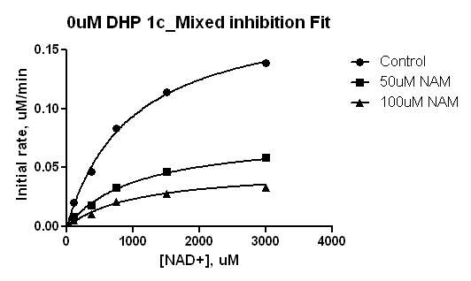
0uM DHP 1c-Mixed Inhibition Fit
Mixed model inhibition
Best-fit values
Vmax | 0.1911 | 0.1911 | 0.1911 | 0.1911
I | = 1.000 | = 50.00 | = 100.0
Alpha | 1.139 | 1.139 | 1.139 | 1.139
Ki | 29.81 | 29.81 | 29.81 | 29.81
Km | 972.9 | 972.9 | 972.9 | 972.9
Std. Error
Vmax | 0.006755 | 0.006755 | 0.006755 | 0.006755
Alpha | 0.3519 | 0.3519 | 0.3519 | 0.3519
Ki | 5.727 | 5.727 | 5.727 | 5.727
Km | 85.04 | 85.04 | 85.04 | 85.04

Slide 9
0 uM DHP 1c-Mixed Inhibition Fit:
Double reciprocal
1/v = Km/Vmax*(1+[I]/Ki)*1/[S]+1/Vmax*(1+[I]/αKi)
(-9.029E-04 uM⁻¹, 0.6232 min.uM⁻¹)

Slide 10
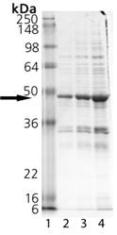

(1) Would you provide the images of SDS-PAGE gel for SIRT3: BML-SE270_02261403 and BML-SE270_02011341?
Lot# 02011341 Image
Lot 02261403 image
13U/ul
0.65mg/ml
2.5U/ul
0.35mg/ml

Slide 11
(2) In general, His-tag proteins require single-step chromatography. Why multi-step chromatography was used for purification as mentioned in certification? Would you indicate whether the His-tag is on N-terminal or C-terminal? Is the His-tag presented in the final protein?
“Multi-step chromatography” is a catch-all term in our documentation. Technically there are two chromatographic steps, but only one of them actively separates macromolecules (the other one is rough size exclusion, which only serves as a buffer exchange step). This product is produced in E. coli. Active SIRT3 (aa 102-199). It contains a N-terminal His-tag. The His-tag is present in the final protein.

Slide 12
(3) In a 2009 paper (Protein Science, vol 18: 514-525), there is a protocol of the purification of mSIRT3 protein. In summary: Supernatant was separated from cell debris by centrifugation at 10,000 g for 40 min at 4oC and loaded onto a Ni-NTA column (Qiagen). The column was washed with 10 CV (column volume) of the Binding buffer (50 mM Tris-HCl, 10% glycerol, 300 mM NaCl, 10 mM MgCl2, pH 8.0), 10 CV of the Wash buffer (50 mM Tris-HCl, 10% glycerol, 300 mM NaCl, 20 mM imidazole, 10 mM MgCl2, pH 8.0) and eluted with the Elution buffer (50 mM Tris-HCl, 10% glycerol, 300 mM NaCl, 250 mM imidazole, 10 mM MgCl2, pH 8.0). The eluted protein was dialyzed against the Binding buffer and then digested with TEV protease (Invitrogen) to remove the N-terminal His tag. The tag-free enzyme was isolated by a 2nd Ni- NTA column. The mSIRT3L-54-334 was further purified to >95% purity by an S200 column (GE) judged by SDS-PAGE. Do you use similar method for purification of SIRT1/SIRT3? What are the differences?
Our purification methods are considered proprietary.

Slide 13
(4) Can you produce SIRT1/SIRT3 protein with higher purity such as >90%? If you can, we are willing to purchase. Would you provide the cost for such high purity? How long does it take?
Our current purification method is intended primarily to service the needs of the related kit to provide maximal activity. It is entirely possible that we could further develop the purity specification, but in that case we can no longer guarantee the specific activity we have seen historically. Active enzymes which are more extensively handled have a tendency to lose their enzymatic activity. If that’s acceptable, we would typically require fairly large bulk purchases or some other compensatory mechanism (eg, authorship or endorsement) to compensate for the cost of method development.

Slide 14

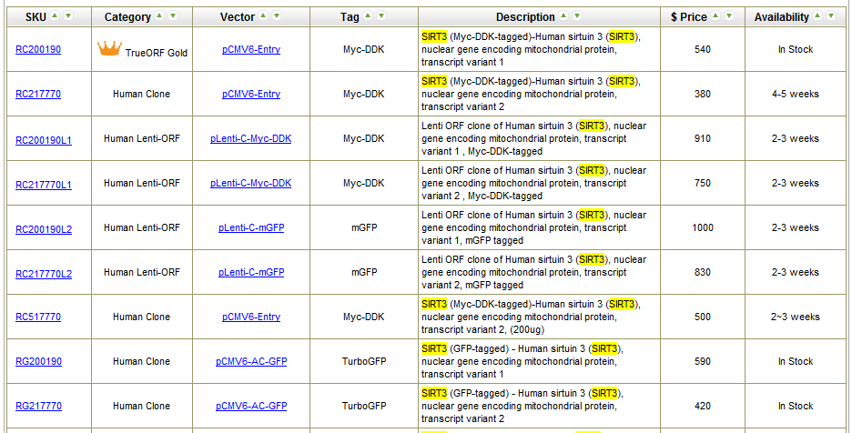

Slide 15
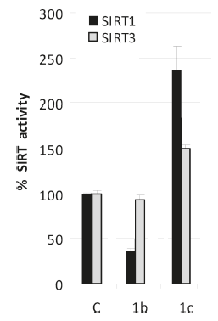
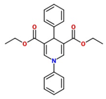
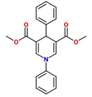
[SIRT1]=1U/reaction
[SIRT3]= 5U/reaction
[NAD⁺]=500 μM
[Substrate]=100 μM
[modulator]=50 μM
Incubation 1 hr after addition of enzyme
Shake for 15 min after addition of Developer
% Activity | SIRT1 | SIRT3 (11.3.14) | SIRT3 (11.7.14)
Control | 100 | 100
Resveratrol | 169.5 | 55.3
NAM | 57.3 | 34.1
DHP 1b | 30.1 | 89.4
DHP 1b analog | 66.5 | 94.4 | 92.1

Slide 16
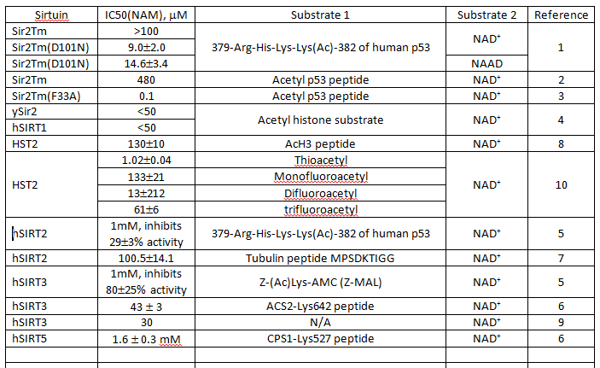
IC50 (NAM) Overview_various sirtuin

Slide 17
BC Smith, JM Denu. Mechanism-Based Inhibition of Sir2 Deacetylases by Thioacetyl-Lysine Peptide, Biochemistry 46(2007) 14478-14486.
BC Smith, JM Denu. Acetyl-lysine analog peptides as mechanistic probes of protein deacetylases. J Biol. Chem. 282(2007)37256-37265.
BC Smith, JM Denu. Sir2 Deacetylases exhibit nucleophilic participation of acetyl-lysine in NAD+ cleavage. JACS, 129(2007) 5802-5803.
Pre-steady-state and steady-state analysis of the thioacetyl-lysine peptide showed rapid nicotinamide formation (4.5 s-1) but slow overall turnover (0.0024 s-1), indicating that the reaction stalled at an intermediate after nicotinamide formation. Mass spectral analysis yielded a novel species (m/z 1754.3) that is consistent with an ADPribose- peptidyl adduct (1¢-S-alkylamidate) as the stalled intermediate.

Slide 18
Rapid-Quench Analysis of the Rate of Nicotinamide Formation
Single-turnover reactions were conducted with 325 μM [¹⁴C]NAD⁺, 15-20 μM thioacetyl-lysine peptide, 40 μM Hst2, and 1 mM DTT in 50 mM Tris-HCl (pH 7.5) at 25 °C. Time points from 28.5 to 4000 ms were assessed using a Hi-Tech RQF-63 rapid-quench flow system (TgK Scientific Ltd., Bradford on Avon, United Kingdom). In the rapid-quench flow, the contents of one syringe containing Hst2 and [¹⁴C]- NAD⁺ were rapidly mixed in a 1:1 ratio with the contents of another syringe containing thioacetyl-lysine peptide to obtain the final concentrations listed above. The concentration of nicotinamide formation was determined by scintillation counting of the HPLC fractions containing [¹⁴C]- nicotinamide liberated from [¹⁴C]NAD⁺. To obtain the rate (k), the plot of product concentration formed over time was fitted to a single-exponential equation (eq 3) where P is the concentration of product formed, [S]₀ is the initial concentration of the limiting substrate, and t is the reaction time.

Slide 19
Unfinished Tasks
Provide a list of all sirtuins with their IC50s for NAM
Also maximum inhibition by NAM for all these sirtuins
All known info on rate constants of all these sirtuins in the same table including which step is rate limiting if known
Also make a table with all known mutants and activity effects, including which mutants were studied computationally
A 2007 paper by Denu measuring the NAM cleavage rate constant by rapid quench methods and radioactivity may have been missed. Please check. Will need to later update the ppt on experimental kinetic characterization accordingly.

