Slide 1
PMC-AT Group meeting
Experimental section

Slide 2
Outline
Background of Ex-527
Review of Ex-527 Kinetic Results
J Med. Chem. Paper (SIRT1)
Methods
Kinetics of inhibition of SIRT1 by Ex527
PNAS paper (SIRT3)
Methods
IC₅₀
Discussion of uncompetitive vs. noncompetitive inhibition mode
Binding affinity measurement (MST)
Ex-527 inhibition study on SIRT3 – PMC AT lab
IC₅₀, comparison to PNAS data
Uncompetitive/noncompetitive inhibition model fitting
Ex-527 patent search
General Info
Ex-527 related patents
High Throughput Screening method(s)
In house, how to use Tecan to increase efficiency
Literature

Slide 3
Outline
Background of Ex-527
Review of Ex-527 Kinetic Results
J Med. Chem. Paper (SIRT1)
Methods
Kinetics of inhibition of SIRT1 by Ex527
PNAS paper (SIRT3)
Methods
IC₅₀
Discussion of uncompetitive vs. noncompetitive inhibition mode
Binding affinity measurement (MST)
Ex-527 inhibition study on SIRT3 – PMC AT lab
IC₅₀, comparison to PNAS data
Uncompetitive/noncompetitive inhibition model fitting
Ex-527 patent search
General Info
Ex-527 related patents
High Throughput Screening method(s)
Literature
In house, how to use Tecan to increase efficiency

Slide 4
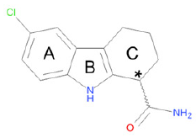
Ex-527
6-​Chloro-​2,3,4,9-​tetrahydro-​1H-​Carbazole-​1-​carboxamide
Ex-527 was firstly reported on Soc. Biomol. Screen. 10th Annual meeting, poster P10045, 2004. Then a patent was applied on Nov. 2004 and granted orphan designation by the European Medicines Evaluation Agency (EMEA) on October 28, 2009, and by the US Food and Drug Administration (FDA) on December 7, 2009.
Ex-527, a Sirt1 inhibitor used in many physiological studies, is one of few compounds for which initial mechanistic data are available and that combine high potency with significant isoform selectivity.
Ex-527 inhibits Sirt1 ∼100-fold more potently than Sirt2 and Sirt3 and has no effect on Sirt5′s deacetylation activity.
Dimond P. Genetic engineering & Biotechnology News, 2.22.2010.
Gertz M, et al. Ex-527 inhibits sirtuins by exploiting their unique NAD⁺-dependent deacetylation mechanism. PNAS (2013) E2772-E2781

Slide 5
Outline
Background of Ex-527
Review of Ex-527 Kinetic Results
J Med. Chem. Paper (SIRT1)
Methods
Kinetics of inhibition of SIRT1 by Ex527
PNAS paper (SIRT3)
Methods
IC₅₀
Discussion of uncompetitive vs. noncompetitive inhibition mode
Binding affinity measurement (MST)
Ex-527 inhibition study on SIRT3 – PMC AT lab
IC₅₀, comparison to PNAS data
Uncompetitive/noncompetitive inhibition model fitting
Ex-527 patent search
General Info
Ex-527 related patents
High Throughput Screening method(s)
Literature
In house, how to use Tecan to increase efficiency

Slide 6
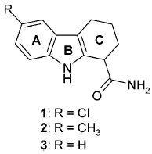
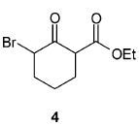
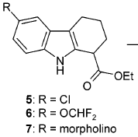
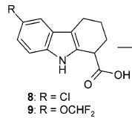
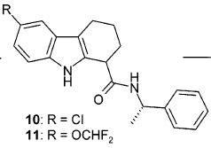
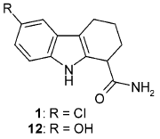
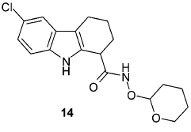
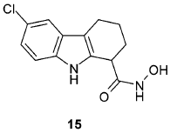
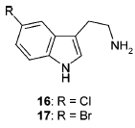
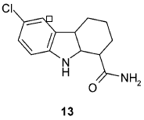
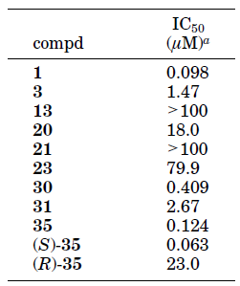
SIRT Fluor-de-Lys Assay
NAM Release Assay
Napper A et. al. Discovery of Indoles as potent and selective inhibitors of the deacetylase SIRT1. J Med. Chem. (2005) 48: 8045-8054.
Notes:
Human SIRT1 (N-terminal His6-tag) and SIRT2 (N-terminal GST tag) were expressed in Escherichia coli and purified by affinity chromatography. SIRT3 is synthesized in mammalian cells as an inactive precursor and activated by a mitochondrial matrix processing peptidase, which removes the first 100 amino acids. Therefore, N-terminal GST-tagged SIRT3 lacking the first 100 amino acids was expressed in bacteria.
The biochemical assay for recombinant human SIRTs was based on the SIRT1 Fluorimetric Drug Discovery Kit (AK-555, Biomol, Plymouth Meeting, PA). In this assay, modified acetyl lysine conjugated to aminomethylcoumarin (AMC) is deacetylated by SIRT enzymes in the presence of NAD, followed by the addition of a proteolytic developer that releases the fluorescent AMC. KM values for NAD and acetylated peptide substrates with SIRT1, SIRT2, and SIRT3 were determined as previously reported. Deacetylase reactions were carried out with all substrates fixed at 70% of their KM values. Enzyme was added at a concentration of 0.5 to 1.0 units/assay well (1 unit of enzyme releases 1 pmol of product per min). Assays were incubated for 45 min at 37 °C. Resulting fluorescence was measured after further incubation for 15 min at 37 °C with Fluor de Lys Developer II (KI-176, Biomol) on a Bio-Tek Synergy HT fluorimeter with excitation set at 360 nm and emission measured at 460 nm. Assays of SIRT1, SIRT2, and SIRT3 were performed in 384-well plates using the p53-K382- (Ac) substrate representing residues 379-382 of p53 acetylated on lysine 382 (KI-177, Biomol). IC50 data were analyzed using XLFit (IDBS, Guildford, UK) or GraphPad Prism software.
Nicotinamide Release Assay. The activity of SIRT1 was measured in a nonfluorimetric assay using a p53 peptide substrate representing residues 368-386 acetylated on lysine 382 (Quality Controlled Biochemicals, Hopkinton, MA). This assay measures the release of [14C]nicotinamide from [carbonyl- 14C]-NAD (CFA372, Amersham Biosciences, Piscataway, NJ), as previously described.
Nicotinamide exchange was measured using the assay as described above in the presence of unlabeled nicotinamide added to a concentration of 52 uM. The added nicotinamide promotes release of [14C]nicotinamide from the labeled NAD through enzyme-catalyzed exchange. After release of [14C]- nicotinamide from NAD, unlabeled nicotinamide binds to the enzyme and is converted to unlabeled NAD.

Slide 7
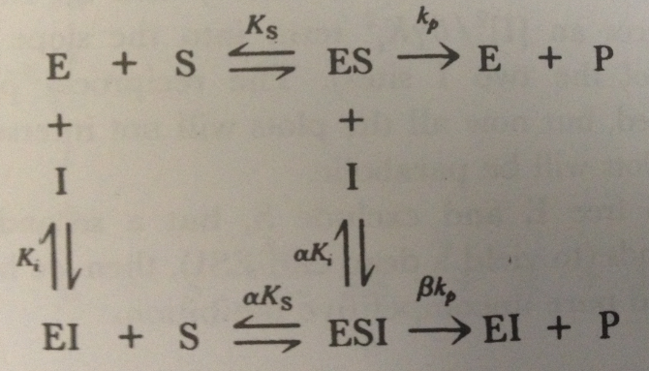
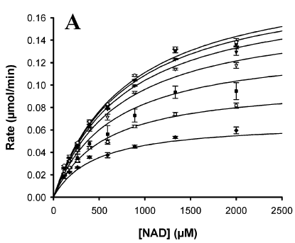
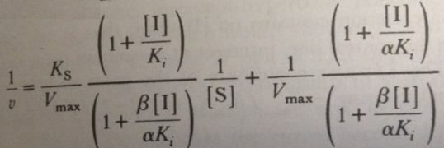
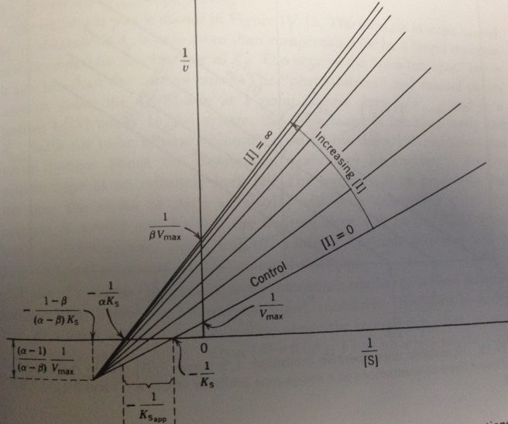
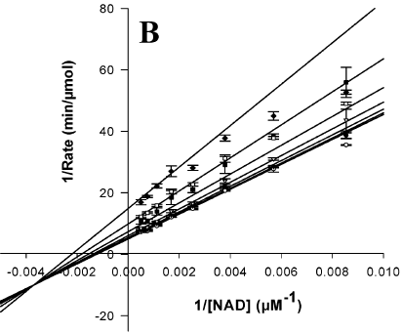
Kinetics of inhibition of SIRT1 by Ex527
A double-reciprocal plot that illustrates the mixed-type inhibition pattern.
Napper A et. al. Discovery of Indoles as potent and selective inhibitors of the deacetylase SIRT1. J Med. Chem. (2005) 48: 8045-8054.
Notes:
Hyperbolic mixed type inhibition, when
1<alpha<infinity, 0<beta<1, the cross point is fell in left-up quarter;
0<alpha<1 and 0<beta<1 is the above case;
Alpha = beta, same as uncompetitive inhibition, called partial uncompetitive inhibition
Alpha<1, beta<1, beta >alpha, the cross point is fell in right-up quarter.

Slide 8
Outline
Background of Ex-527
Review of Ex-527 Kinetic Results
J Med. Chem. Paper (SIRT1)
Methods
Kinetics of inhibition of SIRT1 by Ex527
PNAS paper (SIRT3)
Methods
IC₅₀
Discussion of uncompetitive vs. noncompetitive inhibition mode
Binding affinity measurement (MST)
Ex-527 inhibition study on SIRT3 – PMC AT lab
IC₅₀, comparison to PNAS data
Uncompetitive/noncompetitive inhibition model fitting
Ex-527 patent search
General Info
Ex-527 related patents
High Throughput Screening method(s)
Literature
In house, how to use Tecan to increase efficiency

Slide 9
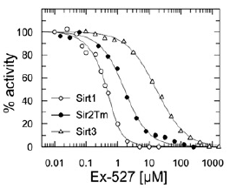
Ex-527 dose–response experiments for Sirt1, Sirt3, and Sir2Tm
 | Sir2Tm | SIRT1 | SIRT3
IC50 | 0.9 uM | 0.09/0.1 uM | 22.4/49 uM
Gertz M, et al. Ex-527 inhibits sirtuins by exploiting their unique NAD⁺-dependent deacetylation mechanism. PNAS (2013) E2772-E2781
Notes:
Ex-527 dose–response experiments for Sirt1, Sirt3, and Sir2Tm.

Slide 10
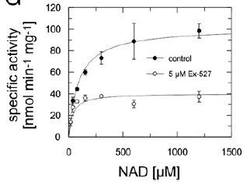
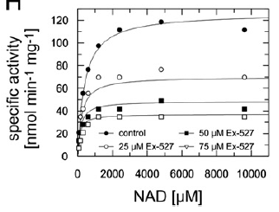
NAD⁺-dependent activity of Sir2Tm (left) and Sirt3 (right) at varying Ex-527 concentrations revealing uncompetitive inhibition.
Gertz M, et al. Ex-527 inhibits sirtuins by exploiting their unique NAD⁺-dependent deacetylation mechanism. PNAS (2013) E2772-E2781

Slide 11
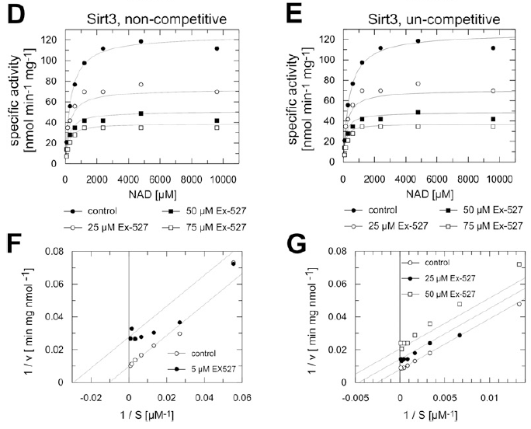
NAD⁺ kinetics for Sirt3 fitted according to noncompetitive (left) and uncompetitive(right) inhibition.
Lineweaver-Burk plots of the NAD⁺ titration curves (left, noncompetitive; right, uncompetitive) for Sirt3.
K_{M} and v_{max} decrease indicating uncompetitive inhibition.
Gertz M, et al. Ex-527 inhibits sirtuins by exploiting their unique NAD⁺-dependent deacetylation mechanism. PNAS (2013) E2772-E2781

Slide 12
Binding affinity measurement
Kd | Sir2Tm | SIRT3
Apo-enzyme | >180 uM | > 330 uM
1 mM peptide substrate | >170 uM | >180 uM
5 mM saturating NAD⁺ | 6 uM | 16.5 uM
NAD+ and peptide substrate | 4.9 uM | 10 uM
Ki_substrate peptide (noncompetitive) | 1.8 uM | 33.4 uM
Ki_NAD⁺(uncompetitive) | 3.3 uM | 31.3 uM
Strong binding-Ex527 binds to C pocket with NAD in subtract binding site.
Affinities were measured by MST. Sirtuins were labeled and mixed with varying concentrations of Ex-527, and thermophoresis was measured in the absence and presence of 5 mM NAD⁺ and 1 mM acetylated peptide (Sir2Tm, acetyl-H3-peptide; Sirt3, acetyl-ACS2-peptide). Kds were determined by nonlinear fitting (one-site and two-site fitting equations).
Gertz M, et al. Ex-527 inhibits sirtuins by exploiting their unique NAD⁺-dependent deacetylation mechanism. PNAS (2013) E2772-E2781
Notes:
It measures the motion of molecules along microscopic temperature gradients and detects changes in their hydration shell, charge or size. It allows measuring a wide range of biomolecular interactions.

Slide 13
Outline
Background of Ex-527
Review of Ex-527 Kinetic Results
J Med. Chem. Paper (SIRT1)
Methods
Kinetics of inhibition of SIRT1 by Ex527
PNAS paper (SIRT3)
Methods
IC₅₀
Discussion of uncompetitive vs. noncompetitive inhibition mode
Binding affinity measurement (MST)
Ex-527 inhibition study on SIRT3 – PMC AT lab
IC₅₀, comparison to PNAS data
Uncompetitive/noncompetitive inhibition model fitting
Ex-527 patent search
General Info
Ex-527 related patents
High Throughput Screening method(s)
Literature
In house, how to use Tecan to increase efficiency

Slide 14
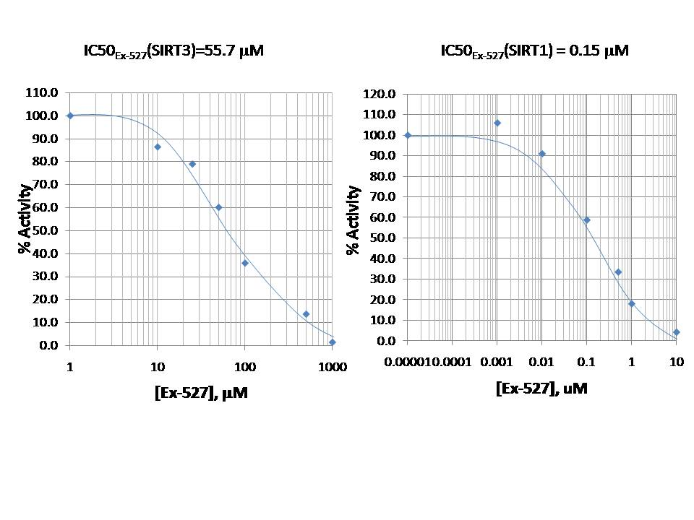
Ex-527 inhibition of SIRT1/SIRT3 (IC₅₀)
IC₅₀ | SIRT1 | SIRT3
PNAS | 0.09/0.1 uM | 22.4/49 uM
PMC-AT | 0.15 uM | 55.7 uM

Slide 15
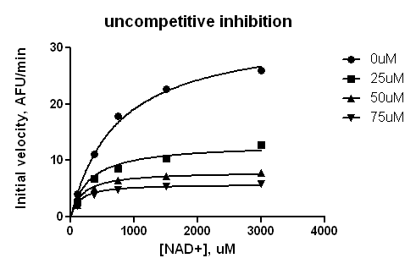
R²= 0.9421
[Ex-527], uM | Km, μM
 | PNAS | PMC-AT Lab
0 | 355.8 | 640.7
25 | 225.1 | 454.5
50 | 183.4 | 285.0
75 | 236.9 | 216.6
R²= 0.9560
R²= 0.9943

Slide 16
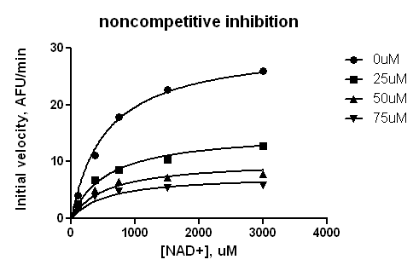
R²= 0.7899
R²= 0.9105
R²= 0.9822
R²= 0.9934

Slide 17
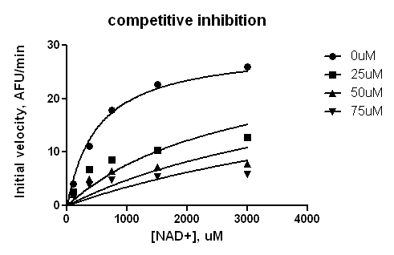
R²= -1.195
R²= -0.3056
R²= 0.5680
R²= 0.9894

Slide 18
Outline
Background of Ex-527
Review of Ex-527 Kinetic Results
J Med. Chem. Paper (SIRT1)
Methods
Kinetics of inhibition of SIRT1 by Ex527
PNAS paper (SIRT3)
Methods
IC₅₀
Discussion of uncompetitive vs. noncompetitive inhibition mode
Binding affinity measurement (MST)
Ex-527 inhibition study on SIRT3 – PMC AT lab
IC₅₀, comparison to PNAS data
Uncompetitive/noncompetitive inhibition model fitting
Ex-527 patent search
General Info
Ex-527 related patents
High Throughput Screening method(s)
Literature
In house, how to use Tecan to increase efficiency

Slide 19
Ex-527 patent search
Website:
Keywords:
Inventors name: Clemens Steegborn; Leonard Guarente; Anthony A Sauve; David Sinclair; Cynthia Wolberger; John Denu; Manfred Jung; Marcia C Haigis; Can Ozbal & William Lamarr.
Assignee: Elixir Pharmaceuticals, Inc
Sirtris Pharmaceuticals, Inc
The John Hopkins University
MIT
Harvard College
Cornell University
Topic: Ex-527, 6-Chloro-2,3,4,9-tetrahydro-1H-Carbazole-1-carboxamide, histone deacetylase inhibitor, SIRT1 inhibitor, sirtuin modulators, sirtuin modulating compounds, Sir2 activity
www.google.com/patents/
http://patft.uspto.gov/
http://www.faqs.org/patents/
Notes:
From 2004 to 2013, 77 patents have been published. Sirtris Pharaceuticals, Inc. (36), Elixir Pharmaceuticals, Inc. (7), The John Hopkins University(4), Mass Institute of Technology(4), Harvard College(3), Princeton University (2), University of Wisconson-Madison (2), Cornell University (2), Enzo life Science (1), et al.

Slide 20
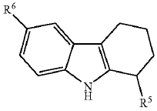
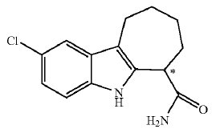
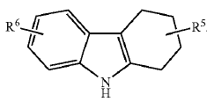
Ex-527 patent search cont’d
SIRT1 Inhibition by Elixir Pharmaceuticals, Inc. (2009)
A SIRT1 inhibitor can be used to enhance the properties of cells, particularly cultured cells and cells for transplantation.
Method of modulating cells (progenitor cells, mammalian cells, human cells)
Method of maintaining cells in vitro
Percentage of containing of enantiomer
It has been shown that the down-regulation of SIRT 2 elicits positive effects on metabolism. Therefore, pharmaceutical compounds that block the activity of this enzyme could have clinical utility to treat a range of metabolic diseases, such as diabetes and obesity.
Notes:
In some embodiments, the compound contains greater than a 60% (e.g., greater than a 65%; 70%, 75%, 80%, or 85%) enantiomeric excess of the enantiomer having an optical rotation of -14.1 (c=0.33 DCM).
Elixir was formed in 1999 based on discoveries from founders Cynthia Kenyon, Ph.D., currently at the University of California San Francisco, and Leonard Guarente, Ph.D., Novartis professor of biology at Massachusetts Institute of Technology. Dr. Guarente decamped from Elixir in 2007 to become co-chair of Sirtris’ scientific advisory board. Sirtris was bought in 2008 by GSK for $720 million.

Slide 21
Ex-527 patent search cont’d
Sirtuin modulating compounds by Sirtris Pharaceuticals, Inc. (2004-2013)
Acridine and quinoline derivatives
N-Phenyl benzamide derivatives
Benzimidazoles and related analogues
Imidazo- [2, 1-b] thiazole derivatives
Pyridines, bicyclic pyridines and analogs
3-substitued imidazo (4,5-b) pyridines and analogs
Chromenone analogs
Qulinazolinone, quinolone and related analogs
Thiazolopyridine compounds
Isoindolinone and related analogs
Benzoxazoles, benzthiazoles and related analogs
Quinazolinone and related analogs
Phthalazinone and related analogs
8-substituted quinolines and related analogs
Notes:
Sirtris Pharmaceuticals, Inc. was a biotechnology company based in Cambridge, MA that developed therapies for type 2 diabetes, cancer, and other diseases. Founded in 2004 by Harvard University biologist David Sinclair, venture capitalist Christoph Westphal, and serial entrepreneur Andrew Perlman, the company went public in 2007 and was subsequently purchased by GlaxoSmithKline in 2008 to acquire the hot biotech with a plan to fight diseases of aging for $720 million. Almost e years after, GlaxoSmithKline shut down Cambridge, MA-based Sirtris Pharmaceuticals,2013 and transferred some of the 60 remaining Sirtris employees to the Philadelphia area. The company's current lead candidates are SRT2104 and SRT2379, which are both potent activators of the SIRT1 enzyme.

Slide 22
Outline
Background of Ex-527
Review of Ex-527 Kinetic Results
J Med. Chem. Paper (SIRT1)
Methods
Kinetics of inhibition of SIRT1 by Ex527
PNAS paper (SIRT3)
Methods
IC₅₀
Discussion of uncompetitive vs. noncompetitive inhibition mode
Binding affinity measurement (MST)
Ex-527 inhibition study on SIRT3 – PMC AT lab
IC₅₀, comparison to PNAS data
Uncompetitive/noncompetitive inhibition model fitting
Ex-527 patent search
General Info
Ex-527 related patents
High Throughput Screening method(s)
In house, how to use Tecan to increase efficiency
New assays and approaches for discovery and design of sirtuin modulators

Slide 23
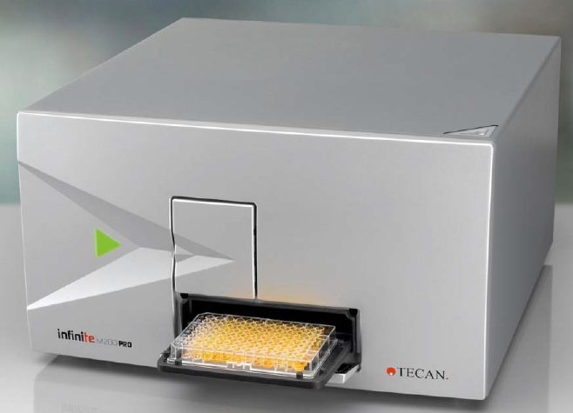
Tecan- Infinite M200 PRO
General
Fluorescence Intensity (FI)
Time-Resolved Fluorescence (TRF)
Fluorescence Resonance Energy Transfer (FRET)
Absorbance
Absorbance in cuvettes
Glow Luminescence
Bioluminescence Resonance Energy Transfer (BRET)
How to improve the efficiency of steady state experiments
6-384 well vs. 96-well
Ex: 355nm, Em: 460 nm
i-control allows a plate to be measured repeatedly in equidistant time intervals.
Fluorescence intensity mode: 230 to 850 nm (Excitation) and 280 to 850 nm (Emission)
Tecan will not be used the study of transient kinetics for sirtuin deacetylation system.
Notes:
The following measurement techniques are supported by …
The Infinite 200 PRO has been designed to meet the requirements of a general purpose laboratory instrument;
The Infinite 200 PRO has been designed as a general purpose laboratory instrument for professional use, supporting common 6 to 384-well microplates;
The Infinite 200 PRO provides a range of parameters for optimizing the measurement results according to: the assay type (cell-based or homogeneous), the microplate type, and the dispensed volumes per well and dispensing speeds.
FI: In many microplate applications, the intensity of fluorescence emission is measured to determine the abundance of fluorescent labeled compounds.
TRF applies to a class of fluorescent labels having fluorescence lifetimes in excess of 100 microseconds. The Infinite 200 PRO uses a Flash lamp light source with flash duration much shorter than fluorescence lifetime of these species. This offers the opportunity to measure fluorescence emission at some time, when stray light and prompt fluorescence have already vanished (Lag Time). Thus, background can be significantly lowered while sensitivity is improved. The benefits of TRF consequently apply to assays using multiple labels with different fluorescence lifetimes.
FRET: Some microplate applications utilize a sophisticated dual labeling strategy. The FRET effect enables you to measure how many of two differently labeled compounds are in close proximity. This makes it suitable for binding studies. Basically, FRET is a fluorescence intensity measurement of one of the two fluorescent labels (acceptor). However, the acceptor is not susceptible to the excitation wavelength of the light source being used. Instead, the acceptor may receive excitation energy from the other fluorescent label (donor), if both are spatially close together. As a prerequisite, the excitation wavelength has to apply to the donor. Secondly, the emission spectrum of the donor has to overlap the excitation spectrum of the acceptor (resonance condition). Nevertheless, the transfer of excitation energy from donor to the acceptor is radiation free.
Temperature range: 5 °C above ambient to 42 °C.
Glow Luminescence: glow type chemi- or bioluminescence. Glow type means that the luminescence assay glows much longer than a minute. Luminescence substrates are available, which provide stable enough light output over hours.

Slide 24
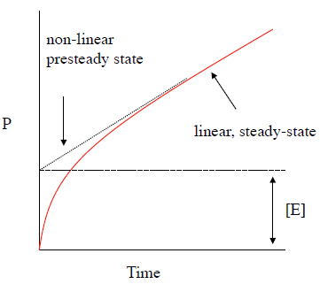
Tecan- Infinite M200 PRO cont’d
whether/how it can be used for transient kinetics experiments
Pre-steady State kinetics
The events that occur prior to the completion of the first catalytic cycle (turnover).
Evidence of pre-steady state events is common, but rarely observed.
Kcat: 1 - 10⁷ s⁻¹, time range 10⁻⁷ s ⁻ ¹
beyond the capacity of a human to initiate and subsequently observe.
Methods
Rapid Mixing Methods
Continuous flow spectrophotometry
Stopped-Flow Spectrophotometry
Rapid Quench-Flow
Notes:
For the purpose of the present discussion the term ‘transient kinetics’ is applied to the time course of a reaction from the moment when enzyme and substrate are mixed, t=0, until either a steady state or equilibrium is established.
Multiple turnover is carried out under the condition that the initial concentration of substrate and enzyme are [S]₀>>[E]₀ and [S]_{t} can be regarded as constant throughout the course of the reaction until a steady state is attained.
Single turnover reaction, when [S]₀<=[E]₀, the transient formation and decay of reaction intermediates is observed until the overall process is essentially complete.
In these experiments, reaction behaviour is tracked during the initial fast transient as the intermediate reaches the steady-state kinetics period. These experiments are more difficult to perform than either of the above two classes because they require specialist techniques (such as flash photolysis of caged compounds) or rapid mixing (such as stopped-flow, quenched flow or continuous flow).

Slide 25
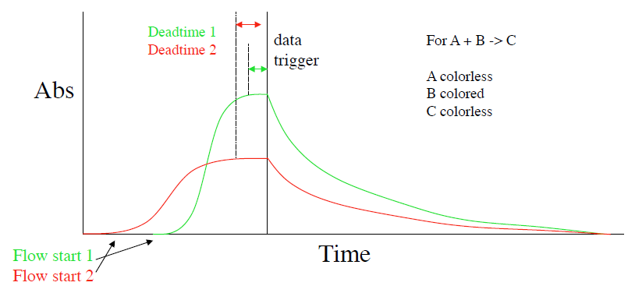
Methods
Rapid Mixing Methods
Continuous flow spectrophotometry
Stopped-Flow Spectrophotometry
Rapid Quench-Flow
Each instrument that relies on rapid mixing of liquids to initiate reactions has a physical
limitation known as the deadtime that is characteristic to it.

Slide 26
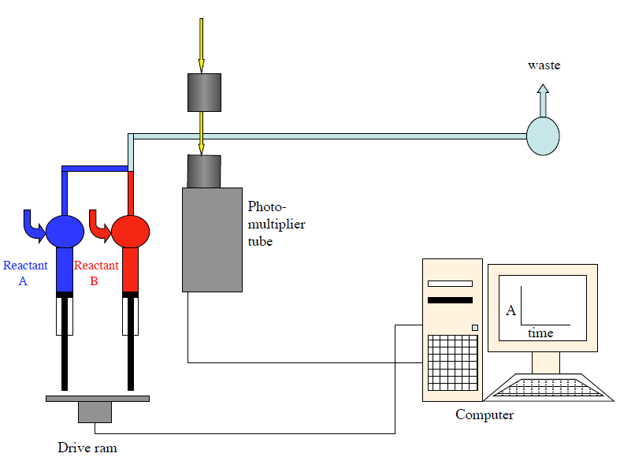
Methods
Rapid Mixing Methods
Continuous flow spectrophotometry
Stopped-Flow Spectrophotometry
Rapid Quench-Flow
Quite a rare method in which two reactants are mixed at a constant flow rate and the observation is made by moving the light source and photomultiplier with respect to the point of mixing.
The reactants are mixed at a constant rate (r in ms⁻¹).
The flow rate must be fast enough to ensure turbulent flow and rapid mixing.
The best continuous flow devices obtain dead times as low as 10 μs.

Slide 27
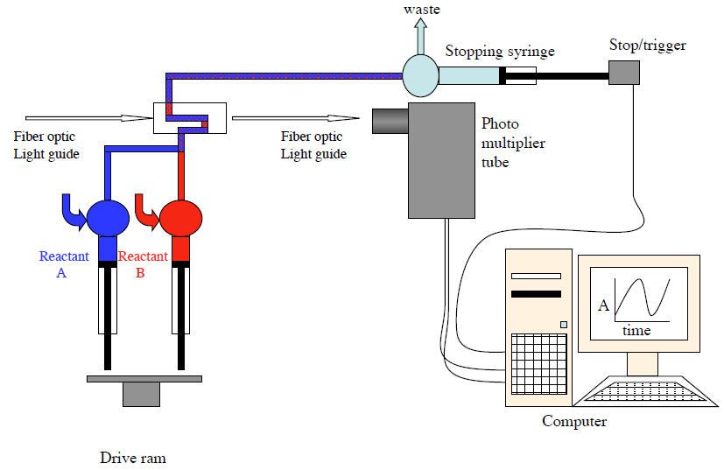
Methods
Rapid Mixing Methods
Continuous flow spectrophotometry
Stopped-Flow Spectrophotometry
Rapid Quench-Flow
Follow fast signal changes. Two or three solutions are mix together rapidly across the light path and data collection begins very shortly after mixing.
In the last decade become more commonplace in
laboratories.

Slide 28
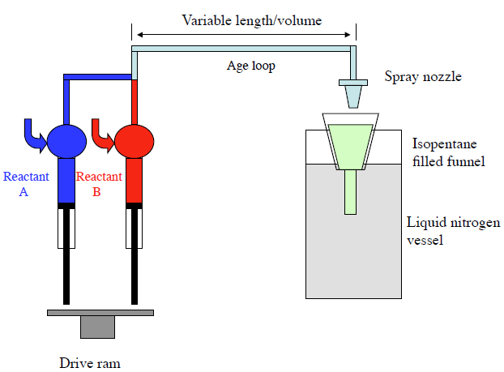
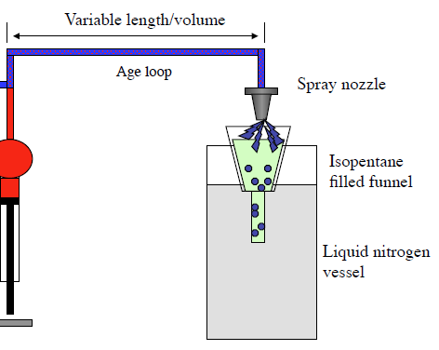
Methods
Rapid Mixing Methods
Continuous flow spectrophotometry
Stopped-Flow Spectrophotometry
Rapid Quench-Flow
Provide an almost unlimited number of metric options for the identification of transients.
Reactants are mixed rapidly, however the mixture exits the instrument at a defined age for analysis by some other methods.
The solution that is ejected from the instrument must be trapped or quenched in some way (acid/rapid freezing) so that the reaction does not progress.

Slide 29
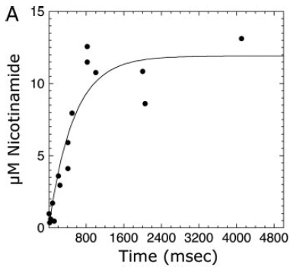
Reported application in Sirtuin study
Determination of the Rates of Nicotinamide Formation
Time points from 28.5 to 4000 ms were performed using a Hi-Tech RQF-63 rapid quench flow system.
These single turnover reactions yielded a first-order nicotinamide formation rate of 1.9 s⁻¹ for homocitrulline peptide compared with 6.7 s⁻¹ for acetyl-lysine peptide.
A syringe containing Hst2 and NAD⁺ was rapidly mixed with another syringe containing the acetyl-lysine peptide analogs. Both syringes contained Tris buffer and DTT.
Radioactivity of fractions collected via reverse-phase HPLC was determined by scintillation counting.
Smith BC and Denu JM. Acetyl-lysie analog peptides as mechanistic perobes of protein deacetylases. JBC(2007) 282:37256-37265.
Smith BC and Denu JM. Sir2 deacetylases Exhibit nucleophilic participation of acetyl-Lysine in NAD+ cleavage. JACS (2007) 129: 5802-5803.

Slide 30
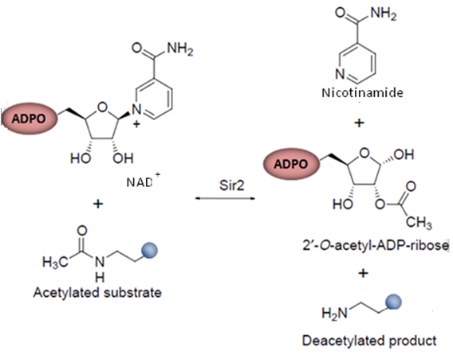
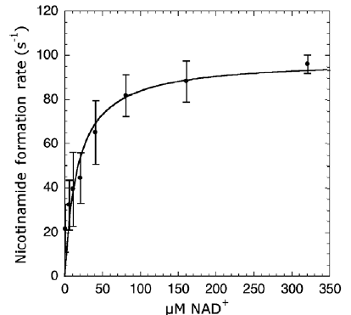
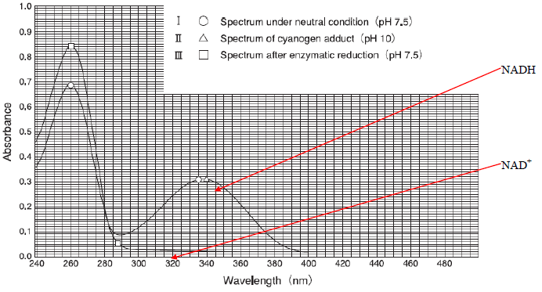
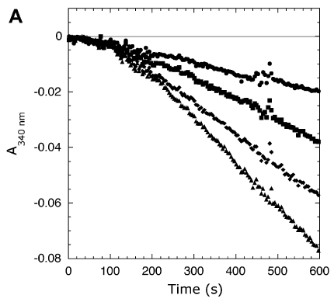
Enzyme coupled continuous assay
GDH
Glutamate
+
NAD⁺
PNC1
Ammonia
+
Nicotinic acid
α-ketoglutarat
+
NADH
Notes:
Steady-state kinetics of Hst2 using the coupled assay.

Slide 31
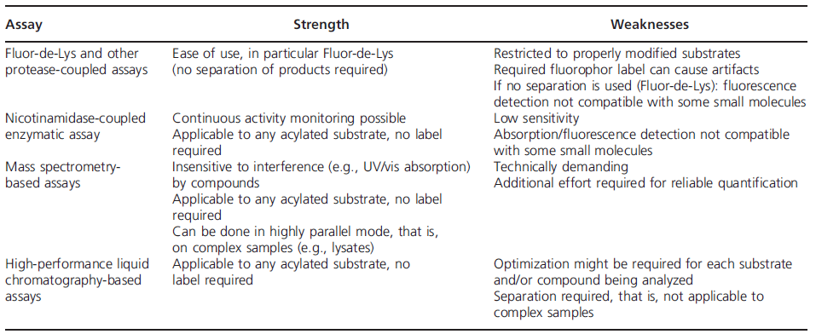
New assays and approaches for discovery
Detecting and studying protein (de)acylation – Quantitative proteomic studies
Separation of substrates and products of sirtuin reactions --- capillary electrophoresis, microchip electrophoresis, microfluidic mobility assay, polyacrylamide gel electrophoresis, HPLC, thin layer chromatography (TLC), charcoal-binding, and radioisotopes applied assay.
MS spectrometry and antibody-based sirtuin assays --- sequence-specific anti-acetyl-Lys antibodies can be used in western blots for ananlyzing specific protein acetylation sites.
Strengths and weaknesses of popular Sirtuin activity assays.
Schutkowski M, et al. New assays and approaches for discovery and design of sirtuin modulators. Expert Opinon (2014) 9:1-17.

Slide 32
Approaches for developing Sirtuin modulators
Screening of natural and synthetic compounds, structure-activity studies
Resveratrol, other plant polyphenols
Ex-527
AGK2
“brute force” screening
Peptide- and acyl-based modulators, mechanism-based inhibition
Lys modifications yield substrate-based inhibitors
carbamoyl, methylthiocarbonyl, methanesulfonyl moieties
Modification by ethyl or methyl malonylation generated mechanism-based inhibitors for Sirt1 through in situ generation of a peptidyl-ADP-ribose conjugate
Thioacetylated peptides, which are accepted as substrates by Sirtuins but form stable thioalkylimidate intermediates blocking the enzyme, also allowed mechanism-based inhibition
Structure-assisted drug development
Ex-527_Ex527:SIRT1, the compound in the C-site, extending into a nearby hydrophobic area.
SRT1720_A Sirt3 structure in complex with inhibitor and the co-substrate analog carba-NAD+ shows that inhibition, which is uncompetitive with NAD+, is caused by SRT1720 binding between the NAD+ NAM moiety and a Phe in the cofactor-binding loop
The resveratrol derivative 4’-bromo-resveratrol was shown to occupy C-site and an as yet not recognized active-site pocket for potent inhibition, rather than activation, of Sirtuins, revealing another Sirtuin site for drug development.
Schutkowski M, et al. New assays and approaches for discovery and design of sirtuin modulators. Expert Opinon (2014) 9:1-17.

