Slide 1
Taq Polymerase Activity
Assays at 50-75ºC with dNTP concentration variation
June-July 2013

Slide 2
Materials
DNA Template and Primer: The template for the polymerase assay is an 80-mer single stranded DNA, TAT2, custom synthesized by Sigma Custom Oligos. A 17-mer primer TAP1, complementary to the 17 bases at the 3’ end of TAT2 was also custom synthesized by Sigma Custom Oligos. (see table 1 for GC content and calculated Tm).
TAT2comp, the complementary strand for TAT2 was also synthesised by Sigma Custom Oligos. This oligomer was used along with TAT2 for the Picogreen calibration.
Reaction Components: Native Taq Polymerase (with its buffer and MgCl₂) is obtained from Life Technologies, dNTP mix from New England Biolabs, Quant-iT PicoGreen ds DNA Reagent from Molecular Probes.
Instruments: The incubation for the activity assays are carried out in the BioRad CFX96 PCR machine (software: CFX Manager ver 1.6.541.1028). PicoGreen fluorescence is measured in the Lab Systems Fluoroskan Ascent Fluorescence 96/384 Well Plate Reader using a PCR plate adapter (Excitation 485nm; Emission 520nm).
Software: Calculation of T_{m}s of synthetic oligomers was done using Sigma DNA Calculator, http://www.sigma-genosys.com/calc/DNACalc.asp. Analysis of secondary structures and of primer-dimer formation was done according to Oligo Analyzer from IDT: http://biotools.idtdna.com/analyzer/applications/oligoanalyzer/ . GraphPad Prism was used for all curve fittings.
Table 1 : Oligos used in the study
Oligo (length) | Sequence | % GC | Tm | Description
TAT2 (80 bases) | 5’- ACA CGT TAG GAA GAT GGA ATT GAT TGG ATC GAA GGA AAT AAA AGA AAT TAA GGC AAT GGT CTC CCG TCG GCG GCG CGA GC-3’ | 47.5 | 92ºC | Template for Taq polymerase extension
TAT2comp (80 bases) | 5’-GCTCGCGCCG CCGACGGGAG ACCATTGCCT TAATTTCTTT TATTTCCTTC GATCCAATCA GCTCGCGCCG CCGACGGGAG ACCATTGCCT TAATTTCTTT TATTTCCTTC GATCCAATCA ATTCCATCTT CCTAACGTGT -3’ | 47.5 | 92ºC | Complementary strand for TAT2
TAP1 (17 bases) | 5’-GCT CGC GCC GCC GAC GG-3’ | 88 | 80ºC | Primer for TAT2

Slide 3
Assay Method 1
Preparation of Template-Primer Mix (see Table 2 for details) :
The single stranded 80-mer template, TAT2 and it 17-mer primer TAP1 were mixed such that the primer was present in a 7 molar excess (this is the molar ratio used in the previous study) in 1X Taq reaction buffer (20 mM Tris-HCl, 50 mM KCl) containing 2mM MgCl₂.
The holding and cooling steps for annealing were as follows (as used in the previous study): hold at 95ºC for 1.5 minute, cool to 75ºC over 30 minutes, hold at 75ºC for 5 minutes, cool to 70ºC over 9 minutes, hold at 70ºC for 5 minutes, cool to 45ºC over 45 minutes and then to room temperature on the bench. (The annealed primer-template complex mix is stored at room temperature for the duration of the assay for up to 24hrs. It is neither chilled nor frozen).
Table 2: Composition of the Template-Primer mix
Initial Conc | Reaction Component | Final Conc | Total amount in 20ul reaction mix
 | Template (TAT2) | 200nM | 4pmols
 | Primer (TAP1) | 1400nM | 28pmols
10X | Taq Polymerase Buffer | 1X
50mM | MgCl₂ | 2mM

Slide 4
Assay Method 2
Set up of the Reaction (see Table 3 for details):
After the preliminary experiments, assay variables were finalized as noted in Table 3.
The template-primer mix was made/ annealed as a single batch for each set of reactions performed together.
The template-primer mix was split into +taq reactions, and -taq controls (0, 5 and 10mins only). Taq Polymerase (appropriately diluted in the dilution buffer to achieve the final concentration stated in the table in each 20ul reaction) was added to the test fractions and water was added to the no-taq control fraction.
For each time point, 3 aliquots of the reaction were incubated at the assay temperature in the CFX96 (PCR machine) for 30mins (for equilibration of the Taq polymerase with the primer-template complex).
After equilibration, the polymerase reaction was initiated by addition of dNTPs (see table for concentration).
At the end of the incubation the reaction was immediately chilled to 0ºC and EDTA was added to a final conc of 20mM.
Table 3: Assay Variables
Temperature | 50º - 75ºC in 5ºC increments
Time points | 0min, 20secs, 30secs, 40secs, 50secs, 1min, 2mins, 3.5mins, 5mins, 6.5mins, 8.5mins, 10mins
Enzyme Concentration | 0.36nM#
dNTP Concentration | 2, 10, 20, 100, 200, 300, 400, 500, 1000uM*
Equilibrations | 30mins@
Replicates | 3
Reaction Volume | 20ul
*: Not all concentrations were tried at all temp.s. See individual assays for the range used in that particular assay. #: This achieves a template:enzyme ratio of 555.55. Also see calculations in later slide. @: Reactions without equilibrations have not been performed in this series at all.

Slide 5
Assay Method 3
Quantitation:
  80ul of Picogreen reagent freshly diluted 178-fold in 1X TE was added to each reaction. The reaction was incubated in the dark for 5min at room temperature and fluorescence was measured in the Fluoroskan with excitation at 485nm and emission at 520nm.
Plots:
  The measured RFU was plotted against time. The curves were fitted using the equation for one-phase association kinetics (see figure with notes in later slide).
  Two trials were performed for each assay temperature. The replicate means of each trial were plotted together to obtain the final fitted curve.
  The initial reaction rate (del RFU/sec) was calculated using the corrected RFU values from the fitted curve.
  The initial rates were then plotted against [dNTP] for each temperature.

Slide 6
Picogreen Calibration Curve Preparation
    Samples were prepared directly in the 96 well PCR plates.
    TAT2 and TAT2comp were mixed in the Taq Assay buffer such that the range of TAT2-TAT2comp ds DNA complex in 20ul would be 0.1- 50ng.
    The mixes were annealed in the CFX96 by heating to 95ºC for 1min and then slowly cooling to 25ºC at the rate of 0.1ºC/sec.
    80ul of Picogreen freshly diluted 1:178 in 1X TE was added to the reaction mix (total volume is now 100ul) and the mix was gently vortexed .
    The samples were incubated in the dark for 5min at room temperature and fluorescence was measured in the Fluoroskan with excitation at 485nm and emission at 520nm.

Slide 7
Description of data
  For all the data, the following background information is provided in the next few slides:
    Picogreen Calibration Curve and its equation
    Correlation between RFU and nanograms/ pmols of dNTPs.
    Correlation between Taq Polymerase enzyme units, pmols, nanograms
    Description of typical one phase association curve
    Prism terms to explain the fit obtained.
For assays at each temperature, the following is available:
  Raw data: actual RFU reading for each reaction.
  Table of means: The corresponding replicate means from each trial.*
  Time courses (RFU vs Time) for each dNTP concentration used.
  Prism data describing the fit and R square value if available.
  Corrected RFU values for the first few time points (from the fitted curve) and the rate calculation in terms of dRFU/dT.
  *: For assays at 70ºC, only one set of trials is available to date due to PCR machine malfunction.

Slide 8
Calibration Curve of Picogreen with TAT2-TAT2comp ds DNA complex (0.1-25ng)
This was made on 2/18/12. A calibration curve has not been done with this series of experiments; however, one does not expect it to change.

Slide 9
Important Calculations, Equations and Numbers
Picogreen Calibration Eq: | y = 0.1037x + 0.0103
y represents RFU
x represents ng ds DNA
When y = 1, x = (1-0.0103)/0.1037 = | 9.54
i.e. 1 RFU = | 9.54 | ng ds DNA
= | 4.77 | ng dNTP incorporated (since only one strand is synthesised)
= | 14.71 | pmols dNTP incorporated
= | 1.47E-02 | nmols dNTP incorporated
= | 1.47E-11 | mols dNTP incorporated
Specific Activity of Taq Polymerase = 292000 units/mg
1unit = 1 = 0.0000034mg = 0.0034μg = 3.4ng
292000
Molecular Weight of Taq Polymerase = 94000
1mole = 94000g
1pmol = 94000 x 10⁻¹²g = 94ng
1unit = 3.4ng = 0.036pmols
0.2unit = 0.68ng = 0.0072pmols (Amt of Taq used in one
20μl reaction)
Concentration of Taq = 0.0072pmols
20μl
= 0.363 x 10-3 pmols/μl
= 0.363 x 10-3 μM
= 0.36nM

Slide 10
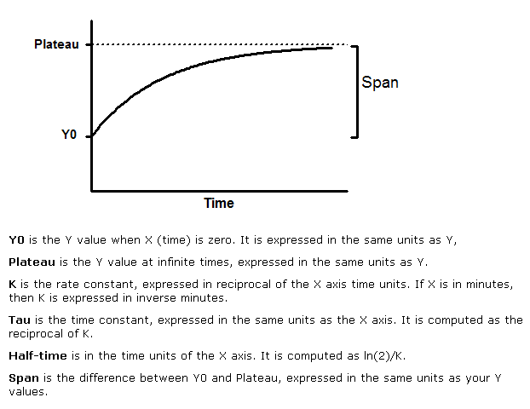
Fig 1: One Phase Association Kinetics
Y=Y0 + (Plateau-Y0)*(1-exp(-K*x))

Slide 11
Prism terms explained
Not Converged: Nonlinear regression works iteratively. Prism starts with initial estimated values for each parameter. It then gradually adjusts these until it converges on the best fit. "Converged" means that any small change in parameter values creates a curve that fits worse (higher sum-of-squares). But in some cases, it simply can't converge on a best fit, and gives up with the message 'not converged'. This happens in two situations:
The model simply doesn't fit the data very well. Perhaps you picked the wrong model, or applied the wrong constraints.
The initial values generated a curve that didn't come close to the points. In that case, Prism may not be able to figure out how to change the parameters to make the curve fit well.
Interrupted: Prism reports 'interrupted' in two situations:
  Nonlinear regression takes more iterations than the maximum entered on the diagnostics tab (the default is 500).
  The fit was slow, and you clicked "Interrupt" on the progress dialog.
Ambiguous: "Ambiguous" is a term coined by GraphPad to describe a fit that doesn't really nail down the values of all the parameters. Changing the value of any parameter will always move the curve further from the data and increase the sum-of-squares. But when the fit is 'ambiguous', changing other parameters can move the curve so it is near the data again. In other words, many combinations of parameter values lead to curves that fit equally well. If the fit is 'ambiguous' you really can't interpret the best-fit values of some parameters.
Prism puts the word 'ambiguous' in the top row of results. For the parameters that are 'ambiguous‘ Prism reports "very wide" for the corresponding confidence intervals.
If your goal is to interpolate unknowns from a standard curve, you won't care that the parameter values are 'ambiguous'. So long as the curve goes through the points, and doesn't wiggle too much, the interpolations will be useful.
If your goal is to learn about your data by inspecting the values of the parameters, then you've got a real problem. At least one of the parameters has a best-fit value that you should not rely upon.
In many cases, the R² will be really high, maybe 0.99. That just means that the curve comes close to the data points. It doesn't mean the data define all the parameters. If the fit is 'ambiguous', you can get an equally well-fitting curve with a different set of values of the parameters.
Reasons for ambiguous fits
Data not collected over a wide enough range of X values
Model too complicated for the data
Model has redundant parameters

Slide 12
Raw data: Trials 1& 2 50ºC assay:
The means of replicates in each trial (columns shaded orange and green respectively) were plotted on Prism to obtain the fitted curve (see following slides).
Blank columns imply that the particular concentrations were not tested in the particular trial.
 | Trial 1 6/18/2013
 | Mins | 2.00 |  |  |  |  | 10.00 |  |  |  |  | 20.00 |  |  |  |  | 100.00 |  |  |  |  | 200.00 |  |  |  |  | 300.00 |  |  |  |  | 400.00 |  |  |  |  | 500.00 |  |  |  |  | 1000.00
 |  | Rep 1 | Rep 2 | Rep 3 | Mean | SE | Rep 1 | Rep 2 | Rep 3 | Mean | SE | Rep 1 | Rep 2 | Rep 3 | Mean | SE | Rep 1 | Rep 2 | Rep 3 | Mean | SE | Rep 1 | Rep 2 | Rep 3 | Mean | SE | Rep 1 | Rep 2 | Rep 3 | Mean | SE | Rep 1 | Rep 2 | Rep 3 | Mean | SE | Rep 1 | Rep 2 | Rep 3 | Mean | SE | Rep 1 | Rep 2 | Rep 3 | Mean | SE
+taq | 10.00 | 6.56 | 9.14 | 9.71 | 8.47 | 1.68 | 7.07 | 10.01 | 10.79 | 9.29 | 1.96 | 8.74 | 11.02 | 11.14 | 10.30 | 1.35 | 9.96 | 11.40 | 12.02 | 11.13 | 1.06 | 9.41 | 10.44 | 12.79 | 10.88 | 1.73 |  |  |  |  |  |  |  |  |  |  | 9.19 | 10.82 | 10.47 | 10.16 | 0.86 | 7.78 | 10.73 | 10.63 | 9.71 | 1.68
 | 8.50 | 7.36 | 9.05 | 9.10 | 8.50 | 0.99 | 9.82 | 8.05 | 9.08 | 8.98 | 0.89 | 10.25 | 9.91 | 9.20 | 9.79 | 0.53 | 11.89 | 11.44 | 10.52 | 11.28 | 0.70 | 11.46 | 12.04 | 11.41 | 11.64 | 0.35 |  |  |  |  |  |  |  |  |  |  | 11.22 | 10.46 | 8.89 | 10.19 | 1.19 | 8.71 | 8.17 | 9.67 | 8.85 | 0.76
 | 6.50 | 6.36 | 9.35 | 9.30 | 8.33 | 1.71 | 8.34 | 10.96 | 9.53 | 9.61 | 1.31 | 8.11 | 10.08 | 9.09 | 9.09 | 0.98 | 8.93 | 11.16 | 11.55 | 10.55 | 1.42 | 8.69 | 10.05 | 9.63 | 9.46 | 0.69 |  |  |  |  |  |  |  |  |  |  | 8.63 | 10.69 | 8.47 | 9.26 | 1.24 | 7.84 | 9.86 | 7.89 | 8.53 | 1.15
 | 5.00 | 7.64 | 8.08 | 8.10 | 7.94 | 0.26 | 8.25 | 8.37 | 8.53 | 8.38 | 0.14 | 8.74 | 8.50 | 9.06 | 8.77 | 0.28 | 10.00 | 9.36 | 10.63 | 10.00 | 0.63 | 10.22 | 10.39 | 10.10 | 10.24 | 0.15 |  |  |  |  |  |  |  |  |  |  | 9.50 | 9.48 | 9.88 | 9.62 | 0.23 | 9.21 | 9.23 | 9.82 | 9.42 | 0.34
 | 3.50 | 6.84 | 9.63 | 9.84 | 8.77 | 1.67 | 7.85 | 10.37 | 9.88 | 9.37 | 1.33 | 8.14 | 10.86 | 9.92 | 9.64 | 1.38 | 9.22 | 11.71 | 11.32 | 10.75 | 1.34 | 8.32 | 10.96 | 11.78 | 10.35 | 1.81 |  |  |  |  |  |  |  |  |  |  | 8.63 | 10.90 | 11.07 | 10.20 | 1.37 | 9.07 | 11.02 | 10.96 | 10.35 | 1.11
 | 2.00 | 7.91 | 8.19 | 8.32 | 8.14 | 0.21 | 8.66 | 8.93 | 7.98 | 8.53 | 0.49 | 8.85 | 8.84 | 8.93 | 8.87 | 0.05 | 9.83 | 9.39 | 10.00 | 9.74 | 0.31 | 10.32 | 9.33 | 10.08 | 9.91 | 0.52 |  |  |  |  |  |  |  |  |  |  | 10.16 | 10.06 | 9.02 | 9.75 | 0.63 | 9.40 | 10.07 | 9.89 | 9.79 | 0.35
 | 1.00 | 6.54 | 8.88 | 8.95 | 8.12 | 1.37 | 6.93 | 8.41 | 9.27 | 8.20 | 1.18 | 7.20 | 9.75 | 9.48 | 8.81 | 1.40 | 8.35 | 10.05 | 8.77 | 9.06 | 0.89 | 7.37 | 9.91 | 10.21 | 9.16 | 1.56 |  |  |  |  |  |  |  |  |  |  | 7.23 | 10.07 | 10.99 | 9.43 | 1.96 | 8.17 | 10.06 | 9.64 | 9.29 | 0.99
 | 0.83 | 7.55 | 7.22 | 7.93 | 7.57 | 0.36 | 7.89 | 8.57 | 6.37 | 7.61 | 1.12 | 8.31 | 8.60 | 7.80 | 8.24 | 0.41 | 7.64 | 8.97 | 9.53 | 8.72 | 0.97 | 8.66 | 8.41 | 9.52 | 8.86 | 0.58 |  |  |  |  |  |  |  |  |  |  | 9.54 | 9.07 | 7.63 | 8.75 | 1.00 | 8.94 | 6.15 | 9.08 | 8.06 | 1.65
 | 0.66 | 7.27 | 10.27 | 9.92 | 9.15 | 1.64 | 8.14 | 10.10 | 8.92 | 9.05 | 0.99 | 7.97 | 10.97 | 8.41 | 9.12 | 1.62 | 8.93 | 10.96 | 10.77 | 10.22 | 1.12 | 8.80 | 10.59 | 11.48 | 10.29 | 1.37 |  |  |  |  |  |  |  |  |  |  | 9.06 | 11.00 | 10.82 | 10.29 | 1.07 | 8.32 | 8.50 | 11.02 | 9.28 | 1.51
 | 0.50 | 8.31 | 8.80 | 8.30 | 8.47 | 0.28 | 8.69 | 8.43 | 8.67 | 8.60 | 0.15 | 8.45 | 8.84 | 9.13 | 8.81 | 0.34 | 9.00 | 9.21 | 9.96 | 9.39 | 0.50 | 9.57 | 9.30 | 10.04 | 9.64 | 0.37 |  |  |  |  |  |  |  |  |  |  | 9.81 | 10.14 | 10.31 | 10.09 | 0.26 | 9.41 | 8.70 | 9.98 | 9.36 | 0.64
 | 0.33 | 6.98 | 8.90 | 9.38 | 8.42 | 1.27 | 8.26 | 10.56 | 10.23 | 9.68 | 1.24 | 7.96 | 10.91 | 10.41 | 9.76 | 1.58 | 9.27 | 11.37 | 11.13 | 10.59 | 1.15 | 8.96 | 11.53 | 11.93 | 10.81 | 1.61 |  |  |  |  |  |  |  |  |  |  | 8.92 | 10.23 | 11.61 | 10.25 | 1.34 | 9.39 | 10.71 | 10.60 | 10.23 | 0.73
 | 0.00 | 8.79 | 8.82 | 8.32 | 8.64 | 0.28 | 8.97 | 9.09 | 8.71 | 8.92 | 0.20 | 9.61 | 9.36 | 8.86 | 9.28 | 0.38 | 9.73 | 10.21 | 10.05 | 10.00 | 0.24 | 11.14 | 10.08 | 10.34 | 10.52 | 0.55 |  |  |  |  |  |  |  |  |  |  | 11.60 | 8.79 | 9.18 | 9.86 | 1.52 | 9.89 | 9.55 | 7.77 | 9.07 | 1.14
 | 10.00 | 7.77 | 8.19 | 7.48 | 7.81 | 0.36 | 9.44 | 8.21 | 9.75 | 9.13 | 0.81 | 10.05 | 10.24 | 10.21 | 10.17 | 0.10 | 9.81 | 10.38 | 10.82 | 10.34 | 0.50 | 10.11 | 9.53 | 10.69 | 10.11 | 0.58 |  |  |  |  |  |  |  |  |  |  | 10.14 | 11.27 | 10.47 | 10.63 | 0.58 | 9.40 | 10.22 | 10.45 | 10.02 | 0.55
 | 5.00 | 6.42 | 6.79 | 7.32 | 6.84 | 0.45 | 7.57 | 8.10 | 8.09 | 7.92 | 0.30 | 7.06 | 8.42 | 8.26 | 7.91 | 0.75 | 8.06 | 8.18 | 8.79 | 8.34 | 0.39 | 7.94 | 7.32 | 7.06 | 7.44 | 0.45 |  |  |  |  |  |  |  |  |  |  | 8.21 | 8.41 | 11.92 | 9.51 | 2.09 | 7.41 | 7.91 | 8.59 | 7.97 | 0.60
-taq | 0.00 | 7.82 | 8.57 | 7.70 | 8.03 | 0.47 | 7.70 | 9.01 | 9.38 | 8.70 | 0.88 | 8.40 | 9.07 | 9.08 | 8.85 | 0.39 | 7.42 | 8.68 | 9.26 | 8.45 | 0.94 | 10.39 | 9.11 | 9.01 | 9.50 | 0.77 |  |  |  |  |  |  |  |  |  |  | 9.70 | 6.93 | 9.15 | 8.59 | 1.47 | 8.24 | 9.27 | 9.42 | 8.98 | 0.64
 | Trial 2 6/25/2013
 | Mins | 2.00 |  |  |  |  | 10.00 |  |  |  |  | 20.00 |  |  |  |  | 100.00 |  |  |  |  | 200.00 |  |  |  |  | 300.00 |  |  |  |  | 400.00 |  |  |  |  | 500.00 |  |  |  |  | 1000.00
 |  | Rep 1 | Rep 2 | Rep 3 | Mean | SE | Rep 1 | Rep 2 | Rep 3 | Mean | SE | Rep 1 | Rep 2 | Rep 3 | Mean | SE | Rep 1 | Rep 2 | Rep 3 | Mean | SE | Rep 1 | Rep 2 | Rep 3 | Mean | SE | Rep 1 | Rep 2 | Rep 3 | Mean | SE | Rep 1 | Rep 2 | Rep 3 | Mean | SE | Rep 1 | Rep 2 | Rep 3 | Mean | SE | Rep 1 | Rep 2 | Rep 3 | Mean | SE
+taq | 10.00 | 7.67 | 8.00 | 8.85 | 8.17 | 0.61 | 9.11 | 10.04 | 10.43 | 9.86 | 0.68 | 9.12 | 11.09 | 10.75 | 10.32 | 1.05 | 9.76 | 12.43 | 11.62 | 11.27 | 1.37 | 10.93 | 12.67 | 12.13 | 11.91 | 0.89 | 9.92 | 11.97 | 13.20 | 11.70 | 1.66 | 10.68 | 10.53 | 9.72 | 10.31 | 0.52 | 10.68 | 10.42 | 11.16 | 10.75 | 0.38
 | 8.50 | 8.87 | 8.91 | 8.59 | 8.79 | 0.17 | 9.31 | 9.54 | 9.16 | 9.33 | 0.19 | 9.81 | 10.46 | 9.46 | 9.91 | 0.51 | 10.76 | 10.42 | 11.49 | 10.89 | 0.55 | 11.83 | 11.65 | 11.43 | 11.64 | 0.20 | 12.78 | 11.38 | 11.62 | 11.93 | 0.75 | 11.62 | 11.03 | 11.34 | 11.33 | 0.30 | 11.25 | 9.75 | 11.72 | 10.91 | 1.03
 | 6.50 | 7.24 | 9.80 | 9.70 | 8.91 | 1.45 | 9.06 | 10.39 | 10.35 | 9.93 | 0.76 | 9.05 | 10.42 | 11.59 | 10.35 | 1.27 | 9.77 | 11.85 | 12.50 | 11.37 | 1.42 | 9.79 | 12.13 | 12.12 | 11.35 | 1.35 | 8.69 | 12.36 | 12.83 | 11.29 | 2.27 | 9.28 | 12.05 | 12.47 | 11.27 | 1.73 | 9.67 | 11.68 | 12.03 | 11.13 | 1.27
 | 5.00 | 7.74 | 8.12 | 6.38 | 7.42 | 0.91 | 8.85 | 8.18 | 8.79 | 8.60 | 0.37 | 9.22 | 9.00 | 9.79 | 9.34 | 0.41 | 9.52 | 10.06 | 10.10 | 9.89 | 0.32 | 10.25 | 10.66 | 10.67 | 10.53 | 0.24 | 11.06 | 11.07 | 11.09 | 11.07 | 0.02 | 8.98 | 10.34 | 11.90 | 10.41 | 1.46 | 10.45 | 10.25 | 11.29 | 10.66 | 0.55
 | 3.50 | 7.21 | 7.84 | 8.89 | 7.98 | 0.85 | 7.70 | 9.64 | 9.42 | 8.92 | 1.06 | 7.62 | 9.61 | 9.69 | 8.97 | 1.17 | 7.91 | 10.68 | 10.35 | 9.65 | 1.51 | 8.61 | 10.06 | 10.42 | 9.70 | 0.96 | 8.18 | 10.76 | 10.48 | 9.81 | 1.41 | 8.71 | 10.16 | 11.03 | 9.97 | 1.17 | 9.21 | 8.94 | 10.90 | 9.68 | 1.06
 | 2.00 | 8.19 | 8.76 | 8.07 | 8.34 | 0.37 | 8.52 | 8.64 | 7.88 | 8.34 | 0.41 | 8.86 | 7.88 | 9.26 | 8.67 | 0.71 | 9.39 | 9.80 | 9.80 | 9.66 | 0.24 | 10.31 | 9.70 | 9.68 | 9.90 | 0.36 | 10.34 | 10.19 | 10.44 | 10.32 | 0.13 | 10.63 | 8.78 | 10.96 | 10.12 | 1.17 | 11.19 | 8.71 | 9.22 | 9.71 | 1.31
 | 1.00 | 7.70 | 9.22 | 9.33 | 8.75 | 0.91 | 8.25 | 10.12 | 10.10 | 9.49 | 1.07 | 8.60 | 10.54 | 10.36 | 9.83 | 1.07 | 8.96 | 10.41 | 10.38 | 9.92 | 0.83 | 8.76 | 9.80 | 9.97 | 9.51 | 0.66 | 9.15 | 10.73 | 10.98 | 10.29 | 0.99 | 9.76 | 10.20 | 11.23 | 10.40 | 0.75 | 10.16 | 9.37 | 10.37 | 9.97 | 0.53
 | 0.83 | 8.01 | 8.28 | 7.85 | 8.05 | 0.22 | 8.74 | 8.81 | 8.81 | 8.79 | 0.04 | 8.91 | 9.48 | 9.21 | 9.20 | 0.28 | 9.45 | 9.91 | 10.37 | 9.91 | 0.46 | 10.10 | 9.91 | 9.82 | 9.94 | 0.14 | 10.62 | 10.29 | 10.32 | 10.41 | 0.18 | 10.17 | 10.07 | 10.50 | 10.25 | 0.23 | 10.65 | 9.96 | 9.83 | 10.15 | 0.44
 | 0.66 | 7.76 | 9.95 | 9.36 | 9.02 | 1.13 | 8.29 | 10.67 | 10.30 | 9.75 | 1.28 | 8.31 | 10.39 | 10.00 | 9.57 | 1.10 | 8.46 | 10.95 | 11.22 | 10.21 | 1.52 | 9.15 | 11.94 | 10.33 | 10.47 | 1.40 | 9.70 | 11.53 | 11.30 | 10.84 | 1.00 | 9.51 | 10.98 | 10.98 | 10.49 | 0.85 | 8.10 | 11.47 | 11.35 | 10.31 | 1.91
 | 0.50 | 8.02 | 8.44 | 7.78 | 8.08 | 0.33 | 8.56 | 8.13 | 7.61 | 8.10 | 0.47 | 8.95 | 8.30 | 8.57 | 8.61 | 0.32 | 9.29 | 9.51 | 9.70 | 9.50 | 0.20 | 9.80 | 9.53 | 9.50 | 9.61 | 0.17 | 9.75 | 10.25 | 10.10 | 10.03 | 0.26 | 9.48 | 9.50 | 10.12 | 9.70 | 0.36 | 10.32 | 9.78 | 10.37 | 10.16 | 0.33
 | 0.33 | 7.72 | 9.58 | 6.73 | 8.01 | 1.45 | 5.99 | 10.80 | 10.06 | 8.95 | 2.59 | 7.60 | 11.03 | 9.90 | 9.51 | 1.75 | 8.29 | 11.33 | 11.37 | 10.33 | 1.77 | 8.80 | 10.57 | 11.19 | 10.19 | 1.24 | 9.06 | 12.12 | 10.83 | 10.67 | 1.54 | 9.45 | 8.84 | 11.08 | 9.79 | 1.16 | 9.02 | 10.76 | 9.96 | 9.91 | 0.87
 | 0.00 | 7.93 | 9.10 | 7.24 | 8.09 | 0.94 | 8.85 | 9.23 | 8.57 | 8.88 | 0.33 | 9.45 | 9.06 | 8.18 | 8.90 | 0.65 | 9.84 | 9.62 | 10.30 | 9.92 | 0.35 | 10.42 | 10.27 | 9.81 | 10.17 | 0.32 | 10.53 | 10.15 | 10.27 | 10.32 | 0.19 | 10.10 | 8.90 | 10.63 | 9.88 | 0.89 | 10.64 | 8.97 | 11.29 | 10.30 | 1.20
-taq | 10.00 | 6.70 | 8.39 | 9.03 | 8.04 | 1.21 | 8.97 | 9.41 | 10.67 | 9.68 | 0.88 | 9.43 | 9.92 | 9.87 | 9.74 | 0.27 | 10.54 | 10.71 | 10.96 | 10.74 | 0.21 | 10.18 | 10.76 | 8.72 | 9.89 | 1.05 | 10.19 | 11.36 | 12.70 | 11.42 | 1.26 | 7.61 | 10.27 | 10.74 | 9.54 | 1.69 | 9.39 | 9.90 | 10.36 | 9.88 | 0.48
 | 5.00 | 8.03 | 8.90 | 8.28 | 8.41 | 0.45 | 8.62 | 9.30 | 8.82 | 8.92 | 0.35 | 8.51 | 9.76 | 8.81 | 9.03 | 0.65 | 8.11 | 8.36 | 9.99 | 8.82 | 1.02 | 8.24 | 8.72 | 10.50 | 9.16 | 1.19 | 9.48 | 11.22 | 11.05 | 10.58 | 0.96 | 9.32 | 9.14 | 10.53 | 9.66 | 0.76 | 9.50 | 10.81 | 9.32 | 9.88 | 0.81
 | 0.00 | 7.83 | 8.37 | 7.65 | 7.95 | 0.38 | 8.95 | 9.10 | 9.55 | 9.20 | 0.31 | 8.83 | 9.38 | 9.30 | 9.17 | 0.30 | 8.45 | 9.51 | 10.21 | 9.39 | 0.88 | 8.31 | 10.03 | 9.04 | 9.13 | 0.86 | 8.20 | 10.25 | 10.37 | 9.61 | 1.22 | 10.22 | 10.31 | 11.07 | 10.53 | 0.47 | 9.33 | 10.65 | 10.02 | 10.00 | 0.66

Slide 13
Mean of 2 trials: 50ºC assay
In each of the plots in following slides, data has been plotted with either the 0min RFU_{+taq} (colored line) or the 0min RFU_{-taq} (black dashed line).
In general, the 0min RFU_{-taq} might be a more reliable 0min value since experimental limitations result in even the 0min reaction actually being incubated at assay temperature for ~2-4secs resulting in likely erroneous RFUs, when Taq is present in the reaction. Early time point (20secs-1min) are also not accurate due to experimental set up limitation and probably need to be excluded for curve fitting.
For each dNTP conc, the black dashed line (using 0min_{-taq}) also has the early time points excluded. Corrected RFU values from this fitted curve have been used to calculate initial rate as dRFU/dT (see highlighted column).
 |  | 2.00 |  |  |  | 10.00 |  |  |  | 20.00 |  |  |  | 100.00 |  |  |  | 200.00 |  |  |  | 300.00 |  |  |  | 400.00 |  |  |  | 500.00 |  |  |  | 1000.00
 | Mins | Mean 1 | Mean 2 | Mean of 2 trials | SE | Mean 1 | Mean 2 | Mean of 2 trials | SE | Mean 1 | Mean 2 | Mean of 2 trials | SE | Mean 1 | Mean 2 | Mean of 2 trials | SE | Mean 1 | Mean 2 | Mean of 2 trials | SE | Mean 1 | Mean 2 | Mean of 2 trials | SE | Mean 1 | Mean 2 | Mean of 2 trials | SE | Mean 1 | Mean 2 | Mean of 2 trials | SE | Mean 1 | Mean 2 | Mean of 2 trials | SE
+taq | 10.00 | 8.47 | 8.17 | 8.32 | 0.210 | 9.29 | 9.861 | 9.58 | 0.404 | 10.30 | 10.32 | 10.31 | 0.015 | 11.13 | 11.27 | 11.20 | 0.100 | 10.88 | 11.91 | 11.40 | 0.728 |  | 11.70 | 11.70 |  |  | 10.31 | 10.31 |  | 10.16 | 10.75 | 10.46 | 0.420 | 9.71 |  | 9.71
 | 8.50 | 8.50 | 8.79 | 8.65 | 0.203 | 8.98 | 9.335 | 9.16 | 0.250 | 9.79 | 9.91 | 9.85 | 0.087 | 11.28 | 10.89 | 11.09 | 0.278 | 11.64 | 11.64 | 11.64 | 0.000 |  | 11.93 | 11.93 |  |  | 11.33 | 11.33 |  | 10.19 | 10.91 | 10.55 | 0.508 | 8.85 |  | 8.85
 | 6.50 | 8.33 | 8.91 | 8.62 | 0.410 | 9.61 | 9.932 | 9.77 | 0.228 | 9.09 | 10.35 | 9.72 | 0.891 | 10.55 | 11.37 | 10.96 | 0.586 | 9.46 | 11.35 | 10.40 | 1.337 |  | 11.29 | 11.29 |  |  | 11.27 | 11.27 |  | 9.26 | 11.13 | 10.20 | 1.318 | 8.53 |  | 8.53
 | 5.00 | 7.94 | 7.42 | 7.68 | 0.371 | 8.38 | 8.605 | 8.49 | 0.157 | 8.77 | 9.34 | 9.05 | 0.402 | 10.00 | 9.89 | 9.95 | 0.073 | 10.24 | 10.53 | 10.38 | 0.205 |  | 11.07 | 11.07 |  |  | 10.41 | 10.41 |  | 9.62 | 10.66 | 10.14 | 0.740 | 9.42 |  | 9.42
 | 3.50 | 8.77 | 7.98 | 8.37 | 0.559 | 9.37 | 8.920 | 9.14 | 0.316 | 9.64 | 8.97 | 9.31 | 0.472 | 10.75 | 9.65 | 10.20 | 0.781 | 10.35 | 9.70 | 10.02 | 0.466 |  | 9.81 | 9.81 |  |  | 9.97 | 9.97 |  | 10.20 | 9.68 | 9.94 | 0.364 | 10.35 |  | 10.35
 | 2.00 | 8.14 | 8.34 | 8.24 | 0.141 | 8.53 | 8.345 | 8.43 | 0.128 | 8.87 | 8.67 | 8.77 | 0.145 | 9.74 | 9.66 | 9.70 | 0.055 | 9.91 | 9.90 | 9.90 | 0.009 |  | 10.32 | 10.32 |  |  | 10.12 | 10.12 |  | 9.75 | 9.71 | 9.73 | 0.029 | 9.79 |  | 9.79
 | 1.00 | 8.12 | 8.75 | 8.44 | 0.443 | 8.20 | 9.491 | 8.85 | 0.912 | 8.81 | 9.83 | 9.32 | 0.725 | 9.06 | 9.92 | 9.49 | 0.608 | 9.16 | 9.51 | 9.34 | 0.244 |  | 10.29 | 10.29 |  |  | 10.40 | 10.40 |  | 9.43 | 9.97 | 9.70 | 0.378 | 9.29 |  | 9.29
 | 0.83 | 7.57 | 8.05 | 7.81 | 0.338 | 7.61 | 8.786 | 8.20 | 0.831 | 8.24 | 9.20 | 8.72 | 0.681 | 8.72 | 9.91 | 9.31 | 0.844 | 8.86 | 9.94 | 9.40 | 0.764 |  | 10.41 | 10.41 |  |  | 10.25 | 10.25 |  | 8.75 | 10.15 | 9.45 | 0.989 | 8.06 |  | 8.06
 | 0.66 | 9.15 | 9.02 | 9.09 | 0.091 | 9.05 | 9.752 | 9.40 | 0.494 | 9.12 | 9.57 | 9.34 | 0.317 | 10.22 | 10.21 | 10.21 | 0.006 | 10.29 | 10.47 | 10.38 | 0.131 |  | 10.84 | 10.84 |  |  | 10.49 | 10.49 |  | 10.29 | 10.31 | 10.30 | 0.011 | 9.28 |  | 9.28
 | 0.50 | 8.47 | 8.08 | 8.27 | 0.275 | 8.60 | 8.101 | 8.35 | 0.350 | 8.81 | 8.61 | 8.71 | 0.140 | 9.39 | 9.50 | 9.44 | 0.078 | 9.64 | 9.61 | 9.62 | 0.021 |  | 10.03 | 10.03 |  |  | 9.70 | 9.70 |  | 10.09 | 10.16 | 10.12 | 0.051 | 9.36 |  | 9.36
 | 0.33 | 8.42 | 8.01 | 8.22 | 0.289 | 9.68 | 8.951 | 9.32 | 0.518 | 9.76 | 9.51 | 9.63 | 0.178 | 10.59 | 10.33 | 10.46 | 0.185 | 10.81 | 10.19 | 10.50 | 0.440 |  | 10.67 | 10.67 |  |  | 9.79 | 9.79 |  | 10.25 | 9.91 | 10.08 | 0.241 | 10.23 |  | 10.23
 | 0.00 | 8.64 | 8.09 | 8.37 | 0.390 | 8.92 | 8.884 | 8.90 | 0.027 | 9.28 | 8.90 | 9.09 | 0.271 | 10.00 | 9.92 | 9.96 | 0.054 | 10.52 | 10.17 | 10.34 | 0.249 |  | 10.32 | 10.32 |  |  | 9.88 | 9.88 |  | 9.86 | 10.30 | 10.08 | 0.313 | 9.07 |  | 9.07
-taq | 0.00 | 8.03 | 7.95 | 7.99 | 0.057 | 8.70 | 9.203 | 8.95 | 0.357 | 8.85 | 9.17 | 9.01 | 0.225 | 8.45 | 9.39 | 8.92 | 0.663 | 9.50 | 9.13 | 9.32 | 0.265 |  | 9.61 | 9.61 |  |  | 10.53 | 10.53 |  | 8.59 | 10.00 | 9.30 | 0.997 | 8.98 |  | 8.98

Slide 14
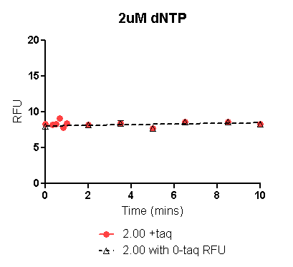
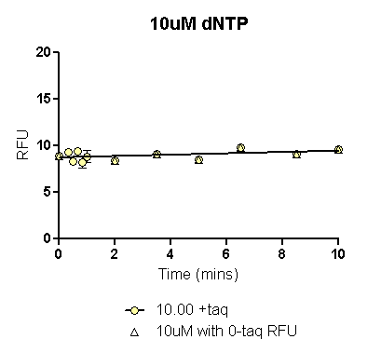
 | 2uM dNTP with 0_{+taq} RFU | 2uM dNTP with 0_{-taq} RFU
One-phase association | Not Converged*
R square |  | 0.1454
*: Nonlinear regression works iteratively. Prism starts with initial estimated values for each parameter. It then gradually adjusts these until it converges on the best fit. "Converged" means that any small change in parameter values creates a curve that fits worse (higher sum-of-squares). But in some cases, it simply cannot converge on a best fit.
 | 2uM dNTP with 0_{+taq} |  | 2uM dNTP with 0_{-taq}
Mins | RFU | dRFU/ dT | RFU | dRFU/ dT
0.000 |  |  | 8.027
0.067 |  | 0.000 | 8.030 | 0.053
0.134 |  | 0.000 | 8.034 | 0.053
0.201 |  | 0.000 | 8.037 | 0.053
 | 10uM dNTP with 0_{+taq} RFU | 10uM dNTP with 0_{-taq} RFU
One-phase association | Interrupted* | Interrupted
*: Nonlinear regression takes more iterations than the maximum entered on the diagnostics tab (1000). Software is unable to calculate an R square value
 | 10uM dNTP with 0_{+taq} |  | 10uM dNTP with 0_{-taq}
Mins | RFU | dRFU/ dT | RFU | dRFU/ dT
0.000 | 8.734 |  | 8.656
0.067 | 8.739 | 0.072 | 8.662 | 0.083
0.134 | 8.744 | 0.072 | 8.668 | 0.083
0.201 | 8.749 | 0.072 | 8.673 | 0.083

Slide 15
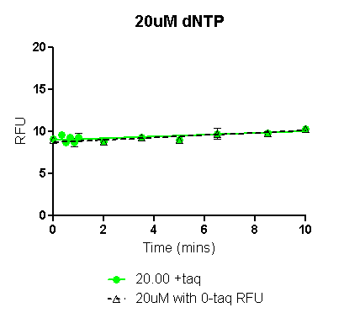
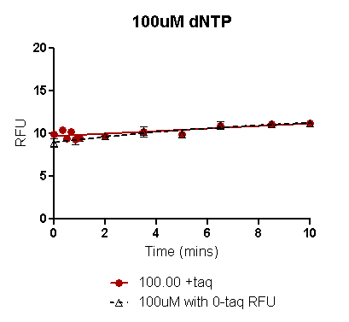
 | 20uM dNTP with 0_{+taq} RFU | 20uM dNTP with 0_{-taq} RFU
One-phase association | Interrupted | Ambiguous*
R square |  | 0.6068
*: "Ambiguous" is a term coined by GraphPad to describe a fit that doesn't really nail down the values of all the parameters. If the fit is 'ambiguous' you really can't interpret the best-fit values of some parameters.
 | 20uM dNTP with 0_{+taq} |  | 20uM dNTP with 0_{-taq}
Mins | RFU | dRFU/ dT | RFU | dRFU/ dT
0.000 | 8.981 |  | 8.723
0.067 | 8.988 | 0.105 | 8.733 | 0.140
0.134 | 8.995 | 0.105 | 8.742 | 0.140
0.201 | 9.002 | 0.105 | 8.751 | 0.140
 | 100uM dNTP with 0_{+taq} RFU | 100uM dNTP with 0_{-taq} RFU
One-phase association | Ambiguous
R square | 0.5184 | 0.7906
 | 100uM dNTP with 0_{+taq} |  | 100uM dNTP with 0_{-taq}
Mins | RFU | dRFU/ dT | RFU | dRFU/ dT
0.000 | 9.681 |  | 8.956
0.067 | 9.691 | 0.150 | 8.981 | 0.369
0.134 | 9.701 | 0.150 | 9.005 | 0.366
0.201 | 9.711 | 0.150 | 9.030 | 0.363

Slide 16
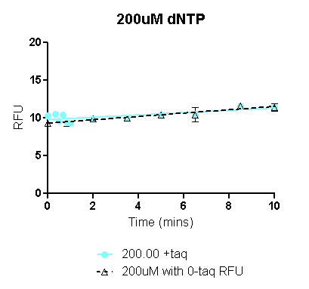
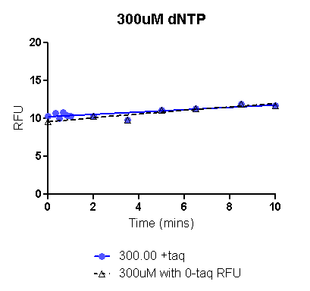
 | 200uM dNTP with 0_{+taq} RFU | 200uM dNTP with 0_{-taq} RFU
One-phase association | Ambiguous | Ambiguous
R square | 0.4429 | 0.6884
 | 200uM dNTP with 0_{+taq} |  | 200M dNTP with 0_{-taq}
Mins | RFU | dRFU/ dT | RFU | dRFU/ dT
0.000 | 9.776 |  | 9.315
0.067 | 9.786 | 0.155 | 9.330 | 0.222
0.134 | 9.797 | 0.155 | 9.345 | 0.222
0.201 | 9.807 | 0.155 | 9.359 | 0.222
 | 300uM dNTP with 0_{+taq} RFU | 300uM dNTP with 0_{-taq} RFU
One-phase association | Ambiguous
R square | 0.6580 | 0.8589
 | 500uM dNTP with 0_{+taq} |  | 500uM dNTP with 0_{-taq}
Mins | RFU | dRFU/ dT | RFU | dRFU/ dT
0.000 | 10.224 |  | 9.558
0.067 | 10.235 | 0.154 | 9.577 | 0.274
0.134 | 10.245 | 0.154 | 9.595 | 0.273
0.201 | 10.256 | 0.154 | 9.614 | 0.273

Slide 17
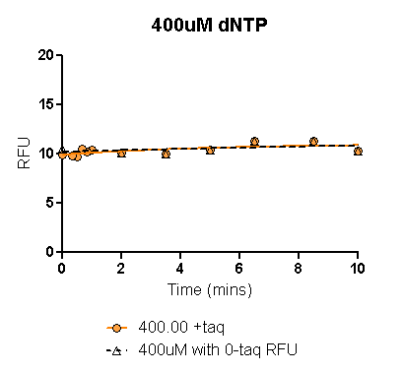
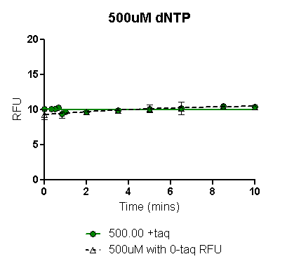
 | 400uM dNTP with 0_{+taq} RFU | 400uM dNTP with 0_{-taq} RFU
One-phase association
R square | 0.4517 | 0.1824
 | 200uM dNTP with 0_{+taq} |  | 200M dNTP with 0_{-taq}
Mins | RFU | dRFU/ dT | RFU | dRFU/ dT
0.000 | 9.918 |  | 10.221
0.067 | 9.933 | 0.211 | 10.227 | 0.075
0.134 | 9.947 | 0.209 | 10.232 | 0.075
0.201 | 9.960 | 0.206 | 10.237 | 0.074
 | 500uM dNTP with 0_{+taq} RFU | 500uM dNTP with 0_{-taq} RFU
One-phase association
R square | 0.0001910 | 0.3608
 | 500uM dNTP with 0_{+taq} |  | 500uM dNTP with 0_{-taq}
Mins | RFU | dRFU/ dT | RFU | dRFU/ dT
0.000 | 10.085 |  | 9.301
0.067 | 10.077 | -0.116 | 9.317 | 0.237
0.134 | 10.072 | -0.082 | 9.332 | 0.235
0.201 | 10.068 | -0.057 | 9.348 | 0.232

Slide 18
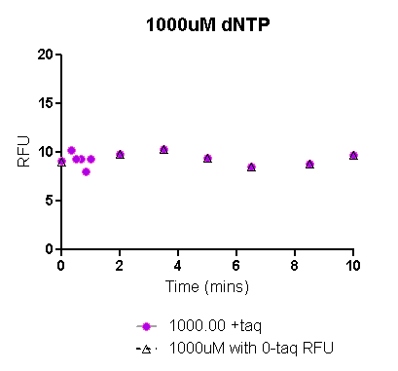
 | 500uM dNTP with 0_{+taq} RFU | 500uM dNTP with 0_{-taq} RFU
One-phase association | Not Converged | Not Converged
 | 500uM dNTP with 0_{+taq} |  | 500uM dNTP with 0_{-taq}
Mins | RFU | dRFU/ dT | RFU | dRFU/ dT
0.000
0.067
0.134
0.201

Slide 19
Raw data: Trials 1& 2 55ºC assay:
The means of replicates in each trial (columns shaded orange and green respectively) were plotted on Prism to obtain the fitted curve (see following slides).
 | Trial 1 7/6/2013
 | Mins | 2.00 |  |  |  |  | 10.00 |  |  |  |  | 20.00 |  |  |  |  | 100.00 |  |  |  |  | 200.00 |  |  |  |  | 300.00 |  |  |  |  | 400.00 |  |  |  |  | 500.00
 |  | Rep 1 | Rep 2 | Rep 3 | Mean | SE | Rep 1 | Rep 2 | Rep 3 | Mean | SE | Rep 1 | Rep 2 | Rep 3 | Mean | SE | Rep 1 | Rep 2 | Rep 3 | Mean | SE | Rep 1 | Rep 2 | Rep 3 | Mean | SE | Rep 1 | Rep 2 | Rep 3 | Mean | SE | Rep 1 | Rep 2 | Rep 3 | Mean | SE | Rep 1 | Rep 2 | Rep 3 | Mean | SE
+taq | 10.00 | 5.72 | 6.80 | 6.82 | 6.44 | 0.63 | 6.64 | 7.46 | 7.61 | 7.24 | 0.52 | 7.15 | 8.99 | 8.07 | 8.07 | 0.92 | 9.35 | 10.50 | 10.54 | 10.13 | 0.67 | 8.95 | 11.08 | 11.47 | 10.50 | 1.36 | 9.45 | 11.39 | 11.65 | 10.83 | 1.20 | 9.23 | 10.12 | 10.36 | 9.90 | 0.60 | 8.23 | 8.53 | 6.93 | 7.90 | 0.85
 | 8.50 | 5.13 | 6.18 | 5.13 | 5.48 | 0.61 | 6.43 | 6.60 | 5.81 | 6.28 | 0.42 | 6.76 | 7.65 | 7.22 | 7.21 | 0.45 | 8.33 | 8.60 | 8.06 | 8.33 | 0.27 | 9.26 | 9.00 | 8.93 | 9.06 | 0.17 | 9.61 | 7.86 | 8.72 | 8.73 | 0.88 | 7.28 | 8.49 | 8.44 | 8.07 | 0.69 | 8.39 | 7.28 | 6.85 | 7.51 | 0.80
 | 6.50 | 4.11 | 6.90 | 6.92 | 5.98 | 1.62 | 5.17 | 7.84 | 7.37 | 6.79 | 1.42 | 6.05 | 8.44 | 7.15 | 7.21 | 1.20 | 7.25 | 8.98 | 8.82 | 8.35 | 0.96 | 7.48 | 9.25 | 10.19 | 8.97 | 1.38 | 6.65 | 10.53 | 9.45 | 8.88 | 2.00 | 7.05 | 9.27 | 9.75 | 8.69 | 1.44 | 6.62 | 6.99 | 8.10 | 7.24 | 0.77
 | 5.00 | 5.75 | 6.18 | 6.39 | 6.10 | 0.33 | 7.33 | 6.77 | 6.98 | 7.03 | 0.28 | 6.66 | 7.31 | 7.18 | 7.05 | 0.34 | 8.86 | 8.06 | 8.70 | 8.54 | 0.42 | 9.39 | 8.03 | 8.86 | 8.76 | 0.69 | 9.60 | 8.10 | 9.00 | 8.90 | 0.75 | 6.89 | 7.59 | 8.26 | 7.58 | 0.68 | 7.98 | 6.75 | 7.32 | 7.35 | 0.61
 | 3.50 | 5.29 | 5.90 | 5.87 | 5.69 | 0.34 | 5.03 | 7.23 | 7.08 | 6.45 | 1.23 | 5.52 | 8.05 | 7.57 | 7.05 | 1.34 | 6.53 | 9.19 | 8.37 | 8.03 | 1.36 | 5.74 | 8.26 | 9.09 | 7.70 | 1.75 | 5.77 | 9.46 | 9.06 | 8.10 | 2.02 | 7.16 | 7.77 | 6.84 | 7.25 | 0.47 | 7.16 | 8.26 | 7.83 | 7.75 | 0.55
 | 2.00 | 5.68 | 6.02 | 5.78 | 5.83 | 0.17 | 5.96 | 5.77 | 6.22 | 5.98 | 0.23 | 6.19 | 6.36 | 6.19 | 6.25 | 0.10 | 6.64 | 7.40 | 6.71 | 6.92 | 0.42 | 7.61 | 7.52 | 7.29 | 7.47 | 0.16 | 8.15 | 6.75 | 6.03 | 6.97 | 1.08 | 5.99 | 7.19 | 7.62 | 6.93 | 0.84 | 7.60 | 6.11 | 7.74 | 7.15 | 0.90
 | 1.00 | 4.55 | 7.16 | 6.47 | 6.06 | 1.36 | 4.73 | 7.41 | 7.06 | 6.40 | 1.45 | 5.30 | 7.46 | 7.16 | 6.64 | 1.17 | 5.89 | 7.45 | 8.30 | 7.22 | 1.22 | 5.89 | 7.81 | 7.61 | 7.10 | 1.05 | 5.42 | 8.28 | 7.95 | 7.22 | 1.57 | 5.64 | 7.00 | 8.26 | 6.97 | 1.31 | 6.46 | 7.67 | 8.02 | 7.38 | 0.82
 | 0.83 | 5.51 | 6.09 | 5.97 | 5.85 | 0.31 | 6.21 | 6.15 | 4.91 | 5.76 | 0.74 | 6.20 | 6.13 | 4.98 | 5.77 | 0.69 | 7.36 | 6.68 | 7.39 | 7.14 | 0.40 | 7.24 | 6.95 | 7.20 | 7.13 | 0.15 | 7.23 | 7.34 | 7.33 | 7.30 | 0.06 | 6.15 | 6.90 | 7.25 | 6.76 | 0.56 | 7.35 | 6.77 | 7.70 | 7.27 | 0.47
 | 0.66 | 5.48 | 6.55 | 6.53 | 6.18 | 0.61 | 5.91 | 7.34 | 6.28 | 6.51 | 0.74 | 5.50 | 7.37 | 6.66 | 6.51 | 0.94 | 5.65 | 7.73 | 8.03 | 7.14 | 1.29 | 4.89 | 7.14 | 7.73 | 6.59 | 1.50 | 4.47 | 9.05 | 8.00 | 7.17 | 2.40 | 5.03 | 7.63 | 7.54 | 6.73 | 1.47 | 5.54 | 7.30 | 8.01 | 6.95 | 1.27
 | 0.50 | 5.91 | 5.89 | 5.93 | 5.91 | 0.02 | 6.03 | 6.29 | 6.00 | 6.11 | 0.16 | 6.27 | 6.17 | 6.19 | 6.21 | 0.05 | 7.14 | 6.76 | 6.95 | 6.95 | 0.19 | 5.92 | 7.03 | 7.00 | 6.65 | 0.63 | 7.20 | 7.05 | 7.12 | 7.12 | 0.07 | 6.66 | 6.99 | 7.40 | 7.02 | 0.37 | 7.51 | 5.72 | 6.68 | 6.64 | 0.90
 | 0.33 | 5.29 | 6.61 | 6.90 | 6.27 | 0.86 | 5.15 | 7.66 | 7.60 | 6.80 | 1.43 | 5.31 | 7.41 | 6.80 | 6.51 | 1.08 | 5.80 | 7.92 | 8.39 | 7.37 | 1.38 | 5.66 | 7.00 | 8.08 | 6.92 | 1.21 | 6.01 | 8.25 | 7.87 | 7.38 | 1.20 | 5.93 | 7.76 | 7.86 | 7.18 | 1.08 | 5.99 | 7.98 | 7.24 | 7.07 | 1.00
 | 0.00 | 6.10 | 6.05 | 6.48 | 6.21 | 0.23 | 5.32 | 6.02 | 6.08 | 5.81 | 0.42 | 6.63 | 6.33 | 5.80 | 6.25 | 0.42 | 6.65 | 6.58 | 6.85 | 6.69 | 0.14 | 7.61 | 6.92 | 6.67 | 7.07 | 0.48 | 6.98 | 6.92 | 6.92 | 6.94 | 0.04 | 6.22 | 6.98 | 7.40 | 6.87 | 0.60 | 7.16 | 7.12 | 7.01 | 7.10 | 0.08
 | 10.00 | 6.62 | 5.91 | 5.82 | 6.12 | 0.44 | 7.38 | 7.44 | 7.39 | 7.40 | 0.03 | 8.05 | 7.63 | 8.82 | 8.17 | 0.60 | 7.79 | 7.97 | 6.84 | 7.53 | 0.61 | 7.68 | 8.05 | 8.96 | 8.23 | 0.66 | 8.19 | 9.05 | 8.44 | 8.56 | 0.44 | 7.11 | 8.33 | 9.09 | 8.18 | 1.00 | 6.29 | 6.92 | 6.96 | 6.73 | 0.37
 | 5.00 | 5.70 | 6.13 | 5.96 | 5.93 | 0.22 | 5.79 | 6.96 | 6.75 | 6.50 | 0.62 | 5.69 | 6.96 | 6.87 | 6.50 | 0.71 | 6.70 | 5.91 | 7.47 | 6.69 | 0.78 | 5.87 | 8.38 | 6.79 | 7.01 | 1.27 | 6.35 | 6.96 | 8.17 | 7.16 | 0.93 | 7.12 | 7.57 | 8.54 | 7.74 | 0.73 | 7.72 | 7.57 | 7.48 | 7.59 | 0.12
-taq | 0.00 | 4.42 | 6.42 | 5.87 | 5.57 | 1.03 | 6.13 | 6.56 | 6.33 | 6.34 | 0.22 | 6.14 | 5.88 | 6.95 | 6.32 | 0.56 | 6.68 | 6.67 | 6.87 | 6.74 | 0.11 | 6.95 | 6.91 | 6.68 | 6.85 | 0.15 | 7.13 | 7.14 | 7.37 | 7.21 | 0.13 | 7.22 | 6.47 | 7.89 | 7.19 | 0.71 | 6.61 | 7.48 | 7.84 | 7.31 | 0.63
 | Trial 2 7/10/2013
 | Mins | 2.00 |  |  |  |  | 10.00 |  |  |  |  | 20.00 |  |  |  |  | 100.00 |  |  |  |  | 200.00 |  |  |  |  | 300.00 |  |  |  |  | 400.00 |  |  |  |  | 500.00
 |  | Rep 1 | Rep 2 | Rep 3 | Mean | SE | Rep 1 | Rep 2 | Rep 3 | Mean | SE | Rep 1 | Rep 2 | Rep 3 | Mean | SE | Rep 1 | Rep 2 | Rep 3 | Mean | SE | Rep 1 | Rep 2 | Rep 3 | Mean | SE | Rep 1 | Rep 2 | Rep 3 | Mean | SE | Rep 1 | Rep 2 | Rep 3 | Mean | SE | Rep 1 | Rep 2 | Rep 3 | Mean | SE
+taq | 10.00 | 8.06 | 9.93 | 9.67 | 9.22 | 1.01 | 9.12 | 11.26 | 11.31 | 10.56 | 1.25 | 10.46 | 11.40 | 10.60 | 10.82 | 0.51 | 10.34 | 12.94 | 13.60 | 12.29 | 1.72 | 12.51 | 13.63 | 14.99 | 13.71 | 1.24 | 9.61 | 13.28 | 14.25 | 12.38 | 2.45 | 9.22 | 13.56 | 12.80 | 11.86 | 2.32 | 8.17 | 10.49 | 11.33 | 10.00 | 1.64
 | 8.50 | 8.28 | 8.23 | 8.00 | 8.17 | 0.15 | 9.50 | 9.17 | 8.57 | 9.08 | 0.47 | 10.50 | 9.78 | 9.59 | 9.96 | 0.48 | 11.78 | 11.28 | 11.80 | 11.62 | 0.29 | 12.76 | 12.23 | 11.86 | 12.28 | 0.45 | 11.73 | 11.42 | 11.70 | 11.62 | 0.17 | 10.99 | 9.98 | 10.87 | 10.61 | 0.55 | 9.58 | 8.40 | 8.60 | 8.86 | 0.63
 | 6.50 | 7.33 | 8.44 | 9.13 | 8.30 | 0.91 | 8.69 | 11.36 | 10.38 | 10.14 | 1.35 | 8.51 | 10.12 | 9.85 | 9.49 | 0.86 | 9.84 | 12.44 | 12.64 | 11.64 | 1.56 | 10.27 | 11.42 | 11.72 | 11.14 | 0.77 | 10.08 | 12.65 | 12.43 | 11.72 | 1.42 | 7.17 | 12.11 | 10.78 | 10.02 | 2.56 | 10.14 | 11.46 | 10.84 | 10.81 | 0.66
 | 5.00 | 7.63 | 8.36 | 7.88 | 7.96 | 0.37 | 8.70 | 9.23 | 8.83 | 8.92 | 0.28 | 10.02 | 7.43 | 9.58 | 9.01 | 1.39 | 9.39 | 11.14 | 11.67 | 10.73 | 1.20 | 11.62 | 11.04 | 10.08 | 10.91 | 0.78 | 11.69 | 12.19 | 10.86 | 11.58 | 0.67 | 9.81 | 10.25 | 10.64 | 10.23 | 0.42 | 9.93 | 8.68 | 9.21 | 9.27 | 0.62
 | 3.50 | 7.66 | 9.67 | 9.52 | 8.95 | 1.12 | 8.08 | 9.97 | 10.03 | 9.36 | 1.11 | 8.64 | 9.95 | 9.27 | 9.29 | 0.66 | 8.74 | 11.55 | 11.21 | 10.50 | 1.53 | 9.43 | 10.34 | 11.53 | 10.43 | 1.05 | 9.43 | 11.41 | 10.80 | 10.55 | 1.01 | 8.52 | 10.40 | 13.03 | 10.65 | 2.26 | 7.59 | 10.83 | 10.04 | 9.49 | 1.69
 | 2.00 | 7.56 | 8.61 | 7.80 | 7.99 | 0.55 | 7.99 | 8.50 | 8.22 | 8.24 | 0.26 | 8.64 | 8.02 | 7.79 | 8.15 | 0.44 | 9.51 | 9.62 | 10.37 | 9.83 | 0.47 | 10.21 | 10.23 | 10.28 | 10.24 | 0.04 | 9.02 | 10.22 | 10.15 | 9.80 | 0.68 | 7.06 | 9.08 | 10.70 | 8.95 | 1.83 | 9.48 | 7.65 | 10.03 | 9.05 | 1.25
 | 1.00 | 7.35 | 8.89 | 9.24 | 8.49 | 1.01 | 7.95 | 10.08 | 10.61 | 9.55 | 1.41 | 7.85 | 10.73 | 9.43 | 9.34 | 1.44 | 8.20 | 10.99 | 10.70 | 9.96 | 1.53 | 8.57 | 10.58 | 11.12 | 10.09 | 1.34 | 8.40 | 10.62 | 10.76 | 9.93 | 1.33 | 9.22 | 10.99 | 10.76 | 10.32 | 0.96 | 10.21 | 10.25 | 10.81 | 10.42 | 0.34
 | 0.83 | 7.99 | 8.16 | 7.58 | 7.91 | 0.30 | 8.32 | 8.50 | 8.31 | 8.38 | 0.11 | 8.36 | 8.86 | 8.40 | 8.54 | 0.27 | 9.54 | 8.92 | 9.52 | 9.32 | 0.35 | 9.35 | 9.93 | 9.78 | 9.69 | 0.30 | 9.63 | 9.62 | 9.81 | 9.69 | 0.11 | 9.14 | 9.73 | 9.98 | 9.61 | 0.43 | 9.32 | 8.99 | 7.97 | 8.76 | 0.70
 | 0.66 | 6.29 | 9.16 | 9.53 | 8.33 | 1.77 | 8.29 | 10.34 | 9.74 | 9.46 | 1.05 | 7.57 | 10.09 | 8.61 | 8.76 | 1.27 | 7.55 | 10.70 | 10.77 | 9.67 | 1.84 | 8.46 | 9.57 | 10.41 | 9.48 | 0.98 | 8.04 | 11.29 | 11.22 | 10.18 | 1.86 | 8.28 | 10.66 | 10.55 | 9.83 | 1.34 | 9.15 | 10.70 | 10.04 | 9.96 | 0.78
 | 0.50 | 7.56 | 8.01 | 6.75 | 7.44 | 0.64 | 8.32 | 8.15 | 8.20 | 8.22 | 0.09 | 8.35 | 8.36 | 8.61 | 8.44 | 0.15 | 9.30 | 8.59 | 9.51 | 9.13 | 0.48 | 9.48 | 9.18 | 9.71 | 9.45 | 0.27 | 9.42 | 9.33 | 8.36 | 9.04 | 0.59 | 9.56 | 8.32 | 9.37 | 9.08 | 0.67 | 8.51 | 8.78 | 6.48 | 7.92 | 1.26
 | 0.33 | 7.43 | 9.07 | 8.80 | 8.43 | 0.88 | 7.91 | 10.31 | 9.03 | 9.08 | 1.20 | 6.99 | 9.78 | 9.47 | 8.75 | 1.53 | 6.25 | 10.51 | 10.80 | 9.19 | 2.55 | 6.56 | 10.34 | 10.82 | 9.24 | 2.33 | 7.92 | 11.15 | 10.65 | 9.91 | 1.74 | 8.31 | 9.71 | 11.24 | 9.75 | 1.47 | 9.76 | 7.35 | 9.76 | 8.96 | 1.39
 | 0.00 | 8.36 | 8.18 | 8.16 | 8.24 | 0.11 | 8.98 | 8.98 | 8.77 | 8.91 | 0.12 | 8.00 | 7.83 | 8.57 | 8.13 | 0.39 | 9.02 | 8.66 | 9.29 | 8.99 | 0.32 | 8.83 | 9.22 | 9.28 | 9.11 | 0.24 | 9.90 | 10.00 | 10.44 | 10.11 | 0.29 | 10.16 | 9.50 | 10.63 | 10.10 | 0.57 | 10.33 | 8.61 | 8.75 | 9.23 | 0.96
-taq | 10.00 | 9.06 | 8.91 | 9.52 | 9.16 | 0.31 | 9.39 | 9.89 | 10.42 | 9.90 | 0.52 | 9.76 | 10.14 | 11.04 | 10.31 | 0.66 | 10.70 | 10.89 | 10.37 | 10.65 | 0.26 | 9.22 | 11.06 | 9.03 | 9.77 | 1.12 | 10.19 | 11.65 | 12.21 | 11.35 | 1.04 | 8.75 | 10.88 | 10.81 | 10.15 | 1.21 | 8.18 | 10.03 | 11.02 | 9.74 | 1.44
 | 5.00 | 7.11 | 8.80 | 8.32 | 8.08 | 0.87 | 7.64 | 8.94 | 9.16 | 8.58 | 0.82 | 8.43 | 9.00 | 9.16 | 8.86 | 0.38 | 8.44 | 8.22 | 9.20 | 8.62 | 0.51 | 9.84 | 9.33 | 9.13 | 9.43 | 0.36 | 9.74 | 9.56 | 9.38 | 9.56 | 0.18 | 9.87 | 9.48 | 9.46 | 9.60 | 0.23 | 10.24 | 9.53 | 8.22 | 9.33 | 1.02
 | 0.00 | 7.42 | 7.87 | 7.80 | 7.70 | 0.25 | 8.36 | 8.23 | 8.88 | 8.49 | 0.34 | 8.61 | 8.93 | 8.97 | 8.84 | 0.20 | 7.46 | 9.44 | 9.47 | 8.79 | 1.15 | 8.21 | 8.77 | 9.20 | 8.72 | 0.49 | 10.19 | 9.84 | 11.11 | 10.38 | 0.66 | 8.56 | 10.27 | 10.37 | 9.73 | 1.02 | 10.17 | 10.20 | 12.05 | 10.81 | 1.08

Slide 20
Mean of 2 trials: 55ºC assay
In each of the plots in following slides, data has been plotted with either the 0min RFU_{+taq} (colored line) or the 0min RFU_{-taq} (black dashed line).
In general, the 0min RFU_{-taq} might be a more reliable 0min value since experimental limitations result in even the 0min reaction actually being incubated at assay temperature for ~2-4secs resulting in likely erroneous RFUs, when Taq is present in the reaction. Early time point (20secs-1min) are also not accurate due to experimental set up limitation and probably need to be excluded for curve fitting.
For each dNTP conc, the black dashed line (using 0min_{-taq}) also has the early time points excluded. Corrected RFU values from this fitted curve have been used to calculate initial rate as dRFU/dT (see highlighted column).
 |  | 2.00 |  |  |  | 10.00 |  |  |  | 20.00 |  |  |  | 100.00 |  |  |  | 200.00 |  |  |  | 300.00 |  |  |  | 400.00 |  |  |  | 500.00
 | Mins | Mean 1 | Mean 2 | Mean of 2 trials | SE | Mean 1 | Mean 2 | Mean of 2 trials | SE | Mean 1 | Mean 2 | Mean of 2 trials | SE | Mean 1 | Mean 2 | Mean of 2 trials | SE | Mean 1 | Mean 2 | Mean of 2 trials | SE | Mean 1 | Mean 2 | Mean of 2 trials | SE | Mean 1 | Mean 2 | Mean of 2 trials | SE | Mean 1 | Mean 2 | Mean of 2 trials | SE
+taq | 10.00 | 6.44 | 9.22 | 7.83 | 1.964 | 7.24 | 10.563 | 8.90 | 2.353 | 8.07 | 10.82 | 9.44 | 1.946 | 10.13 | 12.29 | 11.21 | 1.529 | 10.50 | 13.71 | 12.10 | 2.271 | 10.83 | 12.38 | 11.61 | 1.096 | 9.90 | 11.86 | 10.88 | 1.384 | 7.90 | 10.00 | 8.95 | 1.486
 | 8.50 | 5.48 | 8.17 | 6.82 | 1.904 | 6.28 | 9.081 | 7.68 | 1.981 | 7.21 | 9.96 | 8.58 | 1.941 | 8.33 | 11.62 | 9.97 | 2.328 | 9.06 | 12.28 | 10.67 | 2.278 | 8.73 | 11.62 | 10.17 | 2.042 | 8.07 | 10.61 | 9.34 | 1.798 | 7.51 | 8.86 | 8.18 | 0.957
 | 6.50 | 5.98 | 8.30 | 7.14 | 1.643 | 6.79 | 10.143 | 8.47 | 2.371 | 7.21 | 9.49 | 8.35 | 1.611 | 8.35 | 11.64 | 9.99 | 2.330 | 8.97 | 11.14 | 10.06 | 1.529 | 8.88 | 11.72 | 10.30 | 2.010 | 8.69 | 10.02 | 9.35 | 0.941 | 7.24 | 10.81 | 9.03 | 2.528
 | 5.00 | 6.10 | 7.96 | 7.03 | 1.312 | 7.03 | 8.919 | 7.97 | 1.339 | 7.05 | 9.01 | 8.03 | 1.384 | 8.54 | 10.73 | 9.64 | 1.549 | 8.76 | 10.91 | 9.83 | 1.525 | 8.90 | 11.58 | 10.24 | 1.896 | 7.58 | 10.23 | 8.91 | 1.876 | 7.35 | 9.27 | 8.31 | 1.360
 | 3.50 | 5.69 | 8.95 | 7.32 | 2.307 | 6.45 | 9.359 | 7.90 | 2.059 | 7.05 | 9.29 | 8.17 | 1.585 | 8.03 | 10.50 | 9.27 | 1.748 | 7.70 | 10.43 | 9.06 | 1.934 | 8.10 | 10.55 | 9.32 | 1.732 | 7.25 | 10.65 | 8.95 | 2.402 | 7.75 | 9.49 | 8.62 | 1.229
 | 2.00 | 5.83 | 7.99 | 6.91 | 1.529 | 5.98 | 8.238 | 7.11 | 1.596 | 6.25 | 8.15 | 7.20 | 1.346 | 6.92 | 9.83 | 8.37 | 2.064 | 7.47 | 10.24 | 8.86 | 1.957 | 6.97 | 9.80 | 8.38 | 1.995 | 6.93 | 8.95 | 7.94 | 1.423 | 7.15 | 9.05 | 8.10 | 1.345
 | 1.00 | 6.06 | 8.49 | 7.28 | 1.719 | 6.40 | 9.546 | 7.97 | 2.226 | 6.64 | 9.34 | 7.99 | 1.908 | 7.22 | 9.96 | 8.59 | 1.944 | 7.10 | 10.09 | 8.60 | 2.113 | 7.22 | 9.93 | 8.57 | 1.916 | 6.97 | 10.32 | 8.65 | 2.373 | 7.38 | 10.42 | 8.90 | 2.151
 | 0.83 | 5.85 | 7.91 | 6.88 | 1.452 | 5.76 | 8.376 | 7.07 | 1.853 | 5.77 | 8.54 | 7.15 | 1.960 | 7.14 | 9.32 | 8.23 | 1.542 | 7.13 | 9.69 | 8.41 | 1.808 | 7.30 | 9.69 | 8.49 | 1.690 | 6.76 | 9.61 | 8.19 | 2.016 | 7.27 | 8.76 | 8.02 | 1.054
 | 0.66 | 6.18 | 8.33 | 7.26 | 1.515 | 6.51 | 9.458 | 7.98 | 2.086 | 6.51 | 8.76 | 7.63 | 1.591 | 7.14 | 9.67 | 8.40 | 1.794 | 6.59 | 9.48 | 8.03 | 2.047 | 7.17 | 10.18 | 8.68 | 2.130 | 6.73 | 9.83 | 8.28 | 2.191 | 6.95 | 9.96 | 8.46 | 2.133
 | 0.50 | 5.91 | 7.44 | 6.67 | 1.082 | 6.11 | 8.221 | 7.16 | 1.496 | 6.21 | 8.44 | 7.32 | 1.576 | 6.95 | 9.13 | 8.04 | 1.542 | 6.65 | 9.45 | 8.05 | 1.981 | 7.12 | 9.04 | 8.08 | 1.353 | 7.02 | 9.08 | 8.05 | 1.460 | 6.64 | 7.92 | 7.28 | 0.911
 | 0.33 | 6.27 | 8.43 | 7.35 | 1.531 | 6.80 | 9.084 | 7.94 | 1.612 | 6.51 | 8.75 | 7.63 | 1.587 | 7.37 | 9.19 | 8.28 | 1.284 | 6.92 | 9.24 | 8.08 | 1.643 | 7.38 | 9.91 | 8.64 | 1.790 | 7.18 | 9.75 | 8.47 | 1.816 | 7.07 | 8.96 | 8.01 | 1.334
 | 0.00 | 6.21 | 8.24 | 7.22 | 1.435 | 5.81 | 8.913 | 7.36 | 2.195 | 6.25 | 8.13 | 7.19 | 1.331 | 6.69 | 8.99 | 7.84 | 1.623 | 7.07 | 9.11 | 8.09 | 1.443 | 6.94 | 10.11 | 8.53 | 2.243 | 6.87 | 10.10 | 8.48 | 2.281 | 7.10 | 9.23 | 8.16 | 1.509
-taq | 0.00 | 5.57 | 7.70 | 6.63 | 1.504 | 6.34 | 8.487 | 7.41 | 1.517 | 6.32 | 8.84 | 7.58 | 1.777 | 6.74 | 8.79 | 7.76 | 1.449 | 6.85 | 8.72 | 7.79 | 1.328 | 7.21 | 10.38 | 8.80 | 2.240 | 7.19 | 9.73 | 8.46 | 1.796 | 7.31 | 10.81 | 9.06 | 2.474

Slide 21
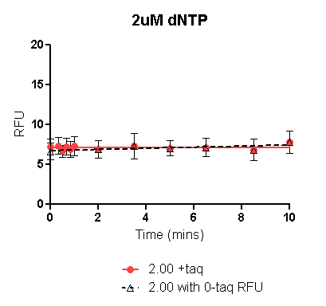
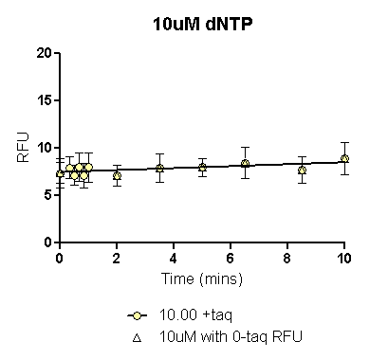
 | 2uM dNTP with 0_{+taq} RFU | 2uM dNTP with 0_{-taq} RFU
One-phase association |  | Interrupted
 | 2uM dNTP with 0_{+taq} |  | 2uM dNTP with 0_{-taq}
Mins | RFU | dRFU/ dT | RFU | dRFU/ dT
0.000 | 7.232 |  | 6.743
0.067 | 7.195 | -0.547 | 6.747 | 0.070
0.134 | 7.172 | -0.343 | 6.752 | 0.070
0.201 | 7.158 | -0.216 | 6.757 | 0.070
 | 10uM dNTP with 0_{+taq} RFU | 10uM dNTP with 0_{-taq} RFU
One-phase association | Interrupted | Interrupted
 | 10uM dNTP with 0_{+taq} |  | 10uM dNTP with 0_{-taq}
Mins | RFU | dRFU/ dT | RFU | dRFU/ dT
0.000 | 7.457 |  | 7.260
0.067 | 7.464 | 0.104 | 7.269 | 0.130
0.134 | 7.471 | 0.104 | 7.277 | 0.130
0.201 | 7.478 | 0.104 | 7.286 | 0.130

Slide 22
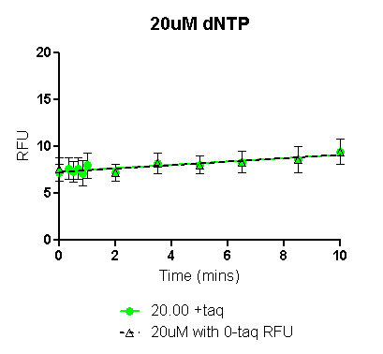
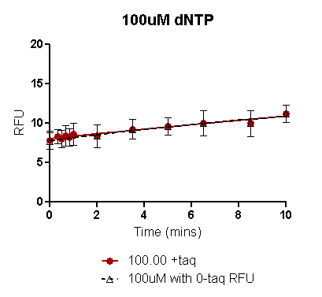
 | 20uM dNTP with 0_{+taq} RFU | 20uM dNTP with 0_{-taq} RFU
One-phase association | Interrupted | Interrupted
 | 20uM dNTP with 0_{+taq} |  | 20uM dNTP with 0_{-taq}
Mins | RFU | dRFU/ dT | RFU | dRFU/ dT
0.000 | 7.316 |  | 7.260
0.067 | 7.328 | 0.178 | 7.273 | 0.184
0.134 | 7.340 | 0.178 | 7.285 | 0.184
0.201 | 7.352 | 0.178 | 7.297 | 0.184
 | 100uM dNTP with 0_{+taq} RFU | 100uM dNTP with 0_{-taq} RFU
One-phase association
R square | 0.3523 | 0.3591
 | 100uM dNTP with 0_{+taq} |  | 100uM dNTP with 0_{-taq}
Mins | RFU | dRFU/ dT | RFU | dRFU/ dT
0.000 | 8.042 |  | 7.774
0.067 | 8.063 | 0.304 | 7.801 | 0.395
0.134 | 8.083 | 0.304 | 7.827 | 0.394
0.201 | 8.104 | 0.304 | 7.854 | 0.393

Slide 23
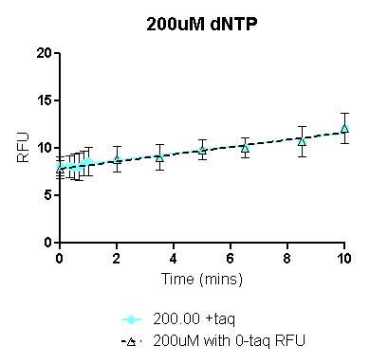
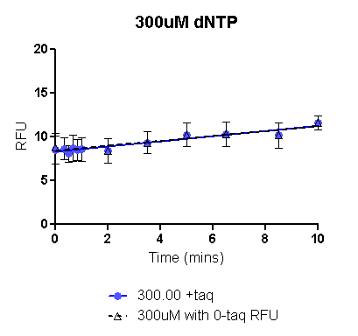
 | 200uM dNTP with 0_{+taq} RFU | 200uM dNTP with 0_{-taq} RFU
One-phase association | Ambiguous | Ambiguous
R square | 0.4375 | 0.4665
 | 200uM dNTP with 0_{+taq} |  | 200M dNTP with 0_{-taq}
Mins | RFU | dRFU/ dT | RFU | dRFU/ dT
0.000 | 7.985 |  | 7.826
0.067 | 8.009 | 0.361 | 7.852 | 0.383
0.134 | 8.033 | 0.361 | 7.877 | 0.383
0.201 | 8.057 | 0.361 | 7.903 | 0.383
 | 300uM dNTP with 0_{+taq} RFU | 300uM dNTP with 0_{-taq} RFU
One-phase association | Interrupted | Interrupted
 | 500uM dNTP with 0_{+taq} |  | 500uM dNTP with 0_{-taq}
Mins | RFU | dRFU/ dT | RFU | dRFU/ dT
0.000 | 8.297 |  | 8.422
0.067 | 8.317 | 0.295 | 8.441 | 0.278
0.134 | 8.336 | 0.295 | 8.459 | 0.278
0.201 | 8.356 | 0.295 | 8.478 | 0.278

Slide 24
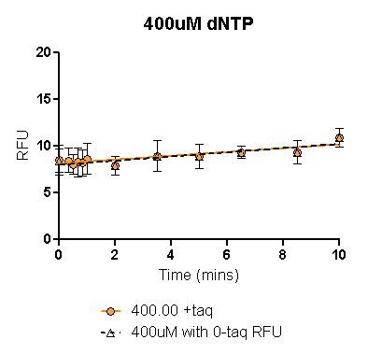
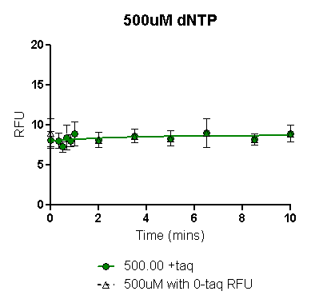
 | 400uM dNTP with 0_{+taq} RFU | 400uM dNTP with 0_{-taq} RFU
One-phase association | Interrupted | Interrupted
 | 200uM dNTP with 0_{+taq} |  | 200M dNTP with 0_{-taq}
Mins | RFU | dRFU/ dT | RFU | dRFU/ dT
0.000 | 8.126 |  | 7.979
0.067 | 8.140 | 0.205 | 7.994 | 0.225
0.134 | 8.154 | 0.205 | 8.009 | 0.225
0.201 | 8.167 | 0.205 | 8.024 | 0.225
 | 500uM dNTP with 0_{+taq} RFU | 500uM dNTP with 0_{-taq} RFU
One-phase association |  | Not Converged
R square | 0.04303
 | 500uM dNTP with 0_{+taq} |  | 500uM dNTP with 0_{-taq}
Mins | RFU | dRFU/ dT | RFU | dRFU/ dT
0.000 | 7.974
0.067 | 7.992 | 0.262 |  | 0.000
0.134 | 8.009 | 0.256 |  | 0.000
0.201 | 8.026 | 0.250 |  | 0.000

Slide 25
Raw data: Trials 1& 2 60ºC assay:
The means of replicates in each trial (columns shaded orange and green respectively) were plotted on Prism to obtain the fitted curve (see following slides).
Blank columns imply that the particular concentrations were not tested in the particular trial.
 | Trial 1 6/6/2013
 | Mins | 2.00 |  |  |  |  | 10.00 |  |  |  |  | 20.00 |  |  |  |  | 100.00 |  |  |  |  | 200.00 |  |  |  |  | 500.00 |  |  |  |  | 1000.00 |  |  |  |  | 2000.00
 |  | Rep 1 | Rep 2 | Rep 3 | Mean | SE | Rep 1 | Rep 2 | Rep 3 | Mean | SE | Rep 1 | Rep 2 | Rep 3 | Mean | SE | Rep 1 | Rep 2 | Rep 3 | Mean | SE | Rep 1 | Rep 2 | Rep 3 | Mean | SE | Rep 1 | Rep 2 | Rep 3 | Mean | SE | Rep 1 | Rep 2 | Rep 3 | Mean | SE | Rep 1 | Rep 2 | Rep 3 | Mean | SE
+taq | 10.00 | 10.00 | 10.42 | 10.45 | 10.29 | 0.25 |  |  |  |  |  | 14.45 | 15.51 | 15.36 | 15.11 | 0.57 | 16.14 | 17.28 | 15.79 | 16.40 | 0.78 | 15.87 | 18.17 | 17.20 | 17.08 | 1.15 |  |  |  |  |  | 10.98 | 14.38 | 13.72 | 13.03 | 1.80 | 13.00 | 13.25 | 14.03 | 13.43 | 0.54
 | 8.50 | 11.59 | 12.08 | 12.03 | 11.90 | 0.27 |  |  |  |  |  | 14.31 | 14.12 | 14.04 | 14.16 | 0.14 | 17.33 | 16.07 | 16.12 | 16.51 | 0.71 | 15.82 | 17.12 | 17.49 | 16.81 | 0.88 |  |  |  |  |  | 12.47 | 12.93 | 14.03 | 13.14 | 0.80 | 12.47 | 12.77 | 13.19 | 12.81 | 0.36
 | 6.50 | 9.38 | 9.38 | 10.73 | 9.83 | 0.78 |  |  |  |  |  | 12.57 | 13.99 | 13.87 | 13.48 | 0.79 | 13.57 | 14.88 | 15.31 | 14.59 | 0.91 | 13.26 | 15.93 | 14.11 | 14.43 | 1.36 |  |  |  |  |  | 11.44 | 11.83 | 12.73 | 12.00 | 0.66 | 10.92 | 12.02 | 12.43 | 11.79 | 0.78
 | 5.00 | 10.05 | 10.86 | 11.17 | 10.69 | 0.58 |  |  |  |  |  | 12.48 | 12.45 | 12.79 | 12.57 | 0.19 | 13.41 | 12.58 | 13.33 | 13.11 | 0.46 | 12.75 | 14.02 | 14.57 | 13.78 | 0.93 |  |  |  |  |  | 10.38 | 11.45 | 11.72 | 11.18 | 0.71 | 10.76 | 10.92 | 11.03 | 10.90 | 0.14
 | 3.50 | 8.18 | 10.04 | 9.38 | 9.20 | 0.94 |  |  |  |  |  | 11.65 | 13.49 | 13.58 | 12.91 | 1.09 | 12.84 | 13.53 | 13.34 | 13.24 | 0.36 | 10.61 | 14.43 | 13.78 | 12.94 | 2.04 |  |  |  |  |  | 10.98 | 11.76 | 11.74 | 11.49 | 0.44 | 11.17 | 12.11 | 12.64 | 11.97 | 0.74
 | 2.00 | 7.36 | 8.50 | 8.45 | 8.11 | 0.64 |  |  |  |  |  | 10.35 | 10.45 | 10.18 | 10.33 | 0.14 | 10.27 | 10.20 | 11.17 | 10.55 | 0.54 | 9.76 | 11.73 | 12.02 | 11.17 | 1.23 |  |  |  |  |  | 9.98 | 10.64 | 11.11 | 10.58 | 0.57 | 10.21 | 9.82 | 10.02 | 10.02 | 0.20
 | 1.00 | 10.13 | 10.71 | 10.06 | 10.30 | 0.36 |  |  |  |  |  | 11.99 | 13.41 | 13.43 | 12.94 | 0.83 | 12.70 | 12.83 | 12.60 | 12.71 | 0.12 | 11.01 | 12.95 | 13.33 | 12.43 | 1.24 |  |  |  |  |  | 11.61 | 12.41 | 12.83 | 12.28 | 0.62 | 9.76 | 11.72 | 12.63 | 11.37 | 1.47
 | 0.83 | 8.32 | 10.24 | 10.27 | 9.61 | 1.11 |  |  |  |  |  | 10.64 | 10.70 | 10.89 | 10.74 | 0.13 | 9.90 | 9.20 | 10.94 | 10.01 | 0.88 | 10.23 | 9.67 | 11.67 | 10.52 | 1.03 |  |  |  |  |  | 10.50 | 11.02 | 11.00 | 10.84 | 0.29 | 10.38 | 10.53 | 10.54 | 10.48 | 0.09
 | 0.66 | 8.37 | 9.99 | 11.16 | 9.84 | 1.40 |  |  |  |  |  | 11.84 | 12.65 | 14.18 | 12.89 | 1.19 | 12.44 | 12.69 | 12.31 | 12.48 | 0.19 | 10.50 | 12.75 | 13.12 | 12.12 | 1.42 |  |  |  |  |  | 11.34 | 12.31 | 13.19 | 12.28 | 0.93 | 11.48 | 12.89 | 12.46 | 12.28 | 0.72
 | 0.50 | 9.15 | 10.69 | 10.96 | 10.27 | 0.98 |  |  |  |  |  | 10.71 | 11.28 | 11.30 | 11.10 | 0.34 | 10.38 | 11.03 | 11.24 | 10.88 | 0.45 | 10.26 | 11.43 | 11.94 | 11.21 | 0.86 |  |  |  |  |  | 10.94 | 11.00 | 9.87 | 10.60 | 0.63 | 10.36 | 10.52 | 11.14 | 10.67 | 0.41
 | 0.00 | 9.39 | 8.93 | 8.77 | 9.03 | 0.32 |  |  |  |  |  | 10.24 | 12.16 | 11.78 | 11.39 | 1.02 | 9.94 | 11.53 | 10.86 | 10.78 | 0.80 | 10.39 | 11.56 | 11.25 | 11.07 | 0.61 |  |  |  |  |  | 10.60 | 11.54 | 12.27 | 11.47 | 0.84 | 11.18 | 12.20 | 11.92 | 11.77 | 0.53
-taq | 0.00 | 7.39 | 9.34 | 9.65 | 8.80 | 1.22 |  |  |  |  |  | 10.53 | 10.68 | 11.47 | 10.89 | 0.51 | 9.47 | 9.01 | 9.22 | 9.23 | 0.23 | 9.35 | 10.58 | 10.26 | 10.06 | 0.64 |  |  |  |  |  | 10.72 | 10.68 | 11.69 | 11.03 | 0.57 | 12.43 | 10.91 | 11.69 | 11.68 | 0.76
 | Trial 2 6/14/2013
 | Mins | 2.00 |  |  |  |  | 10.00 |  |  |  |  | 20.00 |  |  |  |  | 100.00 |  |  |  |  | 200.00 |  |  |  |  | 500.00 |  |  |  |  | 1000.00 |  |  |  |  | 2000.00
 |  | Rep 1 | Rep 2 | Rep 3 | Mean | SE | Rep 1 | Rep 2 | Rep 3 | Mean | SE | Rep 1 | Rep 2 | Rep 3 | Mean | SE | Rep 1 | Rep 2 | Rep 3 | Mean | SE | Rep 1 | Rep 2 | Rep 3 | Mean | SE | Rep 1 | Rep 2 | Rep 3 | Mean | SE | Rep 1 | Rep 2 | Rep 3 | Mean | SE | Rep 1 | Rep 2 | Rep 3 | Mean | SE
+taq | 10.00 | 8.85 | 9.04 | 9.77 | 9.22 | 0.49 | 10.14 | 11.56 | 11.00 | 10.90 | 0.72 | 10.85 | 12.44 | 11.89 | 11.73 | 0.81 | 13.73 | 16.49 | 14.94 | 15.05 | 1.38 | 16.44 | 15.41 | 16.38 | 16.08 | 0.58 | 10.27 | 11.54 | 11.17 | 10.99 | 0.65 | 9.08 | 10.65 | 10.16 | 9.96 | 0.80
 | 8.50 | 7.52 | 9.32 | 9.23 | 8.69 | 1.01 | 10.23 | 10.94 | 11.08 | 10.75 | 0.46 | 10.17 | 10.69 | 11.57 | 10.81 | 0.71 | 11.28 | 14.91 | 15.06 | 13.75 | 2.14 | 12.10 | 14.75 | 14.66 | 13.84 | 1.50 | 8.00 | 10.65 | 11.22 | 9.96 | 1.72 | 7.00 | 8.90 | 10.37 | 8.75 | 1.69
 | 6.50 | 8.31 | 8.80 | 8.32 | 8.47 | 0.28 | 9.23 | 8.98 | 8.87 | 9.03 | 0.19 | 10.03 | 10.40 | 10.29 | 10.24 | 0.19 | 12.54 | 11.34 | 13.66 | 12.51 | 1.16 | 12.30 | 12.93 | 12.55 | 12.59 | 0.32 | 10.11 | 8.91 | 9.15 | 9.39 | 0.64 | 8.47 | 8.18 | 8.18 | 8.28 | 0.17
 | 5.00 | 7.32 | 7.62 | 7.37 | 7.43 | 0.16 | 8.72 | 10.70 | 10.56 | 9.99 | 1.10 | 8.46 | 11.77 | 10.58 | 10.27 | 1.68 | 10.53 | 12.96 | 13.43 | 12.31 | 1.56 | 10.00 | 12.67 | 13.39 | 12.02 | 1.79 | 7.85 | 10.47 | 10.53 | 9.62 | 1.53 | 8.01 | 10.68 | 8.84 | 9.17 | 1.37
 | 3.50 | 7.18 | 7.92 | 7.63 | 7.58 | 0.37 | 7.85 | 8.00 | 7.94 | 7.93 | 0.08 | 7.88 | 8.81 | 8.10 | 8.26 | 0.49 | 9.28 | 9.75 | 10.07 | 9.70 | 0.40 | 10.36 | 10.19 | 9.79 | 10.11 | 0.29 | 8.36 | 8.96 | 8.13 | 8.48 | 0.43 | 7.58 | 8.16 | 8.04 | 7.93 | 0.31
 | 2.00 | 6.60 | 7.98 | 8.33 | 7.64 | 0.91 | 8.31 | 9.74 | 8.84 | 8.96 | 0.72 | 7.60 | 8.79 | 9.79 | 8.73 | 1.10 | 9.10 | 10.65 | 10.62 | 10.12 | 0.89 | 9.87 | 10.63 | 10.35 | 10.28 | 0.39 | 7.61 | 9.79 | 9.76 | 9.05 | 1.25 | 8.52 | 9.77 | 9.03 | 9.11 | 0.63
 | 1.00 | 7.98 | 8.11 | 7.69 | 7.92 | 0.21 | 8.56 | 8.41 | 7.97 | 8.31 | 0.31 | 8.86 | 8.00 | 8.49 | 8.45 | 0.43 | 9.23 | 9.18 | 9.95 | 9.45 | 0.43 | 9.83 | 9.15 | 9.35 | 9.44 | 0.35 | 9.59 | 9.39 | 9.50 | 9.49 | 0.10 | 8.79 | 8.37 | 9.50 | 8.89 | 0.57
 | 0.83 | 6.46 | 8.39 | 8.60 | 7.82 | 1.18 | 7.78 | 9.71 | 9.28 | 8.92 | 1.01 | 7.85 | 10.07 | 9.69 | 9.20 | 1.19 | 8.20 | 10.14 | 9.91 | 9.42 | 1.06 | 8.56 | 9.51 | 10.17 | 9.41 | 0.81 | 8.40 | 9.83 | 9.54 | 9.26 | 0.75 | 7.51 | 9.68 | 8.79 | 8.66 | 1.09
 | 0.66 | 7.91 | 8.42 | 8.37 | 8.24 | 0.28 | 9.05 | 9.16 | 8.86 | 9.02 | 0.15 | 9.25 | 9.27 | 8.89 | 9.14 | 0.22 | 10.00 | 9.76 | 10.36 | 10.04 | 0.30 | 10.27 | 10.23 | 10.17 | 10.22 | 0.05 | 9.91 | 9.67 | 9.35 | 9.64 | 0.28 | 8.42 | 9.32 | 9.96 | 9.24 | 0.77
 | 0.50 | 6.29 | 5.85 | 9.53 | 7.22 | 2.01 | 8.35 | 10.62 | 10.10 | 9.69 | 1.19 | 8.28 | 10.39 | 9.73 | 9.47 | 1.08 | 7.92 | 10.87 | 11.04 | 9.94 | 1.75 | 8.47 | 11.82 | 10.69 | 10.33 | 1.70 | 8.88 | 10.69 | 11.12 | 10.23 | 1.19 | 6.17 | 10.39 | 10.71 | 9.09 | 2.54
 | 0.00 | 8.04 | 8.17 | 7.48 | 7.89 | 0.37 | 8.76 | 8.98 | 8.62 | 8.79 | 0.18 | 9.15 | 8.98 | 8.91 | 9.01 | 0.12 | 9.53 | 9.81 | 10.14 | 9.83 | 0.30 | 9.04 | 10.12 | 9.31 | 9.49 | 0.56 | 10.15 | 10.12 | 8.51 | 9.59 | 0.94 | 8.13 | 6.67 | 9.50 | 8.10 | 1.41
-taq | 10.00 | 8.02 | 8.53 | 8.86 | 8.47 | 0.42 | 9.58 | 9.87 | 10.50 | 9.98 | 0.47 | 10.35 | 10.51 | 11.17 | 10.68 | 0.43 | 10.35 | 10.50 | 11.12 | 10.66 | 0.41 | 9.89 | 10.97 | 10.11 | 10.32 | 0.57 | 10.29 | 11.48 | 10.87 | 10.88 | 0.60 | 7.77 | 9.68 | 10.98 | 9.48 | 1.62
 | 5.00 | 6.86 | 7.41 | 6.54 | 6.93 | 0.44 | 8.74 | 8.97 | 9.80 | 9.17 | 0.56 | 10.05 | 9.40 | 8.38 | 9.28 | 0.84 | 9.80 | 9.93 | 7.63 | 9.12 | 1.30 | 9.10 | 9.53 | 7.62 | 8.75 | 1.00 | 8.49 | 10.42 | 8.55 | 9.15 | 1.10 | 9.62 | 8.75 | 10.35 | 9.57 | 0.80
 | 0.00 | 7.59 | 7.52 | 7.82 | 7.64 | 0.16 | 8.79 | 8.78 | 8.76 | 8.77 | 0.02 | 8.03 | 9.17 | 9.17 | 8.79 | 0.66 | 8.92 | 9.40 | 9.47 | 9.26 | 0.30 | 9.07 | 9.07 | 8.88 | 9.00 | 0.11 | 8.95 | 7.66 | 9.67 | 8.76 | 1.02 | 8.03 | 9.61 | 10.21 | 9.28 | 1.13

Slide 26
Mean of 2 trials: 60ºC assay
In each of the plots in following slides, data has been plotted with either the 0min RFU_{+taq} (colored line) or the 0min RFU_{-taq} (black dashed line).
In general, the 0min RFU_{-taq} might be a more reliable 0min value since experimental limitations result in even the 0min reaction actually being incubated at assay temperature for ~2-4secs resulting in likely erroneous RFUs, when Taq is present in the reaction. Early time point (20secs-1min) are also not accurate due to experimental set up limitation and probably need to be excluded for curve fitting.
For each dNTP conc, the black dashed line (using 0min_{-taq}) also has the early time points excluded. Corrected RFU values from this fitted curve have been used to calculate initial rate as dRFU/dT (see highlighted column).
 |  | 2.00 |  |  |  | 10.00 |  |  |  | 20.00 |  |  |  | 100.00 |  |  |  | 200.00 |  |  |  | 500.00 |  |  |  | 1000.00 |  |  |  | 2000.00
 | Mins | Mean 1 | Mean 2 | Mean of 2 trials | SE | Mean 1 | Mean 2 | Mean of 2 trials | SE | Mean 1 | Mean 2 | Mean of 2 trials | SE | Mean 1 | Mean 2 | Mean of 2 trials | SE | Mean 1 | Mean 2 | Mean of 2 trials | SE | Mean 1 | Mean 2 | Mean of 2 trials | SE | Mean 1 | Mean 2 | Mean of 2 trials | SE | Mean 1 | Mean 2 | Mean of 2 trials | SE
+taq | 10.00 | 10.29 | 9.218 | 9.754 | 0.758 |  | 10.9 | 10.9 |  | 15.11 | 11.73 | 13.42 | 2.39 | 9.18 | 15.05 | 12.12 | 4.155 | 17.08 | 16.08 | 16.58 | 0.709 |  | 10.99 | 10.99 |  | 13.03 | 9.963 | 11.49 | 2.167 | 13.43 |  | 13.43
 | 8.50 | 11.90 | 8.688 | 10.29 | 2.271 |  | 10.75 | 10.75 |  | 14.16 | 10.81 | 12.48 | 2.366 | 8.55 | 13.75 | 11.15 | 3.675 | 16.81 | 13.84 | 15.32 | 2.102 |  | 9.957 | 9.957 |  | 13.14 | 8.755 | 10.95 | 3.103 | 12.81 |  | 12.81
 | 6.50 | 9.83 | 8.474 | 9.152 | 0.958 |  | 9.027 | 9.027 |  | 13.48 | 10.24 | 11.86 | 2.289 | 8.13 | 12.51 | 10.32 | 3.1 | 14.43 | 12.59 | 13.51 | 1.301 |  | 9.389 | 9.389 |  | 12.00 | 8.276 | 10.14 | 2.633 | 11.79 |  | 11.79
 | 5.00 | 10.69 | 7.434 | 9.064 | 2.304 |  | 9.994 | 9.994 |  | 12.57 | 10.27 | 11.42 | 1.63 | 7.77 | 12.31 | 10.04 | 3.206 | 13.78 | 12.02 | 12.9 | 1.246 |  | 9.615 | 9.615 |  | 11.18 | 9.174 | 10.18 | 1.421 | 10.90 |  | 10.9
 | 3.50 | 9.20 | 7.576 | 8.388 | 1.149 |  | 7.933 | 7.933 |  | 12.91 | 8.263 | 10.59 | 3.283 | 7.38 | 9.699 | 8.538 | 1.642 | 12.94 | 10.11 | 11.53 | 1.999 |  | 8.484 | 8.484 |  | 11.49 | 7.927 | 9.71 | 2.522 | 11.97 |  | 11.97
 | 2.00 | 8.11 | 7.636 | 7.871 | 0.332 |  | 8.964 | 8.964 |  | 10.33 | 8.727 | 9.527 | 1.131 | 6.46 | 10.12 | 8.292 | 2.588 | 11.17 | 10.28 | 10.73 | 0.627 |  | 9.054 | 9.054 |  | 10.58 | 9.105 | 9.842 | 1.041 | 10.02 |  | 10.02
 | 1.00 | 10.30 | 7.925 | 9.112 | 1.68 |  | 8.31 | 8.31 |  | 12.94 | 8.449 | 10.7 | 3.178 | 7.44 | 9.454 | 8.448 | 1.423 | 12.43 | 9.442 | 10.94 | 2.113 |  | 9.491 | 9.491 |  | 12.28 | 8.887 | 10.59 | 2.402 | 11.37 |  | 11.37
 | 0.83 | 9.61 | 7.817 | 8.714 | 1.269 |  | 8.925 | 8.925 |  | 10.74 | 9.203 | 9.973 | 1.089 | 6.76 | 9.416 | 8.085 | 1.881 | 10.52 | 9.413 | 9.968 | 0.785 |  | 9.255 | 9.255 |  | 10.84 | 8.66 | 9.75 | 1.541 | 10.48 |  | 10.48
 | 0.66 | 9.84 | 8.235 | 9.038 | 1.134 |  | 9.024 | 9.024 |  | 12.89 | 9.138 | 11.01 | 2.653 | 7.60 | 10.04 | 8.821 | 1.724 | 12.12 | 10.22 | 11.17 | 1.344 |  | 9.642 | 9.642 |  | 12.28 | 9.235 | 10.76 | 2.153 | 12.28 |  | 12.28
 | 0.50 | 10.27 | 7.223 | 8.745 | 2.152 |  | 9.691 | 9.691 |  | 11.10 | 9.467 | 10.28 | 1.152 | 6.97 | 9.944 | 8.456 | 2.105 | 11.21 | 10.33 | 10.77 | 0.624 |  | 10.23 | 10.23 |  | 10.60 | 9.089 | 9.847 | 1.072 | 10.67 |  | 10.67
 | 0.00 | 9.03 | 7.894 | 8.462 | 0.803 |  | 8.785 | 8.785 |  | 11.39 | 9.014 | 10.2 | 1.683 | 6.97 | 9.827 | 8.397 | 2.023 | 11.07 | 9.489 | 10.28 | 1.116 |  | 9.592 | 9.592 |  | 11.47 | 8.097 | 9.784 | 2.385 | 11.77 |  | 11.77
-taq | 0.00 | 8.80 | 7.642 | 8.219 | 0.816 |  | 8.775 | 8.775 |  | 10.89 | 8.787 | 9.84 | 1.489 | 6.71 | 9.263 | 7.984 | 1.808 | 10.06 | 9.004 | 9.534 | 0.749 |  | 8.76 | 8.76 |  | 11.03 | 9.285 | 10.16 | 1.234 | 11.68 |  | 11.68

Slide 27
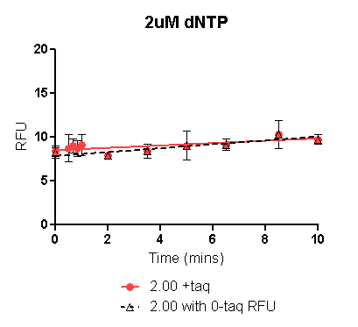
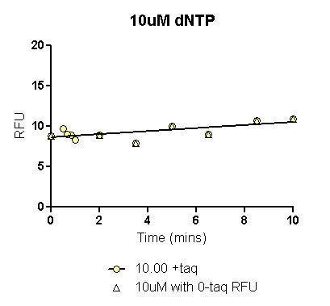
 | 2uM dNTP with 0_{+taq} RFU | 2uM dNTP with 0_{-taq} RFU
One-phase association | Interrupted | Interrupted
 | 2uM dNTP with 0_{+taq} |  | 2uM dNTP with 0_{-taq}
Mins | RFU | dRFU/ dT | RFU | dRFU/ dT
0.000 | 8.492 |  | 7.842
0.067 | 8.501 | 0.135 | 7.857 | 0.221
0.134 | 8.510 | 0.135 | 7.872 | 0.221
0.201 | 8.519 | 0.135 | 7.887 | 0.221
 | 10uM dNTP with 0_{+taq} RFU | 10uM dNTP with 0_{-taq} RFU
One-phase association | Ambiguous | Ambiguous
R square | 0.4974 | 0.6070
 | 10uM dNTP with 0_{+taq} |  | 10uM dNTP with 0_{-taq}
Mins | RFU | dRFU/ dT | RFU | dRFU/ dT
0.000 | 8.641 |  | 8.254
0.067 | 8.653 | 0.188 | 8.271 | 0.241
0.134 | 8.666 | 0.188 | 8.287 | 0.241
0.201 | 8.679 | 0.188 | 8.303 | 0.241

Slide 28
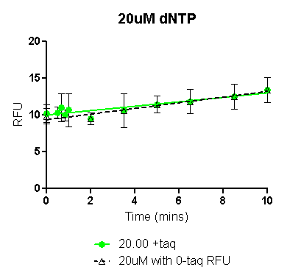
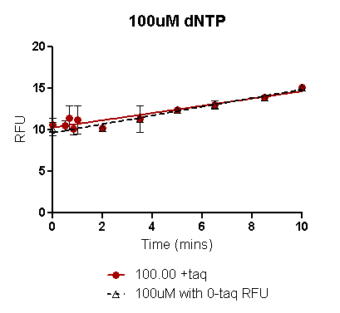
 | 20uM dNTP with 0_{+taq} RFU | 20uM dNTP with 0_{-taq} RFU
One-phase association | Interrupted | Interrupted
 | 20uM dNTP with 0_{+taq} |  | 20uM dNTP with 0_{-taq}
Mins | RFU | dRFU/ dT | RFU | dRFU/ dT
0.000 | 9.994 |  | 9.344
0.067 | 10.014 | 0.300 | 9.370 | 0.387
0.134 | 10.034 | 0.300 | 9.396 | 0.387
0.201 | 10.054 | 0.300 | 9.422 | 0.387
 | 100uM dNTP with 0_{+taq} RFU | 100uM dNTP with 0_{-taq} RFU
One-phase association | Ambiguous | Ambiguous
R square | 0.6615 | 0.8354
 | 100uM dNTP with 0_{+taq} |  | 100uM dNTP with 0_{-taq}
Mins | RFU | dRFU/ dT | RFU | dRFU/ dT
0.000 | 10.274 |  | 9.645
0.067 | 10.303 | 0.438 | 9.680 | 0.523
0.134 | 10.333 | 0.438 | 9.715 | 0.523
0.201 | 10.362 | 0.438 | 9.751 | 0.523

Slide 29
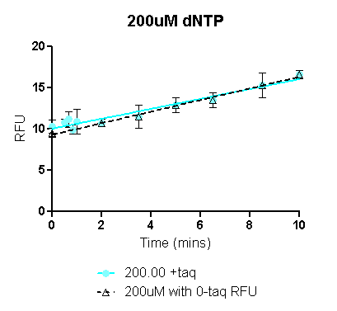
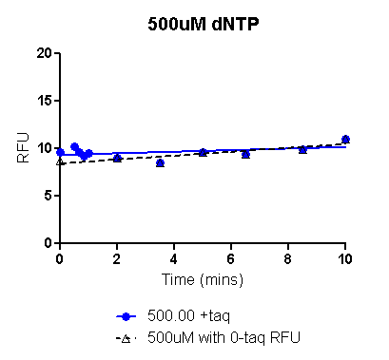
 | 200uM dNTP with 0_{+taq} RFU | 200uM dNTP with 0_{-taq} RFU
One-phase association | Ambiguous | Ambiguous
R square | 0.7763 | 0.8450
 | 200uM dNTP with 0_{+taq} |  | 200M dNTP with 0_{-taq}
Mins | RFU | dRFU/ dT | RFU | dRFU/ dT
0.000 | 10.046 |  | 9.305
0.067 | 10.086 | 0.602 | 9.352 | 0.703
0.134 | 10.127 | 0.602 | 9.399 | 0.703
0.201 | 10.167 | 0.602 | 9.446 | 0.703
 | 500uM dNTP with 0_{+taq} RFU | 500uM dNTP with 0_{-taq} RFU
One-phase association | Interrupted | Ambiguous
R square | 0.7763 | 0.8450
 | 500uM dNTP with 0_{+taq} |  | 500uM dNTP with 0_{-taq}
Mins | RFU | dRFU/ dT | RFU | dRFU/ dT
0.000 | 9.319 |  | 8.428
0.067 | 9.324 | 0.083 | 8.442 | 0.204
0.134 | 9.330 | 0.083 | 8.456 | 0.204
0.201 | 9.335 | 0.083 | 8.470 | 0.204

Slide 30
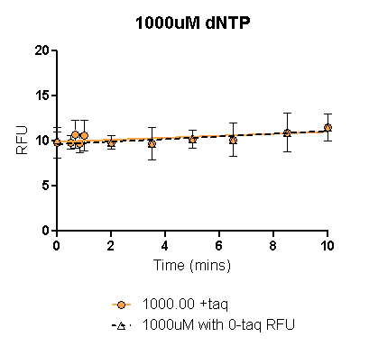
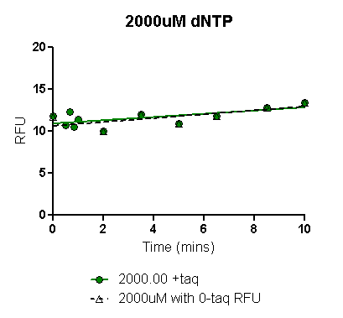
 | 1000uM dNTP with 0_{+taq} RFU | 1000uM dNTP with 0_{-taq} RFU
One-phase association | Interrupted | Interrupted
 | 1000uM dNTP with 0_{+taq} |  | 1000M dNTP with 0_{-taq}
Mins | RFU | dRFU/ dT | RFU | dRFU/ dT
0.000 | 9.888 |  | 9.619
0.067 | 9.895 | 0.111 | 9.629 | 0.145
0.134 | 9.903 | 0.111 | 9.638 | 0.145
0.201 | 9.910 | 0.111 | 9.648 | 0.145
 | 2000uM dNTP with 0_{+taq} RFU | 2000uM dNTP with 0_{-taq} RFU
One-phase association | Ambiguous | Ambiguous
R square | 0.4266 | 0.5167
 | 2000uM dNTP with 0_{+taq} |  | 2000uM dNTP with 0_{-taq}
Mins | RFU | dRFU/ dT | RFU | dRFU/ dT
0.000 | 10.919 |  | 10.638
0.067 | 10.932 | 0.192 | 10.653 | 0.229
0.134 | 10.945 | 0.192 | 10.668 | 0.229
0.201 | 10.958 | 0.192 | 10.684 | 0.229

Slide 31
Raw data: Trials 1& 2 65ºC assay:
The means of replicates in each trial (columns shaded orange and green respectively) were plotted on Prism to obtain the fitted curve (see following slides).
 | Trial 1 7/3/2013
 | Mins | 2.00 |  |  |  |  | 10.00 |  |  |  |  | 20.00 |  |  |  |  | 100.00 |  |  |  |  | 200.00 |  |  |  |  | 300.00 |  |  |  |  | 400.00 |  |  |  |  | 500.00
 |  | Rep 1 | Rep 2 | Rep 3 | Mean | SE | Rep 1 | Rep 2 | Rep 3 | Mean | SE | Rep 1 | Rep 2 | Rep 3 | Mean | SE | Rep 1 | Rep 2 | Rep 3 | Mean | SE | Rep 1 | Rep 2 | Rep 3 | Mean | SE | Rep 1 | Rep 2 | Rep 3 | Mean | SE | Rep 1 | Rep 2 | Rep 3 | Mean | SE | Rep 1 | Rep 2 | Rep 3 | Mean | SE
+taq | 10.00 | 6.75 | 7.14 | 6.95 | 6.95 | 0.19 | 8.56 | 8.87 | 9.93 | 9.12 | 0.72 | 10.14 | 10.17 | 10.86 | 10.39 | 0.41 | 12.75 | 14.76 | 14.99 | 14.17 | 1.23 | 12.64 | 14.68 | 16.12 | 14.48 | 1.75 | 12.71 | 11.98 | 12.49 | 12.39 | 0.37 | 11.33 | 9.73 | 9.35 | 10.14 | 1.05 | 6.62 | 7.95 | 6.96 | 7.18 | 0.69
 | 8.50 | 6.58 | 7.03 | 5.97 | 6.53 | 0.53 | 8.11 | 7.87 | 7.92 | 7.97 | 0.12 | 8.68 | 8.53 | 8.79 | 8.67 | 0.13 | 11.93 | 11.62 | 11.66 | 11.74 | 0.17 | 12.55 | 12.54 | 11.80 | 12.30 | 0.43 | 11.41 | 13.13 | 12.62 | 12.39 | 0.88 | 11.09 | 9.34 | 9.39 | 9.94 | 1.00 | 7.19 | 9.38 | 8.61 | 8.40 | 1.11
 | 6.50 | 5.12 | 5.21 | 6.26 | 5.53 | 0.63 | 6.45 | 7.68 | 8.13 | 7.42 | 0.87 | 7.33 | 8.33 | 8.92 | 8.19 | 0.81 | 9.02 | 11.16 | 11.21 | 10.46 | 1.25 | 8.73 | 11.34 | 12.10 | 10.72 | 1.77 | 8.15 | 10.11 | 11.98 | 10.08 | 1.92 | 8.05 | 9.95 | 9.84 | 9.28 | 1.06 | 7.29 | 7.94 | 8.14 | 7.79 | 0.45
 | 5.00 | 5.16 | 6.24 | 5.65 | 5.68 | 0.54 | 5.34 | 6.53 | 6.75 | 6.21 | 0.76 | 7.20 | 7.29 | 7.88 | 7.45 | 0.37 | 8.37 | 9.66 | 7.95 | 8.66 | 0.89 | 10.38 | 10.01 | 10.55 | 10.31 | 0.28 | 10.10 | 9.96 | 10.09 | 10.05 | 0.08 | 8.69 | 7.89 | 8.59 | 8.39 | 0.44 | 7.57 | 5.11 | 8.40 | 7.02 | 1.71
 | 3.50 | 4.81 | 6.71 | 5.81 | 5.78 | 0.95 | 6.14 | 7.26 | 7.13 | 6.84 | 0.61 | 6.11 | 7.77 | 7.28 | 7.05 | 0.85 | 7.35 | 9.36 | 9.22 | 8.64 | 1.12 | 7.91 | 9.66 | 10.19 | 9.25 | 1.19 | 7.64 | 8.80 | 10.54 | 8.99 | 1.46 | 5.82 | 8.95 | 8.66 | 7.81 | 1.73 | 6.64 | 7.55 | 7.37 | 7.18 | 0.48
 | 2.00 | 5.65 | 6.40 | 4.88 | 5.64 | 0.76 | 6.43 | 6.60 | 6.57 | 6.54 | 0.09 | 6.91 | 6.87 | 6.92 | 6.90 | 0.02 | 8.00 | 8.36 | 8.71 | 8.35 | 0.36 | 8.38 | 8.54 | 8.27 | 8.40 | 0.13 | 8.89 | 7.73 | 8.60 | 8.40 | 0.61 | 7.58 | 7.40 | 8.98 | 7.99 | 0.87 | 7.92 | 6.19 | 7.82 | 7.31 | 0.97
 | 1.00 | 4.28 | 5.97 | 6.51 | 5.59 | 1.16 | 5.37 | 6.78 | 6.76 | 6.30 | 0.81 | 5.53 | 7.41 | 6.55 | 6.50 | 0.94 | 6.38 | 7.62 | 7.57 | 7.19 | 0.70 | 6.15 | 7.90 | 8.10 | 7.38 | 1.07 | 6.26 | 8.22 | 7.73 | 7.41 | 1.02 | 6.95 | 7.74 | 7.67 | 7.45 | 0.44 | 6.67 | 7.57 | 7.11 | 7.11 | 0.45
 | 0.83 | 5.95 | 4.79 | 5.77 | 5.50 | 0.63 | 6.03 | 6.34 | 6.05 | 6.14 | 0.17 | 5.93 | 6.48 | 6.70 | 6.37 | 0.39 | 6.98 | 7.17 | 7.48 | 7.21 | 0.25 | 7.37 | 7.31 | 7.78 | 7.48 | 0.26 | 7.74 | 7.29 | 6.64 | 7.23 | 0.55 | 6.77 | 6.71 | 6.58 | 6.69 | 0.10 | 6.04 | 5.13 | 7.24 | 6.14 | 1.06
 | 0.66 | 5.14 | 7.00 | 7.03 | 6.39 | 1.08 | 5.68 | 7.11 | 7.57 | 6.79 | 0.98 | 5.86 | 7.54 | 6.90 | 6.77 | 0.85 | 6.42 | 8.06 | 8.08 | 7.52 | 0.95 | 6.18 | 8.26 | 8.19 | 7.54 | 1.18 | 6.43 | 8.26 | 8.66 | 7.78 | 1.19 | 6.76 | 7.66 | 8.44 | 7.62 | 0.84 | 7.03 | 7.69 | 7.92 | 7.55 | 0.46
 | 0.50 | 5.82 | 6.33 | 5.88 | 6.01 | 0.28 | 6.39 | 6.29 | 6.40 | 6.36 | 0.06 | 6.39 | 6.67 | 6.49 | 6.52 | 0.14 | 6.94 | 7.25 | 7.51 | 7.23 | 0.28 | 7.78 | 7.82 | 7.43 | 7.68 | 0.22 | 7.90 | 7.75 | 7.85 | 7.83 | 0.07 | 7.40 | 7.70 | 8.30 | 7.80 | 0.46 | 7.12 | 6.58 | 7.21 | 6.97 | 0.34
 | 0.33 | 4.99 | 6.16 | 6.31 | 5.82 | 0.72 | 5.45 | 6.12 | 6.18 | 5.92 | 0.41 | 5.55 | 6.87 | 6.12 | 6.18 | 0.66 | 5.76 | 6.89 | 7.57 | 6.74 | 0.91 | 5.99 | 7.41 | 7.95 | 7.12 | 1.02 | 6.16 | 6.67 | 6.90 | 6.58 | 0.38 | 6.31 | 7.10 | 7.69 | 7.03 | 0.69 | 6.92 | 6.80 | 7.49 | 7.07 | 0.37
 | 0.00 | 5.62 | 5.10 | 5.22 | 5.32 | 0.27 | 5.82 | 5.98 | 5.96 | 5.92 | 0.09 | 6.00 | 6.42 | 6.52 | 6.31 | 0.28 | 6.91 | 7.03 | 7.13 | 7.02 | 0.11 | 6.89 | 7.27 | 7.33 | 7.16 | 0.24 | 7.60 | 6.68 | 6.81 | 7.03 | 0.50 | 6.53 | 6.63 | 6.03 | 6.40 | 0.32 | 7.35 | 6.85 | 7.11 | 7.10 | 0.25
 | 10.00 | 6.12 | 5.42 | 6.81 | 6.11 | 0.70 | 7.97 | 7.95 | 8.51 | 8.14 | 0.32 | 7.77 | 8.67 | 8.94 | 8.46 | 0.61 | 8.59 | 8.52 | 7.90 | 8.33 | 0.38 | 8.15 | 8.77 | 6.98 | 7.96 | 0.91 | 8.62 | 9.24 | 9.13 | 9.00 | 0.33 | 7.19 | 8.96 | 8.75 | 8.30 | 0.97 | 8.73 | 7.94 | 8.51 | 8.39 | 0.41
 | 5.00 | 5.68 | 5.96 | 5.71 | 5.78 | 0.16 | 7.93 | 7.86 | 6.73 | 7.51 | 0.68 | 5.34 | 7.96 | 7.48 | 6.93 | 1.40 | 8.72 | 8.74 | 7.55 | 8.34 | 0.68 | 8.56 | 8.45 | 8.53 | 8.51 | 0.06 | 9.26 | 8.82 | 8.92 | 9.00 | 0.23 | 9.58 | 7.94 | 10.29 | 9.27 | 1.20 | 7.83 | 8.26 | 8.91 | 8.33 | 0.54
-taq | 0.00 | 5.51 | 5.45 | 4.71 | 5.22 | 0.45 | 5.15 | 6.87 | 6.41 | 6.14 | 0.89 | 6.12 | 6.39 | 6.61 | 6.37 | 0.25 | 5.49 | 7.15 | 6.84 | 6.49 | 0.88 | 5.20 | 7.17 | 6.92 | 6.43 | 1.07 | 6.53 | 7.38 | 7.38 | 7.10 | 0.49 | 6.83 | 7.19 | 7.95 | 7.32 | 0.57 | 5.11 | 7.69 | 6.63 | 6.48 | 1.29
 | Trial 2 7/8/2013
 | Mins | 2.00 |  |  |  |  | 10.00 |  |  |  |  | 20.00 |  |  |  |  | 100.00 |  |  |  |  | 200.00 |  |  |  |  | 300.00 |  |  |  |  | 400.00 |  |  |  |  | 500.00
 |  | Rep 1 | Rep 2 | Rep 3 | Mean | SE | Rep 1 | Rep 2 | Rep 3 | Mean | SE | Rep 1 | Rep 2 | Rep 3 | Mean | SE | Rep 1 | Rep 2 | Rep 3 | Mean | SE | Rep 1 | Rep 2 | Rep 3 | Mean | SE | Rep 1 | Rep 2 | Rep 3 | Mean | SE | Rep 1 | Rep 2 | Rep 3 | Mean | SE | Rep 1 | Rep 2 | Rep 3 | Mean | SE
+taq | 10.00 | 8.58 | 9.56 | 9.63 | 9.26 | 0.59 | 11.42 | 11.47 | 11.46 | 11.45 | 0.03 | 10.62 | 13.88 | 11.57 | 12.02 | 1.68 | 14.91 | 16.89 | 16.82 | 16.21 | 1.12 | 15.62 | 15.18 | 16.95 | 15.92 | 0.92 | 16.61 | 17.65 | 17.56 | 17.27 | 0.58 | 14.63 | 14.01 | 15.27 | 14.64 | 0.63 | 12.35 | 11.02 | 11.19 | 11.52 | 0.72
 | 8.50 | 5.42 | 7.76 | 7.46 | 6.88 | 1.27 | 7.78 | 8.11 | 8.10 | 7.99 | 0.19 | 8.11 | 9.34 | 9.36 | 8.94 | 0.72 | 10.79 | 12.19 | 11.87 | 11.62 | 0.73 | 13.47 | 13.19 | 12.64 | 13.10 | 0.42 | 13.13 | 13.25 | 12.59 | 12.99 | 0.35 | 11.33 | 10.88 | 10.95 | 11.05 | 0.24 | 9.79 | 9.16 | 9.51 | 9.49 | 0.31
 | 6.50 | 7.03 | 10.39 | 9.71 | 9.04 | 1.78 | 9.82 | 12.57 | 11.64 | 11.34 | 1.40 | 10.08 | 12.46 | 12.11 | 11.55 | 1.29 | 11.84 | 15.26 | 15.78 | 14.29 | 2.14 | 12.77 | 16.49 | 15.93 | 15.06 | 2.01 | 12.75 | 16.47 | 15.57 | 14.93 | 1.94 | 9.73 | 14.01 | 13.85 | 12.53 | 2.43 | 10.48 | 11.20 | 11.65 | 11.11 | 0.59
 | 5.00 | 8.58 | 8.93 | 8.96 | 8.83 | 0.21 | 9.28 | 9.37 | 9.53 | 9.39 | 0.13 | 9.88 | 10.05 | 10.37 | 10.10 | 0.25 | 13.14 | 12.42 | 13.48 | 13.01 | 0.54 | 13.09 | 14.22 | 13.58 | 13.63 | 0.57 | 13.16 | 13.81 | 13.62 | 13.53 | 0.33 | 10.34 | 11.18 | 12.20 | 11.24 | 0.93 | 10.66 | 9.55 | 10.14 | 10.12 | 0.55
 | 3.50 | 6.73 | 9.15 | 9.72 | 8.53 | 1.58 | 8.68 | 11.04 | 10.88 | 10.20 | 1.32 | 8.88 | 11.46 | 10.80 | 10.38 | 1.34 | 10.89 | 13.90 | 13.26 | 12.68 | 1.59 | 11.03 | 12.84 | 14.44 | 12.77 | 1.71 | 11.05 | 13.68 | 13.20 | 12.64 | 1.40 | 11.07 | 12.98 | 12.45 | 12.17 | 0.99 | 10.35 | 10.30 | 11.41 | 10.69 | 0.63
 | 2.00 | 8.54 | 8.54 | 8.37 | 8.49 | 0.10 | 8.77 | 7.67 | 8.47 | 8.30 | 0.57 | 9.41 | 9.57 | 9.41 | 9.46 | 0.09 | 9.82 | 10.73 | 11.13 | 10.56 | 0.67 | 12.03 | 10.92 | 11.50 | 11.48 | 0.56 | 11.08 | 11.09 | 11.08 | 11.08 | 0.01 | 10.06 | 10.50 | 10.81 | 10.46 | 0.38 | 9.89 | 9.62 | 9.27 | 9.59 | 0.31
 | 1.00 | 7.60 | 9.69 | 9.12 | 8.81 | 1.08 | 8.39 | 10.91 | 10.07 | 9.79 | 1.28 | 8.39 | 10.32 | 9.46 | 9.39 | 0.97 | 8.32 | 9.75 | 11.86 | 9.98 | 1.78 | 9.06 | 10.49 | 10.63 | 10.06 | 0.87 | 9.58 | 12.37 | 11.84 | 11.26 | 1.48 | 9.50 | 11.25 | 11.28 | 10.68 | 1.02 | 8.57 | 10.55 | 10.53 | 9.88 | 1.14
 | 0.83 | 7.89 | 8.51 | 8.23 | 8.21 | 0.31 | 8.11 | 7.43 | 8.31 | 7.95 | 0.46 | 8.69 | 9.09 | 9.01 | 8.93 | 0.21 | 9.85 | 10.32 | 10.30 | 10.16 | 0.27 | 8.57 | 9.41 | 10.43 | 9.47 | 0.93 | 10.41 | 10.88 | 8.91 | 10.07 | 1.03 | 9.46 | 9.63 | 10.65 | 9.91 | 0.64 | 10.15 | 9.23 | 8.01 | 9.13 | 1.07
 | 0.66 | 7.45 | 9.26 | 9.96 | 8.89 | 1.30 | 7.99 | 10.47 | 10.01 | 9.49 | 1.32 | 8.53 | 10.66 | 9.95 | 9.71 | 1.08 | 7.95 | 11.34 | 11.69 | 10.33 | 2.06 | 8.42 | 10.98 | 11.30 | 10.23 | 1.58 | 9.05 | 12.44 | 10.84 | 10.78 | 1.70 | 9.30 | 11.22 | 11.45 | 10.66 | 1.18 | 9.04 | 9.75 | 10.71 | 9.83 | 0.84
 | 0.50 | 8.41 | 8.59 | 8.79 | 8.60 | 0.19 | 8.49 | 8.95 | 8.92 | 8.79 | 0.26 | 6.76 | 9.06 | 8.96 | 8.26 | 1.30 | 9.45 | 10.05 | 10.02 | 9.84 | 0.34 | 10.49 | 10.26 | 8.15 | 9.63 | 1.29 | 10.48 | 11.01 | 10.46 | 10.65 | 0.31 | 9.28 | 8.94 | 7.83 | 8.68 | 0.76 | 10.28 | 7.81 | 8.32 | 8.80 | 1.30
 | 0.33 | 8.92 | 9.46 | 9.57 | 9.32 | 0.35 | 7.91 | 11.07 | 10.63 | 9.87 | 1.71 | 9.35 | 10.06 | 11.34 | 10.25 | 1.01 | 10.16 | 12.50 | 11.44 | 11.37 | 1.17 | 9.99 | 13.75 | 12.58 | 12.11 | 1.93 | 10.98 | 11.36 | 13.05 | 11.80 | 1.10 | 10.13 | 9.88 | 12.73 | 10.91 | 1.58 | 10.18 | 12.28 | 10.12 | 10.86 | 1.23
 | 0.00 | 8.26 | 8.08 | 7.95 | 8.10 | 0.16 | 8.44 | 9.36 | 8.72 | 8.84 | 0.47 | 9.60 | 9.48 | 9.62 | 9.56 | 0.08 | 9.15 | 10.79 | 10.74 | 10.23 | 0.93 | 9.27 | 11.09 | 9.12 | 9.82 | 1.10 | 10.89 | 11.09 | 9.21 | 10.40 | 1.03 | 8.84 | 10.55 | 8.86 | 9.42 | 0.98 | 10.13 | 8.60 | 10.10 | 9.61 | 0.88
-taq | 10.00 | 10.09 | 8.77 | 10.08 | 9.65 | 0.76 | 10.43 | 11.33 | 11.48 | 11.08 | 0.57 | 10.58 | 9.97 | 11.24 | 10.60 | 0.64 | 11.29 | 12.02 | 12.06 | 11.79 | 0.43 | 11.29 | 11.51 | 11.77 | 11.52 | 0.24 | 11.95 | 12.49 | 10.88 | 11.77 | 0.82 | 11.03 | 11.36 | 12.25 | 11.55 | 0.63 | 10.30 | 10.72 | 11.63 | 10.88 | 0.68
 | 5.00 | 7.90 | 6.98 | 7.41 | 7.43 | 0.46 | 8.32 | 8.91 | 8.95 | 8.73 | 0.35 | 8.78 | 9.02 | 9.01 | 8.94 | 0.14 | 8.88 | 8.74 | 8.59 | 8.73 | 0.14 | 9.64 | 8.59 | 9.77 | 9.33 | 0.65 | 10.27 | 8.29 | 10.65 | 9.74 | 1.27 | 10.35 | 6.88 | 10.57 | 9.27 | 2.07 | 9.36 | 11.45 | 10.45 | 10.42 | 1.05
 | 0.00 | 6.85 | 6.32 | 7.54 | 6.90 | 0.61 | 6.83 | 9.09 | 9.44 | 8.45 | 1.42 | 9.69 | 7.71 | 9.44 | 8.95 | 1.08 | 7.11 | 8.88 | 8.83 | 8.27 | 1.01 | 7.70 | 7.96 | 9.46 | 8.37 | 0.95 | 8.56 | 8.80 | 10.02 | 9.13 | 0.78 | 8.07 | 9.26 | 9.49 | 8.94 | 0.76 | 9.51 | 10.26 | 10.06 | 9.94 | 0.39

Slide 32
Mean of 2 trials: 65ºC assay
In each of the plots in following slides, data has been plotted with either the 0min RFU_{+taq} (colored line) or the 0min RFU_{-taq} (black dashed line).
In general, the 0min RFU_{-taq} might be a more reliable 0min value since experimental limitations result in even the 0min reaction actually being incubated at assay temperature for ~2-4secs resulting in likely erroneous RFUs, when Taq is present in the reaction. Early time point (20secs-1min) are also not accurate due to experimental set up limitation and probably need to be excluded for curve fitting.
For each dNTP conc, the black dashed line (using 0min_{-taq}) also has the early time points excluded. Corrected RFU values from this fitted curve have been used to calculate initial rate as dRFU/dT (see highlighted column).
 |  | 2.00 |  |  |  | 10.00 |  |  |  | 20.00 |  |  |  | 100.00 |  |  |  | 200.00 |  |  |  | 300.00 |  |  |  | 400.00 |  |  |  | 500.00
 | Mins | Mean 1 | Mean 2 | Mean of 2 trials | SE | Mean 1 | Mean 2 | Mean of 2 trials | SE | Mean 1 | Mean 2 | Mean of 2 trials | SE | Mean 1 | Mean 2 | Mean of 2 trials | SE | Mean 1 | Mean 2 | Mean of 2 trials | SE | Mean 1 | Mean 2 | Mean of 2 trials | SE | Mean 1 | Mean 2 | Mean of 2 trials | SE | Mean 1 | Mean 2 | Mean of 2 trials | SE
+taq | 10.00 | 6.95 | 9.26 | 8.10 | 1.633 | 9.12 | 11.450 | 10.29 | 1.648 | 10.39 | 12.02 | 11.21 | 1.155 | 14.17 | 16.21 | 15.19 | 1.442 | 14.48 | 15.92 | 15.20 | 1.016 | 12.39 | 17.27 | 14.83 | 3.451 | 10.14 | 14.64 | 12.39 | 3.182 | 7.18 | 11.52 | 9.35 | 3.072
 | 8.50 | 6.53 | 6.88 | 6.70 | 0.249 | 7.97 | 7.994 | 7.98 | 0.018 | 8.67 | 8.94 | 8.80 | 0.192 | 11.74 | 11.62 | 11.68 | 0.085 | 12.30 | 13.10 | 12.70 | 0.568 | 12.39 | 12.99 | 12.69 | 0.427 | 9.94 | 11.05 | 10.50 | 0.789 | 8.40 | 9.49 | 8.94 | 0.771
 | 6.50 | 5.53 | 9.04 | 7.29 | 2.484 | 7.42 | 11.344 | 9.38 | 2.774 | 8.19 | 11.55 | 9.87 | 2.374 | 10.46 | 14.29 | 12.38 | 2.708 | 10.72 | 15.06 | 12.89 | 3.069 | 10.08 | 14.93 | 12.51 | 3.429 | 9.28 | 12.53 | 10.90 | 2.300 | 7.79 | 11.11 | 9.45 | 2.348
 | 5.00 | 5.68 | 8.83 | 7.26 | 2.222 | 6.21 | 9.392 | 7.80 | 2.252 | 7.45 | 10.10 | 8.78 | 1.870 | 8.66 | 13.01 | 10.84 | 3.080 | 10.31 | 13.63 | 11.97 | 2.345 | 10.05 | 13.53 | 11.79 | 2.461 | 8.39 | 11.24 | 9.82 | 2.014 | 7.02 | 10.12 | 8.57 | 2.188
 | 3.50 | 5.78 | 8.53 | 7.15 | 1.948 | 6.84 | 10.199 | 8.52 | 2.373 | 7.05 | 10.38 | 8.72 | 2.351 | 8.64 | 12.68 | 10.66 | 2.856 | 9.25 | 12.77 | 11.01 | 2.487 | 8.99 | 12.64 | 10.82 | 2.581 | 7.81 | 12.17 | 9.99 | 3.083 | 7.18 | 10.69 | 8.94 | 2.476
 | 2.00 | 5.64 | 8.49 | 7.06 | 2.010 | 6.54 | 8.302 | 7.42 | 1.249 | 6.90 | 9.46 | 8.18 | 1.809 | 8.35 | 10.56 | 9.46 | 1.559 | 8.40 | 11.48 | 9.94 | 2.183 | 8.40 | 11.08 | 9.74 | 1.894 | 7.99 | 10.46 | 9.22 | 1.746 | 7.31 | 9.59 | 8.45 | 1.612
 | 1.00 | 5.59 | 8.81 | 7.20 | 2.275 | 6.30 | 9.789 | 8.05 | 2.465 | 6.50 | 9.39 | 7.94 | 2.044 | 7.19 | 9.98 | 8.58 | 1.972 | 7.38 | 10.06 | 8.72 | 1.896 | 7.41 | 11.26 | 9.33 | 2.727 | 7.45 | 10.68 | 9.06 | 2.282 | 7.11 | 9.88 | 8.50 | 1.958
 | 0.83 | 5.50 | 8.21 | 6.86 | 1.913 | 6.14 | 7.949 | 7.04 | 1.280 | 6.37 | 8.93 | 7.65 | 1.812 | 7.21 | 10.16 | 8.68 | 2.080 | 7.48 | 9.47 | 8.48 | 1.406 | 7.23 | 10.07 | 8.65 | 2.009 | 6.69 | 9.91 | 8.30 | 2.281 | 6.14 | 9.13 | 7.63 | 2.116
 | 0.66 | 6.39 | 8.89 | 7.64 | 1.765 | 6.79 | 9.489 | 8.14 | 1.911 | 6.77 | 9.71 | 8.24 | 2.085 | 7.52 | 10.33 | 8.92 | 1.984 | 7.54 | 10.23 | 8.89 | 1.903 | 7.78 | 10.78 | 9.28 | 2.115 | 7.62 | 10.66 | 9.14 | 2.148 | 7.55 | 9.83 | 8.69 | 1.617
 | 0.50 | 6.01 | 8.60 | 7.30 | 1.828 | 6.36 | 8.788 | 7.57 | 1.720 | 6.52 | 8.26 | 7.39 | 1.231 | 7.23 | 9.84 | 8.54 | 1.842 | 7.68 | 9.63 | 8.65 | 1.385 | 7.83 | 10.65 | 9.24 | 1.992 | 7.80 | 8.68 | 8.24 | 0.621 | 6.97 | 8.80 | 7.89 | 1.296
 | 0.33 | 5.82 | 9.32 | 7.57 | 2.475 | 5.92 | 9.870 | 7.89 | 2.794 | 6.18 | 10.25 | 8.22 | 2.879 | 6.74 | 11.37 | 9.06 | 3.269 | 7.12 | 12.11 | 9.61 | 3.528 | 6.58 | 11.80 | 9.19 | 3.691 | 7.03 | 10.91 | 8.97 | 2.746 | 7.07 | 10.86 | 8.96 | 2.681
 | 0.00 | 5.32 | 8.10 | 6.71 | 1.966 | 5.92 | 8.839 | 7.38 | 2.063 | 6.31 | 9.56 | 7.94 | 2.299 | 7.02 | 10.23 | 8.63 | 2.265 | 7.16 | 9.82 | 8.49 | 1.883 | 7.03 | 10.40 | 8.71 | 2.382 | 6.40 | 9.42 | 7.91 | 2.136 | 7.10 | 9.61 | 8.36 | 1.772
-taq | 0.00 | 5.22 | 6.90 | 6.06 | 1.188 | 6.14 | 8.453 | 7.30 | 1.634 | 6.37 | 8.95 | 7.66 | 1.821 | 6.49 | 8.27 | 7.38 | 1.256 | 6.43 | 8.37 | 7.40 | 1.375 | 7.10 | 9.13 | 8.11 | 1.435 | 7.32 | 8.94 | 8.13 | 1.145 | 6.48 | 9.94 | 8.21 | 2.452

Slide 33
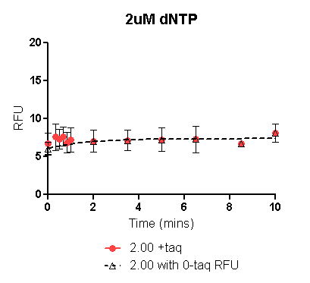
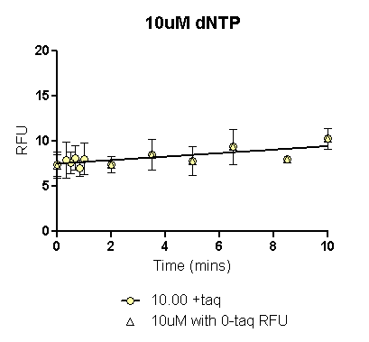
 | 2uM dNTP with 0_{+taq} RFU | 2uM dNTP with 0_{-taq} RFU
One-phase association | Not converged
R square |  | 0.09496
 | 2uM dNTP with 0_{+taq} |  | 2uM dNTP with 0_{-taq}
Mins | RFU | dRFU/ dT | RFU | dRFU/ dT
0.000 |  |  | 6.079
0.067 |  | 0.000 | 6.128 | 0.730
0.134 |  | 0.000 | 6.175 | 0.702
0.201 |  | 0.000 | 6.220 | 0.676
 | 10uM dNTP with 0_{+taq} RFU | 10uM dNTP with 0_{-taq} RFU
One-phase association | Interrupted | Interrupted
 | 10uM dNTP with 0_{+taq} |  | 10uM dNTP with 0_{-taq}
Mins | RFU | dRFU/ dT | RFU | dRFU/ dT
0.000 | 7.496 |  | 7.197
0.067 | 7.509 | 0.194 | 7.213 | 0.234
0.134 | 7.522 | 0.194 | 7.228 | 0.234
0.201 | 7.535 | 0.194 | 7.244 | 0.234

Slide 34
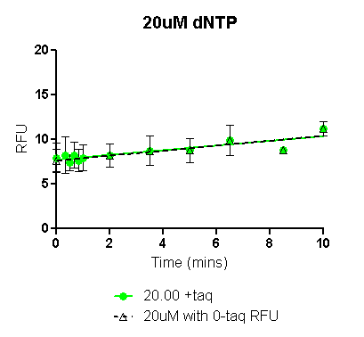
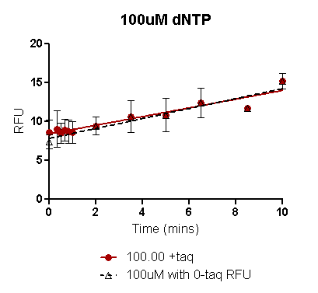
 | 20uM dNTP with 0_{+taq} RFU | 20uM dNTP with 0_{-taq} RFU
One-phase association | Interrupted | Interrupted
 | 20uM dNTP with 0_{+taq} |  | 20uM dNTP with 0_{-taq}
Mins | RFU | dRFU/ dT | RFU | dRFU/ dT
0.000 | 7.724 |  | 7.609
0.067 | 7.742 | 0.264 | 7.627 | 0.280
0.134 | 7.760 | 0.264 | 7.646 | 0.280
0.201 | 7.778 | 0.264 | 7.665 | 0.280
 | 100uM dNTP with 0_{+taq} RFU | 100uM dNTP with 0_{-taq} RFU
One-phase association | Ambiguous | Ambiguous
R square | 0.5440 | 0.6112
 | 100uM dNTP with 0_{+taq} |  | 100uM dNTP with 0_{-taq}
Mins | RFU | dRFU/ dT | RFU | dRFU/ dT
0.000 | 8.404 |  | 7.827
0.067 | 8.442 | 0.560 | 7.870 | 0.642
0.134 | 8.480 | 0.560 | 7.913 | 0.642
0.201 | 8.517 | 0.560 | 7.956 | 0.642

Slide 35
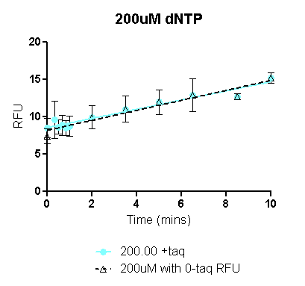
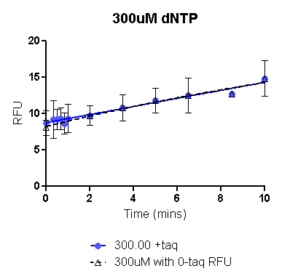
 | 200uM dNTP with 0_{+taq} RFU | 200uM dNTP with 0_{-taq} RFU
One-phase association | Ambiguous | Ambiguous
R square | 0.6247 | 0.6611
 | 200uM dNTP with 0_{+taq} |  | 200M dNTP with 0_{-taq}
Mins | RFU | dRFU/ dT | RFU | dRFU/ dT
0.000 | 8.553 |  | 8.194
0.067 | 8.594 | 0.616 | 8.239 | 0.669
0.134 | 8.635 | 0.616 | 8.284 | 0.669
0.201 | 8.677 | 0.616 | 8.329 | 0.669
 | 300uM dNTP with 0_{+taq} RFU | 300uM dNTP with 0_{-taq} RFU
One-phase association | Ambiguous
R square | 0.5000 | 0.5534
 | 500uM dNTP with 0_{+taq} |  | 500uM dNTP with 0_{-taq}
Mins | RFU | dRFU/ dT | RFU | dRFU/ dT
0.000 | 8.759 |  | 8.234
0.067 | 8.797 | 0.562 | 8.284 | 0.754
0.134 | 8.834 | 0.562 | 8.335 | 0.752
0.201 | 8.872 | 0.561 | 8.385 | 0.750

Slide 36
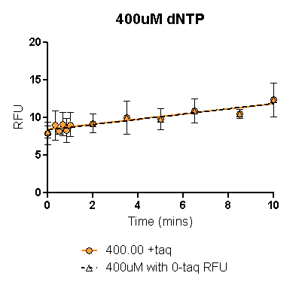
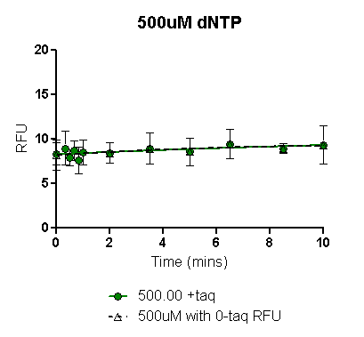
 | 400uM dNTP with 0_{+taq} RFU | 400uM dNTP with 0_{-taq} RFU
One-phase association | Interrupted | Interrupted
 | 200uM dNTP with 0_{+taq} |  | 200M dNTP with 0_{-taq}
Mins | RFU | dRFU/ dT | RFU | dRFU/ dT
0.000 | 8.432 |  | 8.349
0.067 | 8.455 | 0.342 | 8.373 | 0.353
0.134 | 8.478 | 0.342 | 8.397 | 0.353
0.201 | 8.501 | 0.342 | 8.420 | 0.353
 | 500uM dNTP with 0_{+taq} RFU | 500uM dNTP with 0_{-taq} RFU
One-phase association
R square | 0.05015 | 0.04704
 | 500uM dNTP with 0_{+taq} |  | 500uM dNTP with 0_{-taq}
Mins | RFU | dRFU/ dT | RFU | dRFU/ dT
0.000 | 8.281 |  | 8.189
0.067 | 8.290 | 0.131 | 8.203 | 0.201
0.134 | 8.299 | 0.131 | 8.216 | 0.199
0.201 | 8.308 | 0.130 | 8.229 | 0.197

Slide 37
Raw data: Trial 1 (ONLY) 70ºC assay:
The replicates of the first trial ONLY were plotted on Prism to obtain the fitted curves (see following slides).
Due to PCR machine malfunction, data from the second trial has not been used.
In each of the plots in following slides, data has been plotted with either the 0min RFU_{+taq} (colored line) or the 0min RFU_{-taq} (black dashed line).
In general, the 0min RFU_{-taq} might be a more reliable 0min value since experimental limitations result in even the 0min reaction actually being incubated at assay temperature for ~2-4secs resulting in likely erroneous RFUs, when Taq is present in the reaction. Early time point (20secs-1min) are also not accurate due to experimental set up limitation and probably need to be excluded for curve fitting.
For each dNTP conc, the black dashed line (using 0min_{-taq}) also has the early time points excluded. Corrected RFU values from this fitted curve have been used to calculate initial rate as dRFU/dT (see highlighted column).
 | Trial 1 6/17/2013
 | Mins | 2.00 |  |  |  |  | 10.00 |  |  |  |  | 20.00 |  |  |  |  | 100.00 |  |  |  |  | 200.00 |  |  |  |  | 500.00 |  |  |  |  | 1000.00
 |  | Rep 1 | Rep 2 | Rep 3 | Mean | SE | Rep 1 | Rep 2 | Rep 3 | Mean | SE | Rep 1 | Rep 2 | Rep 3 | Mean | SE | Rep 1 | Rep 2 | Rep 3 | Mean | SE | Rep 1 | Rep 2 | Rep 3 | Mean | SE | Rep 1 | Rep 2 | Rep 3 | Mean | SE | Rep 1 | Rep 2 | Rep 3 | Mean | SE
+taq | 10.00 | 8.72 | 5.01 | 8.67 | 7.47 | 2.13 | 10.93 | 7.42 | 11.58 | 9.98 | 2.24 | 12.50 | 13.13 | 13.89 | 13.17 | 0.70 | 17.44 | 18.39 | 18.98 | 18.27 | 0.78 | 17.43 | 18.14 | 20.37 | 18.65 | 1.53 | 10.67 | 10.37 | 11.48 | 10.84 | 0.57 | 9.70 | 9.66 | 9.28 | 9.55 | 0.23
 | 8.50 | 7.97 | 8.74 | 9.14 | 8.62 | 0.59 | 9.94 | 11.64 | 11.90 | 11.16 | 1.07 | 11.18 | 13.01 | 12.39 | 12.19 | 0.93 | 16.07 | 17.44 | 17.52 | 17.01 | 0.82 | 15.69 | 18.09 | 18.27 | 17.35 | 1.44 | 9.46 | 11.53 | 11.29 | 10.76 | 1.13 | 9.26 | 10.11 | 8.94 | 9.44 | 0.60
 | 6.50 | 8.35 | 8.31 | 8.13 | 8.26 | 0.11 | 9.47 | 9.84 | 10.10 | 9.80 | 0.32 | 10.46 | 11.52 | 10.86 | 10.95 | 0.54 | 13.71 | 15.44 | 15.65 | 14.93 | 1.06 | 14.88 | 16.25 | 15.85 | 15.66 | 0.70 | 10.30 | 9.91 | 9.88 | 10.03 | 0.23 | 9.23 | 9.71 | 9.56 | 9.50 | 0.24
 | 5.00 | 7.12 | 9.04 | 9.53 | 8.56 | 1.27 | 9.28 | 11.58 | 10.59 | 10.48 | 1.16 | 10.21 | 12.04 | 11.60 | 11.28 | 0.96 | 12.82 | 15.42 | 15.22 | 14.49 | 1.45 | 13.03 | 15.52 | 17.18 | 15.24 | 2.09 | 8.18 | 10.07 | 10.88 | 9.71 | 1.38 | 8.94 | 7.98 | 8.63 | 8.52 | 0.49
 | 3.50 | 7.56 | 7.95 | 8.07 | 7.86 | 0.27 | 8.35 | 8.39 | 7.35 | 8.03 | 0.59 | 8.89 | 9.37 | 9.65 | 9.30 | 0.38 | 11.02 | 11.18 | 11.81 | 11.34 | 0.42 | 12.04 | 12.31 | 12.51 | 12.29 | 0.24 | 9.17 | 8.88 | 9.39 | 9.15 | 0.26 | 8.57 | 8.76 | 8.97 | 8.77 | 0.20
 | 2.00 | 6.99 | 8.66 | 9.39 | 8.35 | 1.23 | 8.61 | 10.41 | 10.32 | 9.78 | 1.02 | 8.77 | 11.05 | 10.33 | 10.05 | 1.16 | 10.83 | 12.29 | 12.90 | 12.01 | 1.06 | 10.73 | 13.20 | 13.45 | 12.46 | 1.50 | 7.89 | 10.47 | 11.23 | 9.86 | 1.75 | 9.14 | 10.33 | 10.60 | 10.02 | 0.78
 | 1.00 | 7.20 | 7.77 | 7.77 | 7.58 | 0.33 | 7.93 | 8.18 | 7.93 | 8.01 | 0.14 | 8.38 | 8.67 | 8.59 | 8.55 | 0.15 | 9.46 | 9.89 | 10.46 | 9.94 | 0.50 | 10.29 | 8.37 | 10.67 | 9.78 | 1.23 | 8.46 | 8.99 | 9.74 | 9.06 | 0.64 | 7.37 | 8.97 | 9.42 | 8.59 | 1.07
 | 0.83 | 7.09 | 9.54 | 8.87 | 8.50 | 1.27 | 8.20 | 10.04 | 9.54 | 9.26 | 0.95 | 8.37 | 10.41 | 10.44 | 9.74 | 1.19 | 8.89 | 10.67 | 11.70 | 10.42 | 1.42 | 9.49 | 11.14 | 12.19 | 10.94 | 1.36 | 8.26 | 10.35 | 9.81 | 9.48 | 1.08 | 8.44 | 9.97 | 10.03 | 9.48 | 0.90
 | 0.66 | 7.59 | 7.90 | 8.21 | 7.90 | 0.31 | 8.18 | 8.27 | 8.14 | 8.20 | 0.07 | 8.68 | 8.61 | 8.52 | 8.60 | 0.08 | 9.66 | 9.00 | 10.46 | 9.71 | 0.73 | 9.38 | 9.73 | 9.91 | 9.67 | 0.27 | 9.36 | 8.66 | 9.51 | 9.18 | 0.45 | 8.85 | 7.55 | 8.07 | 8.16 | 0.66
 | 0.50 | 8.31 | 8.41 | 9.85 | 8.86 | 0.86 | 9.03 | 10.65 | 10.34 | 10.01 | 0.86 | 9.19 | 9.38 | 9.52 | 9.36 | 0.17 | 9.49 | 10.33 | 10.22 | 10.01 | 0.46 | 10.82 | 10.71 | 10.02 | 10.52 | 0.43 | 9.57 | 11.00 | 9.96 | 10.18 | 0.74 | 9.57 | 10.10 | 9.01 | 9.56 | 0.54
 | 0.33 | 7.69 | 9.99 | 9.56 | 9.08 | 1.23 | 7.73 | 10.56 | 9.86 | 9.39 | 1.47 | 7.83 | 10.05 | 9.62 | 9.17 | 1.18 | 9.02 | 11.54 | 10.17 | 10.24 | 1.26 | 9.47 | 10.28 | 10.90 | 10.22 | 0.72 | 9.05 | 10.52 | 10.12 | 9.90 | 0.76 | 8.25 | 9.93 | 10.93 | 9.70 | 1.35
 | 0.00 | 7.11 | 7.14 | 7.34 | 7.20 | 0.12 | 7.97 | 7.20 | 7.43 | 7.53 | 0.40 | 8.17 | 7.87 | 7.72 | 7.92 | 0.23 | 8.06 | 8.89 | 8.96 | 8.64 | 0.50 | 9.49 | 9.07 | 8.91 | 9.16 | 0.30 | 8.94 | 8.59 | 8.56 | 8.70 | 0.21 | 8.31 | 8.47 | 8.70 | 8.49 | 0.20
 | 10.00 | 7.77 | 6.88 | 7.18 | 7.28 | 0.45 | 8.62 | 9.51 | 7.90 | 8.68 | 0.80 | 8.54 | 8.87 | 10.54 | 9.32 | 1.07 | 9.39 | 10.29 | 10.45 | 10.04 | 0.57 | 8.84 | 11.03 | 11.26 | 10.38 | 1.34 | 8.93 | 9.31 | 10.79 | 9.67 | 0.99 | 7.58 | 10.77 | 10.05 | 9.47 | 1.67
 | 5.00 | 7.19 | 8.48 | 9.18 | 8.28 | 1.01 | 9.71 | 8.46 | 10.10 | 9.42 | 0.86 | 10.12 | 10.47 | 10.89 | 10.49 | 0.39 | 10.36 | 9.66 | 11.19 | 10.40 | 0.77 | 9.14 | 9.67 | 10.57 | 9.79 | 0.72 | 9.97 | 10.61 | 10.30 | 10.29 | 0.32 | 8.35 | 9.34 | 10.41 | 9.37 | 1.03
-taq | 0.00 | 6.67 | 6.51 | 6.97 | 6.72 | 0.23 | 7.23 | 7.92 | 7.70 | 7.62 | 0.35 | 7.20 | 7.96 | 8.39 | 7.85 | 0.60 | 8.24 | 7.76 | 8.51 | 8.17 | 0.38 | 7.39 | 8.45 | 8.37 | 8.07 | 0.59 | 8.77 | 8.51 | 9.21 | 8.83 | 0.36 | 8.32 | 7.26 | 9.28 | 8.29 | 1.01

Slide 38
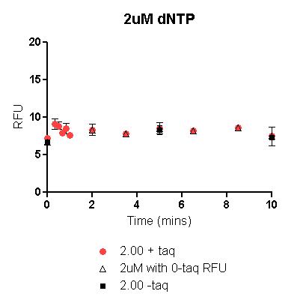
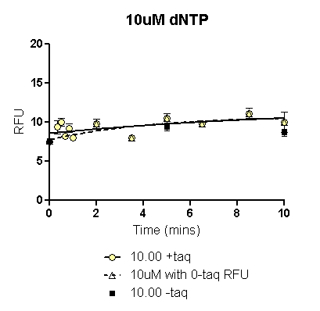
 | 2uM dNTP with 0_{+taq} RFU | 2uM dNTP with 0_{-taq} RFU
One-phase association | Not converged | Ambiguous
R square |  | 0.2238
 | 2uM dNTP with 0_{+taq} |  | 2uM dNTP with 0_{-taq}
Mins | RFU | dRFU/ dT | RFU | dRFU/ dT
0.000 |  |  | 6.717
0.067 |  | 0.000 | 8.186 | 21.895
0.134 |  | 0.000 | 8.186 | 0.000
0.201 |  | 0.000 | 8.186 | 0.000
 | 10uM dNTP with 0_{+taq} RFU | 10uM dNTP with 0_{-taq} RFU
One-phase association
R square | 0.2388 | 0.3520
 | 10uM dNTP with 0_{+taq} |  | 10uM dNTP with 0_{-taq}
Mins | RFU | dRFU/ dT | RFU | dRFU/ dT
0.000 | 8.572 |  | 7.764
0.067 | 8.592 | 0.297 | 7.810 | 0.685
0.134 | 8.612 | 0.295 | 7.856 | 0.675
0.201 | 8.631 | 0.293 | 7.900 | 0.665

Slide 39
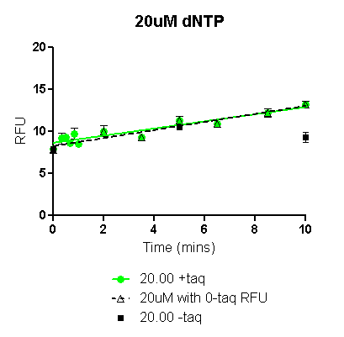
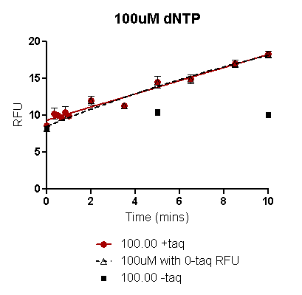
 | 20uM dNTP with 0_{+taq} RFU | 20uM dNTP with 0_{-taq} RFU
One-phase association | Ambiguous | Ambiguous
R square | 0.7493 | 0.7828
 | 20uM dNTP with 0_{+taq} |  | 20uM dNTP with 0_{-taq}
Mins | RFU | dRFU/ dT | RFU | dRFU/ dT
0.000 | 8.647 |  | 8.256
0.067 | 8.675 | 0.426 | 8.289 | 0.479
0.134 | 8.704 | 0.426 | 8.321 | 0.479
0.201 | 8.732 | 0.426 | 8.353 | 0.479
 | 100uM dNTP with 0_{+taq} RFU | 100uM dNTP with 0_{-taq} RFU
One-phase association | Ambiguous
R square | 0.9069 | 0.9074
 | 100uM dNTP with 0_{+taq} |  | 100uM dNTP with 0_{-taq}
Mins | RFU | dRFU/ dT | RFU | dRFU/ dT
0.000 | 9.364 |  | 8.529
0.067 | 9.424 | 0.893 | 8.610 | 1.215
0.134 | 9.484 | 0.893 | 8.692 | 1.211
0.201 | 9.544 | 0.893 | 8.773 | 1.207

Slide 40
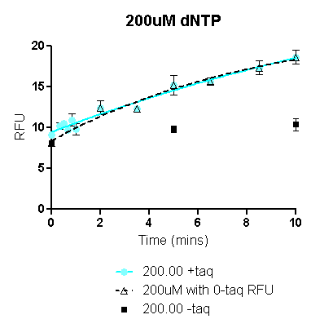
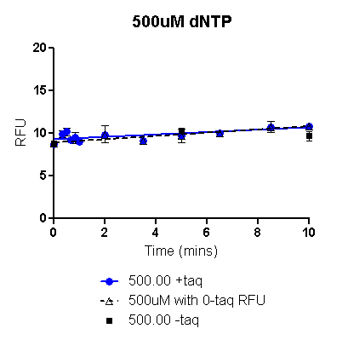
 | 200uM dNTP with 0_{+taq} RFU | 200uM dNTP with 0_{-taq} RFU
One-phase association
R square | 0.8884 | 0.8756
 | 200uM dNTP with 0_{+taq} |  | 200M dNTP with 0_{-taq}
Mins | RFU | dRFU/ dT | RFU | dRFU/ dT
0.000 | 9.481 |  | 8.405
0.067 | 9.558 | 1.145 | 8.516 | 1.661
0.134 | 9.635 | 1.141 | 8.627 | 1.648
0.201 | 9.711 | 1.137 | 8.736 | 1.635
 | 500uM dNTP with 0_{+taq} RFU | 500uM dNTP with 0_{-taq} RFU
One-phase association | Interrupted | Interrupted
 | 500uM dNTP with 0_{+taq} |  | 500uM dNTP with 0_{-taq}
Mins | RFU | dRFU/ dT | RFU | dRFU/ dT
0.000 | 9.279 |  | 8.911
0.067 | 9.289 | 0.141 | 8.924 | 0.192
0.134 | 9.298 | 0.141 | 8.937 | 0.192
0.201 | 9.308 | 0.141 | 8.950 | 0.192

Slide 41
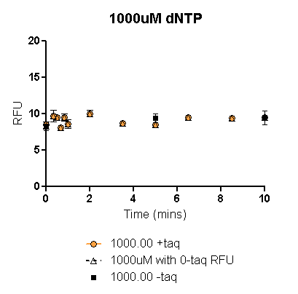
 | 1000uM dNTP with 0_{+taq} RFU | 1000uM dNTP with 0_{-taq} RFU
One-phase association | Not Converged | Not Converged
 | 200uM dNTP with 0_{+taq} |  | 200M dNTP with 0_{-taq}
Mins | RFU | dRFU/ dT | RFU | dRFU/ dT
0.000
0.067
0.134
0.201

Slide 42
Raw data: Trials 1& 2 75ºC assay:
The means of replicates in each trial (columns shaded orange and green respectively) were plotted on Prism to obtain the fitted curve (see following slides).
 | Trial 1 7/4/2013
 | Mins | 2.00 |  |  |  |  | 10.00 |  |  |  |  | 20.00 |  |  |  |  | 100.00 |  |  |  |  | 200.00 |  |  |  |  | 300.00 |  |  |  |  | 400.00 |  |  |  |  | 500.00
 |  | Rep 1 | Rep 2 | Rep 3 | Mean | SE | Rep 1 | Rep 2 | Rep 3 | Mean | SE | Rep 1 | Rep 2 | Rep 3 | Mean | SE | Rep 1 | Rep 2 | Rep 3 | Mean | SE | Rep 1 | Rep 2 | Rep 3 | Mean | SE | Rep 1 | Rep 2 | Rep 3 | Mean | SE | Rep 1 | Rep 2 | Rep 3 | Mean | SE | Rep 1 | Rep 2 | Rep 3 | Mean | SE
+taq | 10.00 | 5.69 | 7.29 | 7.18 | 6.72 | 0.89 | 7.52 | 9.23 | 8.87 | 8.54 | 0.90 | 8.09 | 9.93 | 11.07 | 9.70 | 1.51 | 13.09 | 15.64 | 16.04 | 14.92 | 1.60 | 14.52 | 15.68 | 16.77 | 15.66 | 1.13 | 13.05 | 15.24 | 14.82 | 14.37 | 1.16 | 9.89 | 9.81 | 11.21 | 10.31 | 0.78 | 6.97 | 9.63 | 8.45 | 8.35 | 1.33
 | 8.50 | 5.99 | 6.18 | 4.73 | 5.63 | 0.79 | 7.54 | 7.64 | 7.19 | 7.46 | 0.23 | 8.98 | 8.85 | 8.51 | 8.78 | 0.24 | 13.06 | 10.14 | 12.16 | 11.79 | 1.50 | 10.88 | 12.49 | 11.19 | 11.52 | 0.85 | 11.35 | 11.17 | 10.20 | 10.91 | 0.62 | 6.45 | 6.65 | 8.98 | 7.36 | 1.41 | 5.47 | 5.76 | 8.37 | 6.53 | 1.60
 | 6.50 | 5.36 | 7.44 | 6.79 | 6.53 | 1.07 | 6.95 | 8.88 | 8.38 | 8.07 | 1.00 | 7.16 | 9.40 | 9.25 | 8.60 | 1.25 | 10.41 | 13.82 | 11.80 | 12.01 | 1.71 | 10.78 | 14.20 | 12.66 | 12.55 | 1.71 | 11.97 | 12.16 | 11.52 | 11.88 | 0.33 | 8.00 | 9.19 | 9.44 | 8.88 | 0.77 | 7.57 | 7.90 | 7.62 | 7.69 | 0.18
 | 5.00 | 5.54 | 5.91 | 4.49 | 5.31 | 0.74 | 6.57 | 6.77 | 6.46 | 6.60 | 0.15 | 7.49 | 7.58 | 7.74 | 7.60 | 0.12 | 10.88 | 10.67 | 11.45 | 11.00 | 0.40 | 10.94 | 11.96 | 10.37 | 11.09 | 0.81 | 11.06 | 10.01 | 10.25 | 10.44 | 0.55 | 7.41 | 7.30 | 8.25 | 7.65 | 0.52 | 7.85 | 6.33 | 7.59 | 7.26 | 0.82
 | 3.50 | 5.05 | 5.89 | 6.48 | 5.81 | 0.71 | 4.33 | 7.94 | 7.25 | 6.51 | 1.92 | 6.28 | 8.76 | 7.25 | 7.43 | 1.25 | 8.59 | 10.50 | 10.66 | 9.92 | 1.15 | 8.43 | 9.61 | 10.87 | 9.64 | 1.22 | 8.01 | 10.23 | 10.10 | 9.45 | 1.25 | 7.46 | 7.50 | 8.43 | 7.79 | 0.55 | 6.10 | 7.36 | 8.02 | 7.16 | 0.97
 | 2.00 | 6.09 | 6.53 | 6.33 | 6.31 | 0.22 | 6.57 | 6.55 | 6.12 | 6.41 | 0.25 | 6.61 | 7.54 | 7.08 | 7.08 | 0.46 | 9.26 | 8.40 | 8.72 | 8.79 | 0.43 | 9.24 | 9.85 | 9.22 | 9.44 | 0.35 | 9.47 | 8.85 | 8.91 | 9.08 | 0.34 | 7.38 | 6.33 | 8.17 | 7.29 | 0.93 | 8.15 | 7.00 | 7.48 | 7.54 | 0.58
 | 1.00 | 4.82 | 6.49 | 6.97 | 6.09 | 1.13 | 6.45 | 8.33 | 7.86 | 7.55 | 0.98 | 6.42 | 8.49 | 8.06 | 7.66 | 1.09 | 7.46 | 9.60 | 9.25 | 8.77 | 1.15 | 7.49 | 9.45 | 9.40 | 8.78 | 1.11 | 8.22 | 9.81 | 9.61 | 9.21 | 0.87 | 7.08 | 8.45 | 9.42 | 8.32 | 1.17 | 7.19 | 8.89 | 8.42 | 8.17 | 0.88
 | 0.83 | 6.12 | 6.78 | 6.13 | 6.34 | 0.38 | 6.64 | 6.64 | 6.58 | 6.62 | 0.03 | 6.87 | 6.89 | 7.18 | 6.98 | 0.17 | 8.16 | 8.22 | 8.12 | 8.17 | 0.05 | 8.53 | 8.30 | 8.44 | 8.42 | 0.11 | 8.47 | 8.34 | 8.25 | 8.36 | 0.11 | 8.29 | 7.05 | 8.16 | 7.83 | 0.68 | 7.53 | 6.49 | 7.59 | 7.20 | 0.62
 | 0.66 | 4.22 | 7.51 | 6.92 | 6.22 | 1.75 | 5.80 | 7.51 | 8.01 | 7.11 | 1.16 | 5.89 | 8.24 | 7.04 | 7.06 | 1.18 | 6.21 | 9.23 | 8.68 | 8.04 | 1.61 | 6.67 | 9.71 | 6.91 | 7.76 | 1.69 | 5.90 | 9.07 | 8.87 | 7.95 | 1.78 | 7.08 | 7.39 | 8.55 | 7.67 | 0.78 | 7.07 | 8.98 | 8.80 | 8.28 | 1.05
 | 0.50 | 5.91 | 6.22 | 5.84 | 5.99 | 0.20 | 6.59 | 5.98 | 6.35 | 6.31 | 0.31 | 6.22 | 5.31 | 5.32 | 5.62 | 0.53 | 6.78 | 7.18 | 7.71 | 7.22 | 0.47 | 7.36 | 7.43 | 7.42 | 7.40 | 0.04 | 7.88 | 5.84 | 5.96 | 6.56 | 1.14 | 7.43 | 7.49 | 7.24 | 7.39 | 0.13 | 7.30 | 6.17 | 7.28 | 6.92 | 0.65
 | 0.33 | 4.05 | 6.82 | 6.86 | 5.91 | 1.61 | 4.86 | 8.11 | 7.07 | 6.68 | 1.66 | 4.74 | 7.18 | 7.81 | 6.57 | 1.62 | 6.69 | 8.51 | 8.59 | 7.93 | 1.07 | 6.08 | 7.43 | 6.46 | 6.66 | 0.70 | 6.58 | 8.95 | 8.50 | 8.01 | 1.26 | 6.75 | 6.63 | 8.62 | 7.33 | 1.12 | 6.41 | 7.78 | 8.33 | 7.51 | 0.99
 | 0.00 | 5.89 | 6.85 | 6.10 | 6.28 | 0.50 | 6.28 | 6.38 | 5.20 | 5.95 | 0.66 | 6.97 | 6.61 | 7.07 | 6.89 | 0.24 | 7.32 | 7.21 | 7.48 | 7.34 | 0.14 | 6.52 | 7.40 | 7.48 | 7.13 | 0.53 | 7.03 | 7.06 | 6.74 | 6.94 | 0.18 | 6.05 | 6.06 | 6.33 | 6.15 | 0.16 | 7.37 | 6.24 | 5.70 | 6.44 | 0.85
 | 10.00 | 5.45 | 5.65 | 5.95 | 5.68 | 0.25 | 6.90 | 6.09 | 7.65 | 6.88 | 0.78 | 6.81 | 6.98 | 6.76 | 6.85 | 0.12 | 7.53 | 5.75 | 6.95 | 6.75 | 0.91 | 7.14 | 8.03 | 7.43 | 7.53 | 0.45 | 6.63 | 8.55 | 9.01 | 8.06 | 1.26 | 6.86 | 5.92 | 8.20 | 6.99 | 1.14 | 6.20 | 7.90 | 6.97 | 7.02 | 0.85
 | 5.00 | 5.49 | 5.21 | 5.45 | 5.38 | 0.15 | 5.88 | 6.56 | 6.46 | 6.30 | 0.37 | 6.36 | 7.07 | 6.53 | 6.66 | 0.37 | 6.45 | 7.07 | 6.77 | 6.76 | 0.31 | 6.89 | 6.86 | 7.04 | 6.93 | 0.10 | 6.04 | 6.58 | 7.27 | 6.63 | 0.62 | 6.66 | 7.40 | 6.76 | 6.94 | 0.40 | 6.84 | 6.64 | 7.76 | 7.08 | 0.60
-taq | 0.00 | 5.34 | 5.42 | 6.17 | 5.64 | 0.46 | 6.28 | 7.36 | 7.10 | 6.91 | 0.56 | 5.72 | 7.38 | 6.96 | 6.69 | 0.86 | 5.87 | 6.53 | 7.57 | 6.66 | 0.85 | 5.34 | 6.25 | 7.67 | 6.42 | 1.17 | 7.06 | 8.08 | 8.26 | 7.80 | 0.65 | 6.62 | 6.40 | 8.63 | 7.22 | 1.23 | 7.43 | 7.87 | 7.47 | 7.59 | 0.25
 | Trial 2 7/9/2013
 | Mins | 2.00 |  |  |  |  | 10.00 |  |  |  |  | 20.00 |  |  |  |  | 100.00 |  |  |  |  | 200.00 |  |  |  |  | 300.00 |  |  |  |  | 400.00 |  |  |  |  | 500.00
 |  | Rep 1 | Rep 2 | Rep 3 | Mean | SE | Rep 1 | Rep 2 | Rep 3 | Mean | SE | Rep 1 | Rep 2 | Rep 3 | Mean | SE | Rep 1 | Rep 2 | Rep 3 | Mean | SE | Rep 1 | Rep 2 | Rep 3 | Mean | SE | Rep 1 | Rep 2 | Rep 3 | Mean | SE | Rep 1 | Rep 2 | Rep 3 | Mean | SE | Rep 1 | Rep 2 | Rep 3 | Mean | SE
+taq | 10.00 | 8.11 | 9.52 | 10.33 | 9.32 | 1.13 | 10.68 | 11.63 | 11.54 | 11.28 | 0.52 | 11.53 | 13.02 | 13.20 | 12.58 | 0.92 | 15.08 | 17.98 | 19.08 | 17.38 | 2.07 | 16.87 | 18.80 | 20.03 | 18.57 | 1.59 | 14.30 | 18.46 | 15.58 | 16.11 | 2.13 | 12.22 | 13.70 | 14.16 | 13.36 | 1.01 | 10.08 | 12.10 | 11.33 | 11.17 | 1.02
 | 8.50 | 6.85 | 8.64 | 8.62 | 8.03 | 1.02 | 9.70 | 9.74 | 8.42 | 9.29 | 0.75 | 9.18 | 11.08 | 10.46 | 10.24 | 0.97 | 14.40 | 15.20 | 15.88 | 15.16 | 0.74 | 16.62 | 15.94 | 15.62 | 16.06 | 0.51 | 12.18 | 15.62 | 13.94 | 13.91 | 1.72 | 11.33 | 11.09 | 11.78 | 11.40 | 0.35 | 10.24 | 9.37 | 7.25 | 8.95 | 1.54
 | 6.50 | 6.64 | 8.18 | 9.71 | 8.18 | 1.54 | 8.85 | 11.39 | 10.61 | 10.28 | 1.30 | 10.29 | 11.90 | 11.77 | 11.32 | 0.89 | 12.71 | 15.14 | 16.66 | 14.84 | 1.99 | 12.99 | 15.79 | 17.04 | 15.27 | 2.07 | 11.52 | 13.87 | 15.12 | 13.50 | 1.83 | 10.62 | 11.86 | 12.03 | 11.50 | 0.77 | 10.50 | 9.69 | 8.48 | 9.56 | 1.02
 | 5.00 | 7.95 | 7.61 | 7.37 | 7.64 | 0.29 | 8.79 | 8.89 | 8.98 | 8.89 | 0.10 | 9.89 | 10.12 | 10.24 | 10.08 | 0.18 | 11.27 | 12.44 | 13.61 | 12.44 | 1.17 | 12.11 | 14.00 | 13.47 | 13.19 | 0.97 | 12.23 | 13.30 | 13.23 | 12.92 | 0.60 | 9.60 | 11.01 | 11.15 | 10.59 | 0.86 | 9.38 | 7.94 | 9.24 | 8.85 | 0.79
 | 3.50 | 7.72 | 10.61 | 10.46 | 9.60 | 1.63 | 8.42 | 12.01 | 10.39 | 10.27 | 1.80 | 9.00 | 12.96 | 10.93 | 10.96 | 1.98 | 11.36 | 14.72 | 13.66 | 13.25 | 1.72 | 11.39 | 14.06 | 14.15 | 13.20 | 1.57 | 10.32 | 14.23 | 13.68 | 12.74 | 2.12 | 9.36 | 11.73 | 12.23 | 11.11 | 1.53 | 10.87 | 15.08 | 10.68 | 12.21 | 2.49
 | 2.00 | 8.32 | 8.79 | 7.66 | 8.26 | 0.57 | 8.47 | 9.00 | 8.01 | 8.49 | 0.49 | 8.85 | 9.81 | 9.43 | 9.36 | 0.48 | 10.27 | 11.46 | 11.72 | 11.15 | 0.77 | 11.83 | 11.70 | 11.61 | 11.71 | 0.11 | 11.34 | 11.04 | 11.32 | 11.23 | 0.17 | 10.39 | 9.77 | 10.57 | 10.24 | 0.42 | 9.89 | 9.39 | 9.55 | 9.61 | 0.26
 | 1.00 | 7.58 | 9.69 | 9.25 | 8.84 | 1.11 | 8.46 | 10.90 | 9.74 | 9.70 | 1.22 | 7.92 | 9.89 | 10.48 | 9.43 | 1.34 | 8.96 | 11.07 | 11.43 | 10.49 | 1.33 | 8.68 | 11.10 | 10.69 | 10.16 | 1.29 | 7.66 | 11.80 | 11.40 | 10.29 | 2.29 | 8.79 | 10.66 | 10.82 | 10.09 | 1.13 | 9.96 | 10.01 | 10.05 | 10.01 | 0.05
 | 0.83 | 8.36 | 5.89 | 5.27 | 6.51 | 1.64 | 9.15 | 8.85 | 8.41 | 8.80 | 0.37 | 9.43 | 8.89 | 9.37 | 9.23 | 0.29 | 10.15 | 9.88 | 10.68 | 10.24 | 0.41 | 9.72 | 10.35 | 10.65 | 10.24 | 0.48 | 10.75 | 10.16 | 8.07 | 9.66 | 1.41 | 9.17 | 8.97 | 8.99 | 9.04 | 0.11 | 9.33 | 6.98 | 9.31 | 8.54 | 1.35
 | 0.66 | 7.62 | 9.43 | 9.24 | 8.76 | 1.00 | 8.17 | 11.07 | 10.24 | 9.83 | 1.49 | 8.32 | 9.46 | 10.75 | 9.51 | 1.22 | 8.99 | 12.53 | 9.96 | 10.49 | 1.83 | 9.01 | 12.20 | 12.25 | 11.15 | 1.86 | 7.77 | 12.66 | 11.06 | 10.50 | 2.49 | 6.94 | 11.10 | 8.88 | 8.97 | 2.08 | 8.06 | 10.21 | 10.43 | 9.57 | 1.31
 | 0.50 | 7.98 | 8.06 | 7.39 | 7.81 | 0.36 | 8.60 | 8.03 | 8.26 | 8.30 | 0.29 | 6.98 | 8.27 | 9.12 | 8.12 | 1.08 | 8.49 | 9.73 | 9.66 | 9.29 | 0.69 | 9.68 | 10.27 | 10.25 | 10.07 | 0.33 | 8.39 | 9.96 | 10.21 | 9.52 | 0.99 | 7.78 | 9.69 | 10.51 | 9.33 | 1.40 | 6.82 | 8.99 | 7.26 | 7.69 | 1.15
 | 0.33 | 7.55 | 9.32 | 9.39 | 8.75 | 1.04 | 7.12 | 11.28 | 10.71 | 9.70 | 2.25 | 7.87 | 10.46 | 10.95 | 9.76 | 1.65 | 9.13 | 12.45 | 9.33 | 10.30 | 1.86 | 9.51 | 11.05 | 11.58 | 10.71 | 1.07 | 8.48 | 12.04 | 11.84 | 10.79 | 2.00 | 6.43 | 10.86 | 11.05 | 9.45 | 2.62 | 7.47 | 10.03 | 8.06 | 8.52 | 1.34
 | 0.00 | 8.70 | 8.73 | 8.27 | 8.57 | 0.26 | 7.48 | 5.93 | 6.03 | 6.48 | 0.87 | 8.86 | 9.25 | 7.95 | 8.69 | 0.67 | 7.99 | 10.10 | 10.47 | 9.52 | 1.34 | 9.62 | 10.45 | 10.37 | 10.15 | 0.46 | 10.44 | 10.17 | 10.23 | 10.28 | 0.14 | 9.32 | 9.48 | 7.97 | 8.92 | 0.83 | 11.19 | 9.70 | 9.81 | 10.23 | 0.83
-taq | 10.00 | 8.11 | 9.11 | 9.62 | 8.94 | 0.77 | 10.06 | 9.84 | 10.96 | 10.29 | 0.59 | 10.15 | 11.10 | 11.60 | 10.95 | 0.74 | 10.69 | 11.35 | 11.59 | 11.21 | 0.47 | 9.74 | 11.87 | 11.55 | 11.05 | 1.15 | 12.34 | 11.59 | 12.56 | 12.16 | 0.51 | 9.76 | 10.88 | 12.14 | 10.93 | 1.19 | 8.54 | 9.78 | 10.61 | 9.65 | 1.04
 | 5.00 | 7.45 | 7.89 | 7.38 | 7.57 | 0.28 | 8.03 | 7.71 | 8.38 | 8.04 | 0.34 | 8.28 | 8.40 | 8.78 | 8.49 | 0.26 | 7.80 | 7.06 | 7.92 | 7.59 | 0.46 | 8.50 | 8.80 | 8.98 | 8.76 | 0.24 | 9.08 | 7.54 | 8.73 | 8.45 | 0.81 | 9.33 | 8.87 | 10.57 | 9.59 | 0.88 | 9.04 | 7.92 | 9.09 | 8.68 | 0.66
 | 0.00 | 7.34 | 8.47 | 5.92 | 7.24 | 1.28 | 7.28 | 8.06 | 9.71 | 8.35 | 1.24 | 5.35 | 6.17 | 9.15 | 6.89 | 2.00 | 7.94 | 6.73 | 9.25 | 7.97 | 1.26 | 7.11 | 8.30 | 7.96 | 7.79 | 0.61 | 7.20 | 9.49 | 9.64 | 8.78 | 1.37 | 9.52 | 8.20 | 9.24 | 8.99 | 0.70 | 10.52 | 11.37 | 10.03 | 10.64 | 0.68

Slide 43
Mean of 2 trials: 75ºC assay
In each of the plots in following slides, data has been plotted with either the 0min RFU_{+taq} (colored line) or the 0min RFU_{-taq} (black dashed line).
In general, the 0min RFU_{-taq} might be a more reliable 0min value since experimental limitations result in even the 0min reaction actually being incubated at assay temperature for ~2-4secs resulting in likely erroneous RFUs, when Taq is present in the reaction. Early time point (20secs-1min) are also not accurate due to experimental set up limitation and probably need to be excluded for curve fitting.
For each dNTP conc, the black dashed line (using 0min_{-taq}) also has the early time points excluded. Corrected RFU values from this fitted curve have been used to calculate initial rate as dRFU/dT (see highlighted column).
 |  | 2.00 |  |  |  | 10.00 |  |  |  | 20.00 |  |  |  | 100.00 |  |  |  | 200.00 |  |  |  | 300.00 |  |  |  | 400.00 |  |  |  | 500.00
 | Mins | Mean 1 | Mean 2 | Mean of 2 trials | SE | Mean 1 | Mean 2 | Mean of 2 trials | SE | Mean 1 | Mean 2 | Mean of 2 trials | SE | Mean 1 | Mean 2 | Mean of 2 trials | SE | Mean 1 | Mean 2 | Mean of 2 trials | SE | Mean 1 | Mean 2 | Mean of 2 trials | SE | Mean 1 | Mean 2 | Mean of 2 trials | SE | Mean 1 | Mean 2 | Mean of 2 trials | SE
+taq | 10.00 | 6.72 | 9.32 | 8.02 | 1.841 | 8.54 | 11.283 | 9.91 | 1.939 | 9.70 | 12.58 | 11.14 | 2.042 | 14.92 | 17.38 | 16.15 | 1.737 | 15.66 | 18.57 | 17.11 | 2.058 | 14.37 | 16.11 | 15.24 | 1.233 | 10.31 | 13.36 | 11.83 | 2.160 | 8.35 | 11.17 | 9.76 | 1.994
 | 8.50 | 5.63 | 8.03 | 6.83 | 1.697 | 7.46 | 9.287 | 8.37 | 1.293 | 8.78 | 10.24 | 9.51 | 1.031 | 11.79 | 15.16 | 13.47 | 2.385 | 11.52 | 16.06 | 13.79 | 3.210 | 10.91 | 13.91 | 12.41 | 2.126 | 7.36 | 11.40 | 9.38 | 2.857 | 6.53 | 8.95 | 7.74 | 1.711
 | 6.50 | 6.53 | 8.18 | 7.35 | 1.164 | 8.07 | 10.282 | 9.18 | 1.564 | 8.60 | 11.32 | 9.96 | 1.923 | 12.01 | 14.84 | 13.42 | 1.999 | 12.55 | 15.27 | 13.91 | 1.928 | 11.88 | 13.50 | 12.69 | 1.146 | 8.88 | 11.50 | 10.19 | 1.857 | 7.69 | 9.56 | 8.63 | 1.318
 | 5.00 | 5.31 | 7.64 | 6.48 | 1.650 | 6.60 | 8.888 | 7.74 | 1.618 | 7.60 | 10.08 | 8.84 | 1.754 | 11.00 | 12.44 | 11.72 | 1.018 | 11.09 | 13.19 | 12.14 | 1.487 | 10.44 | 12.92 | 11.68 | 1.754 | 7.65 | 10.59 | 9.12 | 2.075 | 7.26 | 8.85 | 8.05 | 1.129
 | 3.50 | 5.81 | 9.60 | 7.70 | 2.680 | 6.51 | 10.273 | 8.39 | 2.663 | 7.43 | 10.96 | 9.20 | 2.497 | 9.92 | 13.25 | 11.58 | 2.354 | 9.64 | 13.20 | 11.42 | 2.520 | 9.45 | 12.74 | 11.09 | 2.332 | 7.79 | 11.11 | 9.45 | 2.343 | 7.16 | 12.21 | 9.69 | 3.570
 | 2.00 | 6.31 | 8.26 | 7.29 | 1.376 | 6.41 | 8.492 | 7.45 | 1.469 | 7.08 | 9.36 | 8.22 | 1.616 | 8.79 | 11.15 | 9.97 | 1.667 | 9.44 | 11.71 | 10.57 | 1.611 | 9.08 | 11.23 | 10.15 | 1.526 | 7.29 | 10.24 | 8.77 | 2.086 | 7.54 | 9.61 | 8.58 | 1.460
 | 1.00 | 6.09 | 8.84 | 7.47 | 1.942 | 7.55 | 9.700 | 8.62 | 1.523 | 7.66 | 9.43 | 8.54 | 1.253 | 8.77 | 10.49 | 9.63 | 1.216 | 8.78 | 10.16 | 9.47 | 0.974 | 9.21 | 10.29 | 9.75 | 0.760 | 8.32 | 10.09 | 9.20 | 1.255 | 8.17 | 10.01 | 9.09 | 1.301
 | 0.83 | 6.34 | 6.51 | 6.42 | 0.116 | 6.62 | 8.804 | 7.71 | 1.545 | 6.98 | 9.23 | 8.11 | 1.591 | 8.17 | 10.24 | 9.20 | 1.462 | 8.42 | 10.24 | 9.33 | 1.283 | 8.36 | 9.66 | 9.01 | 0.922 | 7.83 | 9.04 | 8.44 | 0.854 | 7.20 | 8.54 | 7.87 | 0.945
 | 0.66 | 6.22 | 8.76 | 7.49 | 1.800 | 7.11 | 9.827 | 8.47 | 1.924 | 7.06 | 9.51 | 8.28 | 1.736 | 8.04 | 10.49 | 9.27 | 1.734 | 7.76 | 11.15 | 9.46 | 2.396 | 7.95 | 10.50 | 9.22 | 1.803 | 7.67 | 8.97 | 8.32 | 0.919 | 8.28 | 9.57 | 8.92 | 0.909
 | 0.50 | 5.99 | 7.81 | 6.90 | 1.288 | 6.31 | 8.297 | 7.30 | 1.409 | 5.62 | 8.12 | 6.87 | 1.773 | 7.22 | 9.29 | 8.26 | 1.462 | 7.40 | 10.07 | 8.73 | 1.885 | 6.56 | 9.52 | 8.04 | 2.092 | 7.39 | 9.33 | 8.36 | 1.372 | 6.92 | 7.69 | 7.30 | 0.544
 | 0.33 | 5.91 | 8.75 | 7.33 | 2.011 | 6.68 | 9.704 | 8.19 | 2.137 | 6.57 | 9.76 | 8.17 | 2.253 | 7.93 | 10.30 | 9.12 | 1.677 | 6.66 | 10.71 | 8.69 | 2.868 | 8.01 | 10.79 | 9.40 | 1.962 | 7.33 | 9.45 | 8.39 | 1.496 | 7.51 | 8.52 | 8.01 | 0.715
 | 0.00 | 6.28 | 8.57 | 7.42 | 1.614 | 5.95 | 6.483 | 6.22 | 0.374 | 6.89 | 8.69 | 7.79 | 1.273 | 7.34 | 9.52 | 8.43 | 1.544 | 7.13 | 10.15 | 8.64 | 2.129 | 6.94 | 10.28 | 8.61 | 2.360 | 6.15 | 8.92 | 7.54 | 1.964 | 6.44 | 10.23 | 8.33 | 2.684
-taq | 0.00 | 5.64 | 7.24 | 6.44 | 1.131 | 6.91 | 8.351 | 7.63 | 1.018 | 6.69 | 6.89 | 6.79 | 0.142 | 6.66 | 7.97 | 7.32 | 0.931 | 6.42 | 7.79 | 7.11 | 0.970 | 7.80 | 8.78 | 8.29 | 0.689 | 7.22 | 8.99 | 8.10 | 1.250 | 7.59 | 10.64 | 9.12 | 2.156

Slide 44
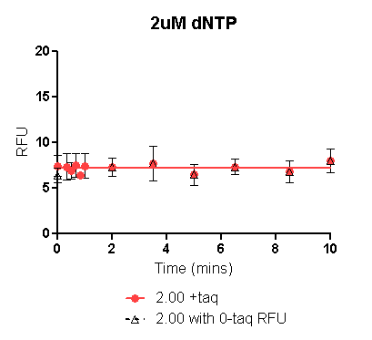
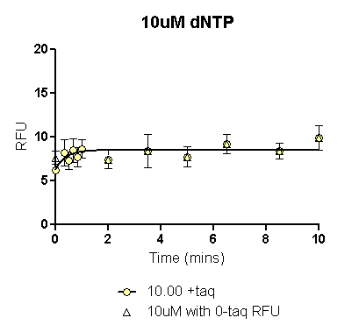
 | 2uM dNTP with 0_{+taq} RFU | 2uM dNTP with 0_{-taq} RFU
One-phase association |  | Not converged
R square | 0.002253
 | 2uM dNTP with 0_{+taq} |  | 2uM dNTP with 0_{-taq}
Mins | RFU | dRFU/ dT | RFU | dRFU/ dT
0.000 | 7.428
0.067 | 7.334 | -1.391 |  | 0.000
0.134 | 7.280 | -0.807 |  | 0.000
0.201 | 7.249 | -0.469 |  | 0.000
 | 10uM dNTP with 0_{+taq} RFU | 10uM dNTP with 0_{-taq} RFU
One-phase association |  | Interrupted
R square | 0.1653
 | 10uM dNTP with 0_{+taq} |  | 10uM dNTP with 0_{-taq}
Mins | RFU | dRFU/ dT | RFU | dRFU/ dT
0.000 | 6.320 |  | 7.355
0.067 | 6.673 | 5.265 | 7.368 | 0.203
0.134 | 6.970 | 4.413 | 7.382 | 0.203
0.201 | 7.218 | 3.699 | 7.396 | 0.203

Slide 45
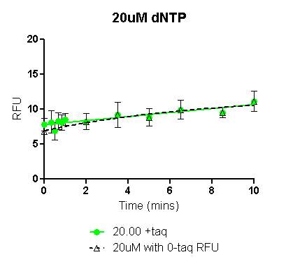
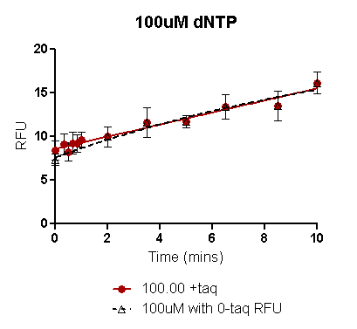
 | 20uM dNTP with 0_{+taq} RFU | 20uM dNTP with 0_{-taq} RFU
One-phase association | Interrupted
R square |  | 0.4545
 | 20uM dNTP with 0_{+taq} |  | 20uM dNTP with 0_{-taq}
Mins | RFU | dRFU/ dT | RFU | dRFU/ dT
0.000 | 7.787 |  | 6.944
0.067 | 7.806 | 0.288 | 6.987 | 0.630
0.134 | 7.826 | 0.288 | 7.029 | 0.625
0.201 | 7.845 | 0.288 | 7.070 | 0.620
 | 100uM dNTP with 0_{+taq} RFU | 100uM dNTP with 0_{-taq} RFU
One-phase association | Ambiguous
R square | 0.7535 | 0.7636
 | 100uM dNTP with 0_{+taq} |  | 100uM dNTP with 0_{-taq}
Mins | RFU | dRFU/ dT | RFU | dRFU/ dT
0.000 | 8.617 |  | 7.609
0.067 | 8.664 | 0.691 | 7.683 | 1.097
0.134 | 8.710 | 0.691 | 7.756 | 1.092
0.201 | 8.757 | 0.691 | 7.829 | 1.086

Slide 46
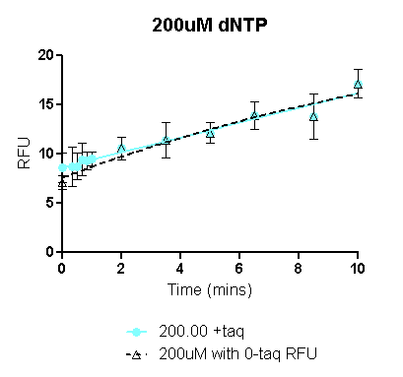
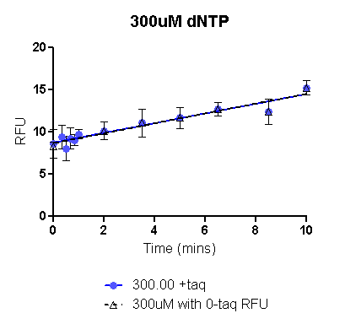
 | 200uM dNTP with 0_{+taq} RFU | 200uM dNTP with 0_{-taq} RFU
One-phase association | Ambiguous
R square | 0.7153 | 0.7409
 | 200uM dNTP with 0_{+taq} |  | 200M dNTP with 0_{-taq}
Mins | RFU | dRFU/ dT | RFU | dRFU/ dT
0.000 | 8.662 |  | 7.593
0.067 | 8.713 | 0.755 | 7.669 | 1.143
0.134 | 8.764 | 0.755 | 7.746 | 1.138
0.201 | 8.814 | 0.755 | 7.822 | 1.134
 | 300uM dNTP with 0_{+taq} RFU | 300uM dNTP with 0_{-taq} RFU
One-phase association | Ambiguous | Ambiguous
R square | 0.6669 | 0.6875
 | 500uM dNTP with 0_{+taq} |  | 500uM dNTP with 0_{-taq}
Mins | RFU | dRFU/ dT | RFU | dRFU/ dT
0.000 | 8.743 |  | 8.681
0.067 | 8.781 | 0.577 | 8.720 | 0.588
0.134 | 8.820 | 0.577 | 8.760 | 0.588
0.201 | 8.859 | 0.577 | 8.799 | 0.588

Slide 47
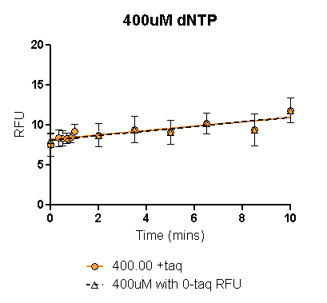
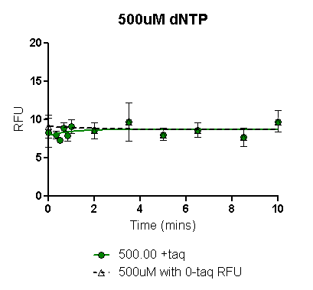
 | 400uM dNTP with 0_{+taq} RFU | 400uM dNTP with 0_{-taq} RFU
One-phase association | Interrupted | Interrupted
 | 200uM dNTP with 0_{+taq} |  | 200M dNTP with 0_{-taq}
Mins | RFU | dRFU/ dT | RFU | dRFU/ dT
0.000 | 8.190 |  | 8.108
0.067 | 8.208 | 0.276 | 8.127 | 0.284
0.134 | 8.227 | 0.276 | 8.146 | 0.284
0.201 | 8.245 | 0.276 | 8.165 | 0.284
 | 500uM dNTP with 0_{+taq} RFU | 500uM dNTP with 0_{-taq} RFU
One-phase association
R square | 0.03370 | 0.007303
 | 500uM dNTP with 0_{+taq} |  | 500uM dNTP with 0_{-taq}
Mins | RFU | dRFU/ dT | RFU | dRFU/ dT
0.000 | 7.969 |  | 9.107
0.067 | 8.016 | 0.709 | 9.094 | -0.192
0.134 | 8.061 | 0.667 | 9.082 | -0.186
0.201 | 8.103 | 0.627 | 9.069 | -0.180

Slide 48
Remarks
It appears that 10mins of incubation is insufficient to reach a plateau in the polymerase reaction. This brings into question the one-phase association equation used for the curve fitting as also Prism’s description of the fit. However practical considerations limit extension of the experiment beyond a 10min incubation. With longer incubations, experiment cannot be completed in one day.
It is not clear at this point whether fit depends on other data columns in the group being analysed.
Initial rate increases with increasing [dNTP] till 200uM and after that decreases with further increase in [dNTP]. Can the data be fitted into classical Michaelis-Menten kinetics?
Non-overlap of error bars for –taq RFU with its corresponding +taq RFU (at 5 and 10mins and preferably all other time points except 0) indicates increase in activity with time. Therefore, overlap of error bars of 2 [dNTP] conc.s at a particular temperature-time point is not that significant.
Is Zero correction significant? In this analyses, zero correction was tried on the final mean rather than on individual values, this seems to improve fit in some cases but not in others. Thus for purposes of purity, only actual RFU values are plotted for each [dNTP] for each temp.
0_{-taq} and 0_{+taq} also show variation. While it appears that 0_{-taq} has greater chances of being accurate , even this can sometimes be off the mark due to the various elements of experimental variability.
Variability (batch-to-batch) is due to:
  Template-primer mixes
  Taq polymerase dilutions
  Picogreen dilutions
  Pipett inaccuracy.

Slide 49
Conclusions
Please analyze each plot
Determine whether 0_{-taq} or 0_{+taq} is better for the particular assay.
Determine whether early time point (20secs to 1min) maybe eliminated without compromising the experiment.
Determine whether zero correction would improve the quality of the fit and hence the results.
Is one phase association still the model to be used for fitting?
Only based on these, can we finalise the calculate the rate values to plot rate vs [dNTP].
Does the Michealis-Menten kinetic model still fit?

