Slide 1
SIRT3 Inhibition: mechanistic study and de novo drug design
̶ Starting from a potent inhibitor: Ex-527

Slide 2
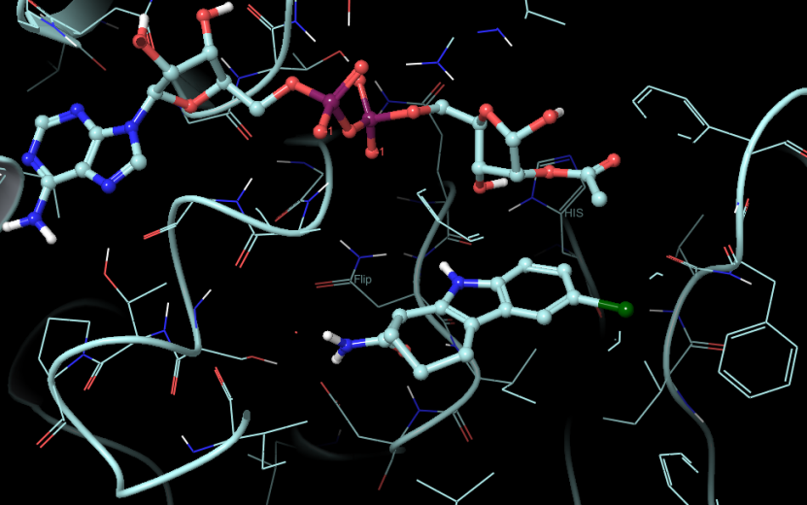
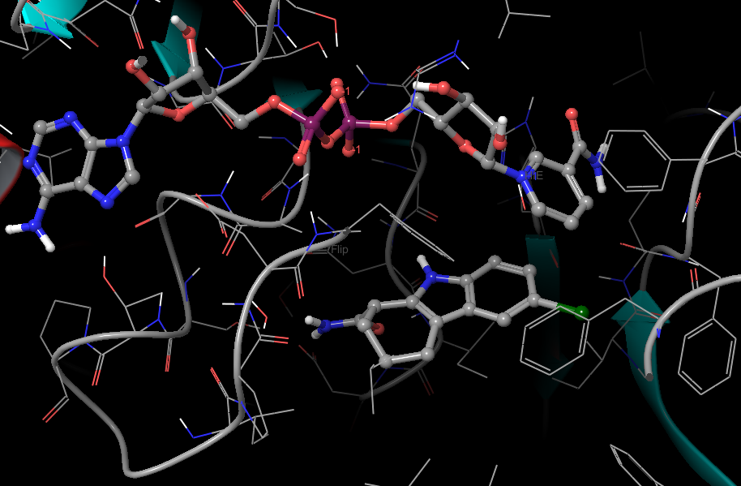
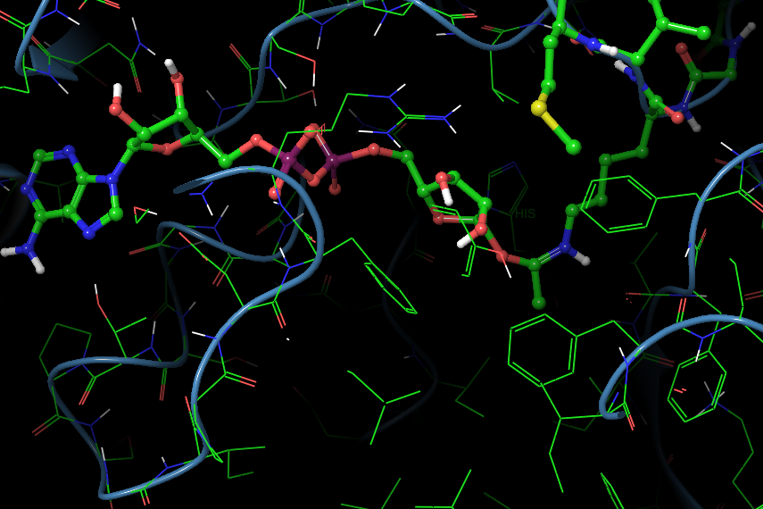
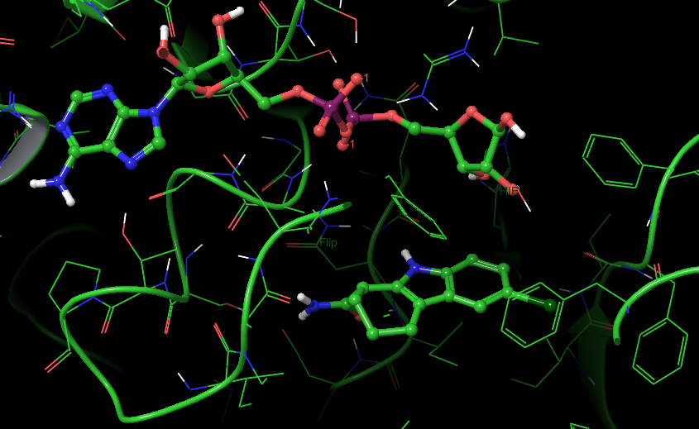
Ex-527 is a selective Sirtuins inhibitor
Ex-243 (The S enantiomer of Ex-527) occupies the extended C-site.
SIRT3/ac-ADPR/Ex-243 pdbID:4BVH
SIRT3/NAD+/Ex-243 pdbID:4BV3
SIRT3/ADPR/Ex-243 pdbID: 4BV3/4BVB
SIRT3/intermediate pdbID:4BVG

Slide 3
Crystallization conditions
SIRT3/NAD+/Ex-243: SIRT3 mixed with acetyl-ACS2-peptide (1 mM), NAD+ (10 mM), Ex-527 (1 mM), and 10% (vol/vol) DMSO andthe reservoir (20% (wt/vol) PEG 3350 and 0.2 M ammonium nitrate)
SIRT3/ADPR/Ex-243: SIRT3 in presence of NAD+ (5 mM), Ex-527 (1 mM), and 10% (vol/vol) DMSO in reservoir [0.08 M KH2PO4, 18% (wt/vol) PEG 8000, and 20% (vol/vol) glycerol] providing cryoprotection
Sirt3/2′-O-acetyl-ADP ribose/Ex-243: Sirt3 with O-acetyl-ADP ribose (10 mM), Ex-527 (1 mM), and 10% (vol/vol) DMSO and as reservoir 20%(wt/vol) PEG 6000 and 0.1 M Hepes, pH 7
SIRT3/Intermediate: SIRT3/acetyl-ACS2-peptide crystals soaked with NAD+ (5mM), Ex-527 (1mM), and 10%(vol/vol) DMSO in reservoir supplemented with 25% (vol/vol) glycerol for 80 min.

Slide 4
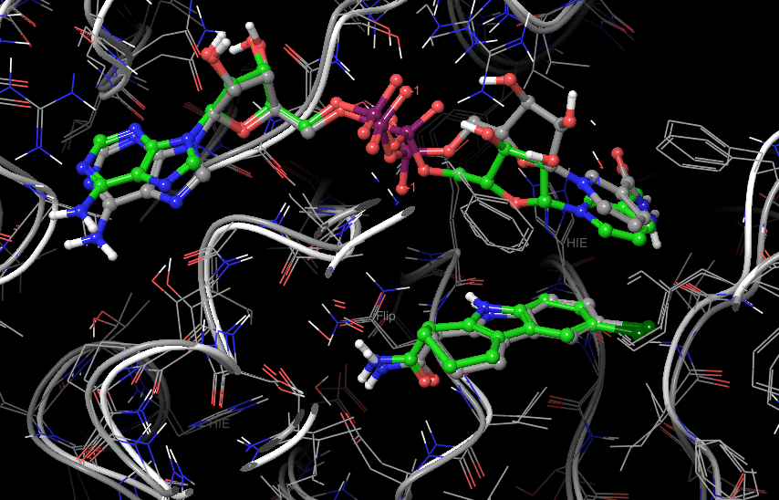
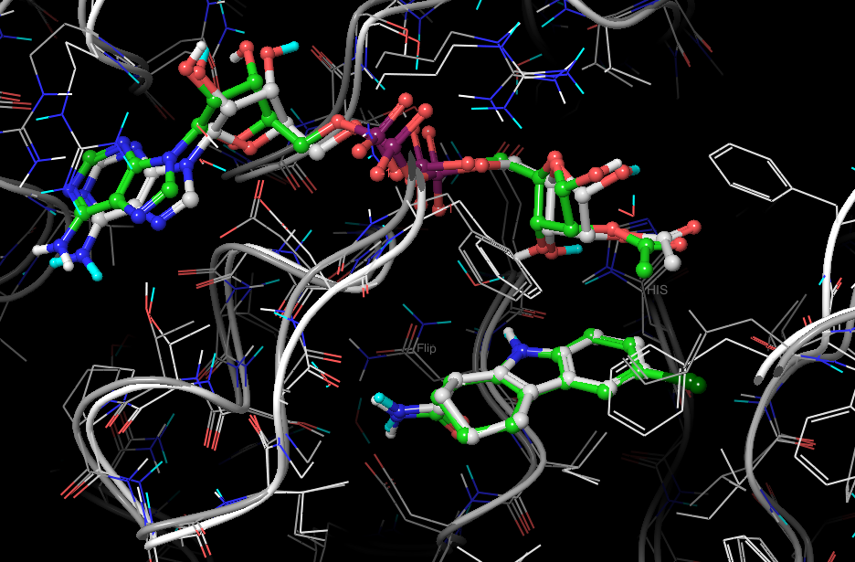
Mechanistic study using MD/MM-PB(GB)SA
SIRT3/NAD+/Ex-243
MD: green; Crystal: grey
RMSD: 1.192 Angstrom
Expt. ΔG(Ex-527) = -6.52
MM-PBSA:
NAD+ (-5.56)
Ex-243 (-7.42)
MM-GBSA:
NAD+ (-82.21)
Ex-243 (-42.57)
SIRT3/ac-ADPR/Ex-243
MD: green; Crystal: white
RMSD: 1.025 Angstrom
MM-PBSA:
ac-ADPR (-19.91)
Ex-243 (-6.56)
MM-GBSA:
ac-ADPR (-93.64)
Ex-243 (-37.75)
* units in kcal/mol
Notes:
MD simulation runs for more than 23 ns
MM-PB(GB)SA averaged over 22 ns
NAD+ binding fluctuates significantly
Binary structure between ac-ADPR and SIRT3 is stable.

Slide 5
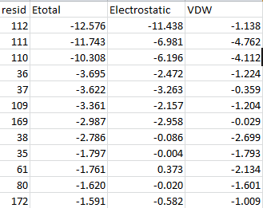
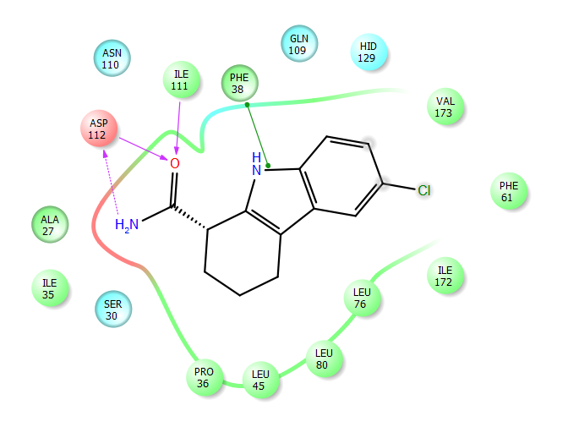
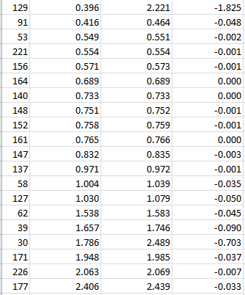
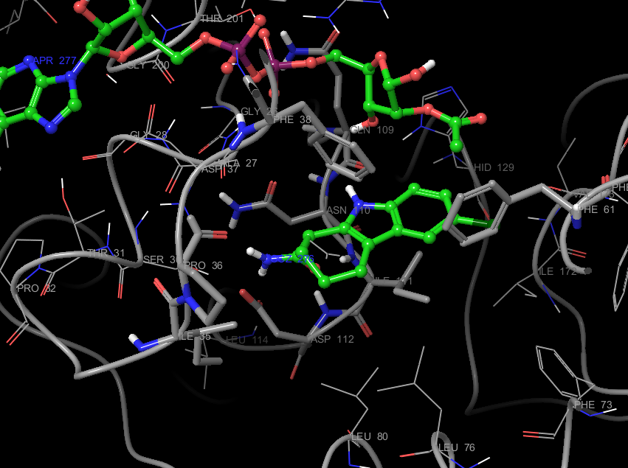
Residue interaction with Ex-527
Notes:
To convert, add 119 to the residue number

Slide 6
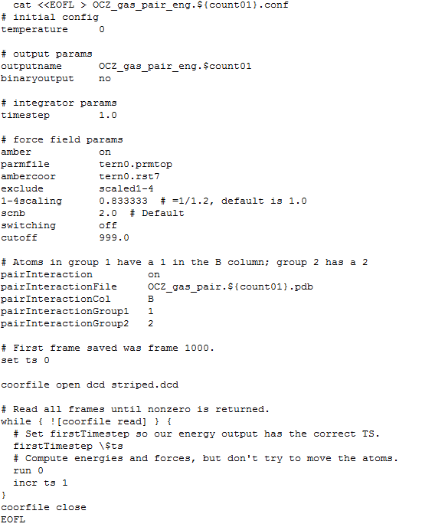
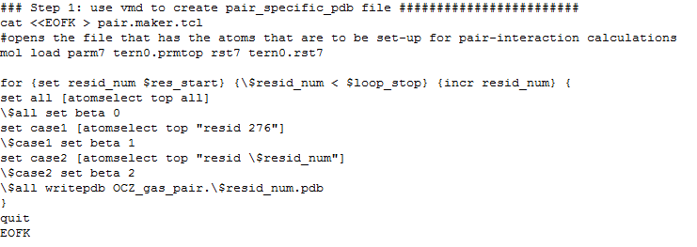
Calculating residue pair interactions
Create vmd scripts to create pairs in pdb format;
Create NAMD input to calculate MM energies between pairs;
Run NAMD for each pairs and selected trajectories;
Extract residue pair energy terms;
Run statistics to calculate the mean and standard deviation.

Slide 7
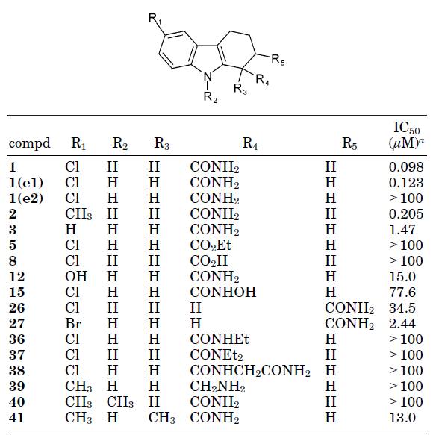
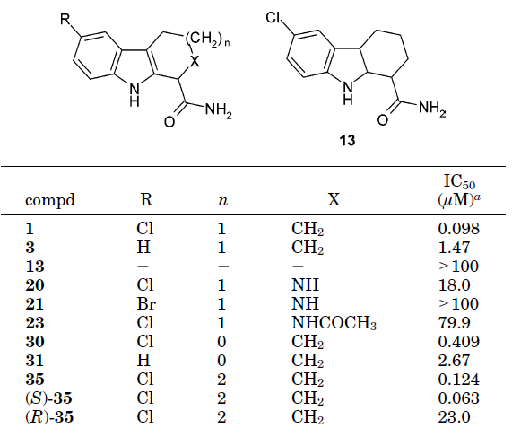
Early exploration of indoles as SIRT1 inhibitor
Napper et al. J. Med. Chem. 2005, 48, 8045-8054

Slide 8
De novo drug design of SIRT3 modulator
Using the inhibition mechanism revealed in PNAS paper, three possible receptors are targeted.
SIRT3/ac-ADPR
SIRT3/NAD+
SIRT3/intermediate
The first two targets are for inhibitions; the third target is for inhibiting the second-step of the deacetylation
The approach: structure-based scaffold hopping
  Based on hits from previous database screening (Ex-243 in our case)

Slide 9
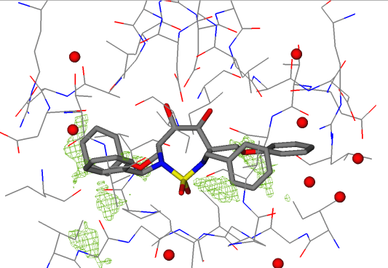
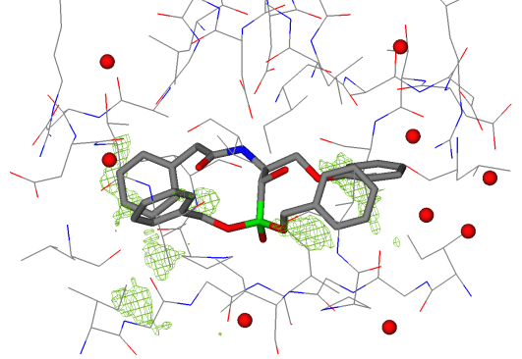
Scaffold hopping: Example with HIV protease
Bergmann R. et al., J. Med. Chem. 2007. 50(11): 2708-2717

Slide 10
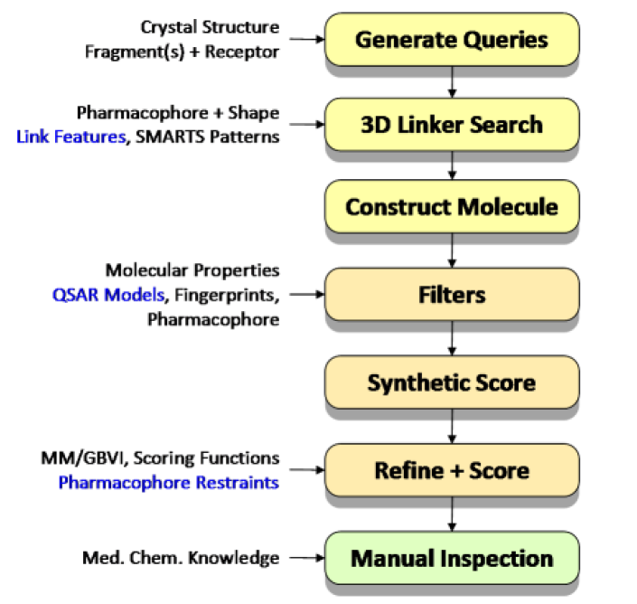
MOE workflow for scaffold replacement and ligand optimization
A simple-to-use interface for automatically create complex scaffold replacement queries; generate 3D molecules; filter using pharmcophore model or other properties; estimate synthetic feasibilities; score with receptors.

Slide 11
Fragment library in MOE
4.3 million molecules were obtained from vendor catalogues and 10 years of medicinal chemistry literature.
A rule-based tautomer and ionization state enumerator was applied, retaining most minor tautomers and protonation states.
Scarffolds as ring blocks, retaining either the ring block plus exocyclic double bonds, or ring blocks connected by a single rotatable bond; or fragmentation by using RECAP rules or Schuffenhauer decomposition.
The resulting unique fragments were subjected to a full conformational search to produce a set of conformations with low strain energy, as determined using the MMFF94 forcefield.
The resulting database contained 800,000 fragments and 16.5 million conformations.

Slide 12
Filtering rules and synthetic feasibility
Filters were set up to ensure reasonable, drug-like molecules using molecular weight, SlogP and TPSA.
Use some scoring scheme or disconnection protocol to estimate synthesis feasibility.
Notes:
Topological Polar Surface Area (tPSA), a physicochemical property describing the polarity of molecules
SlogP: Log of the octanol/water partition coefficient (including implicit hydrogens). This property is an atomic contribution model [Crippen 1999] that calculates logP from the given structure; i.e., the correct protonation state (washed structures). Results may vary from the logP(o/w) descriptor. The training set for SlogP was ~7000 structures.

Slide 13
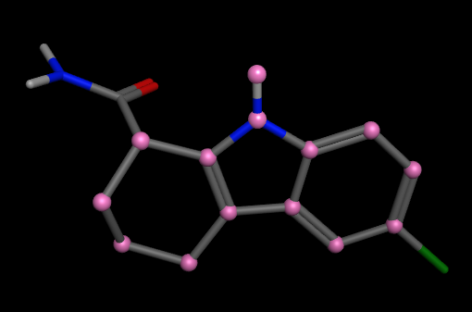
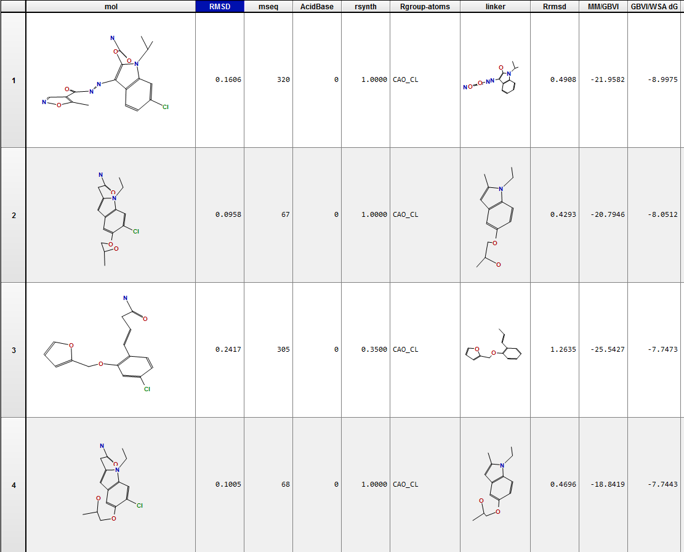
Testing with MOE
Define the scaffold
Using SIRT3 (4BVH0 as receptor
Evaluate ΔG(GBVI/WSA)
Using default linker library, 20599 linkers used, 493 new leads were identified

Slide 14
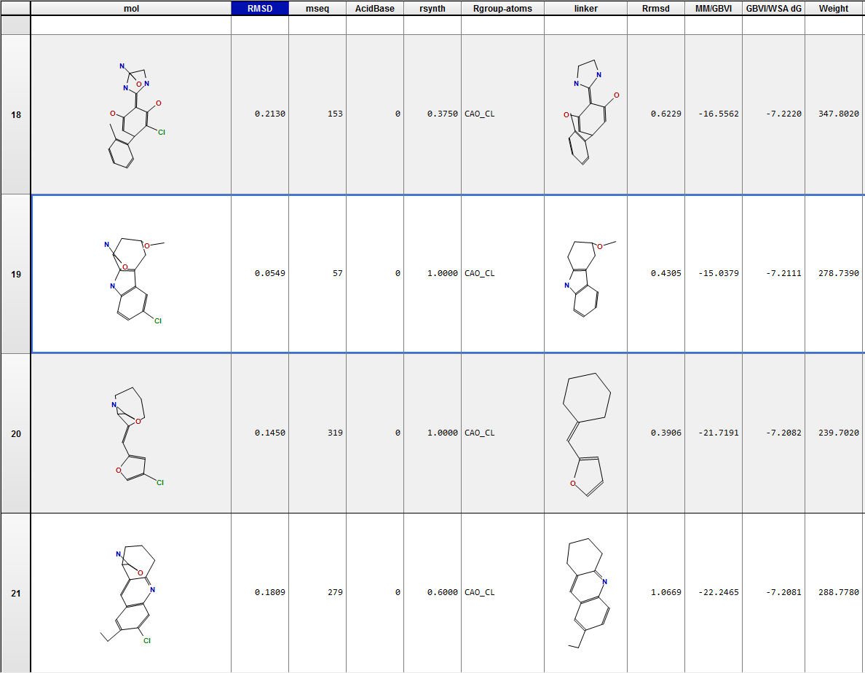
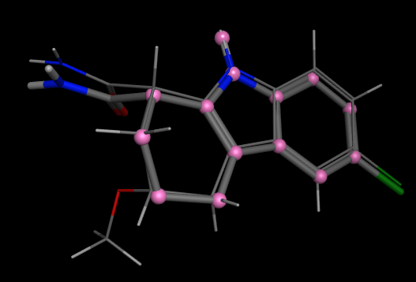
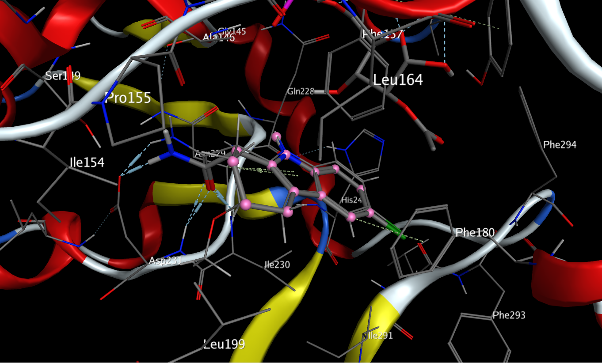
Testing with MOE (cont.)
#19 on the GBVI/WSA DG list
RMSD: 0.0549 Angstrom

Slide 15
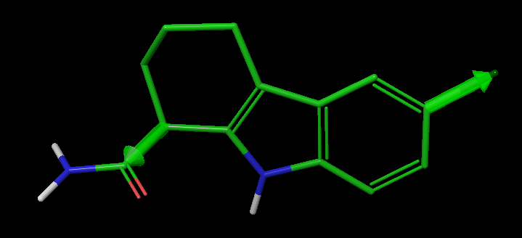
Schrodinger’s Core Hopping method
Core-hopping screen multiple potential scaffolds against a template (a lead compound), and search for alignments of potential attachment points on the scaffold.
  Ligand-based core hopping (rated on alignment alone)
  Structure-based core hopping (Glide-based)
  Isosteric-matching method (matching of the shape)
Large selection of core library
  Up to 97k cores
  Core libraries are selected to be more drug-like
  User customizable
Automatic linker addition

Slide 16
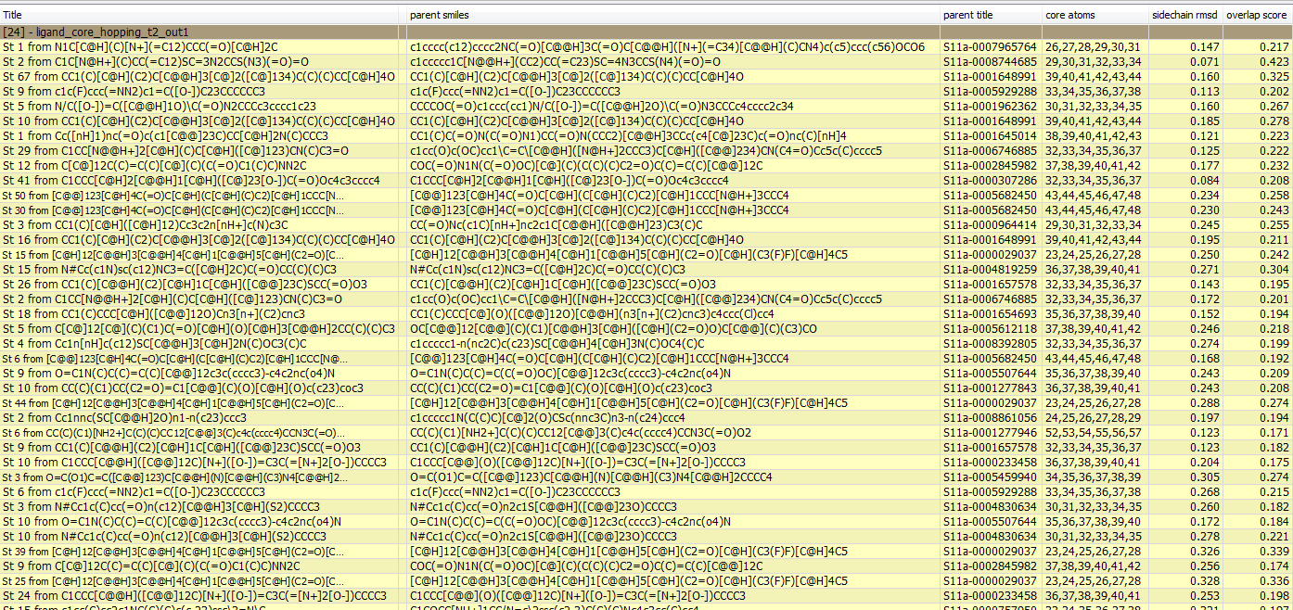
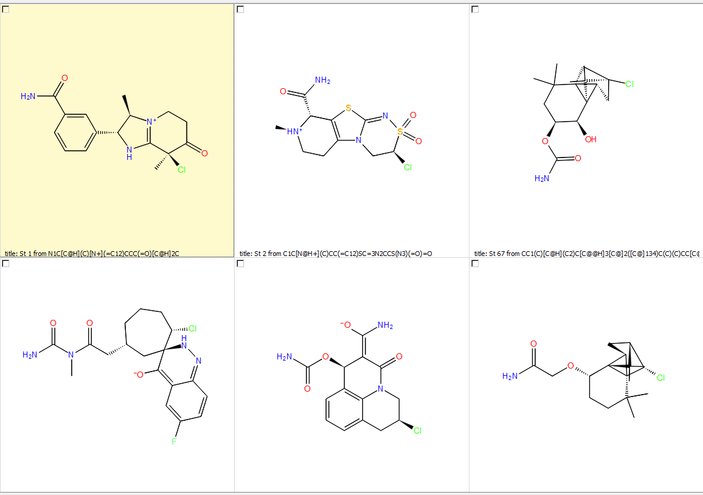
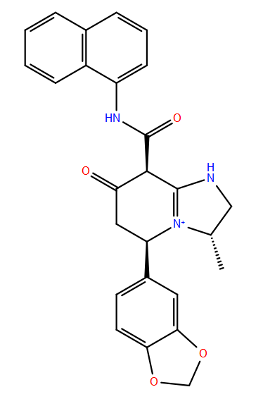
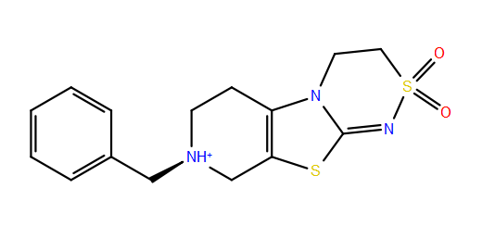
Ligand-based core hopping, trial 1
Using small core library (97 cores)
1131 new ligands (multiple ligands from same core structure)
2D View
Core structures for 1 and 2

Slide 17
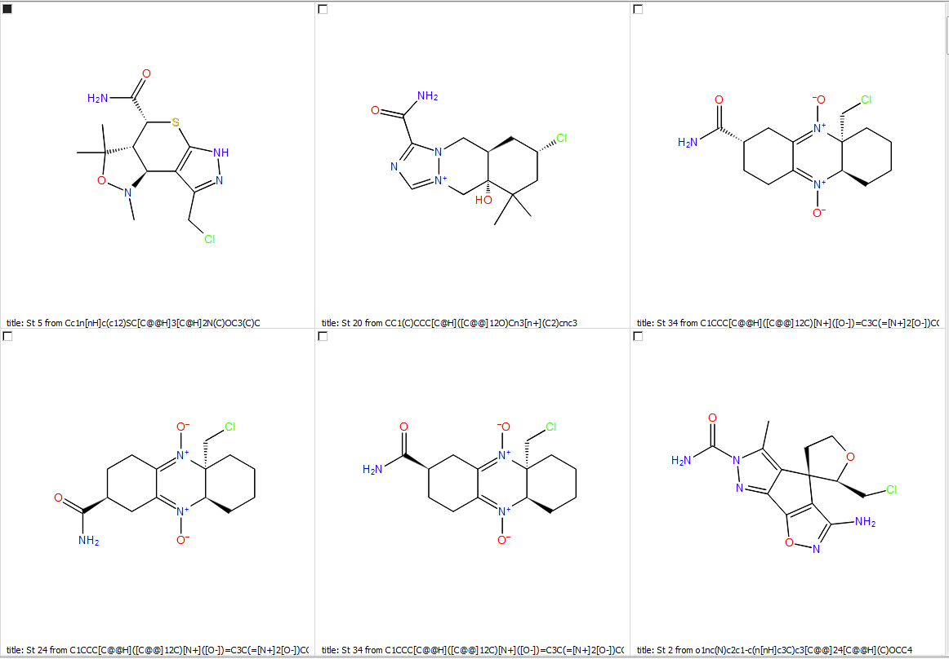
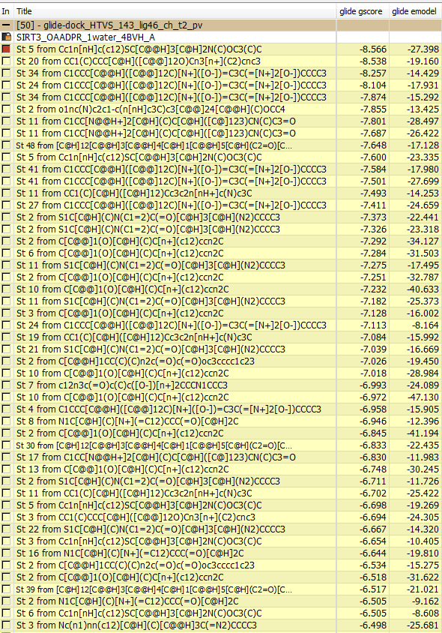
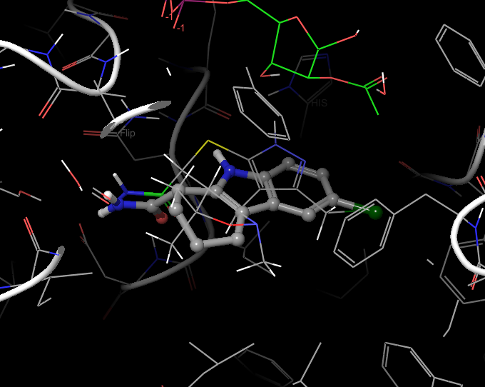
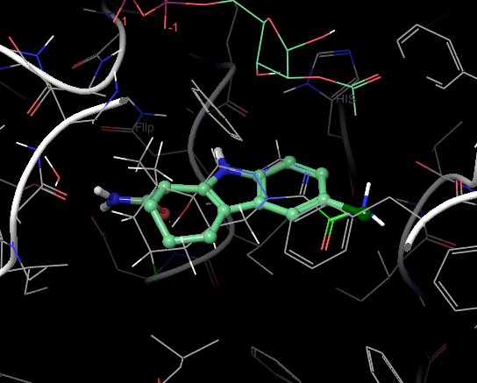
Ligand-based core hopping, trial 1 (cont.)
HTVS Glide docking using SIRT3/ac-ADPR as receptor (4BVH)
  94 poses obtained

Slide 18
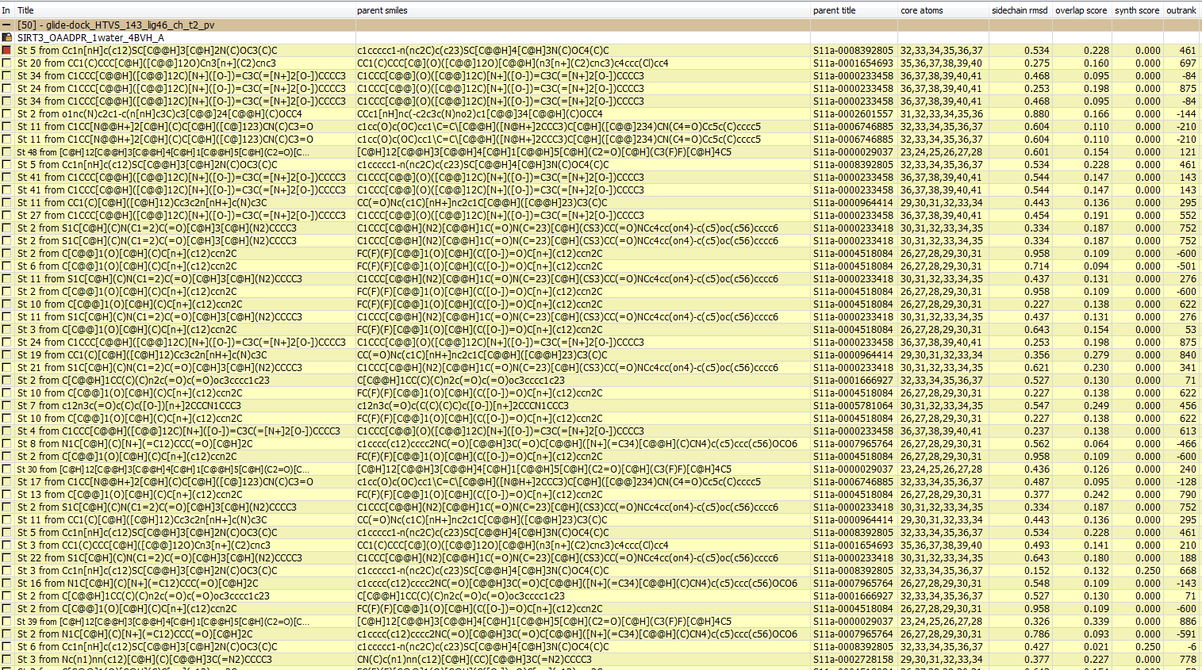

Slide 19
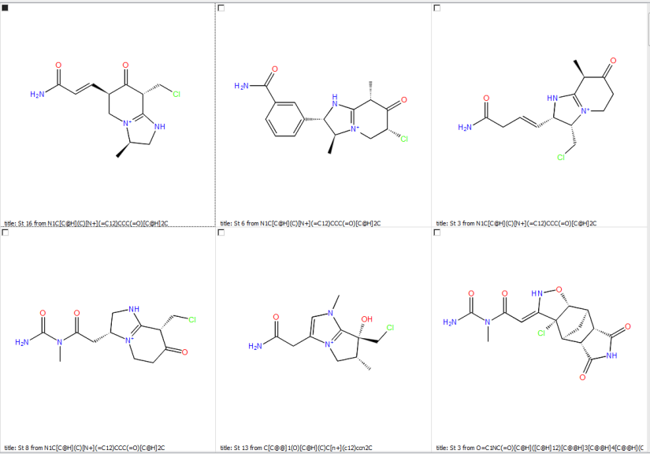
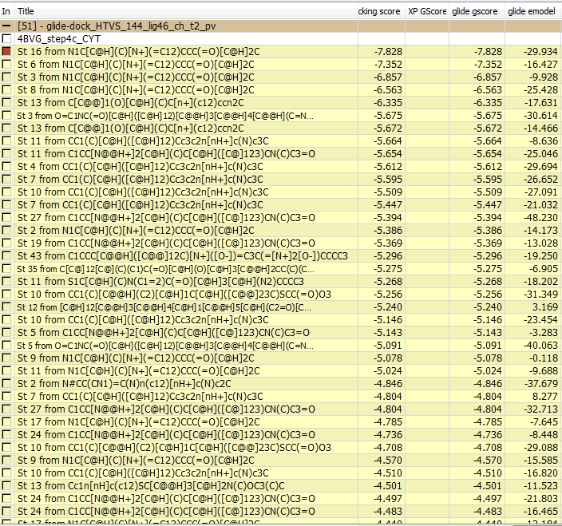
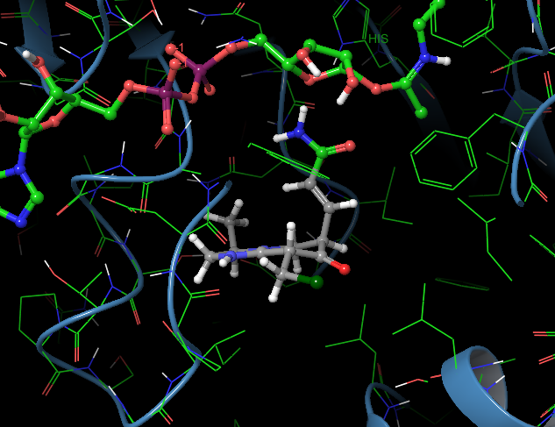
Ligand-based core hopping, trial 1 (cont.)
HTVS Glide docking using SIRT3/Intermediate as receptor (4BVG)
  74 poses obtained

Slide 20
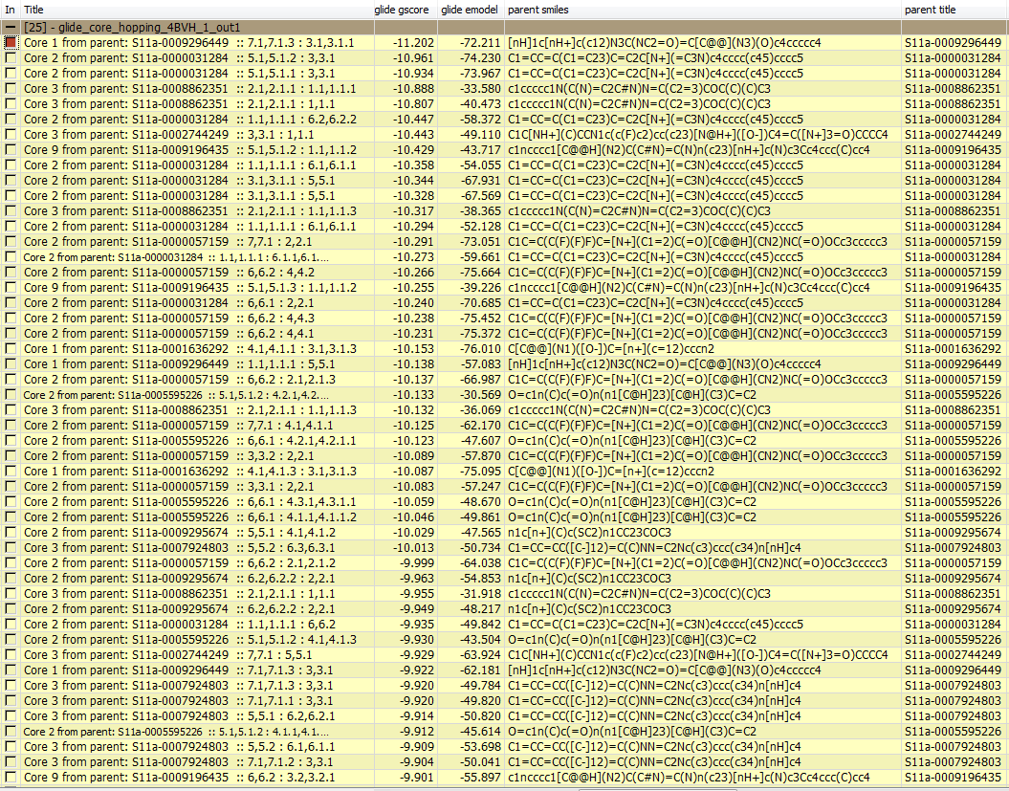
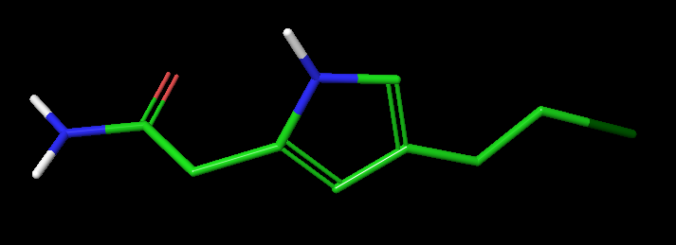
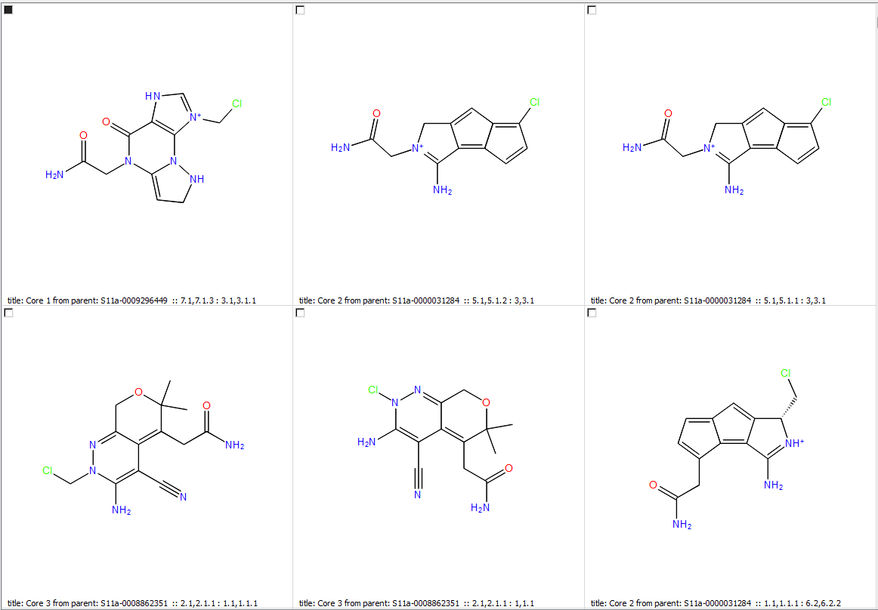
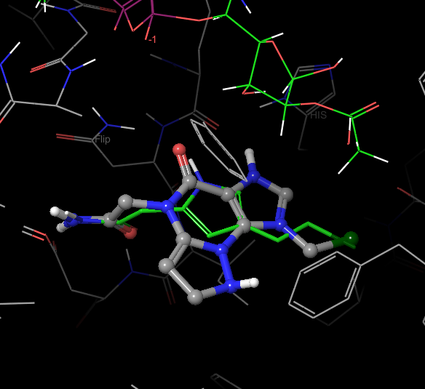
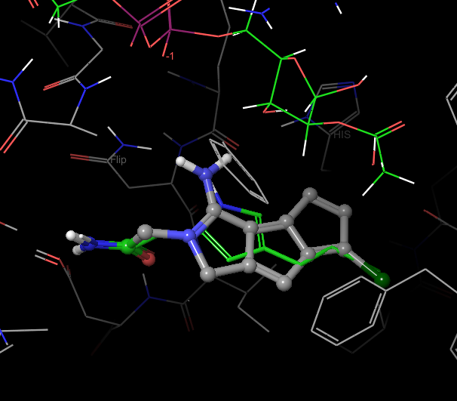
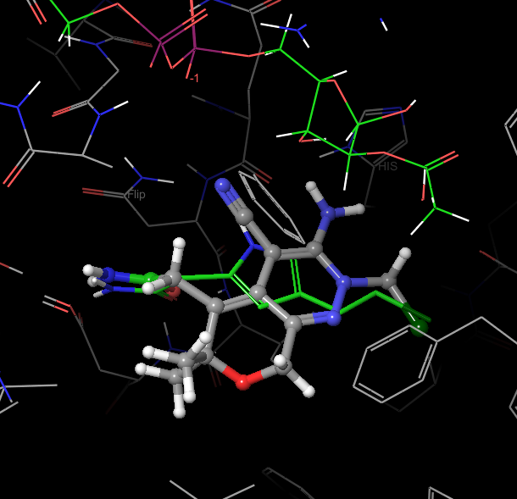
Structure-based core hopping, trial 2
A testing case of Schrodinger’s core library and core hopping strategy: Ex-527 fragment as lead molecule (coordinate retained)
Using SIRT3/ac-ADPR as receptor (4BVH) as receptor, 97 core library, 770 poses obtained
Glide-based core hopping first aligns the attachment bonds of the protocore, then adds the template side chains at the attachment points of these structures, and docks them with Glide.

Slide 21
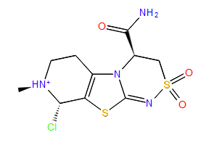
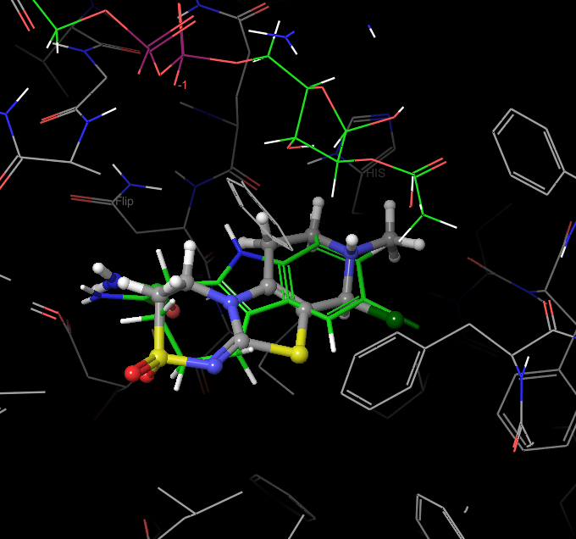
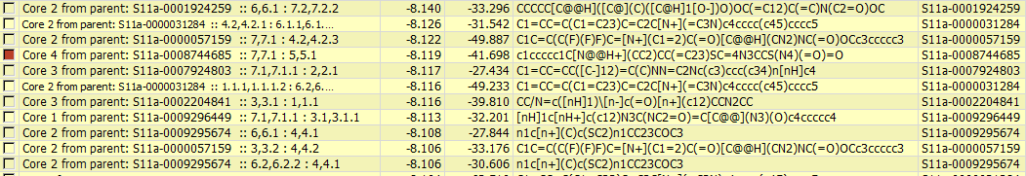
Rank 459

Slide 22
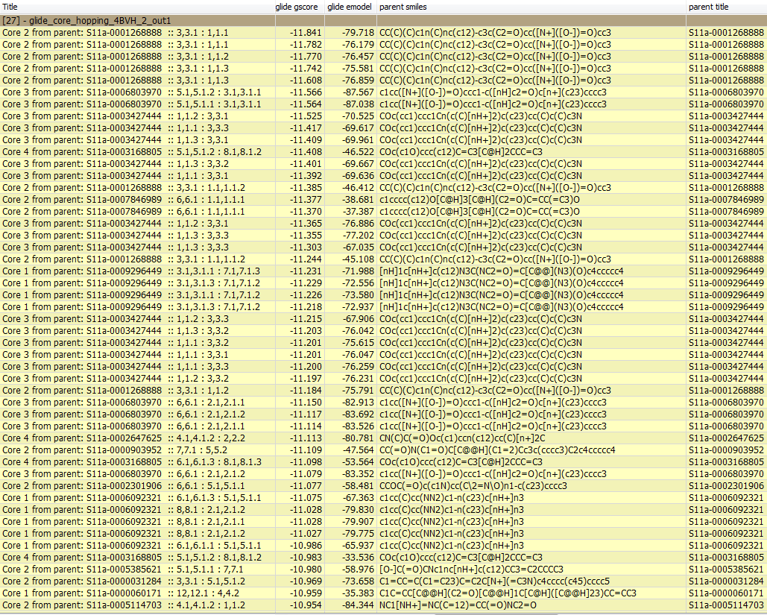
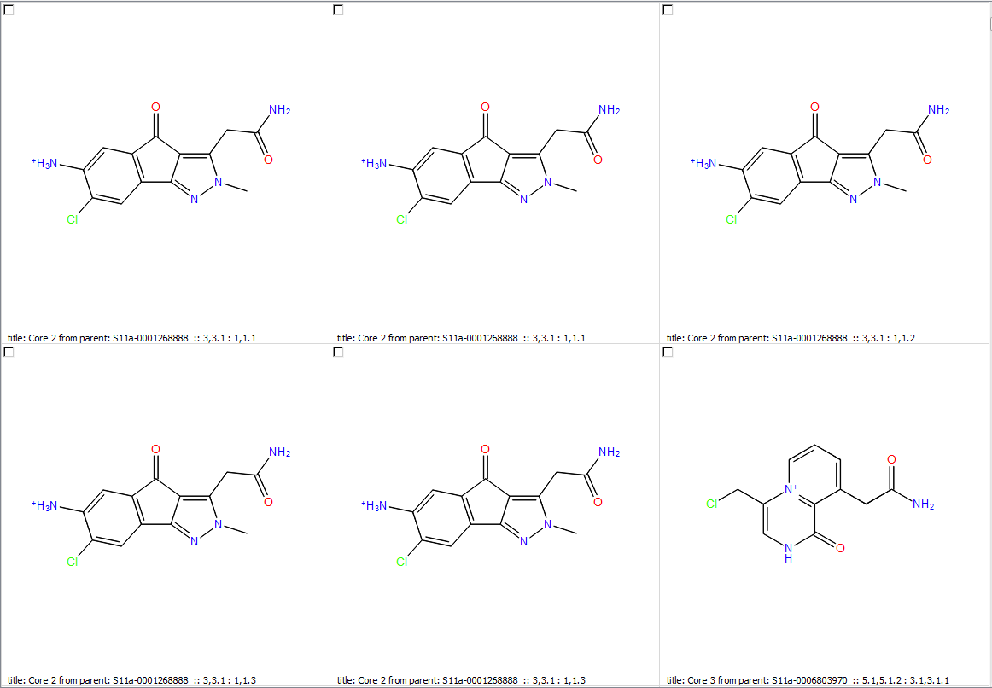
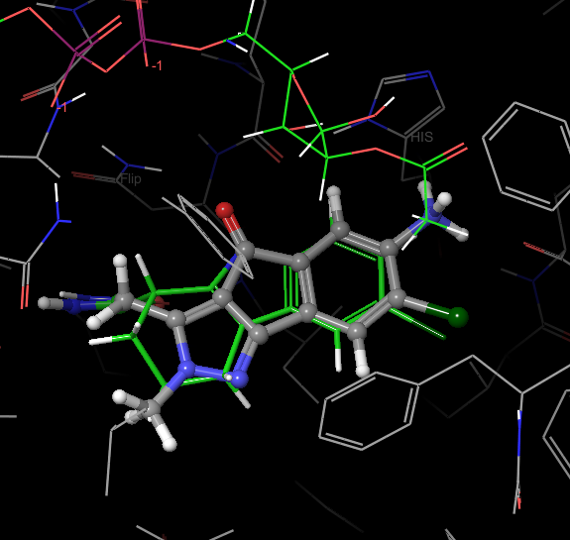
Trail 2 (cont.)
Using SIRT3/ac-ADPR as receptor (4BVH) as receptor, 970 core library, 19391 poses obtained

Slide 23
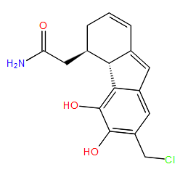
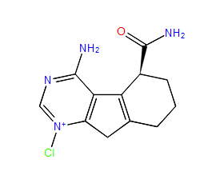
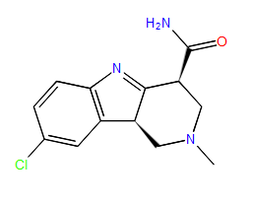



Some Ex-527-like hits
Rank 11
Rank 76
Rank 88

Slide 24




Rank 364
Rank 19391

Slide 25




Trail 2 (cont.)
Using SIRT3/ac-ADPR as receptor (4BVH) as receptor, 9.7k core library, 40000 poses obtained (at preset output limit)

Slide 26






Some promising new scaffolds
Rank 17
Rank 19
Rank 60
Notes:
There is no collision with 7 member ring, and the mostly hydrophobic environment created by LEU and ILE favors aliphatic ring, except in near the position of proline backbone.

Slide 27







look-alikes
Rank 202
Rank 218
Rank 223

Slide 28




Ex-527 mimics
Rank 434
Rank 839
Notes:
-10.735

Slide 29

Structure-based core hopping, trial 3
Use Ex-527 fragment as template molecule (after ligprep, docked in SIRT3/intermediate)
Using SIRT3/Intermediate as receptor (4BVG) as receptor, 97 core library, 346 poses obtained
Template pose

Slide 30



Notes:
The glide score is significantly lower

Slide 31






Isosteric-matching core hopping, trial 4
Use Ex-527 as template
–(C=O)NH2 as the preserved group
9.7k core library
2563 leads generated

Slide 32




Trial 4 (cont.)
Run HTVS Glide dock agaist SIRT3/Intermediate, 1109 pose obtained.
Rank 1
Notes:
Not all pose share the same binding pattern, but some do.

Slide 33



Isosteric-matching core hopping, trial 5
Run the same procedure as trial 4 and use 97k core library
15774 leads identified

Slide 34





After HTSV glide docking against SIRT3/Intermediate, 52470 poses obtained

Slide 35
Current status
The core hopping capability and core libraries were not extensively explored.
The core libraries shipped with Schrodinger is able to find some Ex-527 mimic, but not the same scaffold.
Using Ex-527 as lead molecule, different approaches can be chosen for different target receptors.
Simple ligand-based approach is no better than simple combinatorial library generation. Follow-up docking is needed and the result is not optimal. (Trail 1)
Structure-based core hopping in Schrodinger is a decent choice for explore new scaffolds with SIRT3/ac-ADPR (or NAD+). (Trail 2)
New routes for searching SIRT3/Intermediate binding ligand is explored. (Trail 3 & 4)
Isosteric-matching core hopping that generate a large ligand library for HTVS may be better for receptor without starting ligand but desired feature.

Slide 36
Suggested plan
Inhibitor discovery for SIRT3/ac-ADPR(or NAD+) can use Ex-243 as lead molecule and structure-based core hopping to find new scaffolds. (Larger library and/or new libraries using corefinder can be used.)
Modulator targeting SIRT3/Intermediate can use NAM as lead molecule and structure-based core hopping or isosteric-matching core hopping//HTVS to find new scaffolds.
SIRT1 and/or other sirtuins can be used if selectivity is desired.

Slide 37
Customerize core library using corefinder.py
Corefinder is a tool to extract cores and prepare them for use with ligand-based core hopping
Input and output files can be sqlite or structure files. Input structure files are presumed to contain molecules from which cores are to be extracted. Output files contain the extracted cores.
With corefinder, other fragments can also be used for scaffold replacement, i.e. the commercial fragments extracted from the FDA approved drugs (e-LEA3D collection as of 04-02-2014: 1491 molecules); or create new core library from FDA approved drugs sdf file (e-LEA3D collection has 1632 drugs).
Notes:
The use of corefinder may not be an urgent need as we are not sure if we can identify better cores outside of what Schrodinger provides.
It may very well create molecules with undesired properties.

Slide 38

LEA3D Workflow for lead generation
LEA3D, (Ligand by Evolutionary Algorithm) is designed to conceive organic molecules by combining 3D fragments.
Fragments were extracted from both biological compounds and known drugs.
A fitness function guides the search process in optimizing the molecules toward an optimal value of the properties.
The fitness function is build up by combining several independent property evaluations, including the score provided by the FlexX or other docking programs.

Slide 39

Fragment library creation
7621 drugs from the Comprehensive Medicinal Chemistry database and 7282 compounds from the LIGAND database of KEGG were dissected into rings and acyclic parts.
Approximately 8000 fragments that led potentially to a virtual size library of 10¹⁴

Slide 40

Fitness Function
Scores from docking can be used for optimization, therefore provides an option for structure-based drug design.
Other scores can be designed and used for ligand-based design or other type of designs.
Notes:
The use of one single fitness function that combines different properties with different weighting factor may not be the best option.

Slide 41
Genetic Algorithm
Parent molecules obtained using roulette wheel selection.
A new population is created by performing crossover and mutation (including permutation, deletion, addition, and substitution) operations on the selected parent molecules.
A parameterization study similar to the previous one performed with LEA showed that 100 generations along with a population of 40 individuals, an elitism strategy, and a fitness scale of 2-5 are optimal to efficiently optimize our molecules and thereby avoid a premature convergence.

Slide 42
Tools used in LEA3D & Property Filters
FROG2 (free) or Corina (commercial) program for 3D conformer generation
PLANTS (free) or FlexX (commercial) or Surflex (commercial) program for docking calculations
XLOGP for estimate Xlogp property (Wang R. et al., J. Chem. Inf. Comput. Sci. 1997, 37, 615-621.)
XSCORE for re-evaluating dock scores
CHEMICALC2 for solubility estimation (Suzuki T., Development of an automatic estimation system for both the partition coefficient and aqueous solubility, J Comput Aided Mol Des., 1991, 5, 149-166.)
Lipinski property:
  Molecular weight (mw) ≤ 500
  Number of hydrogen acceptors (nbha) ≤ 10
  Number of hydrogen donnors (nbhd) ≤ 5
  LogP ≤ 5 ( → ≤ 6 when using XLogP)
  Additional: Number of atoms ≤ 50
Lipinski, C. A.; Lombardo, F.; Dominy, B. W.; Feeney, P. J. Experimental and computational approaches to estmate solubility and permeability in drug discovery and development settings. Adv. Drug Delivery Rev. 1997, 23, 4-25.

Slide 43


LEA3D example 1
Use molecular property to identify aspirin
(m.w = 180; natom=13; nring=1)

Slide 44

LEA3D example 2
Evaluate ligands by docking program PLANTS

Slide 45
Comparison between MOE, Schrodinger, LEA3D
Both MOE and Schrodinger are commercial software and extensive tools for molecular modeling and drug design. LEA3D provides source code for free to academic.
MOE has a larger library with ~ 800,000 fragment; Schrodinger currently has 97,000; LEA3D’s current library has 8,000.
MOE provides literatures on the methods and details of their drug design suite. Some of Schrodinger’s modules serve as black boxes. LEA3D published its methods on scientific paper.
Schrodinger provide integrated tools such as Glide in their package. MOE requires extra license for some docking package, such as GOLD. LEA3D makes use of free software or commercial software to complete some of the tasks.
LEA3D also differs in its approach to find new hits.

Slide 46
Supplementary materials

Slide 47
4BV3(SIRT3, Ex243, NAD+) |  |  |  |  | 4BVH(SIRT3, Ex243, AADPR) |  |  |  |  | 4BVH(SIRT3, AADPR) |  | MM-PB(GB)SA analysis only
 |  |  | Mean |  |  |  |  | Mean
Ex243 Binding: PBSA |  |  | -7.4241 |  | Ex243 Binding: PBSA |  |  | -6.5583
-5.6197 | 3.6376 | 0.2566 |  |  | -9.0409 | 3.2103 | 0.2264
-7.0917 | 3.1002 | 0.2187 |  |  | -8.3610 | 3.3108 | 0.2335
-9.1204 | 3.6103 | 0.2546 |  |  | -6.9906 | 3.2477 | 0.2291
-7.8944 | 3.3606 | 0.2370 |  |  | -7.6387 | 3.6870 | 0.2601
-6.0428 | 3.6764 | 0.2593 |  |  | -7.8927 | 3.2500 | 0.2292
-7.3684 | 3.5251 | 0.2486 |  |  | -8.5071 | 3.8591 | 0.2722
-7.0899 | 3.3460 | 0.2360 |  |  | -7.7878 | 3.5026 | 0.2471
-7.6578 | 3.4399 | 0.2426 |  |  | -4.4322 | 3.8537 | 0.2718
-7.8478 | 3.5353 | 0.2494 |  |  | -5.8591 | 3.3190 | 0.2341
-7.1886 | 3.6346 | 0.2564 |  |  | -3.3333 | 3.7239 | 0.2627
-8.7431 | 3.2624 | 0.2301 |  |  | -2.2980 | 3.5948 | 0.2536
 |  |  | Mean |  |  |  |  | Mean
Ex243 Binding: GBSA |  |  | -42.5660 |  | Ex243 Binding: GBSA |  |  | -37.7524
-39.9688 | 2.7975 | 0.1973 |  |  | -37.9178 | 2.4311 | 0.1715
-40.0264 | 2.6611 | 0.1877 |  |  | -36.6527 | 2.4424 | 0.1723
-42.8435 | 2.8556 | 0.2014 |  |  | -36.9105 | 2.4641 | 0.1738
-42.6962 | 2.4166 | 0.1705 |  |  | -36.8320 | 2.1828 | 0.1540
-42.9350 | 2.6100 | 0.1841 |  |  | -37.8608 | 2.3891 | 0.1685
-43.2357 | 2.2706 | 0.1602 |  |  | -39.0029 | 2.4904 | 0.1757
-43.3978 | 2.5732 | 0.1815 |  |  | -38.7928 | 2.3026 | 0.1624
-43.0746 | 2.2800 | 0.1608 |  |  | -37.3272 | 2.1729 | 0.1533
-43.8251 | 2.4603 | 0.1735 |  |  | -38.6895 | 2.4073 | 0.1698
-43.3814 | 2.2166 | 0.1563 |  |  | -37.9142 | 2.1267 | 0.1500
-42.8415 | 2.3965 | 0.1690 |  |  | -37.3760 | 2.3060 | 0.1627
 |  |  | Mean |  |  |  |  | Mean |  |  |  |  | Mean
NAD+ Binding: PBSA |  |  | -5.5636 |  | AADPR Binding: PBSA |  |  | -19.9103 |  | AADPR Binding: PBSA |  |  | -19.2559
-3.9725 | 8.2794 | 0.5840 |  |  | -21.4296 | 6.9769 | 0.4921 |  |  | -21.0228 | 6.3404 | 0.4472
-7.9421 | 9.3367 | 0.6586 |  |  | -22.0272 | 6.3794 | 0.4500 |  |  | -20.5932 | 6.1182 | 0.4315
-0.5104 | 7.6185 | 0.5374 |  |  | -21.0751 | 6.6560 | 0.4695 |  |  | -19.9816 | 6.3779 | 0.4499
-1.8137 | 7.7709 | 0.5481 |  |  | -20.3548 | 7.0177 | 0.4950 |  |  | -19.0934 | 6.7697 | 0.4775
1.2185 | 7.2527 | 0.5116 |  |  | -21.7683 | 7.1613 | 0.5051 |  |  | -20.8428 | 7.0722 | 0.4988
-2.5002 | 8.0275 | 0.5662 |  |  | -19.3325 | 6.2343 | 0.4397 |  |  | -18.6765 | 6.1324 | 0.4325
-11.6769 | 8.5433 | 0.6026 |  |  | -20.2800 | 6.2822 | 0.4431 |  |  | -20.1680 | 6.4509 | 0.4550
-12.3603 | 8.3256 | 0.5872 |  |  | -18.8798 | 6.6265 | 0.4674 |  |  | -18.3969 | 6.2880 | 0.4435
-7.2841 | 8.4307 | 0.5947 |  |  | -18.8514 | 6.0468 | 0.4265 |  |  | -18.6909 | 6.0752 | 0.4285
-5.5453 | 11.9031 | 0.8396 |  |  | -18.8834 | 7.0447 | 0.4969 |  |  | -18.4692 | 6.7509 | 0.4762
-8.8124 | 11.5502 | 0.8147 |  |  | -16.1309 | 6.0190 | 0.4245 |  |  | -15.8799 | 5.6362 | 0.3975
 |  |  | Mean |  |  |  |  | Mean |  |  |  |  | Mean
NAD+ Binding: GBSA |  |  | -82.2149 |  | AADPR Binding: GBSA |  |  | -93.6443 |  | AADPR Binding: GBSA |  |  | -89.1580
-83.8869 | 5.8233 | 0.4107 |  |  | -96.5586 | 5.5241 | 0.3896 |  |  | -91.7767 | 5.4560 | 0.3848
-85.9095 | 8.3047 | 0.5858 |  |  | -96.0371 | 5.2407 | 0.3697 |  |  | -91.5942 | 5.1843 | 0.3657
-75.1379 | 4.9513 | 0.3492 |  |  | -94.3962 | 5.4968 | 0.3877 |  |  | -89.9327 | 5.4096 | 0.3816
-77.2099 | 6.6612 | 0.4698 |  |  | -94.2898 | 5.5848 | 0.3939 |  |  | -89.7430 | 5.4544 | 0.3847
-77.6457 | 5.6982 | 0.4019 |  |  | -95.1063 | 5.8409 | 0.4120 |  |  | -90.6804 | 5.7293 | 0.4041
-80.1467 | 6.4875 | 0.4576 |  |  | -93.5591 | 5.4493 | 0.3844 |  |  | -89.2840 | 5.3091 | 0.3745
-88.7904 | 7.3812 | 0.5206 |  |  | -94.9278 | 5.4763 | 0.3863 |  |  | -90.5411 | 5.3864 | 0.3799
-86.5045 | 6.4552 | 0.4553 |  |  | -92.1347 | 5.2375 | 0.3694 |  |  | -87.6520 | 5.0229 | 0.3543
-78.4785 | 7.8690 | 0.5550 |  |  | -92.7110 | 5.4193 | 0.3823 |  |  | -88.1930 | 5.3730 | 0.3790
-83.7717 | 9.0479 | 0.6382 |  |  | -91.5807 | 5.9320 | 0.4184 |  |  | -87.0578 | 5.6775 | 0.4005
-86.8818 | 9.8356 | 0.6937 |  |  | -88.7856 | 5.1560 | 0.3637 |  |  | -84.2828 | 5.0014 | 0.3528

Slide 48
 | 4BV3(SIRT3, Ex243, NAD+) |  |  | 4BV3(SIRT3, Ex243, NAD+) |  |  | 4BVH(SIRT3, Ex243, AADPR) |  |  | 4BVH(SIRT3, Ex243, AADPR)
 | NAD+ interactions |  |  | Ex243 interactions |  |  | AADPR interactions |  |  | Ex243 interactions
 | Average | STD |  | Average | STD |  | Average | STD |  | Average | STD
VDWAALS_complex | -2244.1649 | 23.9709 |  | -2244.1649 | 23.9709 |  | -2233.5601 | 22.8900 |  | -2233.5601 | 22.8900
EEL_complex | -17980.8743 | 116.2920 |  | -17980.8743 | 116.2920 |  | -17831.6168 | 98.2474 |  | -17831.6168 | 98.2474
EGB_complex | -3284.2986 | 60.0723 |  | -3284.2986 | 60.0723 |  | -3575.6471 | 74.8697 |  | -3575.6471 | 74.8697
ESURF_complex | 94.4458 | 1.9353 |  | 94.4458 | 1.9353 |  | 97.1458 | 1.8318 |  | 97.1458 | 1.8318
EPB_complex | -3031.2415 | 57.8292 |  | -3031.2415 | 57.8292 |  | -3322.4267 | 74.7095 |  | -3322.4267 | 74.7095
ENPOLAR_complex | 2125.1492 | 10.2513 |  | 2125.1492 | 10.2513 |  | 2139.9354 | 9.1387 |  | 2139.9354 | 9.1387
EDISPER_complex | -1210.7686 | 13.3196 |  | -1210.7686 | 13.3196 |  | -1232.8459 | 11.6484 |  | -1232.8459 | 11.6484
G_gas_complex | -3869.4795 | 80.2286 |  | -3869.4795 | 80.2286 |  | -3559.9410 | 93.5804 |  | -3559.9410 | 93.5804
G_solv_igb2_complex | -3189.8528 | 59.3553 |  | -3189.8528 | 59.3553 |  | -3478.5013 | 74.1742 |  | -3478.5013 | 74.1742
G_solv_pb_complex | -2116.8609 | 59.1863 |  | -2116.8609 | 59.1863 |  | -2415.3373 | 75.2986 |  | -2415.3373 | 75.2986
VDWAALS_receptor | -2150.0316 | 23.2859 |  | -2201.2036 | 24.0389 |  | -2151.6346 | 22.4086 |  | -2191.7965 | 22.6712
EEL_receptor | -17911.4666 | 113.5417 |  | -17966.8913 | 116.1674 |  | -17960.8487 | 94.7349 |  | -17825.7913 | 98.4816
EGB_receptor | -3204.4954 | 57.7662 |  | -3299.9617 | 60.2953 |  | -3325.1986 | 70.1888 |  | -3586.5203 | 74.8739
ESURF_receptor | 98.7699 | 1.9110 |  | 96.4999 | 1.9270 |  | 100.9933 | 1.8178 |  | 99.1107 | 1.8215
EPB_receptor | -2965.4607 | 55.2921 |  | -3060.0633 | 57.6782 |  | -3090.4112 | 69.0158 |  | -3342.8553 | 74.8146
ENPOLAR_receptor | 2116.7083 | 10.2031 |  | 2123.6995 | 10.2507 |  | 2132.9012 | 9.1177 |  | 2138.3735 | 9.0970
EDISPER_receptor | -1238.1006 | 13.3188 |  | -1227.3790 | 13.2372 |  | -1257.4155 | 11.6536 |  | -1249.0922 | 11.6239
G_gas_receptor | -3608.5796 | 78.3848 |  | -3781.6665 | 80.2460 |  | -3478.9295 | 88.9402 |  | -3481.7189 | 93.6539
G_solv_igb2_receptor | -3105.7255 | 57.0730 |  | -3203.4618 | 59.5710 |  | -3224.2053 | 69.5348 |  | -3487.4095 | 74.1735
G_solv_pb_receptor | -2086.8530 | 56.4502 |  | -2163.7429 | 58.9572 |  | -2214.9255 | 69.4513 |  | -2453.5740 | 75.4571
VDWAALS_ligand | -9.8286 | 1.8438 |  | -3.2770 | 0.3130 |  | -9.2009 | 0.9848 |  | -3.2982 | 0.3211
EEL_ligand | 31.1446 | 9.8378 |  | 20.5494 | 1.0013 |  | 119.4819 | 7.2744 |  | 20.5682 | 1.0568
EGB_ligand | -192.0948 | 5.1095 |  | -20.3244 | 0.6625 |  | -228.5826 | 3.5332 |  | -20.4797 | 0.6447
ESURF_ligand | 5.3254 | 0.0384 |  | 2.2829 | 0.0137 |  | 4.9563 | 0.0381 |  | 2.2812 | 0.0136
EPB_ligand | -201.0812 | 4.8567 |  | -18.5975 | 0.6324 |  | -235.7382 | 3.6237 |  | -18.7565 | 0.6095
ENPOLAR_ligand | 58.8633 | 0.3404 |  | 27.3327 | 0.1409 |  | 53.8720 | 0.2799 |  | 27.3287 | 0.1421
EDISPER_ligand | -67.0834 | 0.3442 |  | -28.6456 | 0.1534 |  | -61.6097 | 0.3069 |  | -28.6363 | 0.1589
G_gas_ligand | -76.0429 | 8.1814 |  | -13.5965 | 3.7143 |  | -18.0370 | 6.7550 |  | -13.3630 | 3.6804
G_solv_igb2_ligand | -186.7694 | 5.0951 |  | -18.0416 | 0.6616 |  | -223.6262 | 3.5177 |  | -18.1986 | 0.6438
G_solv_pb_ligand | -209.3013 | 4.8044 |  | -19.9105 | 0.6633 |  | -243.4760 | 3.6400 |  | -20.0641 | 0.6419
VDWAALS_diff | -84.3047 | 4.2547 |  | -39.6843 | 2.4852 |  | -72.7246 | 4.5184 |  | -38.4655 | 2.3333
EEL_diff | -100.5523 | 23.4007 |  | -34.5323 | 3.2038 |  | 9.7501 | 16.6965 |  | -26.3937 | 2.9341
EGB_diff | 112.2916 | 17.0809 |  | 35.9875 | 1.7319 |  | -21.8660 | 14.0578 |  | 31.3529 | 1.6489
ESURF_diff | -9.6495 | 0.2458 |  | -4.3370 | 0.0979 |  | -8.8038 | 0.2218 |  | -4.2461 | 0.1255
EPB_diff | 135.3004 | 17.6683 |  | 47.4194 | 2.8970 |  | 3.7227 | 14.4405 |  | 39.1851 | 2.7245
ENPOLAR_diff | -50.4224 | 1.0351 |  | -25.8830 | 0.2830 |  | -46.8378 | 0.9029 |  | -25.7668 | 0.3951
EDISPER_diff | 94.4154 | 1.3554 |  | 45.2561 | 0.7936 |  | 86.1793 | 1.1329 |  | 44.8826 | 0.9061
DG_gas | -184.8570 | 23.3639 |  | -74.2166 | 3.3396 |  | -62.9745 | 16.1930 |  | -64.8592 | 3.0039
DG_solv_igb2 | 102.6421 | 17.0055 |  | 31.6506 | 1.7278 |  | -30.6697 | 14.0145 |  | 27.1068 | 1.6394
DG_solv_pb | 179.2934 | 17.7860 |  | 66.7925 | 3.2614 |  | 43.0642 | 14.3478 |  | 58.3008 | 3.3240
DG_igb2 | -82.2149 | 8.5256 |  | -42.5660 | 2.8050 |  | -93.6443 | 5.8912 |  | -37.7524 | 2.4672
DG_pb | -5.5636 | 9.9083 |  | -7.4241 | 3.6057 |  | -19.9103 | 6.8001 |  | -6.5583 | 4.1254

Slide 49

MD simulation of SIRT3/ac-ADPR binary complex
SIRT3/ac-ADPR
C atom:
  MD: green
  Crystal: white
RMSD: 1.403 Angstrom
MM-PBSA:
ac-ADPR (-19.26)
MM-GBSA:
ac-ADPR (-89.16)

Slide 50




SIRT3 interactions with Ex-527 (Ex-243)
4BV3 (SIRT3/NAD+/Ex-243)
4BVH(SIRT3/2’-O-acetyl-ADPR/Ex-243)

Slide 51

Comparison between 4BV3 and 4BVH
RMSD for whole protein is 0.677 Å.
RMSD for Ex-243 after protein structure alignment is 0.438 Å.

Slide 52

MM-GBSA for Ex-243 in-place or Glide XP docked
 | MM-GBSA (kcal/mol) | Ex-243
 | SIRT3 (4BV3) | -74.93
 | SIRT3 (4BV3), w/ NAD+ | -85.82
 | SIRT3 (4BV3), w/ NAD+ & water | -93.94
 | SIRT3 (4BVH) | -77.59
 | SIRT3 (4BVH), w/ AADPR | -89.62
 | SIRT3 (4BVH), w/ AADPR & 1 water | -97.31
 | SIRT3 (4BVH), w/ AADPR & 2 water | -101.70
 | SIRT3 (4BVG), w/ Intermediate (Glide XP)* | -46.76
 | SIRT3 (4BVH), w/ AADPR (Glide XP)* | -87.66
4BV3: SIRT3/NAD+/Ex-243 complex
4BVH: SIRT3/2’-O-acetyl-ADPR/Ex-243 complex
4BVG: SIRT3/Intermediate complex
AADPR: 2’-O-acetyl-ADPR
4BVG (light blue) and 4BVH (pink)

Slide 53
Other tools from Schrodinger
fragment based screening
  Dock fragments with Glide, with widened docking funnel;
  Scripts available for working with fragments. For example, the "Combine Fragments" GUI can be used to generate new compounds from pre-positioned fragments that make favorable interactions with a target. These fragments could come from crystal structures of bound ligands, or from docking fragments with Glide;
  The Glide fragment library is available for download.
  CombiGlide can use fragment library for combinatorial screening tool. CombiGlide performs rapid screening of the combinatorial space without requiring the docking of every member of combinatorial library. A diverse side-chain collection is available on their web site.
Qikprop for estimate of molecular properties

Slide 54

Using Phase for filtering
Make use of Schrodinger’s pharmacophore tool (Phase)

Slide 55


fragments extracted from the FDA approved drugs
Notes:
LEA3D offers 1491 fragments extracts

Slide 56
Lead optimization with FEP
The latest Schrodinger provides FEP with improved capability.
The use of replica exchange w/ solute tempering (REST)
The improve force field in OPLS2 (including CM1A-BCC charge method & automatic force field parameter generation)
FEP mapper for automatic and efficient calculation planning

Slide 57


FEP-Guided Optimization
  Heterocycle scans
  Small group scans
  Small group and linker refinement
Jorgensen, W. L. Acc. Chem. Res. 2009, 42, 724– 733
Bollini, M.; et al. J. Med. Chem. 2011, 54, 8582– 8591

Slide 58
Workflow for residue pair interaction calculations
Specify topology parameter file, prepare coordinate files
run00.sh
Use vmd to create interaction pairs and create namd input files for each pairs
run01.sh
Run namd calculations in multi-threads
run02.sh
Collect MM interactions from namd output files
run03.sh

Slide 59








binding affinity estimates for C pocket ligands
pIC50 | SIRT3 (4FVT), w/o water | SIRT3 (3GLS) | SIRT3 (4BVG) | SIRT3 (4JSR) | SIRT3 (4BN5) | SIRT3 (4BVG) with Int
-1.6180 | -24.24 | -21.71 | -26.74 | -27.14 | -19.71 | -27.34 | Pyridine, 1-oxide
-1.8386 | -34.89 | -32.80 | -36.59 | -46.72 | -29.40 | -36.73 | Nicotinic Acid (neutral)
-1.8601 | -31.54 | -31.53 | -34.68 | -38.50 | -28.70 | -32.36 | Iso-NAM
-1.8861 | -30.05 | -30.39 | -33.06 | -35.30 | -27.70 | -34.16 | Nicotinic Acid, 1-oxide
-2.0362 | -40.03 | -34.52 | -48.04 | -44.83 | -37.19 | -44.51 | N(1)-methylnicotinamide
-4.565 | -61.16 | -65.98 | -78.54 | -67.82 | -74.38
-4.740 | -101.05 | -80.27 | -89.31 | -93.32 | -88.71
Nicotinamide (NAM)
Iso-Nicotinamide (IsoNAM)
Nicotinic Acid
Pyridine, 1-oxide
N(1)-methylnicotinamide
Nicotinic Acid, 1-oxide

