Slide 1
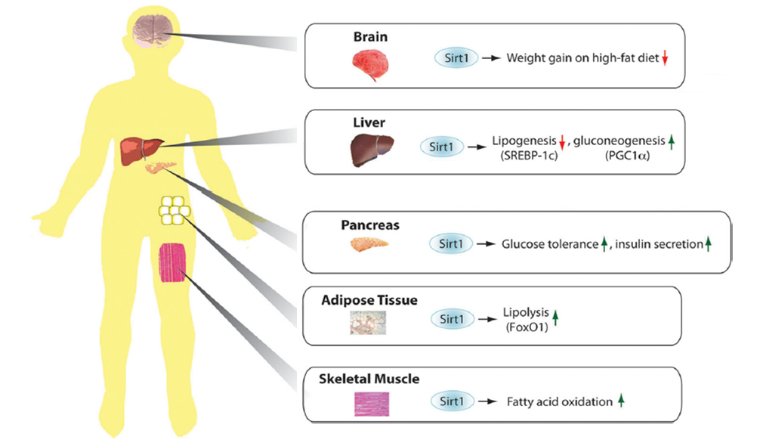
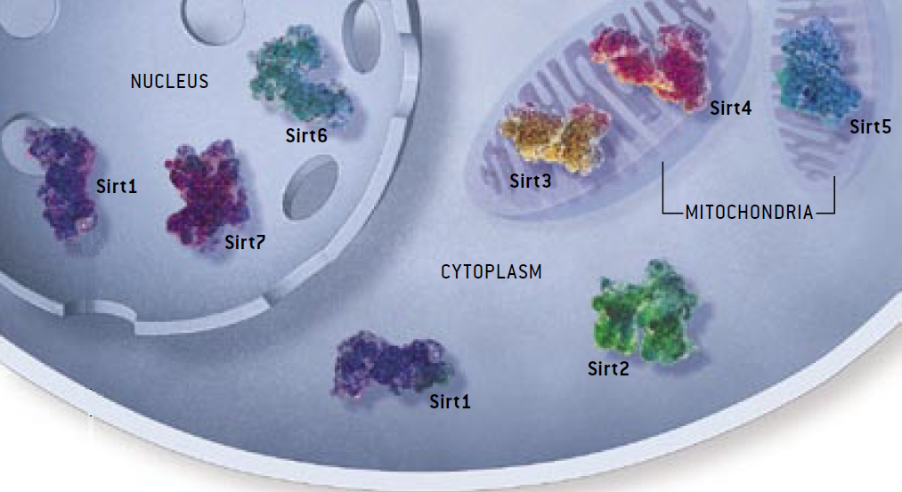
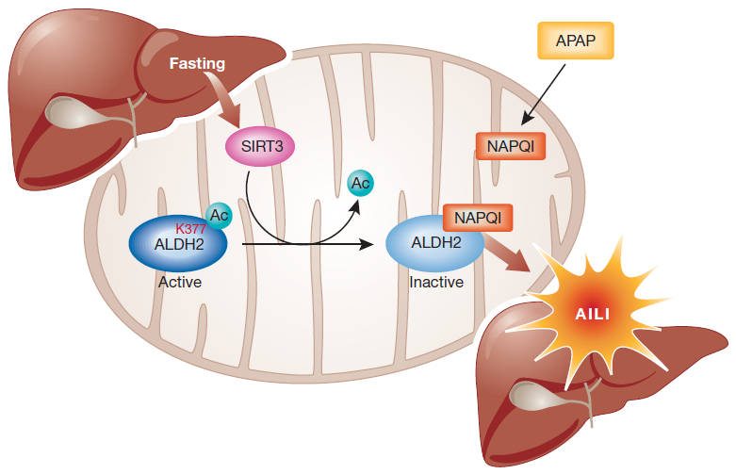
Sirtuin Family
Understanding the properties of the inhibitory mechanism
Elucidation of the mechanism of SIRT3 mediated deacetylation
Improvements in inhibitor selectivity and affinity
Potential therapeutic agents.
Only SIRT3 has been reported to be associated with an extended lifespan of man by regulating its expression.
Increased level of SIRT3 associated with node-positive breast cancer; oral squamlors cell carcinoma; as well as acetaminophen-induced liver injury.
Sinclair, DA and Guarente L (2006) Scientific American 48-57.
Frye, R.A. (2000) Biochemical and Biophysical Research Communications, 273, 793–798.
Alhazzazi TY et al. (2011) Biochim Biophy Acta. 1816, 80-88.
Lu Z et al (2011) EMBO Rep 12:840-846.
Notes:
There are seven human sirtuins, SIRT1–7 with diverse subcellular localization. SIRT1, SIRT6, and SIRT7 are nuclear proteins. SIRT1 can also shuttle between cytosol and the nucleoplasm. SIRT3, SIRT4, and SIRT5 are found in mitochondria, and SIRT2 is primarily in cytoplasm.
The Sirt1 enzyme is the best characterized Sirtuin, deacetylating other proteins and thereby altering their behavior. Metabolic functions of mamalian sirtuins in different tissues. Brain, Liver, Pancreas, Adipose Tissue, Skeletal muscles.
Among these 7 sirtuins, only SIRT3 has been reported to be associated with an extended lifespan of man by regulating its expression. Increasing SIRT3 activity will promote breast cancer, oral cancer and direct liver injury. Understanding the properties of the inhibitory mechanism will give support to the elucidation of the mechanism of SIRT3 mediated deacetylation and allow improvements in inhibitor selectivity and affinity. In this way, its inhibitors are of interest not only as tools for elucidating in detail the biological functions of the enzyme, but also as potential therapeutic agents.
1

